Slide 1

MTN ADAM ML Ops
The MLOps process overview
10 Jan 2022

Slide 2
Objectives of the project:
Develop Inactivity churn model.
Using ML-Ops practices, build, deploy and maintain the machine learning model in production reliably and efficiently.
Visualize the key performance metrices/results using data studio dashboard.
Monitor the model performance after deployment and enable the retrain capabilities.

Slide 3
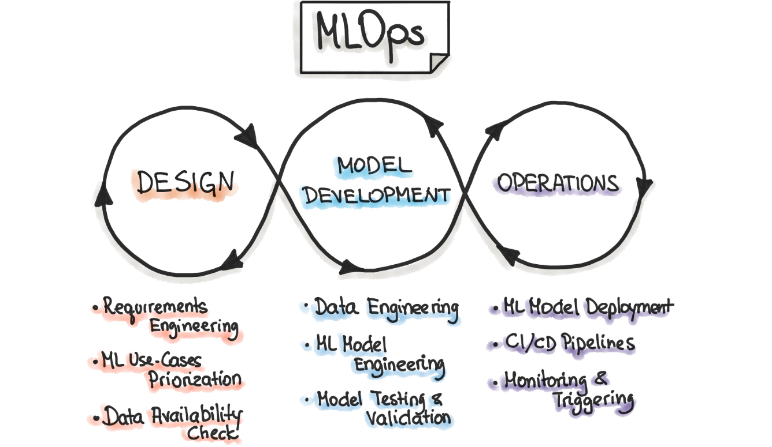
Iterative-Incremental Process in ML Ops
All three phases are interconnected and influence each other. For example, the design decision during the design stage will propagate into the experimentation phase and finally influence the deployment options during the final operations phase.

Slide 4
ML Ops principles and practices:
ML Ops Principles | Practices followed
Automation | Data extraction/ pipeline ML training pipeline automation ML inference pipeline automation CI/CD pipeline automation
CI/CD | Containerization of Pipeline components to be deployed. Build and Deployed pipeline with new implementation of the model. Model Continuous Delivery (Model serving for prediction)
Versioning | Code versioning and configuration Data, features and metadata versioning. Model training pipeline, scoring pipeline Models and artifacts versioning. Experiment tracking

Slide 5
ML Ops principles and practices:
ML Ops Principles | Practices followed
Testing | Conventional unit testing for any feature creation, ML model specification code (training) and testing. (Manual) ML infrastructure test. (Manual) Data validation Validating performance of a model
Reproducibility | Every phase of either data processing, ML model training, and ML model deployment should produce identical results given the same input by versioning code, data, features and containerizing the ML stack.
Monitoring | Collecting data about the model performance on live data. Trigger to retrain the model.

Slide 6
Tools used:
ML Ops Principles | Tools used
Automation | Gitlab CI/CD pipeline Kubeflow for training pipeline(GCP AI platform pipeline) Kubeflow for batch inference pipeline( Kubeflow Pipelines standalone on a local Kubernetes cluster using K3s)
CI/CD | Gitlab CI/CD pipeline
Versioning | Git for code versioning. GCS for data, features, models and corresponding artifacts versioning. Kubeflow for pipeline versioning and experimentation tracking.
Containerization | Docker
Container and pipeline orchestration | Kubernetes and Kubeflow pipeline
Container registry | Google container registry
Model training | Google AI Platform training job
Visualization/monitoring | Data studio Big query table for backend table

Slide 7
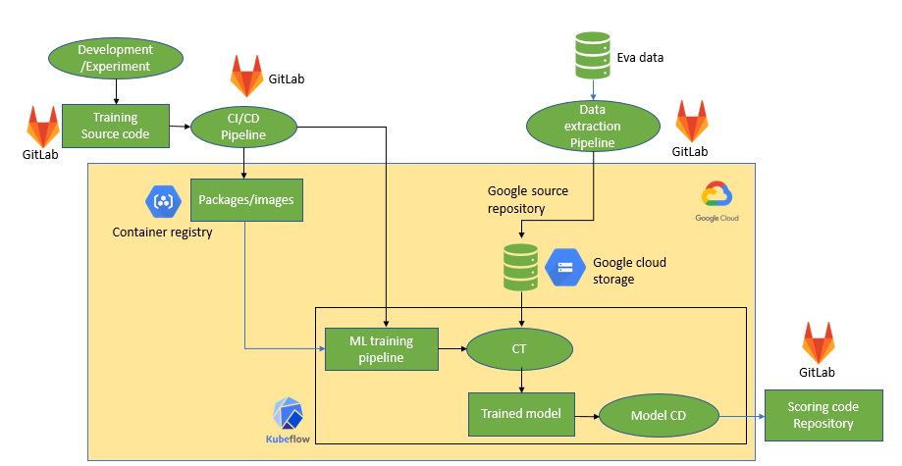
ML OPS PROCESS FLOW FOR MTN SOUTH AFRICA (TRAINING)

Slide 8
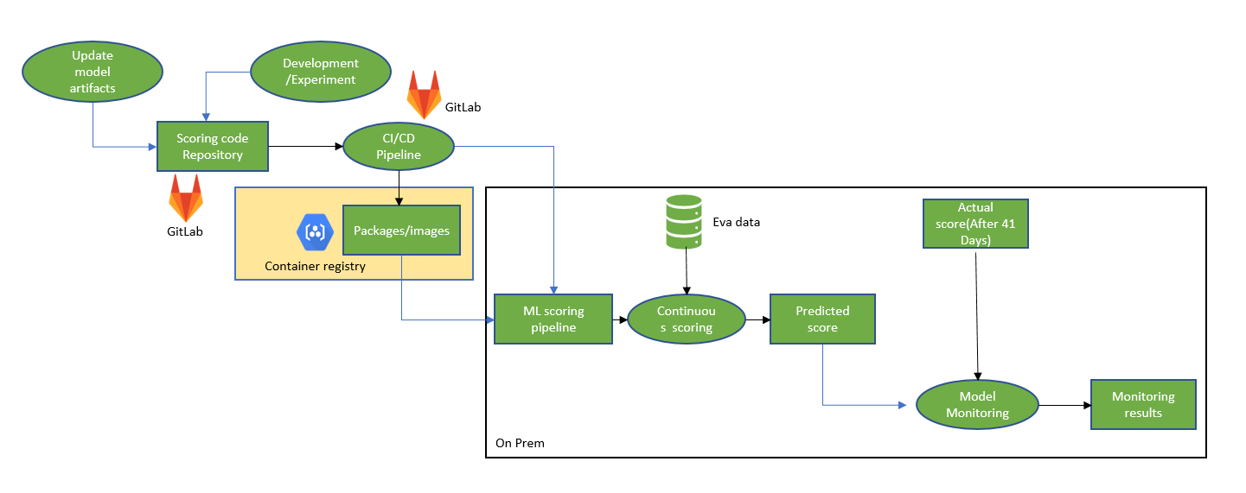
ML OPS PROCESS FLOW FOR MTN SOUTH AFRICA (SCORING)

Slide 9











MLOps Architecture: Detailed
Detailed architecture with repositories, training and scoring pipeline.
Gitlab Source Repository
Gitlab CI/CD Pipleine
Components source code
Unit tests
Run unit tests
Push to Container Registry
Container Registry
Component specs
Dockerfiles
Trigger build
Create docker images
Container images for the Kubeflow Pipelines components
Notebooks
Scripts
Update component specs
Kubeflow pipelines workflow source code
Settings
Compile Kubeflow Pipelines
Download container images
Push/Merge
Deploy Kubeflow pipeline
Data science environment
Google Kubernetes Engine environments (develop, test, staging, pre-production)
AI Platform Notebooks
Experimenting
Kubeflow Pipelines
Retrain model
Data extraction
Data validation
Data transformation
Model training
Model evaluation
Model validation
Model serving
Trigger
Trained model
Deploy
ML metadata Cloud Storage
Commit code
Data analysis (data drift etc.)
Model registry AI Hub
Manual retraining
Feature Store Cloud Storage
Performance monitoring
Continuous training
EVA
Batch score on scheduled time and store prediction score
Scoring Pipeline
Developer
Data scientists
Data drift detected
On Prem

Slide 10
DEMO

Slide 11
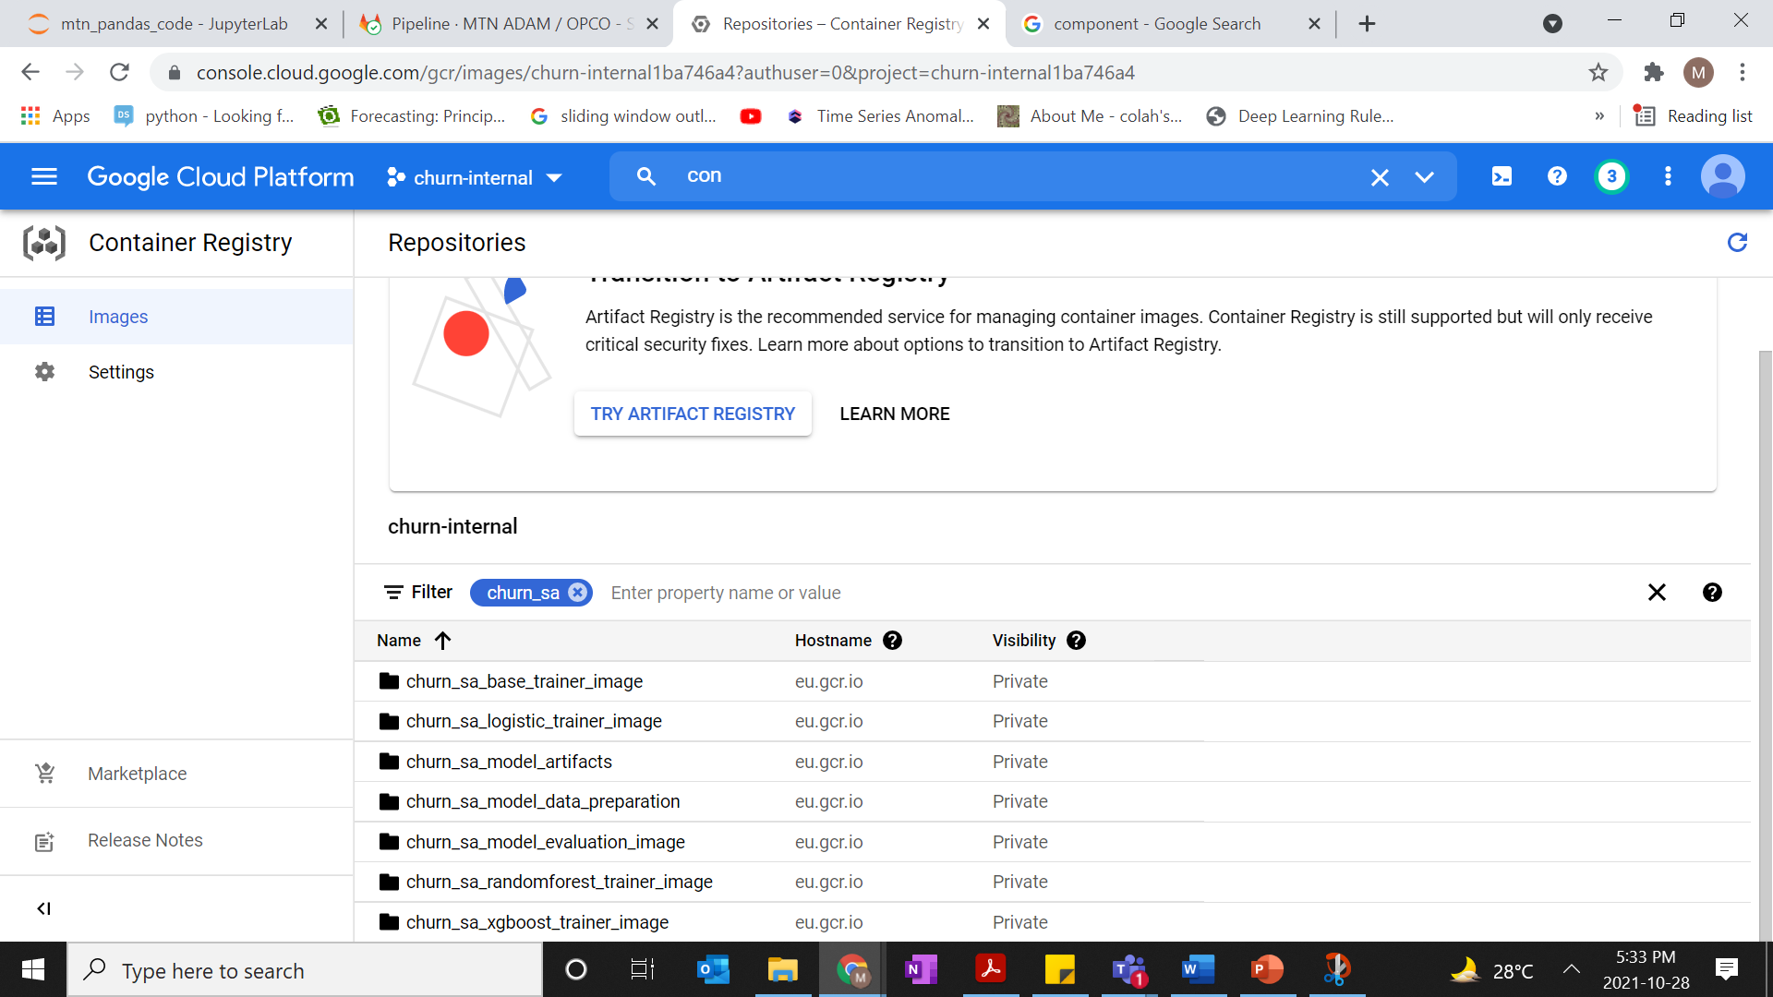
Google container registry

Slide 12
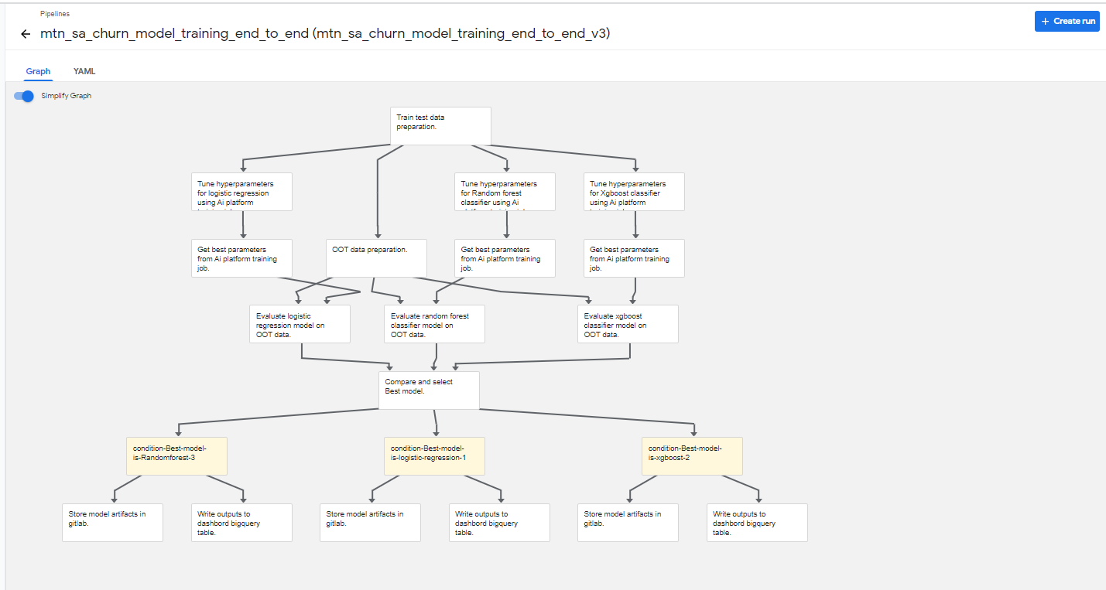
Kubeflow training pipeline

Slide 13
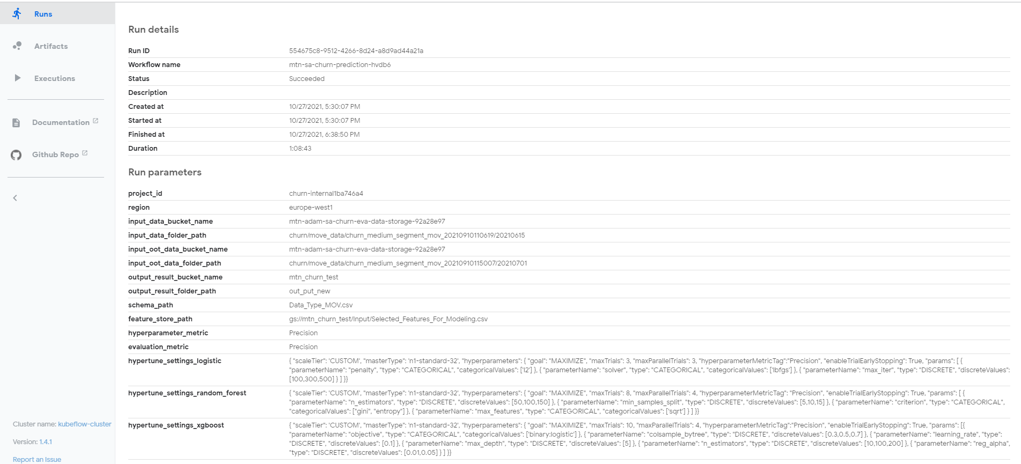
Runtime parameters

Slide 14
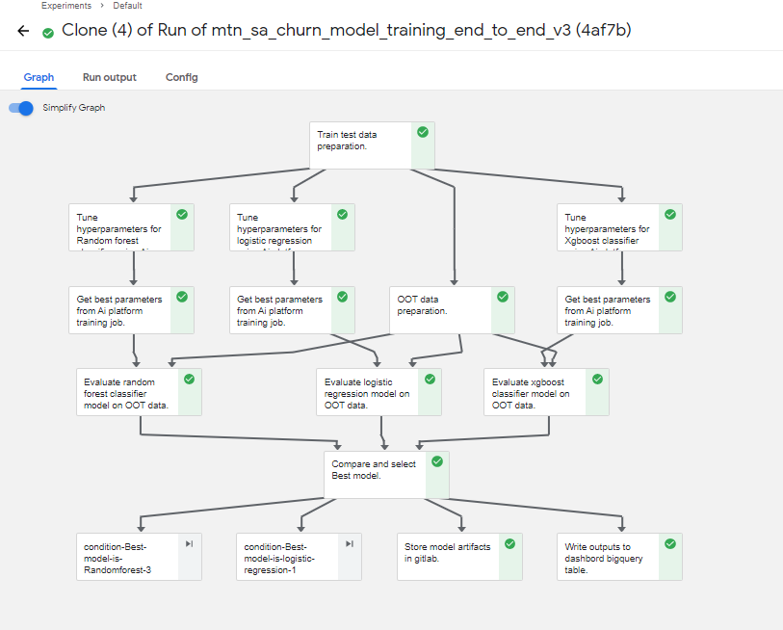
Successfully executed pipeline

Slide 15
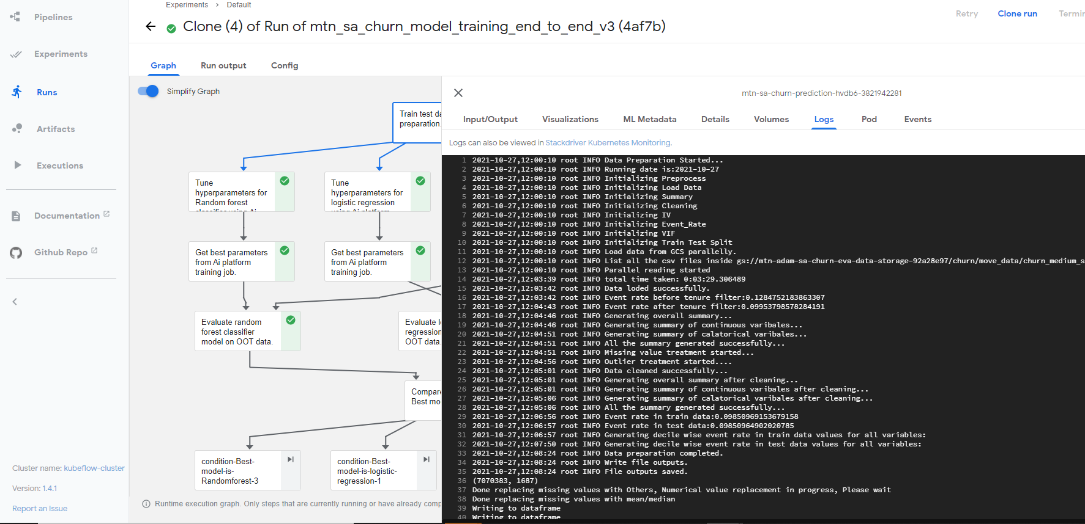
Runtime logs of pipeline component

Slide 16
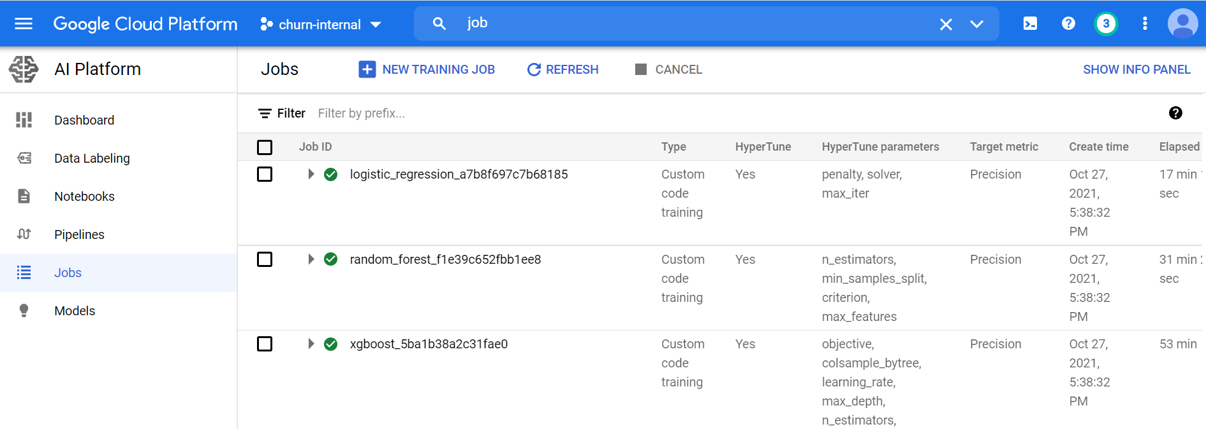
Hyperparameter tuning using AI Platform training job

Slide 17
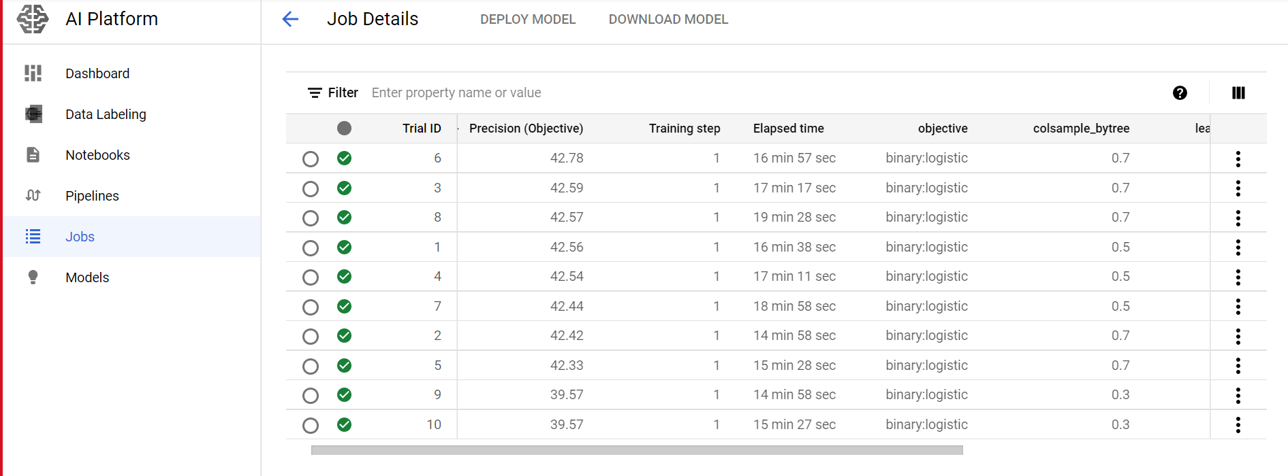
Different trials of a model

Slide 18
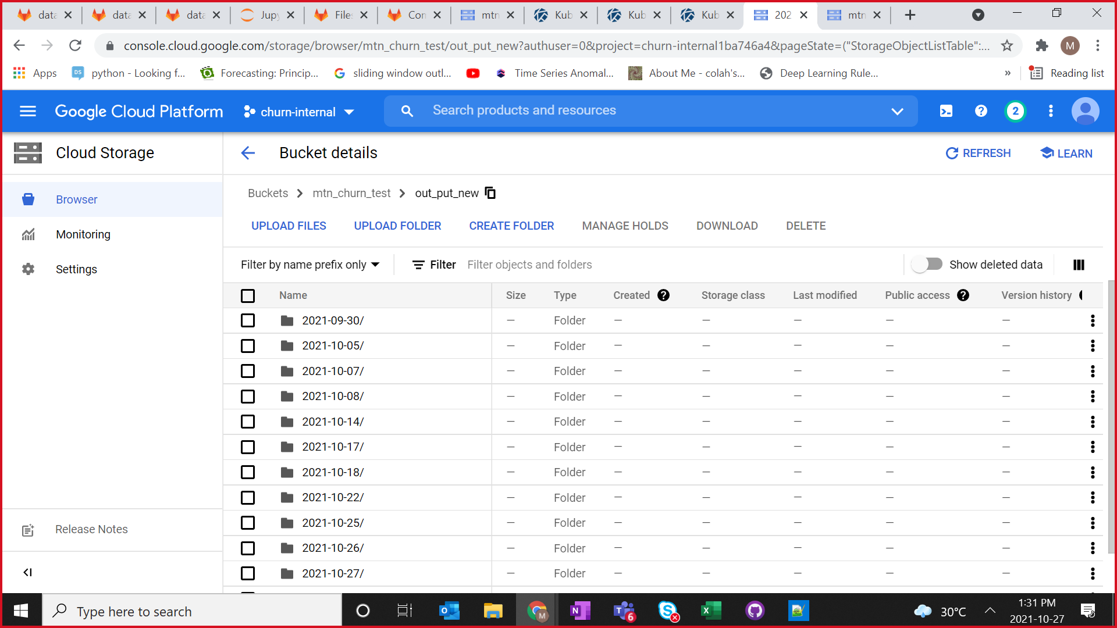
Training pipeline outputs and model artifacts

Slide 19
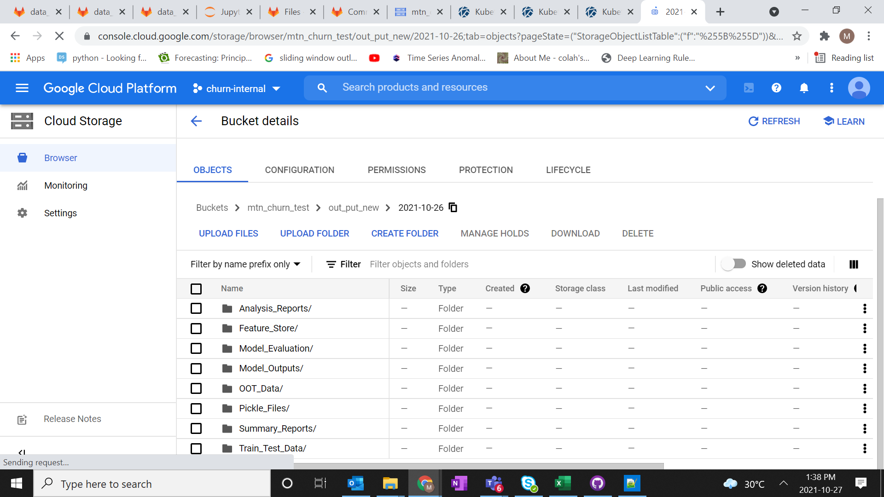
Training pipeline outputs and model artifacts

Slide 20
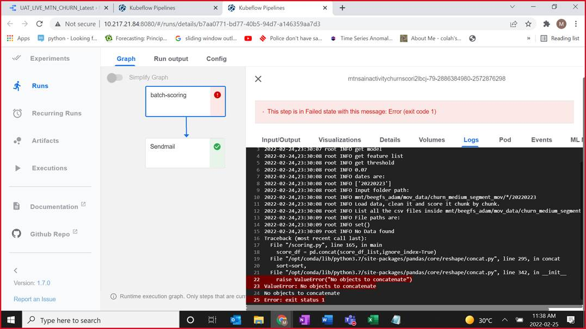
Scoring pipeline

Slide 21
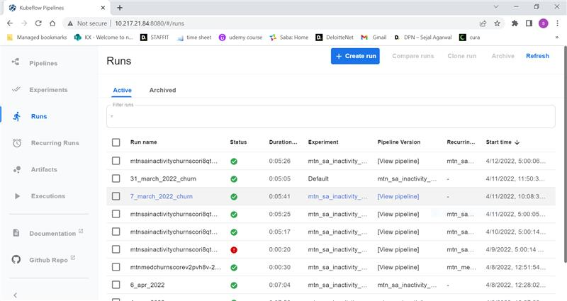
Recurring batch scoring status

