Slide 1
0
0
E
0
C
1
A
0
S
0
1
1
X
+
1
1
0
1
1
D
0
B
F
1
0
0

Slide 2
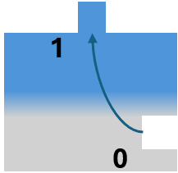
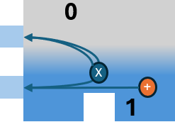
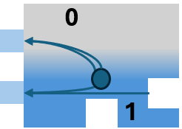
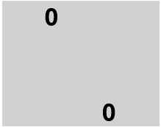
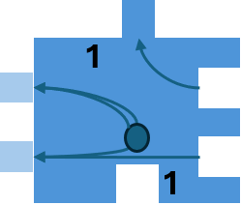
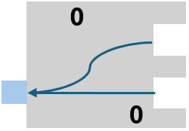
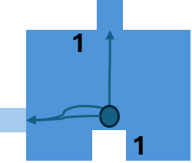
0
S
1
D
X
+
1
1
0
0
0
0
C
0
E
1
0
0
0
B
1
A
0
1
1
F
1

Slide 3
1
A
0
S
1
1
D
F
X
+
1
1
0
0
C
0
E
1
0
0
0
B
0
0
0
A
1
A
1
A
S
0
X
+
0
1
1
0
0
0
1
A
1
A
1
A
S
X
+
0
1
1
1

Slide 4
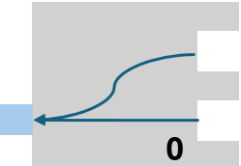
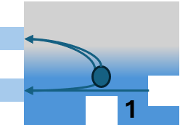
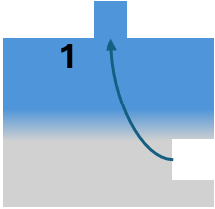

Slide 8
One!
One!
Five
Thirteen
Seventeen
Eleven
Seven

