Slide 1
American Express® Early Pay

Slide 2
Welcome to Early Pay!
Here’s how it works

Slide 3
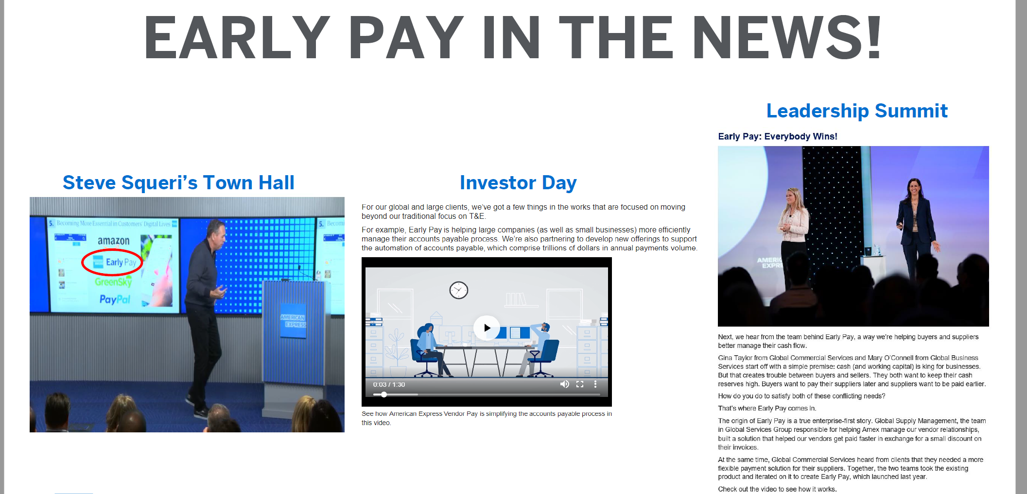
Early Pay

Slide 4
Opportunity
Amex B2B currently captures only 2% of our client’s spend file. We have an amazing opportunity to increase our share.
Current
Opportunity
“We need products that better address customers’ needs, particularly the middle and tail of the AP file – like the recently launched Early Pay.”
Anna Mars
2%
98%
https://square.americanexpress.com/community/GCS/blog/2019/03/25/annas-march-blog-closing-the-loop

Slide 5
The buyer-supplier relationship is a partnership. What if you could automate a “win-win” for both parties?
Improved working capital and operating cash flow
Increased flexibility and funding control
Increased efficiency in payment processes
Stronger business relationships

Slide 6

Now you can — with American Express® Early Pay
Buyers can capture discounts¹ – by using American Express’s funds to pay early and keep original days payable outstanding or by using their own funds to pay early…
…providing a simple solution for eligible suppliers to accept discounted early payment offers² on their invoices on the dates they prefer.
¹ Suppliers decide if they accept early payment offers, and take a discount on their invoice amount if they accept the offer. Economic benefit generated for Buyers depends on this, discount amount and funding arrangement with American Express.
² Discount will vary based on early payment date selected, supplier creditworthiness and other factors.

Slide 7
Completing early payments in 5 simple steps
Once you choose your preferred funding method, send us your approved invoices and we’ll take care of the rest through the Early Pay Supplier Platform.
1. You digitally send approved invoices to American Express
2. American Express sends early payment offers on invoices to eligible suppliers via email and the supplier platform
3. Your supplier chooses a date from among offered dates for early payment with a corresponding discount¹
5. Reconciliation and payments between you and American Express will be made based on the selected funding method
4. Based on your selected funding method, either you or American Express will pay your supplier directly into their bank account²
a.
Client-Funded
American Express-Funded
Early Pay Supplier Platform
b.
¹ Discount will vary based on early payment date selected, supplier creditworthiness and other factors.
² When American Express funds early payments, offers and subsequent payments are subject to a funding limit.

Slide 8

Early Pay brings you the best of both worlds.
We’ve combined best practices to oﬀer a ﬂexible and easy way for and your suppliers to get on-demand working capital depending on which model you choose.
Product Feature
Supply Chain Finance
(Large Financial Institutions)
Dynamic Discounting
(Platform Providers)
Generate Early Pay discounts while maintaining days payable outstanding (American Express-Funded Model)
No implementation or at-scale costs
LOW
HIGH
Option to ﬂex between Supply Chain Financing and Dynamic Discounting¹
Quick and easy supplier onboarding
¹ New program set up is required.

Slide 9
Early Pay alongside other American Express products.
Early Pay fulfills a distinct need among other American Express products
Dollar Spend
BIG BANK LED SCF PRODUCTS
EARLY PAY
Digital solution that enables working capital optimization.
Suppliers have option to receive payments early on select
invoices at a small discount.
BUYER INITIATED PAYMENTS
vPAYMENT
PURCHASING CARD
Solution enabling automated payments of invoices
to suppliers
Integrated or stand-alone
virtual card payment
solution with transaction
and date controls
Traditional Card providing flexibility, customizable transaction controls and float
LARGEST
MIDDLE TAIL SPEND (LARGE/MID-SIZE)
TAIL SPEND
Rank Order of Suppliers

Slide 10



Early Pay alongside other competitor products.
Early Pay fulfills a distinct need among other American Express competitors*.
Dollar Spend
BIG BANK LED SCF PRODUCTS
EARLY PAY
EARLY PAY
Dynamic discounting, dynamic offers, buyer driven
liquidity exchange
PURCHASING CARD
E-PAYABLES
Traditional Card providing flexibility, customizable transaction controls and float
LARGEST
MIDDLE TAIL SPEND (LARGE/MID-SIZE)
TAIL SPEND
Rank Order of Suppliers
*All trademarks and logos are the property of their respective owners and are not associated with or sponsored by American Express.

Slide 11
Supplier Portal Demo
https://aexp.invisionapp.com/share/WAAIC8S6RUN#/screens/219608936_1_-_Unregistered_Offer_Email

