Slide 1
Content sharing site
Name: Motiur Rahman
Project url: localhost/sample_project

Slide 2
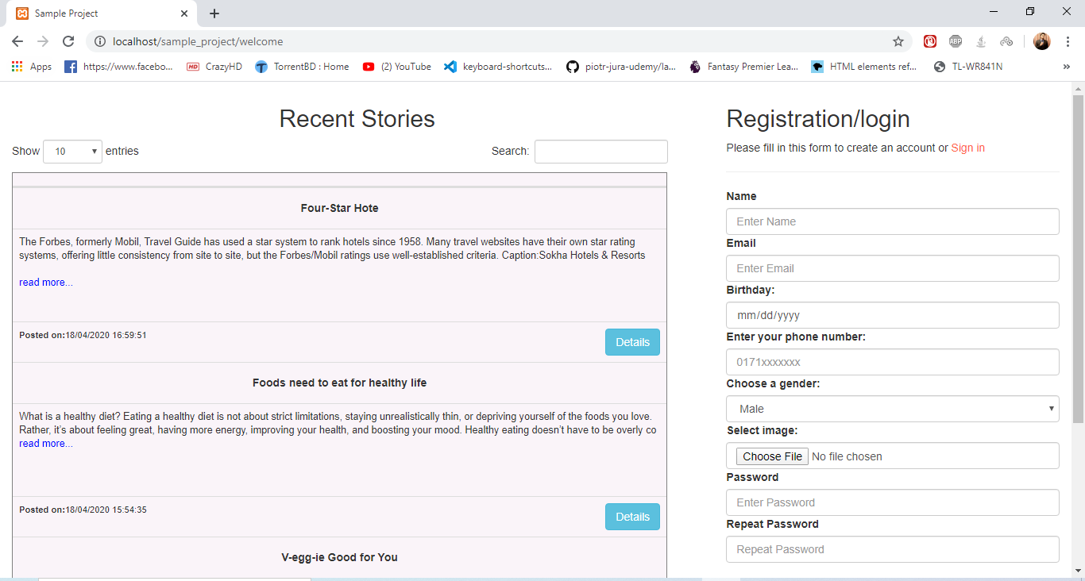
Welcome page
Only story will be showed.
For login I used phone number as user id.
Login ID: 01679118554 Password: 3214 (admin)
Login ID: 01716519801
Password: 1234(non-admin)
Login ID: 01712076120
Password: 1234
(admin and a blocked user)

Slide 3
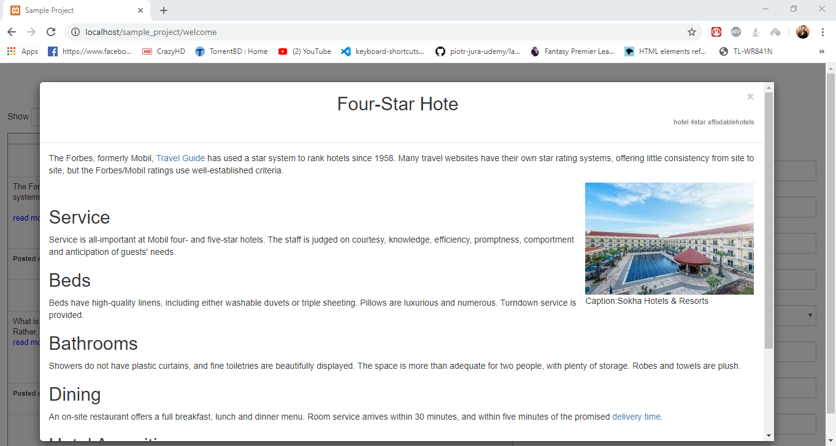
Story details
Non logged in users only can see the stories with all details

Slide 4
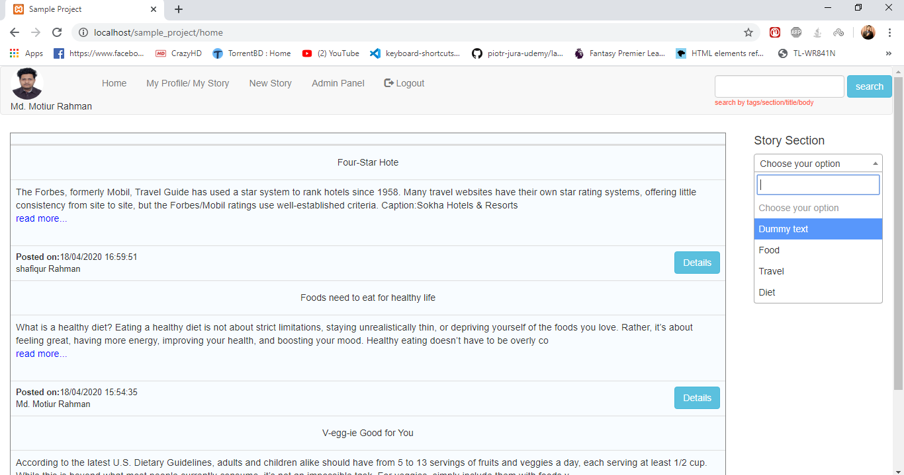
Home page
After login user can post new story.
Comment on stories
Can search by tags , section, title, body
An admin gets all the admin privileges mentioned in your project details paper

Slide 5
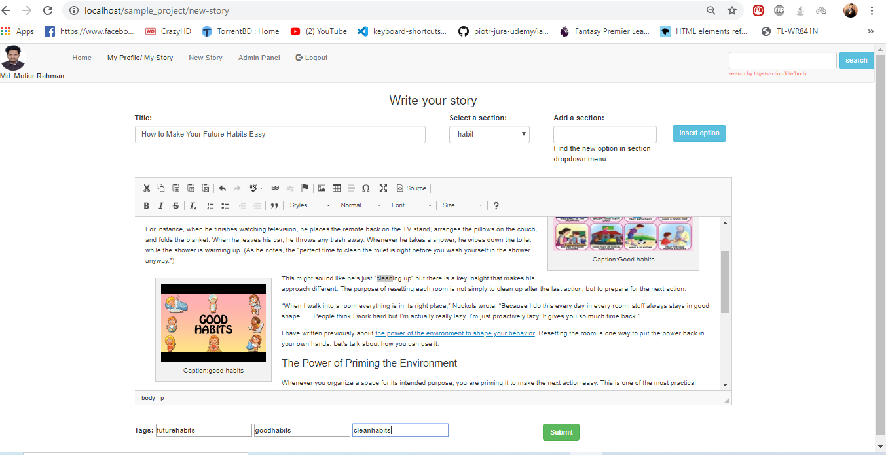
New story
User can add a new section if only the desired section is not in our database.
Every story must have section
User can add three tags for every new story
Rich editor will help user to decorate his story.

Slide 6
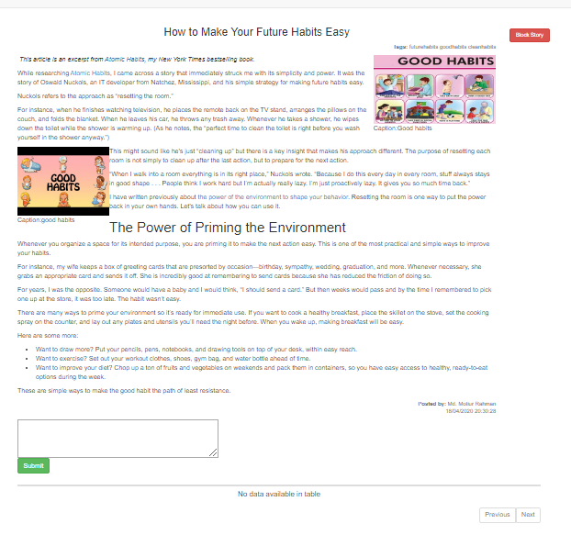
Story details and comment
Logged is user can comment.
Only admin gets that bock story option
Admin also gets comment delete option on this page.
Story tags are shown on the top right corner.

Slide 7
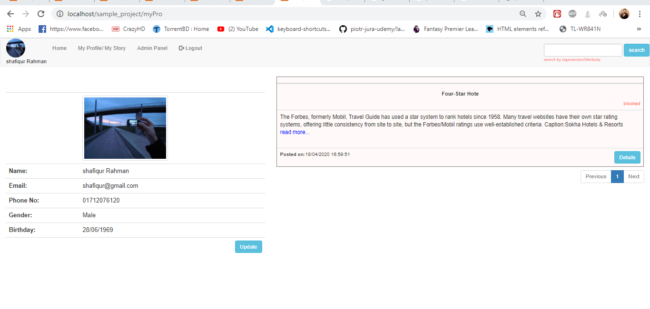
Profile and story update
User can update his profile and also can update stories shared by the user himself.
Blocked story only shown on the profile page.
Other users cant see blocked stories.

Slide 8
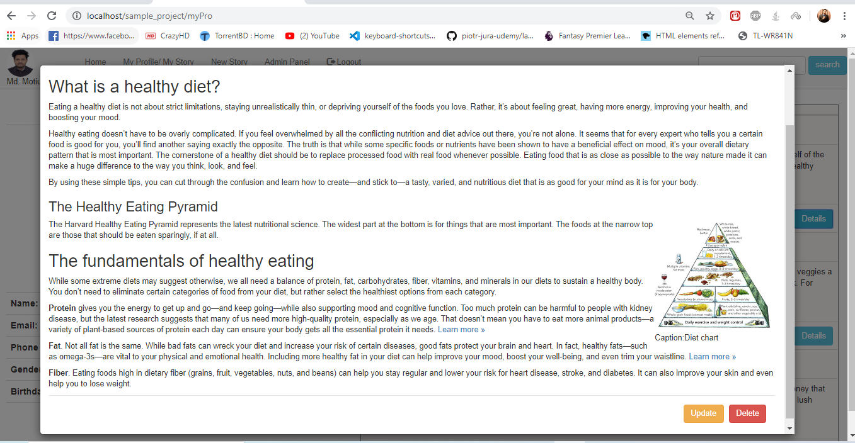
Story details
Update and delete story option will only be available from user profile upon viewing the story.

Slide 9
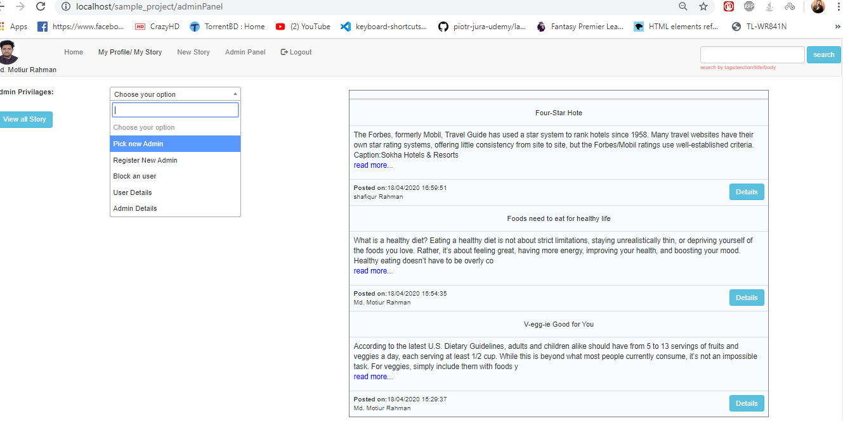
Admin panel
Admin can add new admin from registered users
Admin can register and make him new admin.
Admin can block users
Admin can see all the story details
Admin can see all the admin detail
Admin can block/unblock and delete other admin

Slide 10
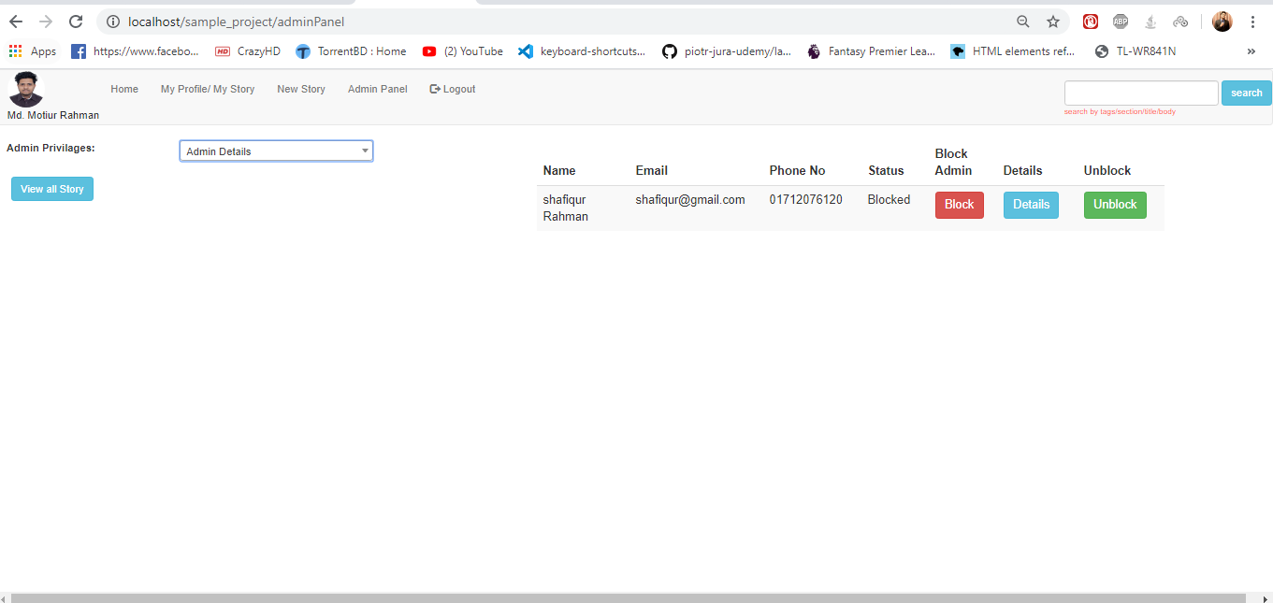
Details of admins
Other admin details and all the available options.
When a admin is blocked then only unblock option will appear

Slide 11
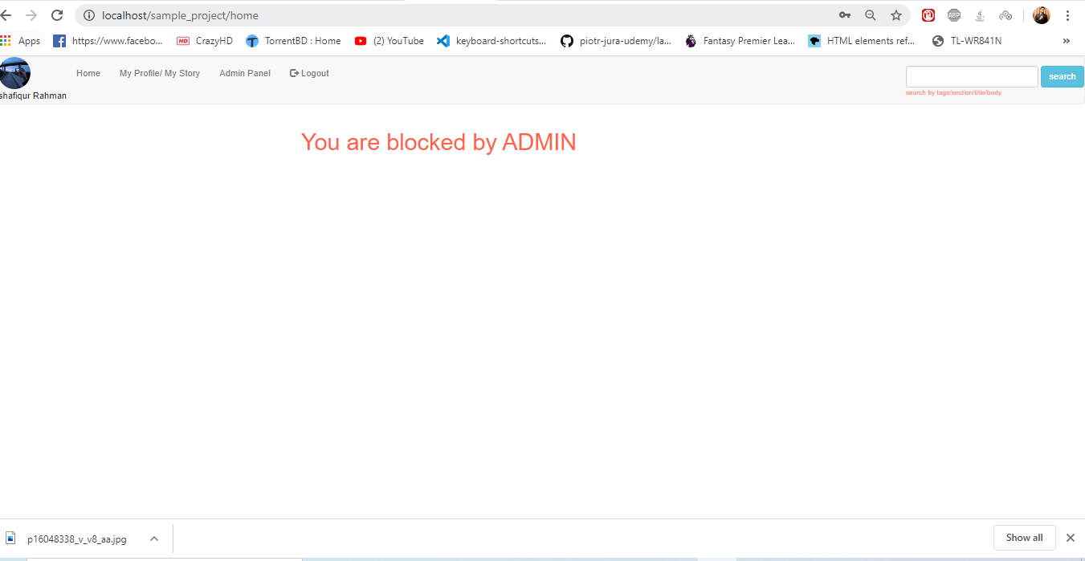
Blocked user
A blocked user will get a empty home screen
A blocked user only can see his own shared story from his profile page.
A blocked user also can see stories before login as all stories are public

Slide 12

Thank you for reaching me out and give me this amazing sample project to build. I hope I fulfilled all the requirements for this project.
For any queries contact me. I am also excited to talk about the exciting opportunity.

