Slide 1
Prediction of Liver Disease Based on Random Forest and Support Vector Machine
Name：Gaotang Li
Instructor：Dr. Chen

Slide 2
1
|
Introduction and Background
2
|
Data analysis
CONTENTS
3
|
Model
4
|
Results and Discussion
5
Conclusions

Slide 3
1
1
|
Introduction and background

Slide 4
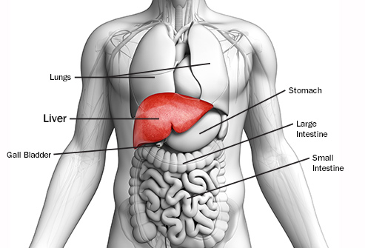
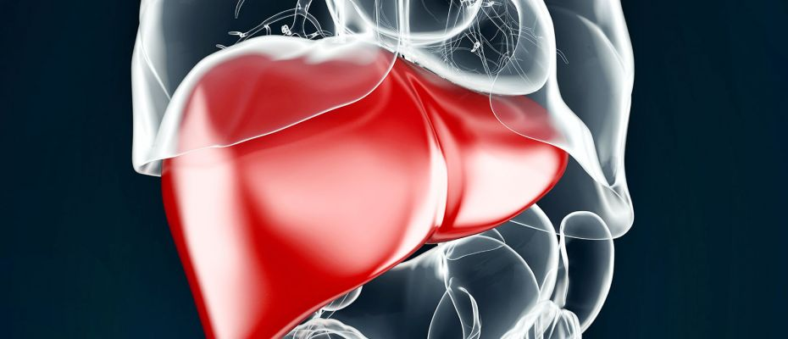
Introduction and Background
Liver is the largest organ in human body that helps with food digestion and immune system. It determines how healthy human body is .
Liver disease accounts for 2 million deaths per year worldwide, 1 million due to complications of cirrhosis and 1 million due to viral hepatitis and hepatocellular carcinoma.
Today it is common to have liver disease due to chronic alcohol abuse or fat accumulation.

Slide 5
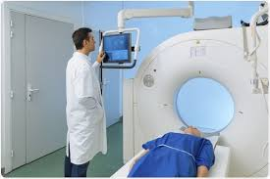
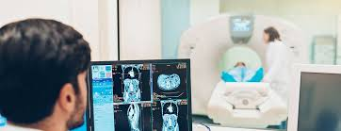
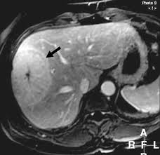
Introduction and Background
The death rate of liver disease keeps climbing though the medical treatments become more advanced.
The problem tends to lie in the subjective and manual diagnosis stage of analyzing the morphological criteria on magnetic resonance(MR) imaging.
This diagnosis process is subjective and difficult for inexperienced radiologists and doctors.
It is necessary to establish a more accurate and precise way of diagnosis. Designing a computer-aided model could potentially be the best way to help with the diagnosis process.

Slide 6


Introduction and Background
More reason for establishing an intelligent diagnosis model other than precision
Machines and models could always be improved and up-to-dated, while human doctors need extensive time to be trained.
Once model is established, it could be applied anywhere in the world.
Using the model can significantly reduce extra cost for both patients and hospitals.

Slide 7
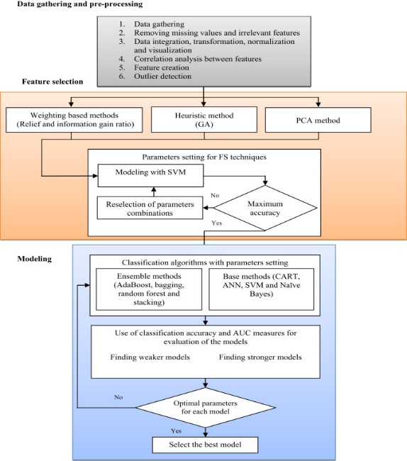
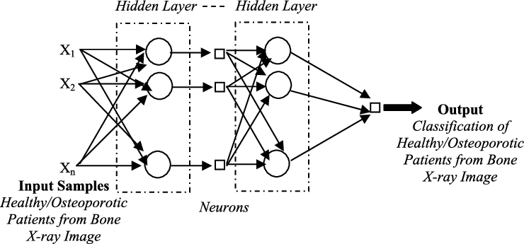
Introduction and Background
Previously, many researchers proposed their models.
Mohamed A. et al. proposed a new hybrid data mining model to provide a comprehensive analytic method for finding an optimal number of different pathological types of any disease and its complications
S. Karthik et al. attempted to apply ANN Classification and LEM algorithm for intelligent diagnosis of liver disease
Agnieszka Onisko et al. presented a Bayesian network model for diagnosis of liver disorders

Slide 8
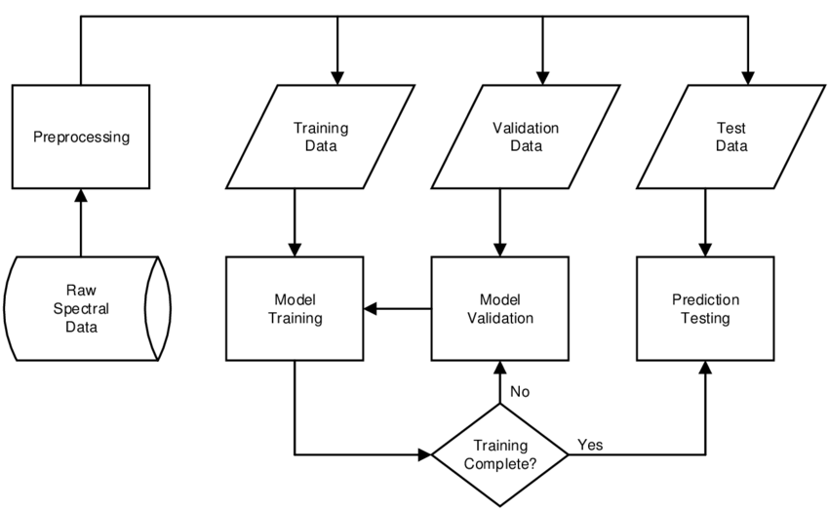
Introduction and Background
This research will establish a machine learning model based on a data set by using the SVM and the Random Forest method.
This data set contains 416 liver patient records and 167 non liver patient records collected from North East of Andhra Pradesh, India.
All data comes from the UCI ML Repository: UCI Machine Learning Repository Evaluation：Accuracy，Precision，Recall， F1 score， ROC

Slide 9
2
2
|
Data analysis

Slide 10
Data Analysis
The left figure is a basic description of the dataset.
9 major factors are evaluated in this dataset, and the “12” in the rightmost column indicates whether the sample has liver disease; 1 stands for having the disease while 2 means not having the disease
Notably, the standard deviation of many biochemical indicators are extremely high, indicating that the sample is widely spread out.
The max value of certain factors, such as albumin, is extremely higher than the 75% value, which could result from errors in collecting primary data.
Description of the dataset
 | age | total Bilirubin | direct Bilirubin | total proteins | albumin | A/G ratio | SGPT | SGOT | Alkphos | 12
count | 579 | 579 | 579 | 579 | 579 | 579 | 579 | 579 | 579 | 579
mean | 44.8 | 3.3 | 1.5 | 291.4 | 81.1 | 110.4 | 6.5 | 3.1 | 0.9 | 1.3
std | 16.2 | 6.2 | 2.8 | 243.6 | 183.2 | 289.9 | 1.1 | 0.8 | 0.3 | 0.5
min | 4 | 0.4 | 0.1 | 63 | 10 | 10 | 2.7 | 0.9 | 0.3 | 1
25% | 33 | 0.8 | 0.2 | 175.5 | 23 | 25 | 5.8 | 2.6 | 0.7 | 1
50% | 45 | 1 | 0.3 | 208 | 35 | 42 | 6.6 | 3.1 | 0.93 | 1
75% | 58 | 2.6 | 1.3 | 298 | 61 | 87 | 7.2 | 3.8 | 1.1 | 2
max | 90 | 75 | 19.7 | 2110 | 2000 | 4929 | 9.6 | 5.5 | 2.8 | 2

Slide 11
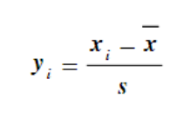
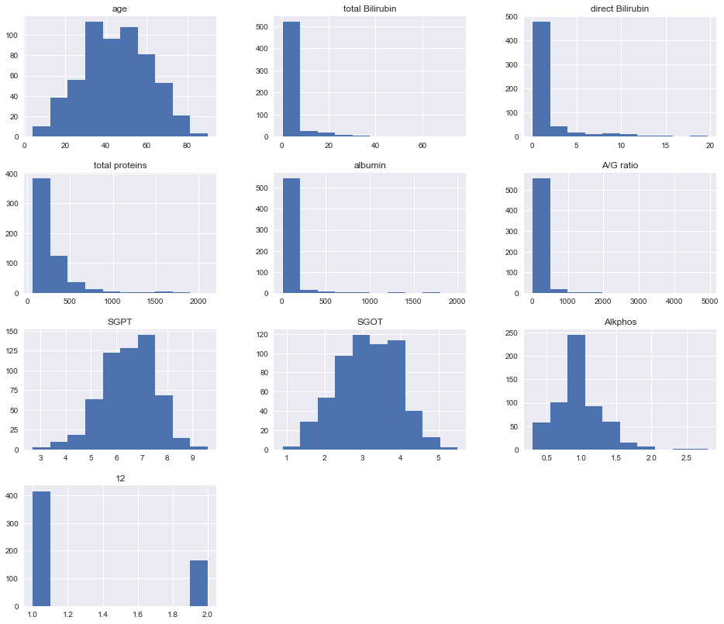
Data Analysis
Some data are directly shown in normal distribution, such as age and Akphos
Some data are heavily accumulated in a small range, such as total Bilirubin and total proteins, and the difference between the smallest and highest value is high
This research uses the formula to standardize the standard deviation of all sample data so that all samples approximately follow a normal distribution

Slide 12
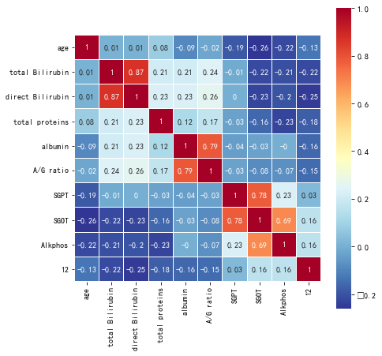
Data Analysis
A/G ratio and albumin is highly and positively related.
Alkphos and albumin has no relationships at all.
Many factors have slight negative relations with each other, such as SGOT with total Billirubin.
A heat map showing the correlation between each factor

Slide 13
3
3
|
Model

Slide 14
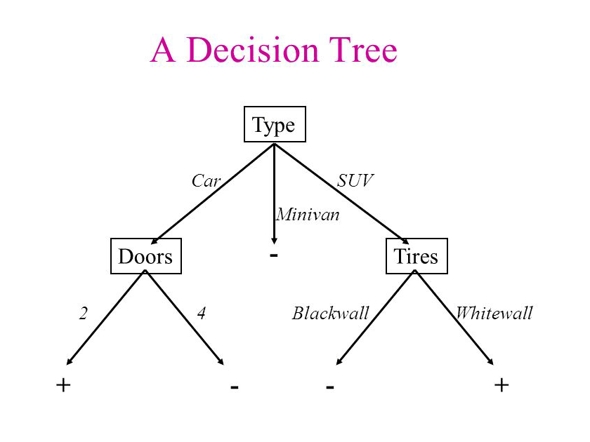
Decision Tree
Decision Tree is a flowchart-like structure in which each internal node represents a “test” on a feature, each branch represents the outcome of the test, and each leaf node represents a class label. The paths from root to leaf present classification rules.
The key in decision tree lies in choosing which factor is in which node.
The result with highest difference in information entropy would be chosen, calculated by the formula
𝑖(𝑝) = −∑ 𝑃(𝜔_{𝑗})log₂𝑃(𝜔_{𝑗})
Decision Tree

Slide 15

Random Forest
Random Forest is an ensemble learning method for classification that operate by constructing a multitude of decision trees at training time and outputting the class that is the mode of the classes of the individual trees.
It is one of the best supervised learning algorithms
It provides a reliable feature importance estimate
It offers efficient estimates of the test error without incurring the cost of repeated model training associated with cross-validation

Slide 16
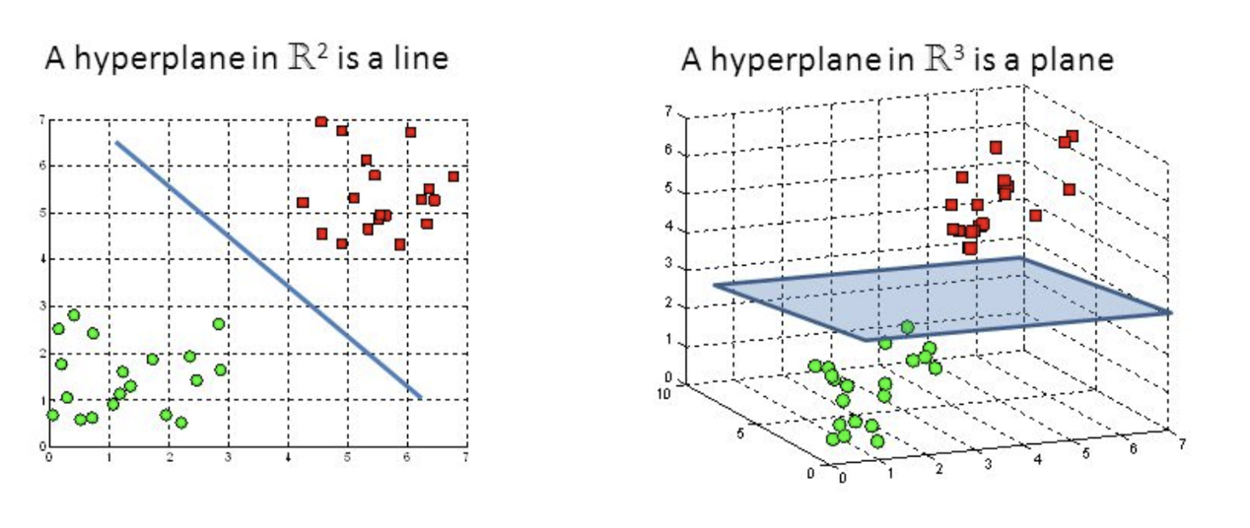
Support Vector Machine (SVM)
The objective of the support vector machine algorithm is to find a hyperplane in an N-dimensional space (N -the number of features) that distinctly classifies the data points.
However, it is not possible that every hyperplane can be easily divided as the first graph. Usually, we may need to introduce a new (extra) dimension to form the hyperplane.

Slide 17
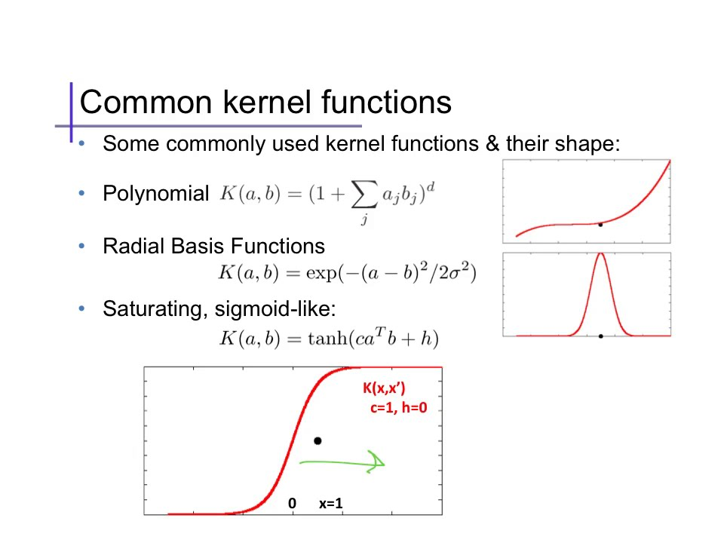
Support Vector Machine (SVM)
Following the last slide, the new dimension is calculated by using the “Kernel” function and common kernel functions are listed below.
Advantages of SVM
Works well with even unstructured and semi structured data like text, Images and trees.
Unlike in neural networks, SVM is not solved for local optima.
It scales relatively well to high dimensional data.
SVM models have generalization in practice, the risk of over-fitting is less in SVM.

Slide 18
4
4
|
Results and Discussions

Slide 19




Results and Discussion
Evaluation Criteria
Recall rate
Precision rate
Accuracy rate
F-score
ROC：The ROC curve is generally FPR on the horizontal axis and TPR on the vertical axis. AUC is the area under the curve. Generally, the larger the AUC value, the better the model.

Slide 20
Results and Discussion
SVM
Random Forest
{'C': 1,
'cache_size': 200,
'class_weight': None,
'coef0': 0.0,
'decision_function_shape': 'ovr',
'degree': 3,
'gamma': 'scale',
'kernel': 'rbf',
'max_iter': -1,
'probability': False,
'random_state': None,
'shrinking': True,
'tol': 0.001,
'verbose': False}
{'bootstrap': True,
'class_weight': None,
'criterion': 'gini',
'max_depth': 40,
'max_features': 'auto',
'max_leaf_nodes': None,
'min_impurity_decrease': 0.0,
'min_impurity_split': None,
'min_samples_leaf': 1,
'min_samples_split': 2,
'min_weight_fraction_leaf': 0.0,
'n_estimators': 40,
'n_jobs': None,
'oob_score': False,
'random_state': None,
'verbose': 0,
'warm_start': False}

Slide 21
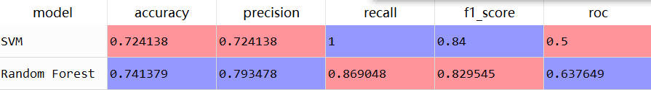
Results and Discussion
Random Forest outperforms SVM with gauss kernel according the evaluation indicator of ROC
F1 score shows SVM with gauss kernel is better than Random Forest.
These two models can help predict the liver disease.

Slide 22
5
5
|
Conclusions

Slide 23
conclusions
Further Improvement
Various parameters can be tested to improve the result
More models can be used for comparison purposes.
Different models can also be integrated together to improve the accuracy and precision of the final result.

Slide 24
THANKS

