Slide 1
CI/CD for Yocto Project® Maintainers with Kubernetes and Tekton Pipelines
Trevor Gamblin, Wind River Systems
Tim Orling, Intel Corporation
Yocto Project Virtual Summit Europe, October 29-30, 2020

Slide 2
Introduction
Trevor:
  Userspace/Infrastructure Developer at Wind River
Tim:
  Yocto Project Architect at Intel
Both meta-python maintainers
Very excited about k8s and Tekton

Slide 3
Agenda
State of Yocto CI/CD
K8S and Tekton
Pipelines!
Shared State!
Cool Tools!
Future Work

Slide 4
Disclaimer
Yocto experts, not k8s experts (suggestions welcome!)
Focusing on single-node developer setup (for now)

Slide 5
State of Yocto CI/CD
The Yocto Autobuilder and Other Pursuits

Slide 6

The Yocto Autobuilder
Based on the Buildbot framework
Bare metal (could be containerized)
Official Yocto Autobuilder has restricted access (and that’s OK)
Incredibly useful – but maybe overkill for average developer workflow

Slide 7
Other Current Solutions
Homegrown Autobuilder instances
Jenkins (security issues!)
TravisCI
GitLabCI
Others?

Slide 8
Kubernetes and Tekton
Containers All The Way Down

Slide 9

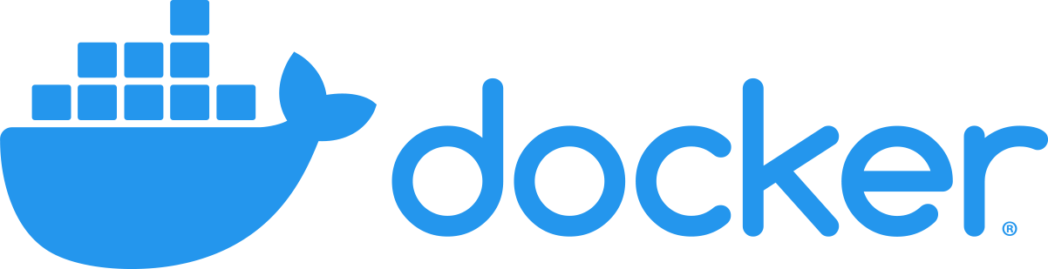


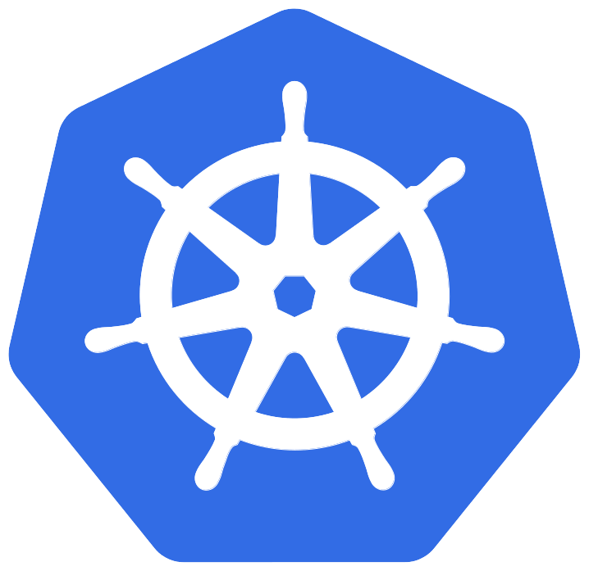

What is Kubernetes?
Container orchestrator maintained by CNCF, built for resiliency and scalability
Application-agnostic – use it to build and deploy what you want
Supports various container runtimes
https://kubernetes.io/

Slide 10
Why Kubernetes?
It’s everywhere, highly-scalable, with lots of existing use cases, extensions, services
Provides building blocks for the user to adapt, rather than a specific, tailored solution
Yocto is doing more containerized builds – why not use k8s for that?

Slide 11
What is Tekton?
CI/CD framework for Kubernetes
Adds:
  Tasks
  Pipelines
  TaskRuns and PipelineRuns
  EventListeners
  TriggerTemplates, TriggerBindings
https://tekton.dev/

Slide 12
Why Tekton?
Tekton is very customizable, relatively easy to understand
More modern, designed around contemporary technologies
Has a rich dashboard, CLI

Slide 13
Our Setup
Single-node cluster
HP Z640, E5-2630v4 x2, 64GB RAM
Fedora 32 Server Edition
kubeadm, not Minikube

Slide 14
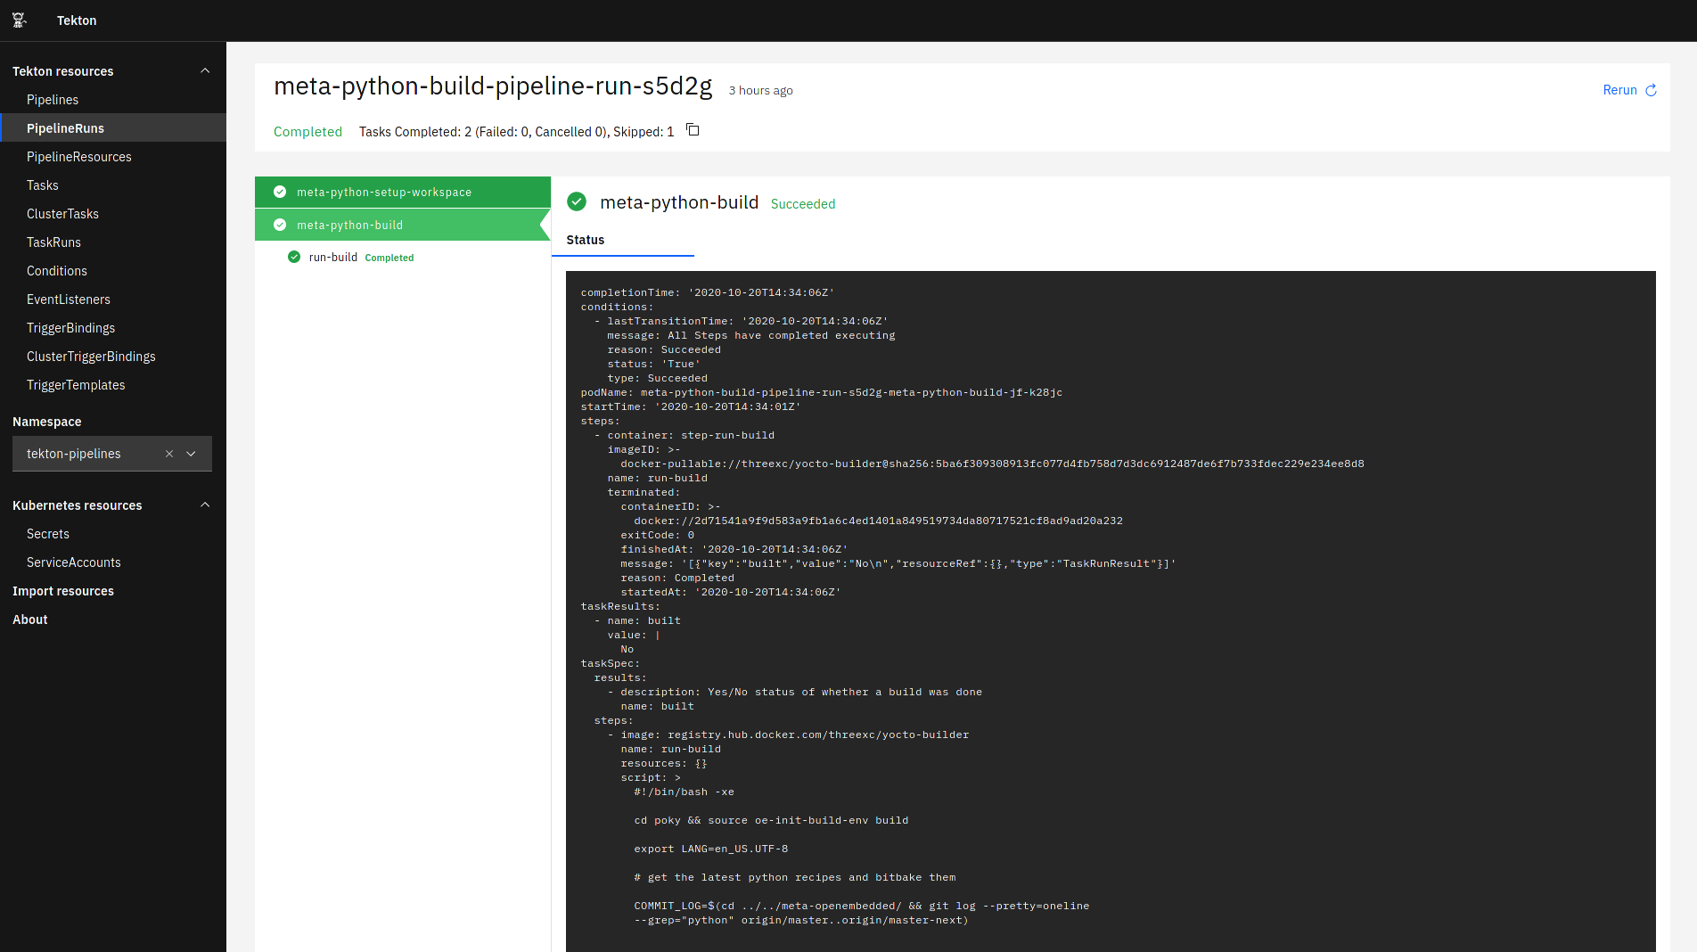
End Goal – Pipelines on a Dashboard

Slide 15
How Do We Get There?
https://github.com/threexc/yocto-tekton
Setup instructions, example pipelines (we’ll get to those shortly)
Already in use in the wild – created to help maintain the meta-python layer

Slide 16
A Pipeline for Poky

Slide 17
Concept
Identify delta between master and master-next branches
Get a list of corresponding recipes, build with bitbake
Report results and any unmappable patches
https://github.com/threexc/yocto-tekton/tree/main/poky

Slide 18
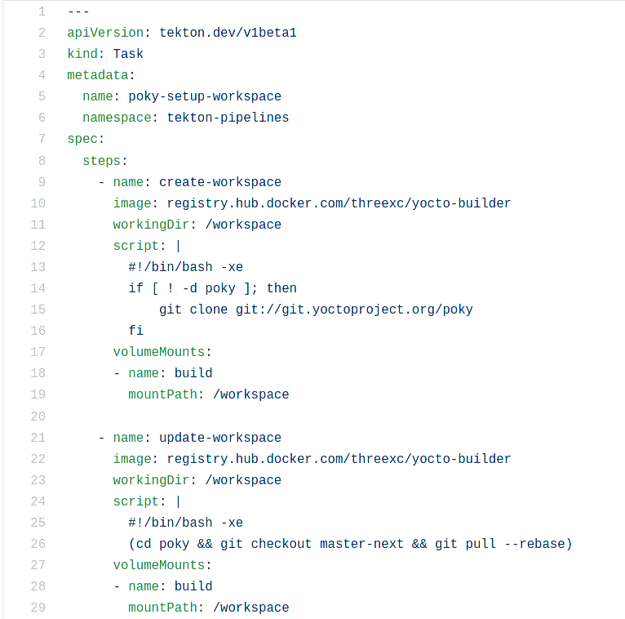
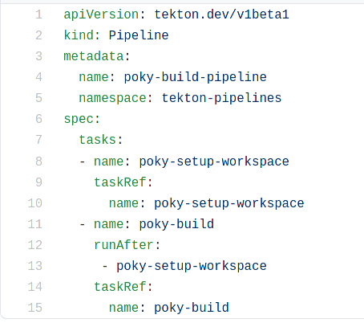
Pipeline Implementation Examples

Slide 19
A Pipeline for meta-python

Slide 20
Concept
Same idea as the poky pipeline (identify recipes, build, report), for meta-python
Makes maintaining meta-python way easier!
Will eventually include containerized image tests (e.g. meta-python-ptest-image)
https://github.com/threexc/yocto-tekton/tree/main/meta-python

Slide 21
Workflow Example (meta-python)
serviceaccount.yaml
cronjob.yaml
eventlistener.yaml
triggertemplate.yaml
(automatic)
POST
pipeline-run.yaml
pipeline.yaml
(manual)
log-task.yaml
build-task.yaml
setup-workspace.yaml

Slide 22
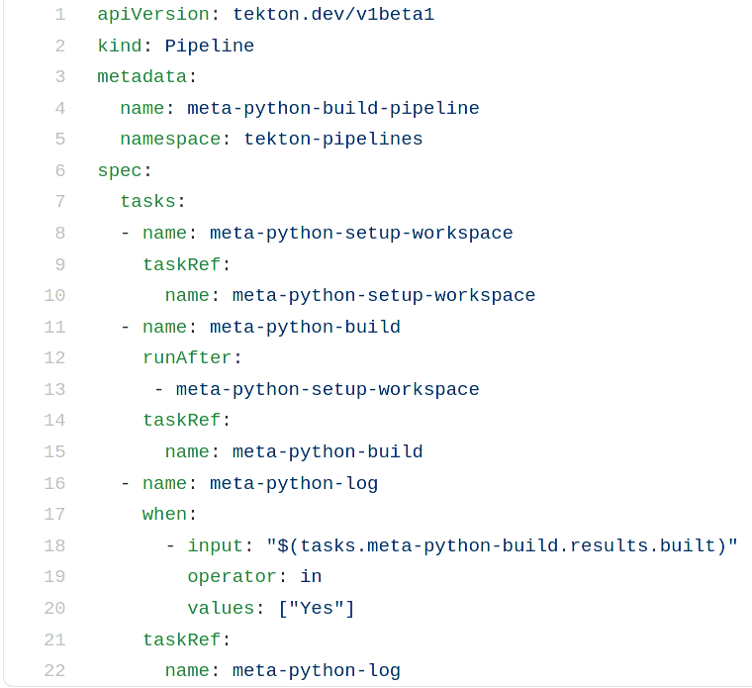
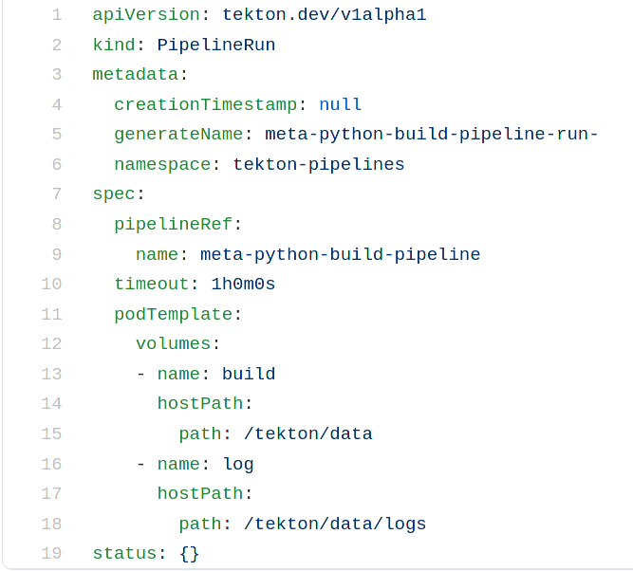
Pipeline Implementation Examples

Slide 23
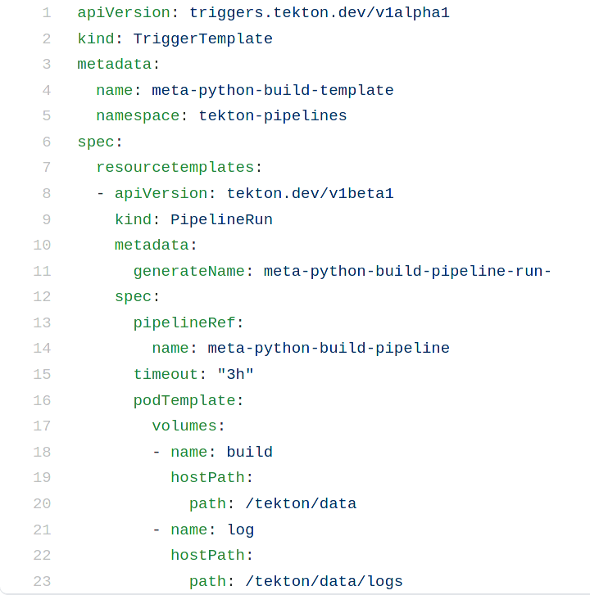
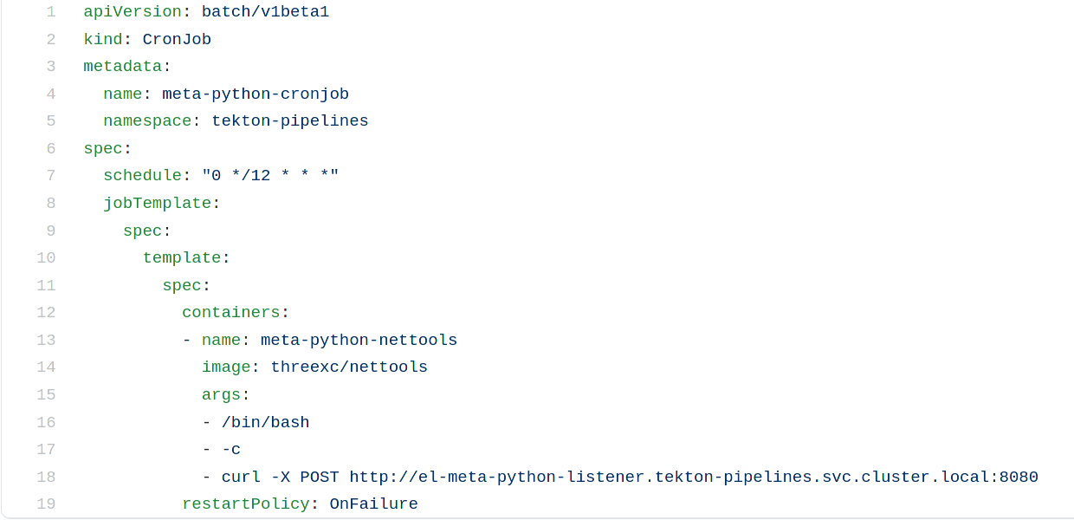
Implementation Examples - Continued

Slide 24
Automatic Shared State
Pay no attention to the man behind the curtain...

Slide 25
Shared State for Pipelines
Everything you’ve seen actually relies on another pipeline for building sstate!
Similar fundamentals – pipeline runs once per day, runs a poky build that is then used as the SSTATE_MIRROR to reduce build time
https://github.com/threexc/yocto-tekton/tree/main/sstate/automated

Slide 26
Useful Tools
Improving the Workflow

Slide 27
Useful Tools
K9s: https://github.com/derailed/k9s
Helm: https://github.com/helm/helm
Tekton Catalog: https://github.com/tektoncd/catalog

Slide 28
meta-python + k9s Demo
Demo Video Link

Slide 29
Future Work

Slide 30
Future Work
Better pipelines/less hard-coding (haven’t used TriggerBindings, Secrets, ConfigMaps, etc. at all)
Proper ingress (i.e. do more than NodePort)
Take it to the cloud – AWS/GCP/etc.
Run built image using libvirt/kubevirt?
Patches from patchwork using pwclient

Slide 31
Thanks for your time!

Slide 32
Questions?

Slide 33







