Slide 1
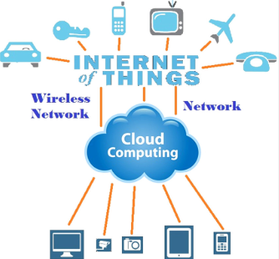
IOT AND CLOUD COMPUTING
By,
Ass. Prof. Kunal D Gaikwad
Pursuing PHD (IOT and Machine Learning)
M.E(Computer Networks)
B.E(Computer Science & Engineering)
Diploma(Computer Engineering)
Ass. Prof. Kunal D Gaikwad
CSE Department, CMRIT

Slide 2
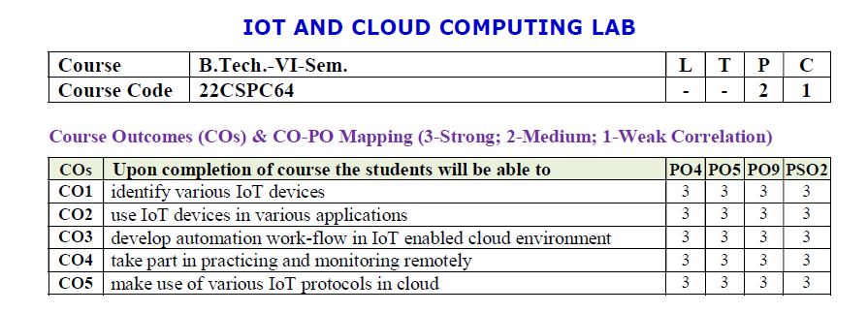
Ass. Prof. Kunal D Gaikwad
CSE Department, CMRIT

Slide 3
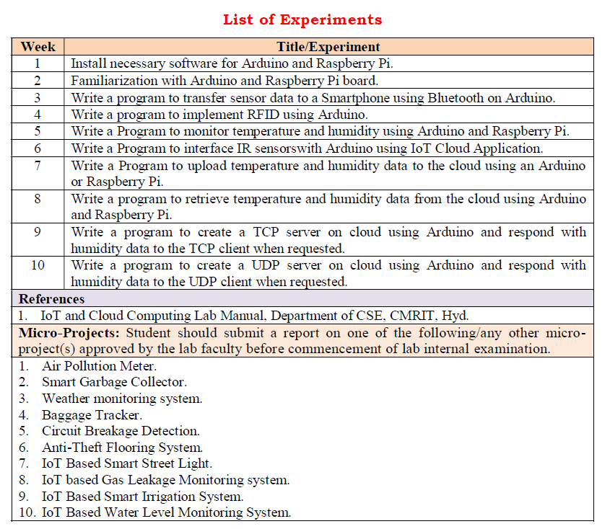
Ass. Prof. Kunal D Gaikwad
CSE Department, CMRIT

Slide 4
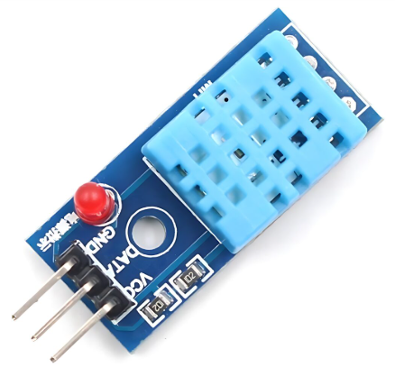
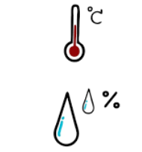
The DHT11 is a digital temperature and humidity sensor that provides calibrated output via a single-wire communication protocol. It is commonly used in weather monitoring systems, home automation, and IoT applications.
1. Weather Monitoring Systems
🌤️ Used in DIY and professional weather stations to measure temperature and humidity levels.
2. Home Automation & Smart Homes
🏡 Integrated into IoT-based smart home systems for automatic climate control, triggering fans, air purifiers, or dehumidifiers.
3. Greenhouse Monitoring
🌱 Helps maintain optimal temperature and humidity levels for plant growth in agricultural environments.
4. Industrial Environmental Monitoring
🏭 Used in factories and warehouses to monitor environmental conditions that affect machinery and stored goods.
5. HVAC (Heating, Ventilation, and Air Conditioning) Systems
❄️ Helps in climate control systems by providing real-time temperature and humidity data for automated adjustments.
DHT11 Temperature and Humidity Sensor
Ass. Prof. Kunal D Gaikwad
CSE Department, CMRIT

Slide 5
Specifications:
Temperature Range: 0°C to 50°C (±2°C accuracy)
Humidity Range: 20% to 90% RH (±5% accuracy)
Operating Voltage: 3.3V - 5V
Output Signal: Digital (single-wire)
Sampling Rate: 1 Hz (one reading per second)
Response Time: ~2 seconds
Dimensions: 15mm x 12mm x 5mm
Pinout:
VCC - Power supply (3.3V or 5V)
Data - Digital output (connect to a pull-up resistor, typically 4.7kΩ)
GND - Ground
DHT11 Temperature and Humidity Sensor
Ass. Prof. Kunal D Gaikwad
CSE Department, CMRIT

Slide 6
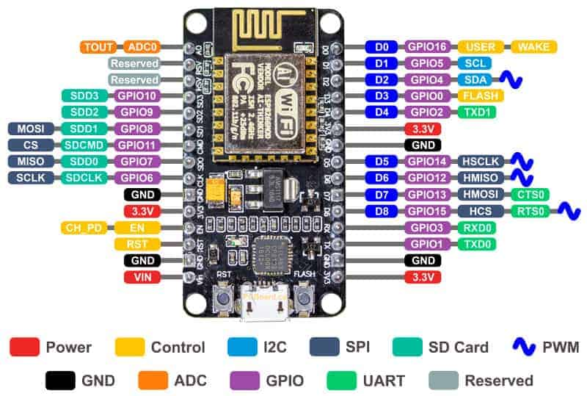
Ass. Prof. Kunal D Gaikwad
CSE Department, CMRIT

Slide 7
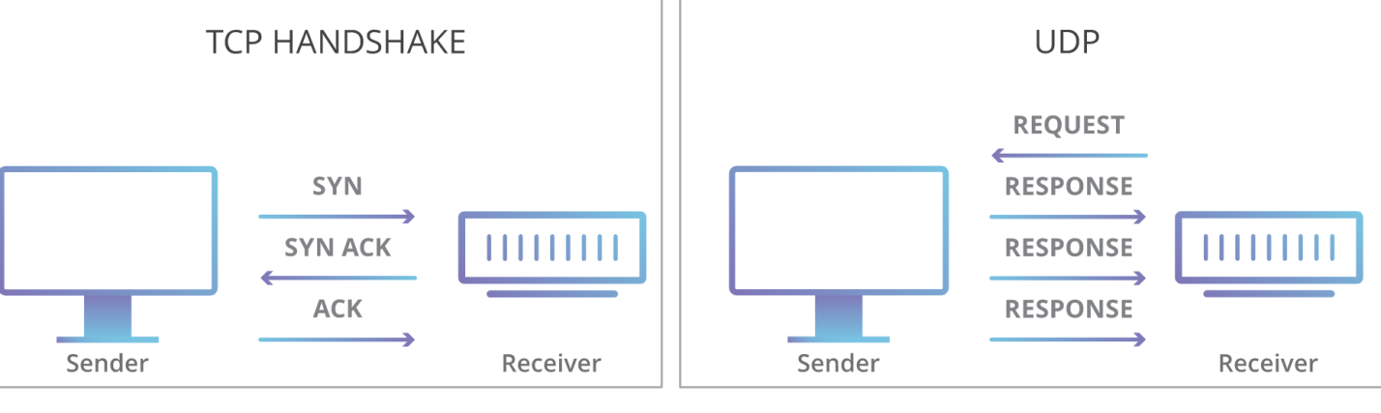
UDP is a standardized method for transferring data between two computers in a network. Compared to other protocols, UDP accomplishes this process in a simple fashion: it sends packets (units of data transmission) directly to a target computer, without establishing a connection first, indicating the order of said packets, or checking whether they arrived as intended. (UDP packets are referred to as ‘datagrams’.)
UDP is faster but less reliable than TCP, another common transport protocol. In a TCP communication, the two computers begin by establishing a connection via an automated process called a ‘handshake.’ Only once this handshake has been completed will one computer actually transfer data packets to the other.
UDP communications do not go through this process. Instead, one computer can simply begin sending data to the other:
Ass. Prof. Kunal D Gaikwad
CSE Department, CMRIT

Slide 8
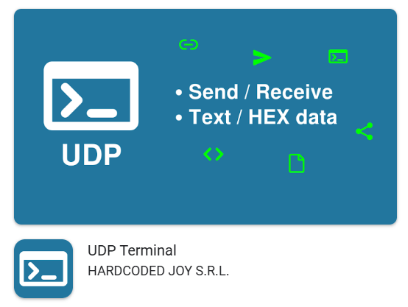
Software requirement:-
Ass. Prof. Kunal D Gaikwad
CSE Department, CMRIT

Slide 9
#include <ESP8266WiFi.h>
#include <WiFiUdp.h>
#include <DHT.h>
const char* ssid = “ak";
const char* password = “12345678";
const char* udpAddress = "192.168.68.144";
const int udpPort = 1234;
#define DHTPIN D3
#define DHTTYPE DHT11
DHT dht(DHTPIN, DHTTYPE);
WiFiUDP udp;
void setup() {
Serial.begin(115200);
Serial.println();
Serial.println("Connecting to WiFi...");
WiFi.begin(ssid, password);
while (WiFi.status() != WL_CONNECTED) {
delay(1000);
Serial.println("Connecting");
}
Serial.println();
Serial.println("Connected to WiFi.IP:");
dht.begin();
}
void loop() {
delay(10000);
float temperature = dht.readTemperature();
float humidity = dht.readHumidity();
if (isnan(temperature) || isnan(humidity)) {
Serial.println("Failed to read from DHT sensor!");
return;
}
Serial.print("Temperature: ");
Serial.print(temperature);
Serial.print(" °C\tHumidity: ");
Serial.print(humidity);
Serial.println(" %");
Serial.println("Sending data over UDP...");
udp.beginPacket(udpAddress, udpPort);
udp.print("Temperature: ");
udp.print(temperature);
udp.print(" °C, Humidity: ");
udp.print(humidity);
udp.println(" %");
udp.endPacket();
Serial.println("Data sent over UDP.");
}
Ass. Prof. Kunal D Gaikwad
CSE Department, CMRIT

Slide 10
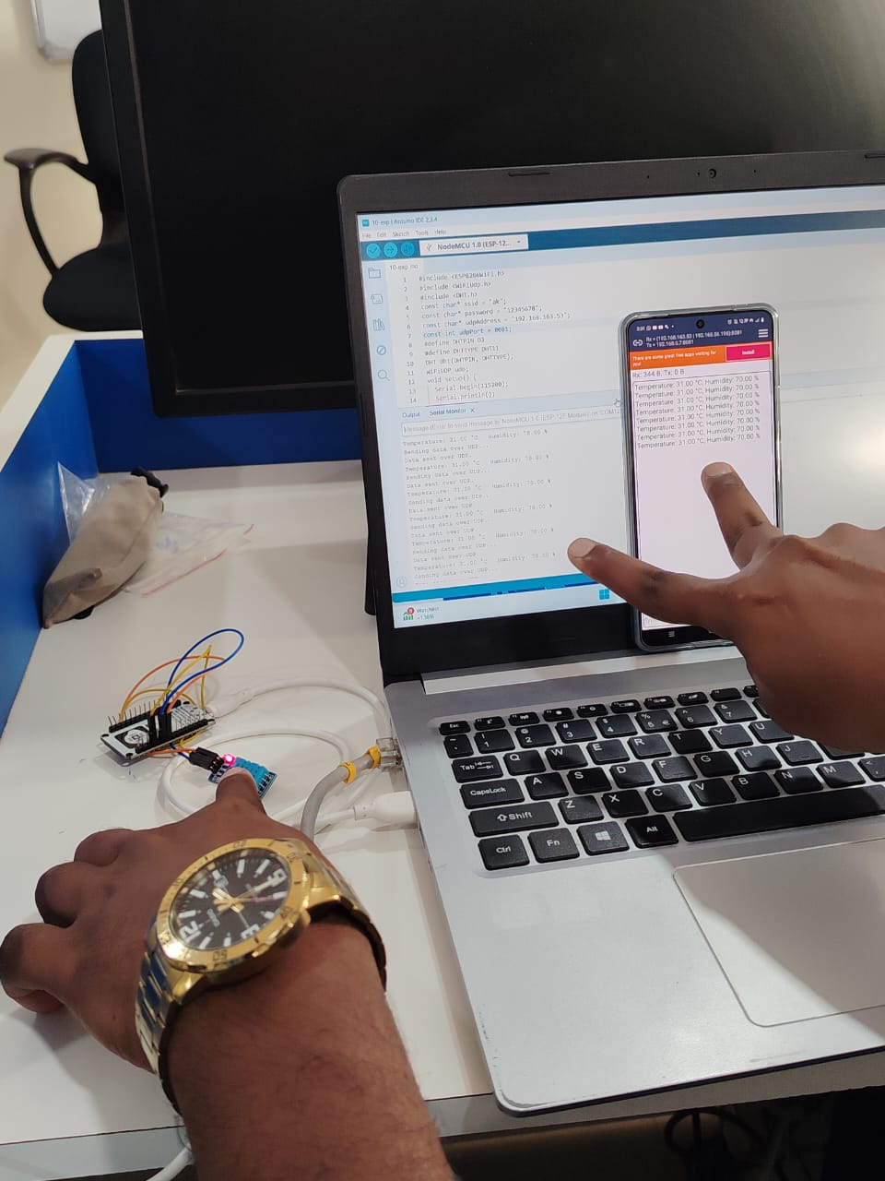
Final Output

Slide 11
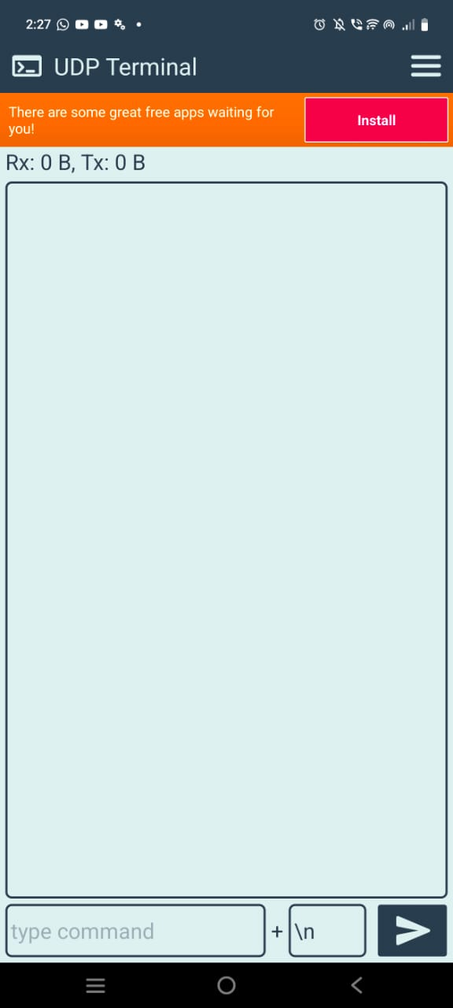
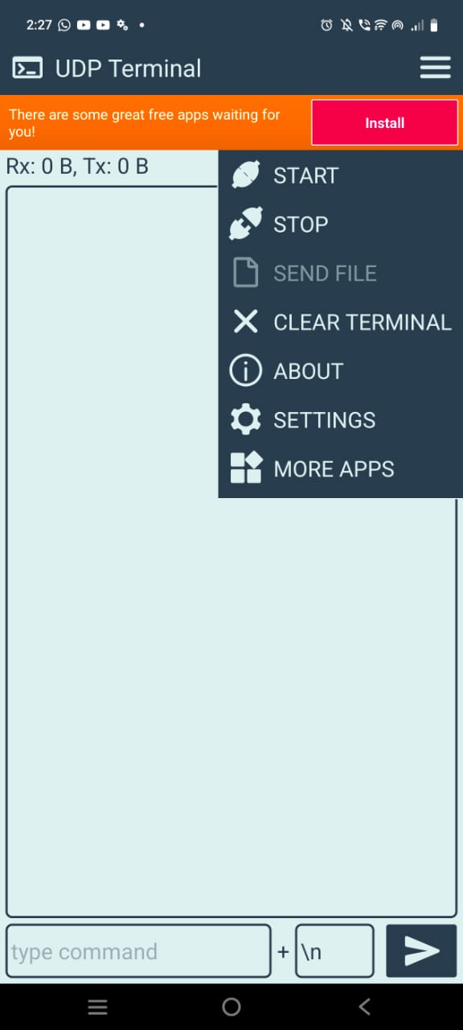
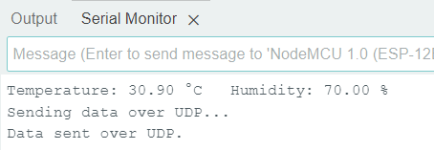
Output in serial monitor:
Output in UDP server:
Ass. Prof. Kunal D Gaikwad
CSE Department, CMRIT

Slide 12
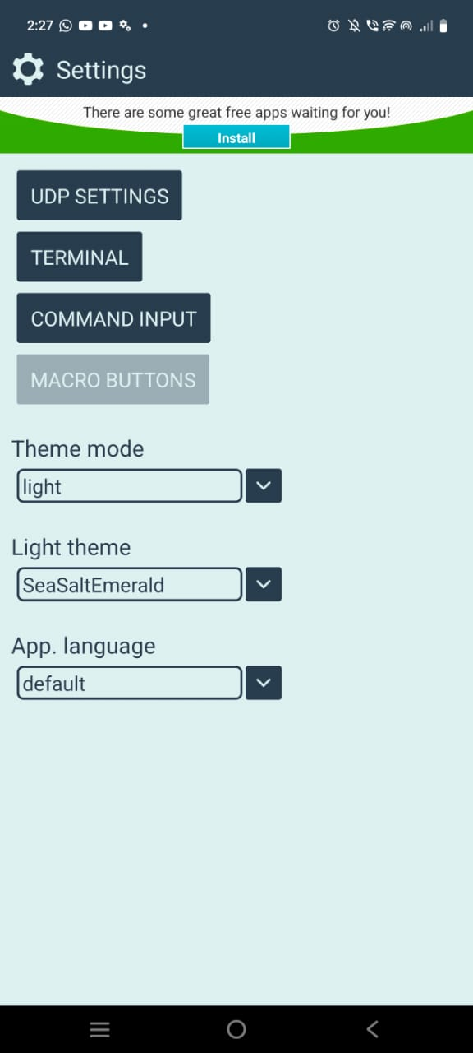

Output in serial monitor:
Output in UDP server:
Ass. Prof. Kunal D Gaikwad
CSE Department, CMRIT

