Slide 1
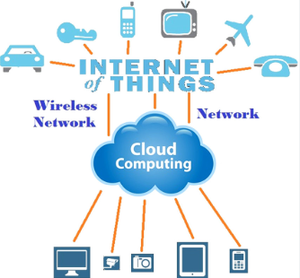
IOT AND CLOUD COMPUTING
By,
Ass. Prof. Kunal D Gaikwad
Pursuing PHD (IOT and Machine Learning)
M.E(Computer Networks)
B.E(Computer Science & Engineering)
Diploma(Computer Engineering)
Ass. Prof. Kunal D Gaikwad
CSE Department, CMRIT

Slide 2
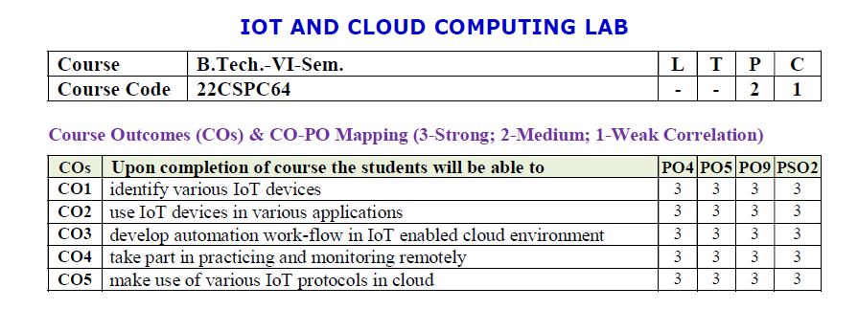
Ass. Prof. Kunal D Gaikwad
CSE Department, CMRIT

Slide 3
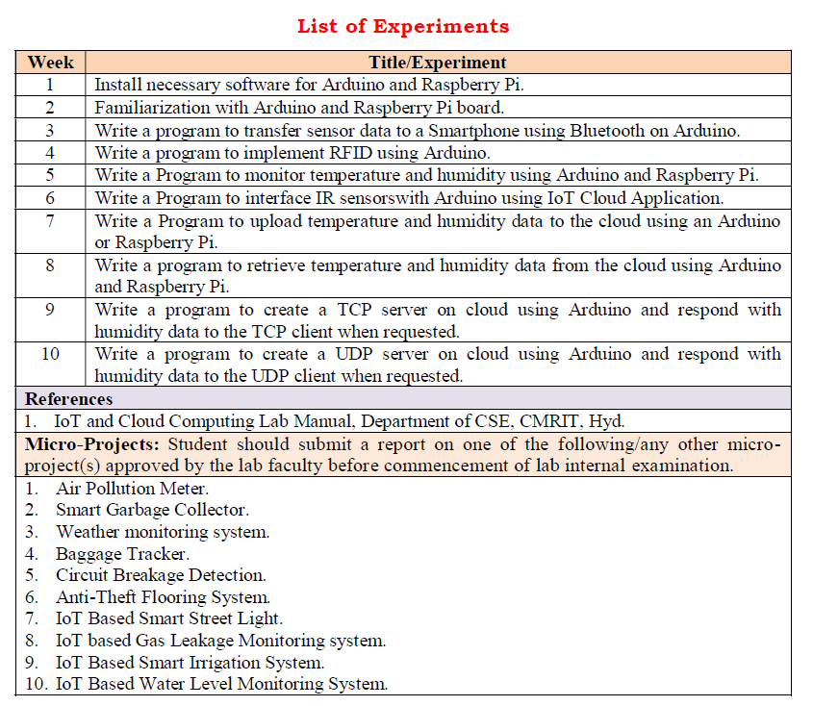
Ass. Prof. Kunal D Gaikwad
CSE Department, CMRIT

Slide 4
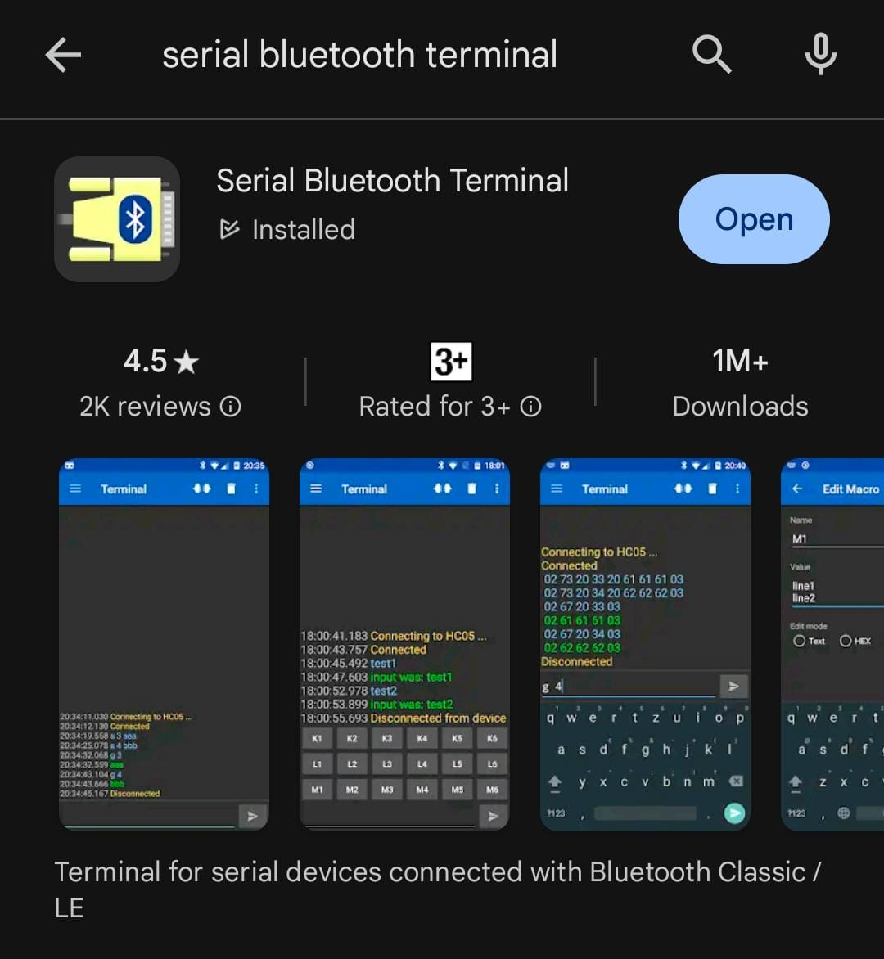
Ass. Prof. Kunal D Gaikwad
CSE Department, CMRIT

Slide 5
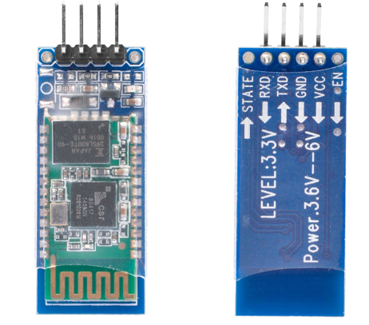

A Bluetooth sensor in IoT is a device that uses Bluetooth technology to wirelessly transmit data over short distances. It is widely used for low-power and low-cost IoT applications due to its ease of integration and compatibility.
Key IoT applications include:
Wearables: Fitness trackers and smartwatches use Bluetooth to send health data to smartphones.
Smart home devices: Connects devices like smart locks, lights, and thermostats for remote control.
Asset tracking: Monitors and locates objects or vehicles in real-time.
Healthcare: Transfers data from medical devices like glucose monitors to mobile apps.
Industrial IoT: Enables machine-to-machine communication for monitoring and automation.
Bluetooth sensors are essential for creating interconnected IoT ecosystems, enabling seamless communication and data sharing between devices.
Bluetooth Sensor HC 05
Ass. Prof. Kunal D Gaikwad
CSE Department, CMRIT

Slide 6
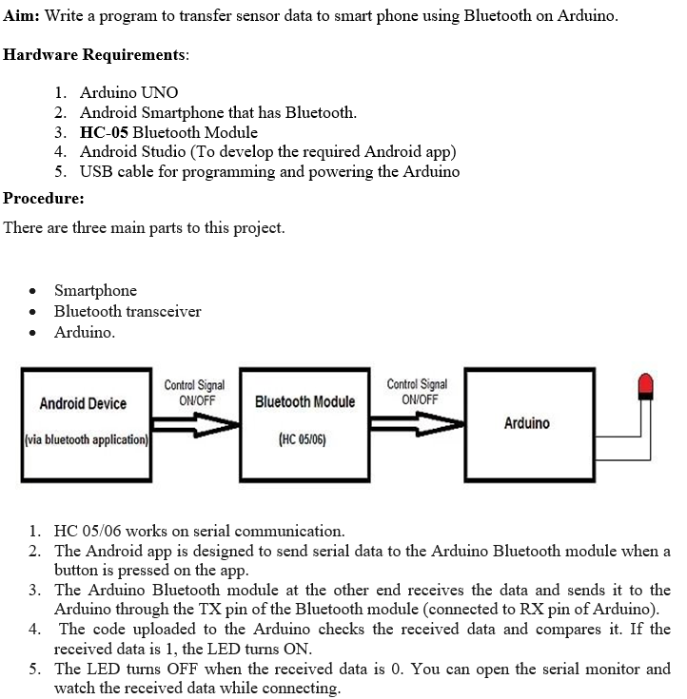
Ass. Prof. Kunal D Gaikwad
CSE Department, CMRIT

Slide 7
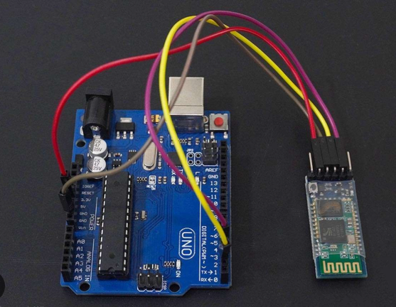
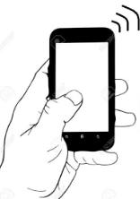
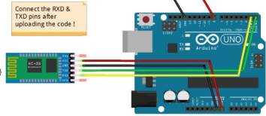
Ass. Prof. Kunal D Gaikwad
CSE Department, CMRIT

Slide 8
Source Code:
#include <SoftwareSerial.h>
SoftwareSerial Bluetooth(8, 9); // RX, TX (Interchange to 9, 8 on Arduino)
int LED = 13; // the on-board LED
int Data; // the data received
void setup() {
Bluetooth.begin(9600);
Serial.begin(9600);
Serial.println("Waiting for command...");
Bluetooth.println("Send 1 to turn on the LED. Send 0 to turn Off");
pinMode(LED,OUTPUT);
}
void loop() {
if (Bluetooth.available()){ //wait for data received
Data=Bluetooth.read();
if(Data=='1'){
digitalWrite(LED,HIGH);
Serial.println("LED On!");
Bluetooth.println("LED On!");
}
else if(Data=='0'){
digitalWrite(LED,LOW);
Serial.println("LED Off!");
Bluetooth.println("LED Off ! ");
}
else{;}
}
delay(1000);
}
Ass. Prof. Kunal D Gaikwad
CSE Department, CMRIT

Slide 9
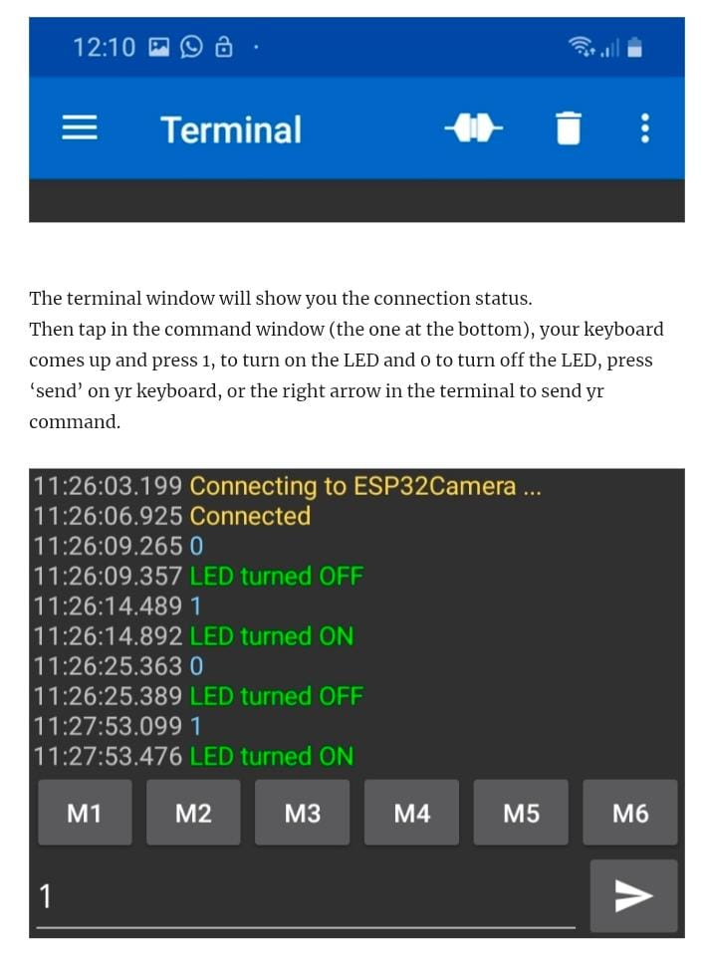
Ass. Prof. Kunal D Gaikwad
CSE Department, CMRIT

