Slide 1

IOT AND CLOUD COMPUTING
By,
Ass. Prof. Kunal D Gaikwad
Pursuing PHD (IOT and Machine Learning)
M.E(Computer Networks)
B.E(Computer Science & Engineering)
Diploma(Computer Engineering)
Ass. Prof. Kunal D Gaikwad
CSE Department, CMRIT

Slide 2
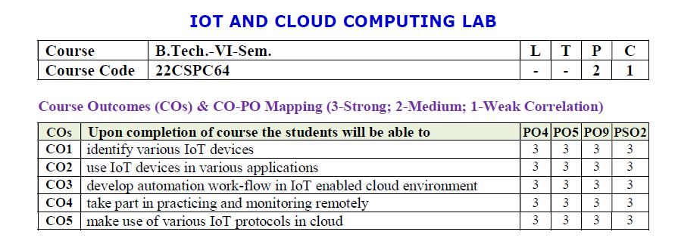
Ass. Prof. Kunal D Gaikwad
CSE Department, CMRIT

Slide 3
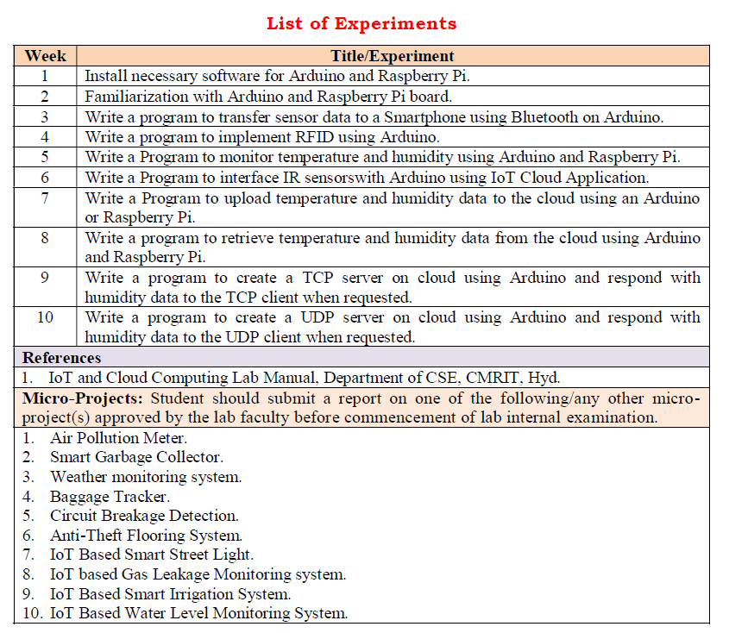
Ass. Prof. Kunal D Gaikwad
CSE Department, CMRIT

Slide 4
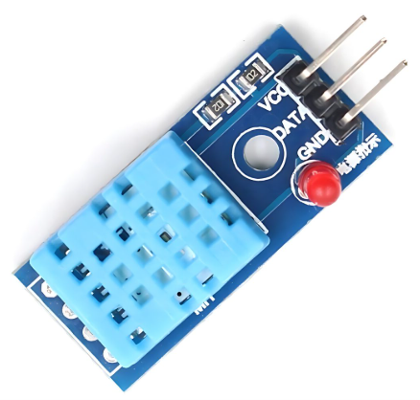
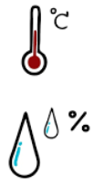
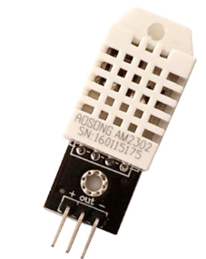
The DHT11 is a digital temperature and humidity sensor that provides calibrated output via a single-wire communication protocol. It is commonly used in weather monitoring systems, home automation, and IoT applications.
1. Weather Monitoring Systems
🌤️ Used in DIY and professional weather stations to measure temperature and humidity levels.
2. Home Automation & Smart Homes
🏡 Integrated into IoT-based smart home systems for automatic climate control, triggering fans, air purifiers, or dehumidifiers.
3. Greenhouse Monitoring
🌱 Helps maintain optimal temperature and humidity levels for plant growth in agricultural environments.
4. Industrial Environmental Monitoring
🏭 Used in factories and warehouses to monitor environmental conditions that affect machinery and stored goods.
5. HVAC (Heating, Ventilation, and Air Conditioning) Systems
❄️ Helps in climate control systems by providing real-time temperature and humidity data for automated adjustments.
DHT11 Temperature and Humidity Sensor
DHT22 Temperature and Humidity Sensor
Ass. Prof. Kunal D Gaikwad
CSE Department, CMRIT

Slide 5
Specifications:
Temperature Range: 0°C to 50°C (±2°C accuracy)
Humidity Range: 20% to 90% RH (±5% accuracy)
Operating Voltage: 3.3V - 5V
Output Signal: Digital (single-wire)
Sampling Rate: 1 Hz (one reading per second)
Response Time: ~2 seconds
Dimensions: 15mm x 12mm x 5mm
Pinout:
VCC - Power supply (3.3V or 5V)
Data - Digital output (connect to a pull-up resistor, typically 4.7kΩ)
GND - Ground
DHT11 Temperature and Humidity Sensor
Ass. Prof. Kunal D Gaikwad
CSE Department, CMRIT

Slide 6
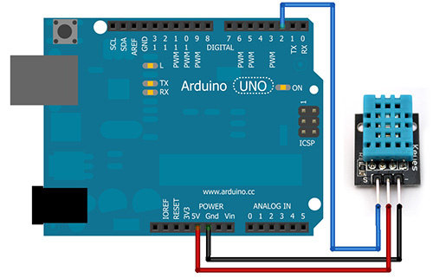
Ass. Prof. Kunal D Gaikwad
CSE Department, CMRIT

Slide 7
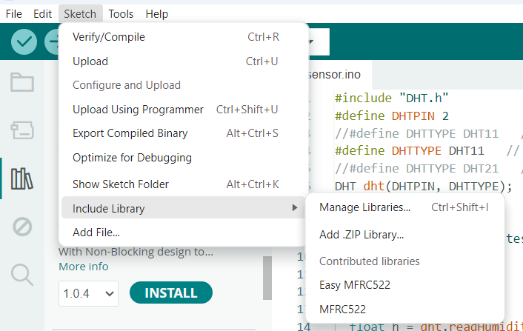
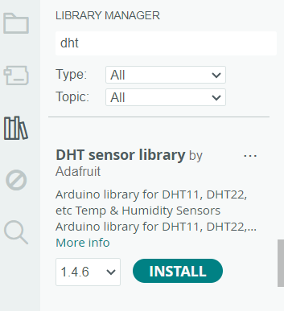
Ass. Prof. Kunal D Gaikwad
CSE Department, CMRIT

Slide 8
Source Code:
#include "DHT.h"
#define DHTPIN 2
//#define DHTTYPE DHT11 // DHT 11
#define DHTTYPE DHT11 // DHT 22 (AM2302), AM2321
//#define DHTTYPE DHT21 // DHT 21 (AM2301)
DHT dht(DHTPIN, DHTTYPE);
void setup() {
Serial.begin(9600);
Serial.println(F("DHTxx test!"));
dht.begin();
}
void loop() {
delay(2000);
float h = dht.readHumidity();
// Read temperature as Celsius (the default)
float t = dht.readTemperature();
// Read temperature as Fahrenheit (isFahrenheit = true)
float f = dht.readTemperature(true);
if (isnan(h) || isnan(t) || isnan(f)) {
Serial.println(F("Failed to read from DHT sensor!"));
return;
}
float hif = dht.computeHeatIndex(f, h);
float hic = dht.computeHeatIndex(t, h, false);
Serial.print(F("Humidity: "));
Serial.print(h);
Serial.print(F("% Temperature: "));
Serial.print(t);
Serial.print(F("°C "));
Serial.print(f);
Serial.print(F("°F Heat index: "));
Serial.print(hic);
Serial.print(F("°C "));
Serial.print(hif);
Serial.println(F("°F"));
}
Ass. Prof. Kunal D Gaikwad
CSE Department, CMRIT

Slide 9
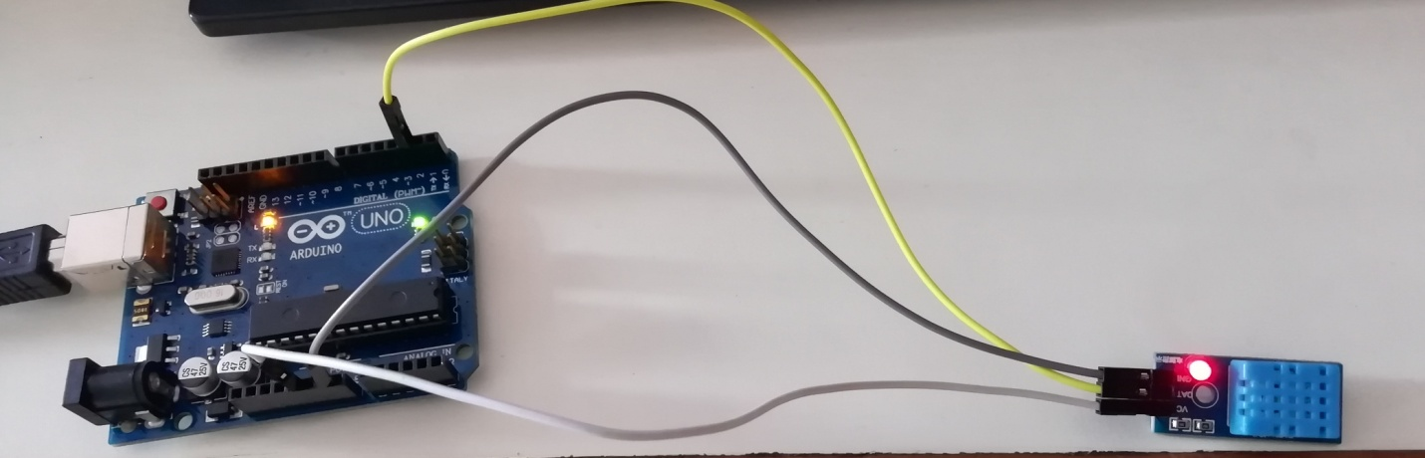
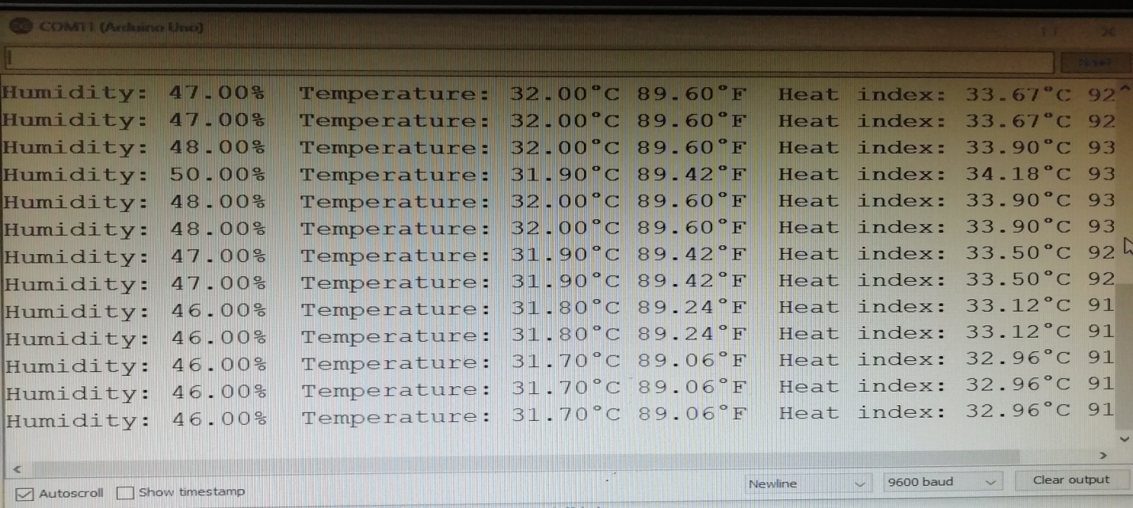
OUTPUT:
Ass. Prof. Kunal D Gaikwad
CSE Department, CMRIT

