Slide 1
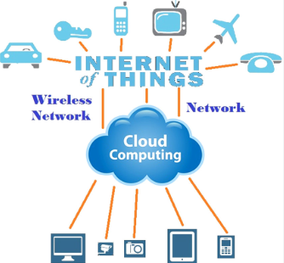
IOT AND CLOUD COMPUTING
By,
Ass. Prof. Kunal D Gaikwad
Pursuing PHD (IOT and Machine Learning)
M.E(Computer Networks)
B.E(Computer Science & Engineering)
Diploma(Computer Engineering)
Ass. Prof. Kunal D Gaikwad
CSE Department, CMRIT

Slide 2
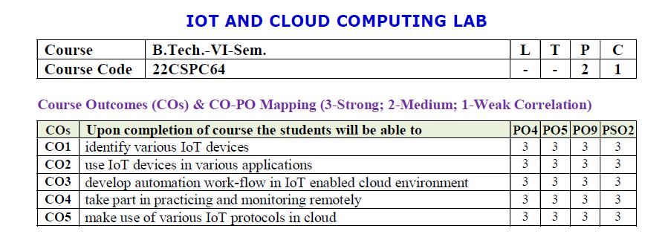
Ass. Prof. Kunal D Gaikwad
CSE Department, CMRIT

Slide 3
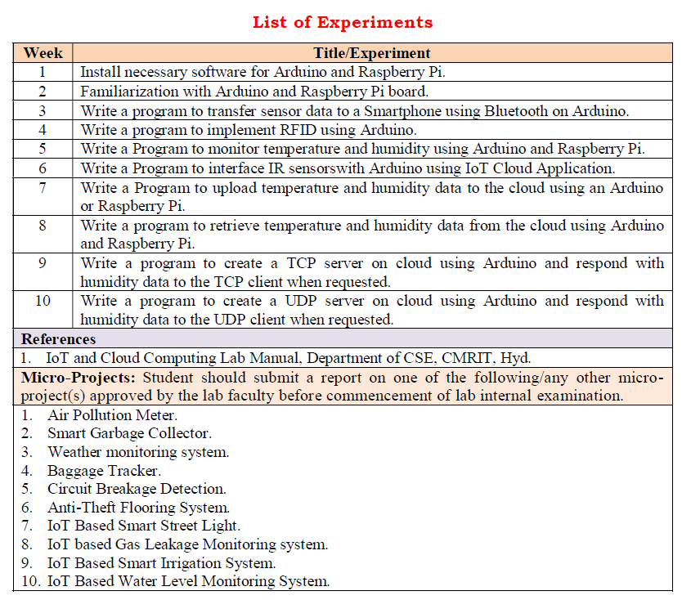
Ass. Prof. Kunal D Gaikwad
CSE Department, CMRIT

Slide 4
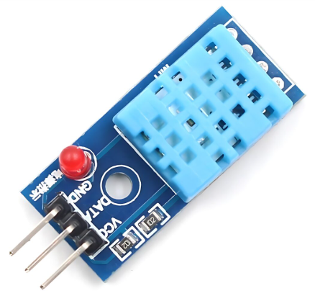
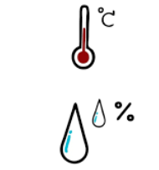
The DHT11 is a digital temperature and humidity sensor that provides calibrated output via a single-wire communication protocol. It is commonly used in weather monitoring systems, home automation, and IoT applications.
1. Weather Monitoring Systems
🌤️ Used in DIY and professional weather stations to measure temperature and humidity levels.
2. Home Automation & Smart Homes
🏡 Integrated into IoT-based smart home systems for automatic climate control, triggering fans, air purifiers, or dehumidifiers.
3. Greenhouse Monitoring
🌱 Helps maintain optimal temperature and humidity levels for plant growth in agricultural environments.
4. Industrial Environmental Monitoring
🏭 Used in factories and warehouses to monitor environmental conditions that affect machinery and stored goods.
5. HVAC (Heating, Ventilation, and Air Conditioning) Systems
❄️ Helps in climate control systems by providing real-time temperature and humidity data for automated adjustments.
DHT11 Temperature and Humidity Sensor
Ass. Prof. Kunal D Gaikwad
CSE Department, CMRIT

Slide 5
Specifications:
Temperature Range: 0°C to 50°C (±2°C accuracy)
Humidity Range: 20% to 90% RH (±5% accuracy)
Operating Voltage: 3.3V - 5V
Output Signal: Digital (single-wire)
Sampling Rate: 1 Hz (one reading per second)
Response Time: ~2 seconds
Dimensions: 15mm x 12mm x 5mm
Pinout:
VCC - Power supply (3.3V or 5V)
Data - Digital output (connect to a pull-up resistor, typically 4.7kΩ)
GND - Ground
DHT11 Temperature and Humidity Sensor
Ass. Prof. Kunal D Gaikwad
CSE Department, CMRIT

Slide 6
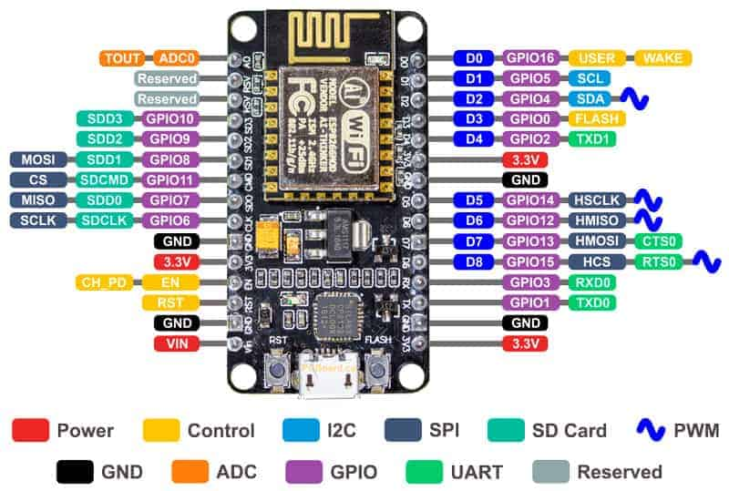
Ass. Prof. Kunal D Gaikwad
CSE Department, CMRIT

Slide 7
What is TCP (Transmission Control Protocol)?
Transmission Control Protocol (TCP) is a connection-oriented protocol for communications that helps in the exchange of messages between different devices over a network.
Ass. Prof. Kunal D Gaikwad
CSE Department, CMRIT

Slide 8
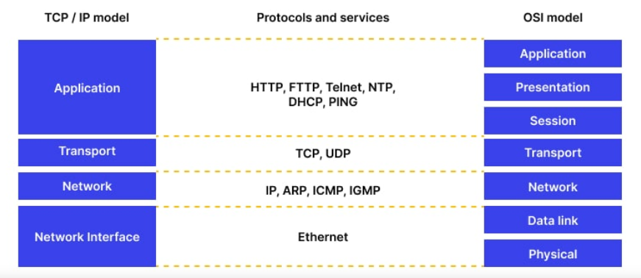
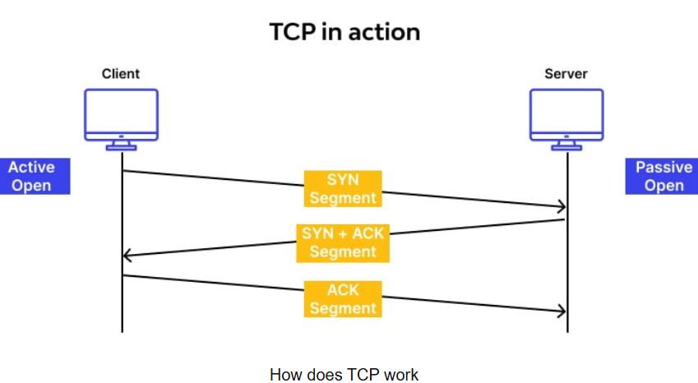
TCP is a connection-oriented protocol, which means a connection is established and maintained until the applications at each end have finished exchanging messages.
Ass. Prof. Kunal D Gaikwad
CSE Department, CMRIT

Slide 9

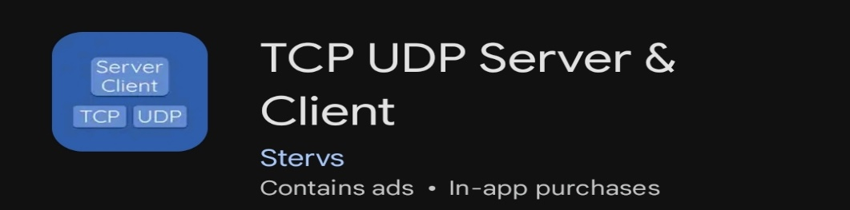
Software requirement:-
OR
Ass. Prof. Kunal D Gaikwad
CSE Department, CMRIT

Slide 10
#include "ESP8266WiFi.h"
#include "DHT.h"
const char* ssid = "****";
const char* password = "****";
WiFiServer wifiServer(8080);
DHT dht(D3, DHT11);
void setup() {
Serial.begin(115200);
delay(1000);
WiFi.begin(ssid, password);
while (WiFi.status() != WL_CONNECTED) {
delay(1000);
Serial.println("Connecting..");
}
Serial.print("Connected to WiFi. IP:");
Serial.println(WiFi.localIP());
wifiServer.begin();
dht.begin();
}
void loop() {
WiFiClient client = wifiServer.available();
if (client) {
while (client.connected()) {
while (client.available()>0) {
float t=dht.readTemperature();
float h = dht.readHumidity();
client.println("humidity :");
client.println("temperature :");
client.println(h);
Serial.println(h);
client.println(t);
Serial.println(t);
delay(2000);
}
}
client.stop();
Serial.println("Client disconnected");
}
}
Ass. Prof. Kunal D Gaikwad
CSE Department, CMRIT

Slide 11
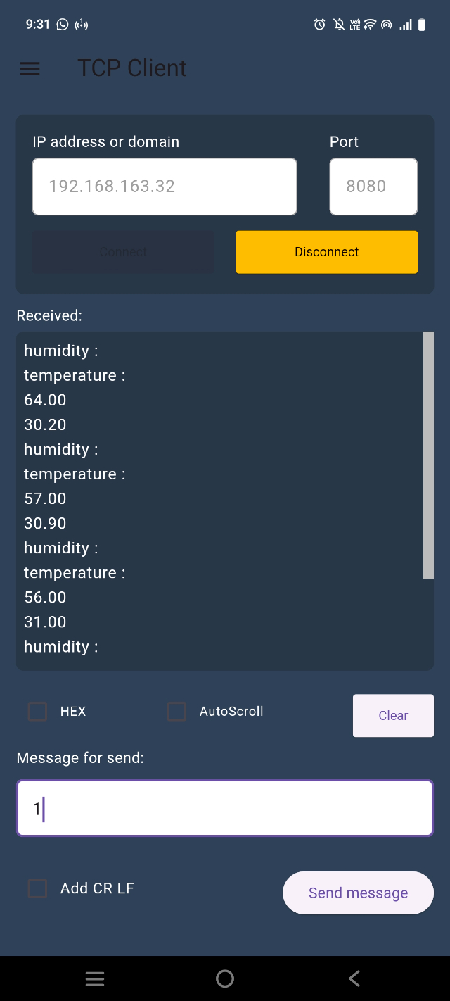

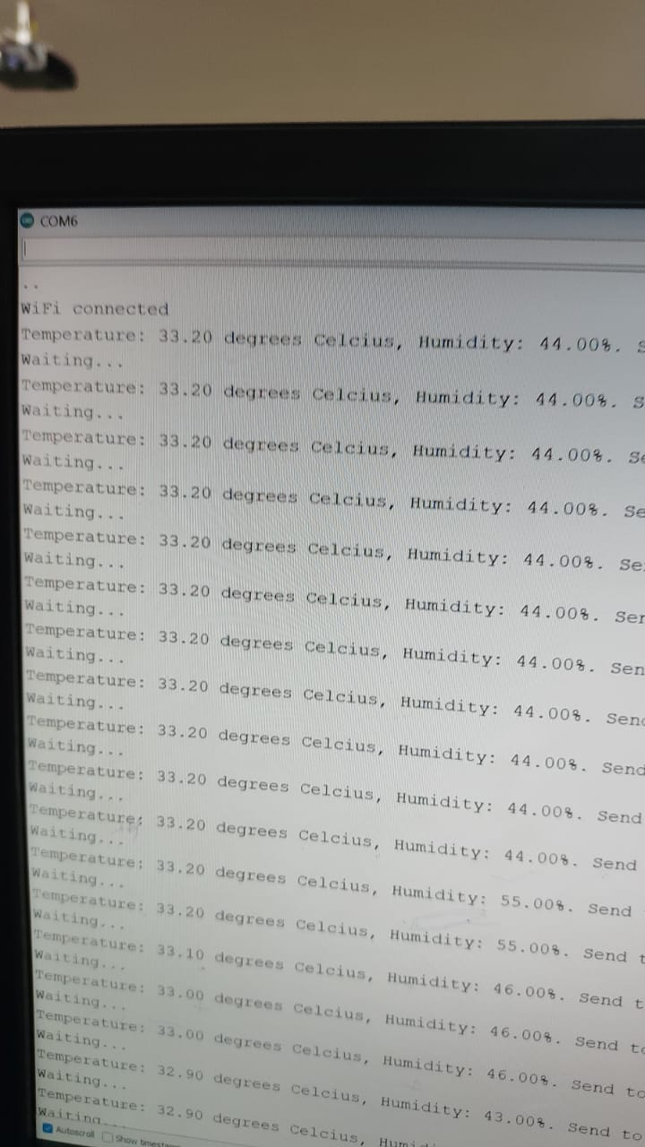
Output in serial monitor:
Output in tcp client server:
Ass. Prof. Kunal D Gaikwad
CSE Department, CMRIT

Slide 12
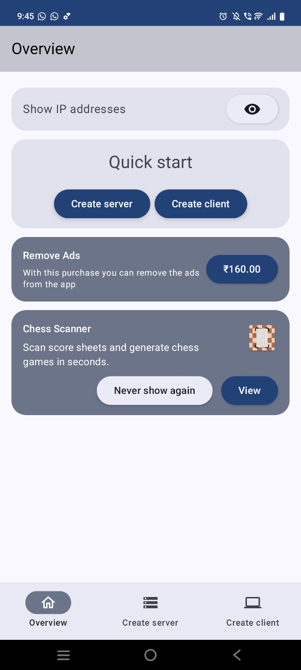
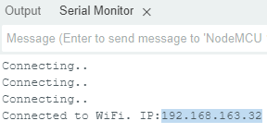
Output in serial monitor:
Output in tcp client server:
Ass. Prof. Kunal D Gaikwad
CSE Department, CMRIT

Slide 13
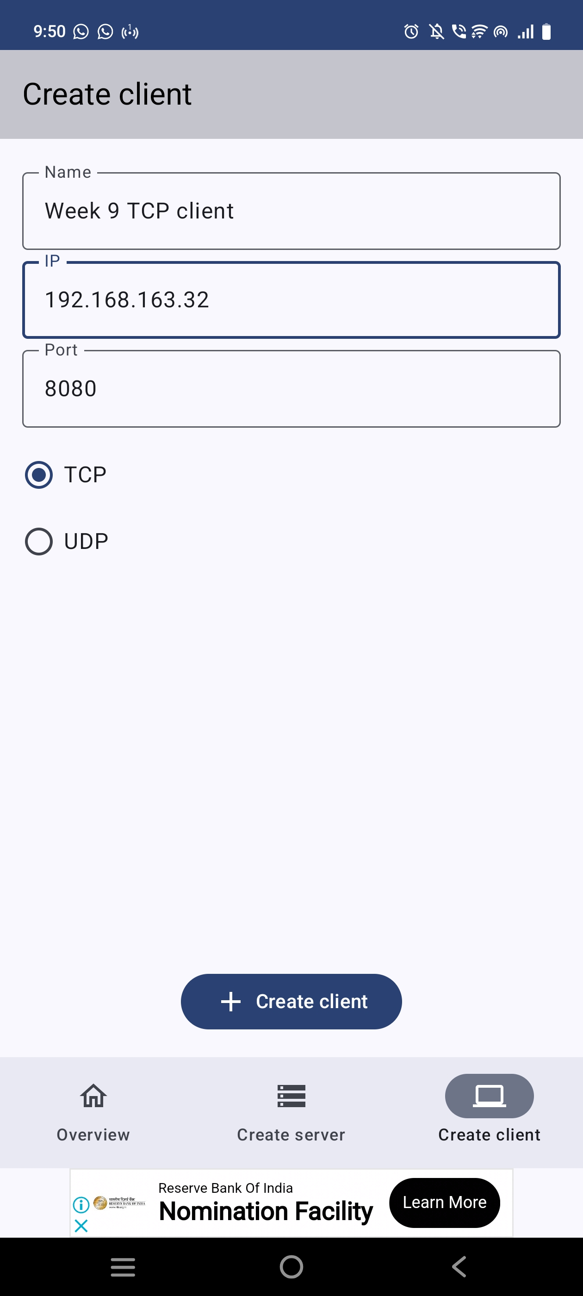
Output in serial monitor:
Output in tcp client server:
Ass. Prof. Kunal D Gaikwad
CSE Department, CMRIT

Slide 14
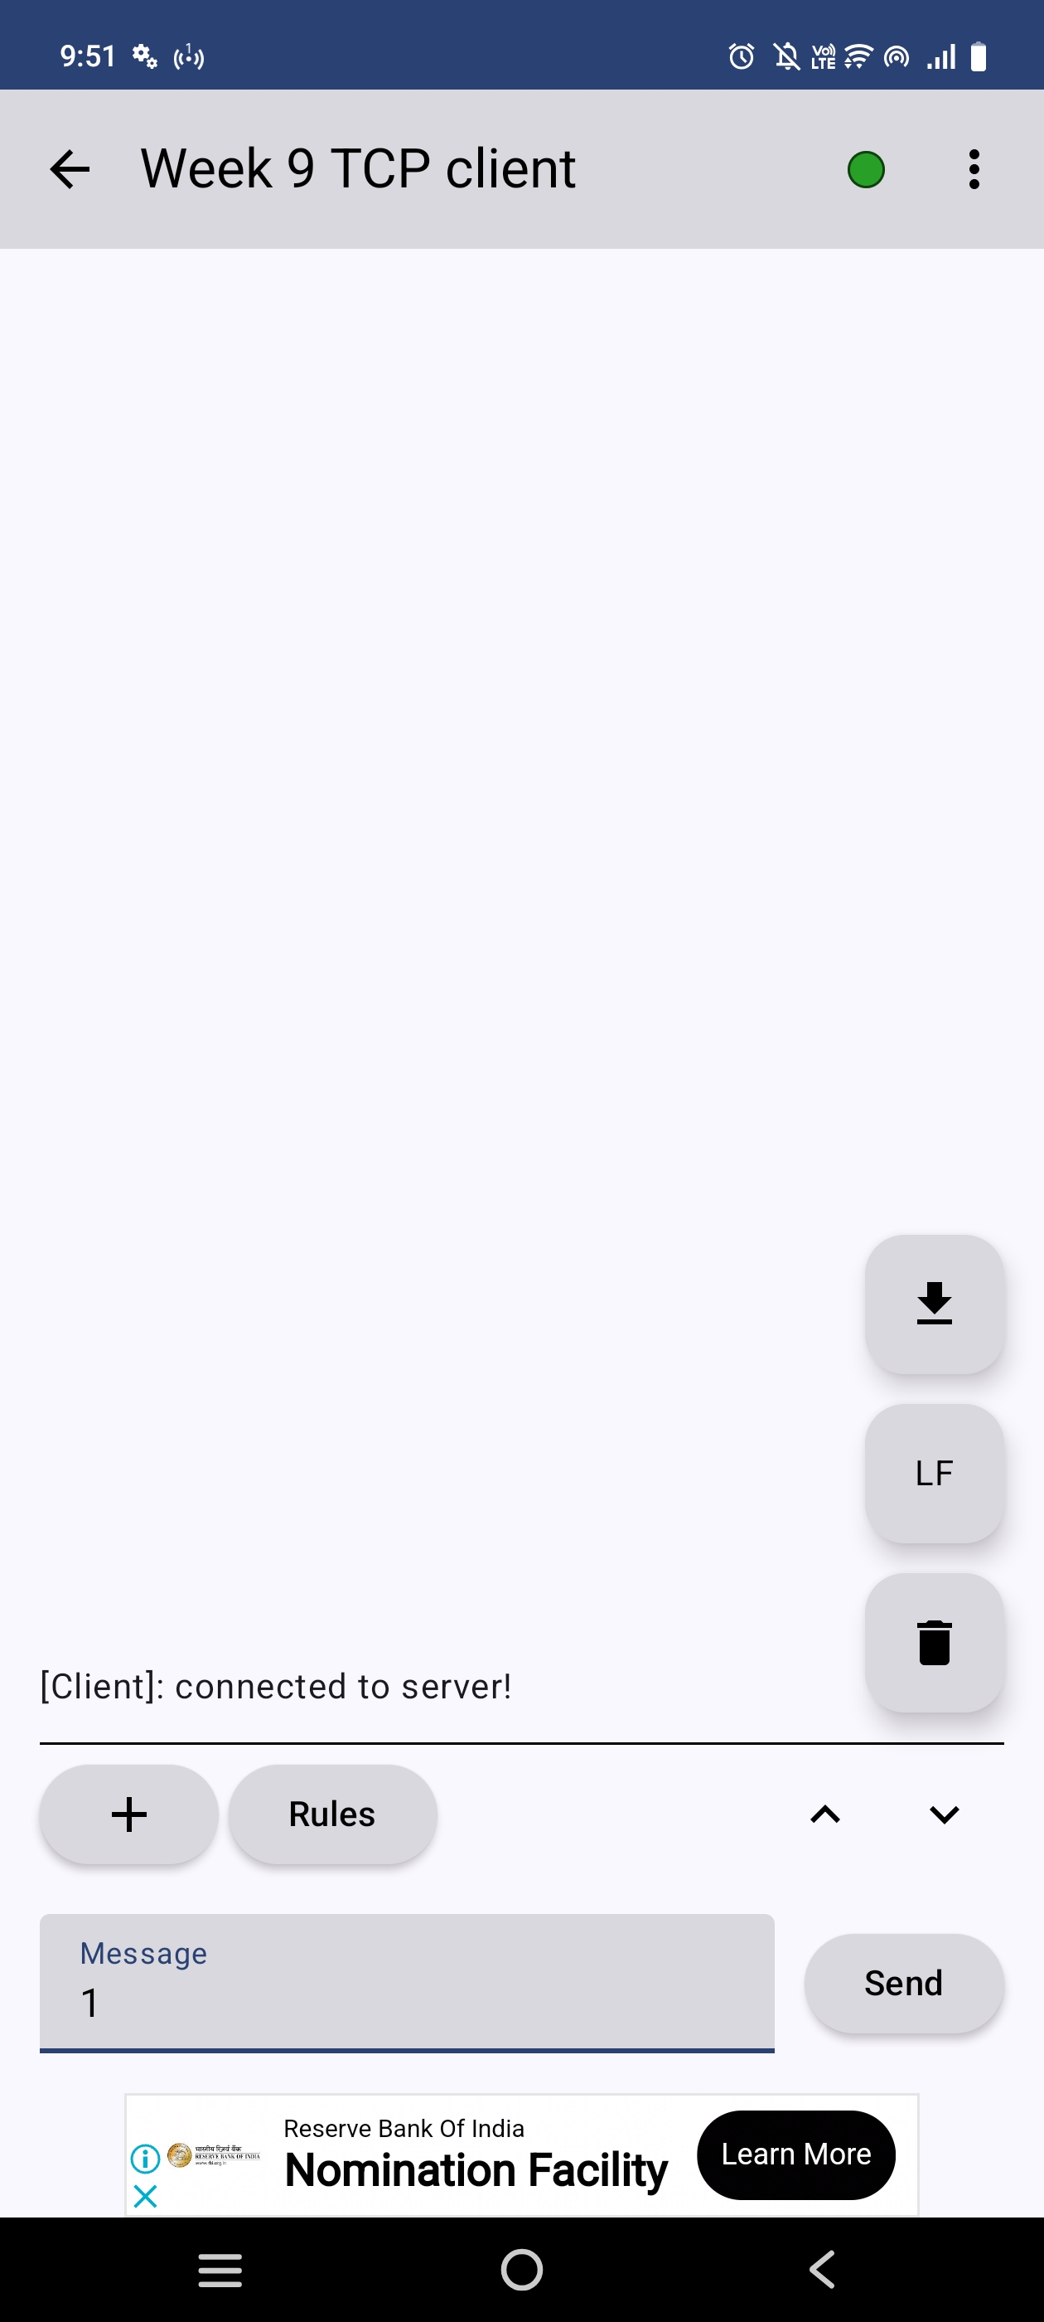
Output in serial monitor:
Output in tcp client server:
Ass. Prof. Kunal D Gaikwad
CSE Department, CMRIT

Slide 15
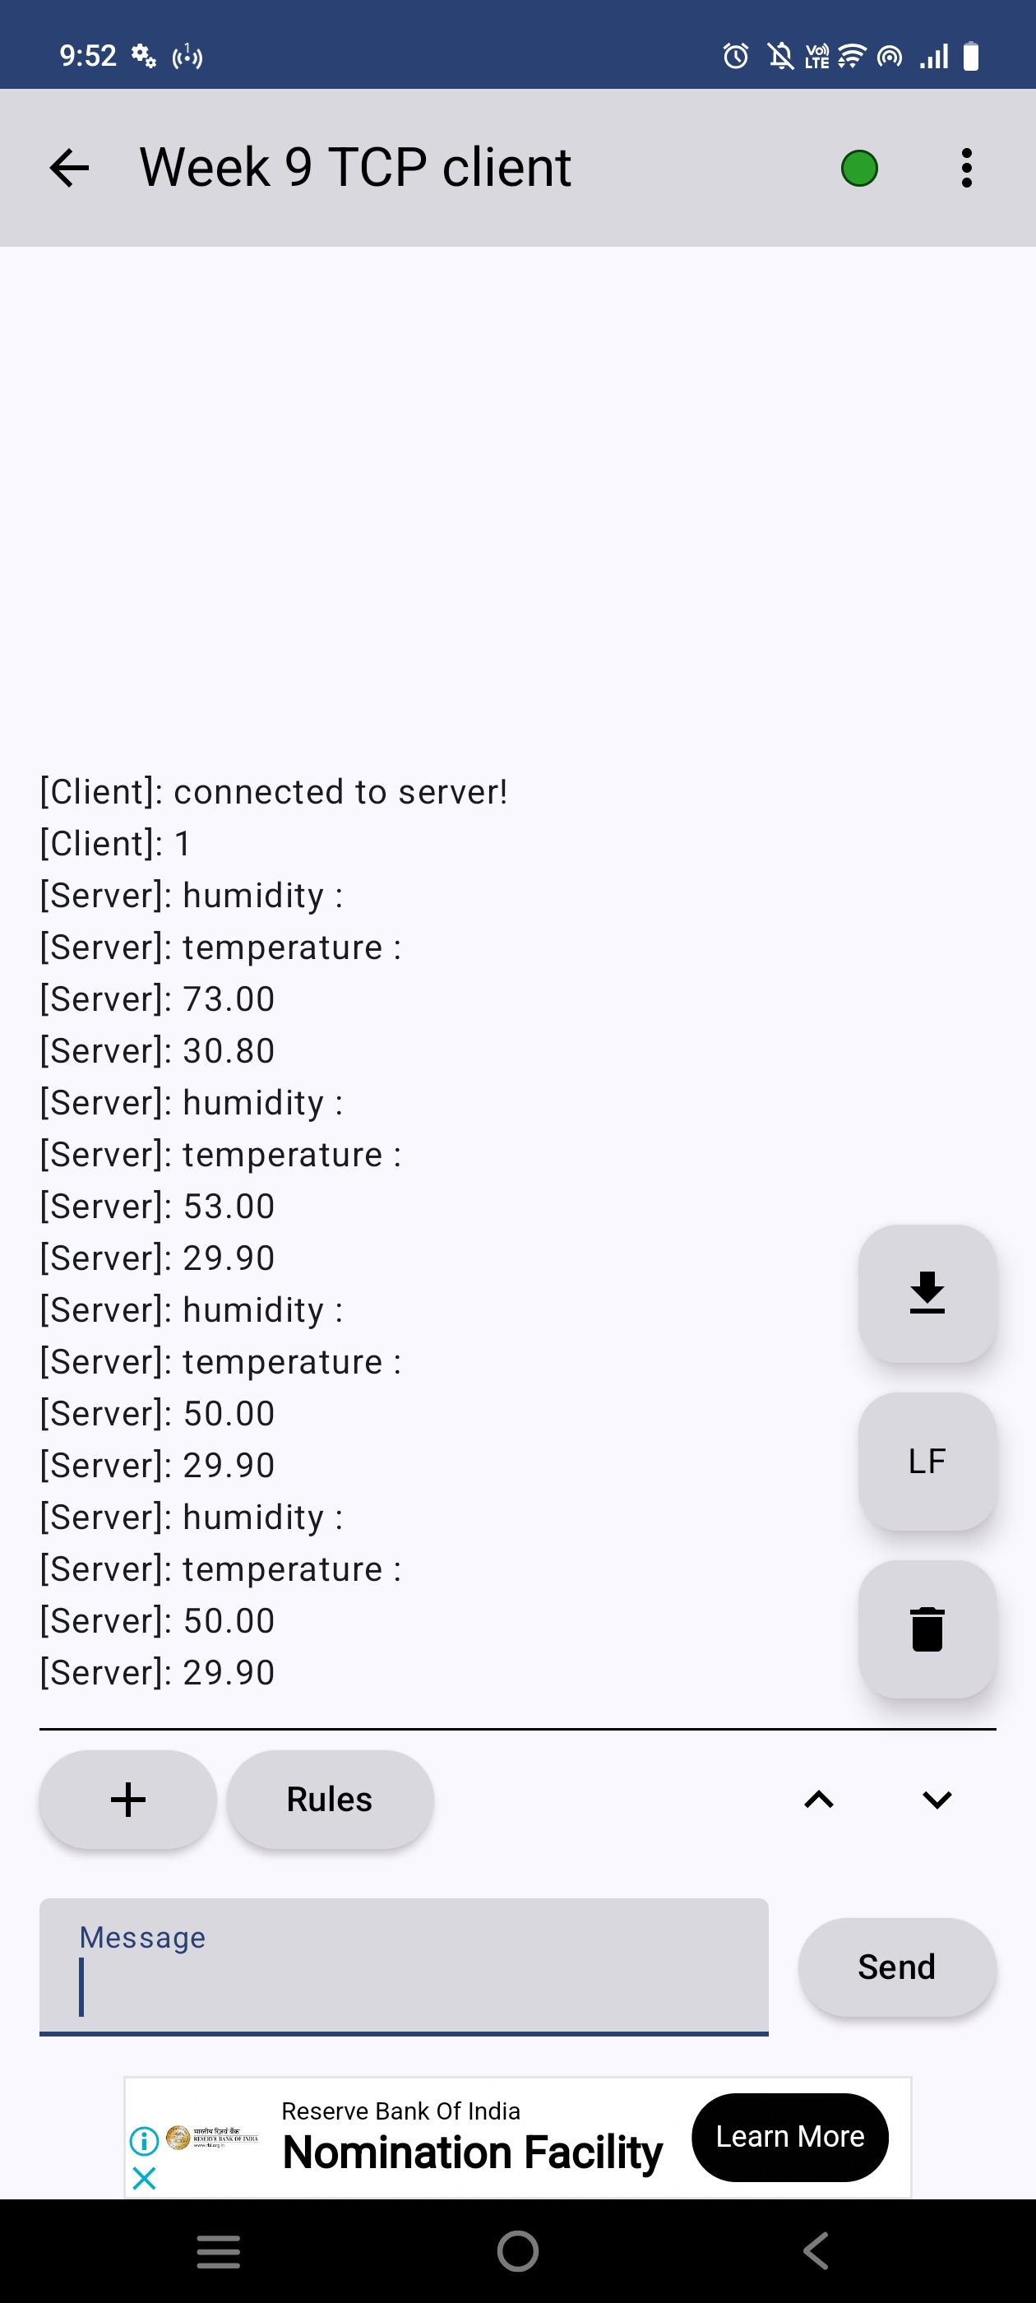
Output in serial monitor:
Output in tcp client server:
Ass. Prof. Kunal D Gaikwad
CSE Department, CMRIT

