Slide 1
Lambda Lambda Lambda!
Chris Mitchell
Programmer analyst
E& J Gallo Winery
@motobreath
Github.com/motobreath
Blog.chrismitchellonline.com
chris@chrismitchellonline.com

Slide 2
Lets Go Over
What is Lambda & the Lambda dashboard?
Versioning with Lambda qualifiers
Lambda Layers
Local Development

Slide 3
PRE-REQ’S
AWS Account
CLI == Dashboard
Demo using dashboard, all commands available with CLI
CLI demo at https://blog.chrismitchellonline.com
Local development will require AWS CLI and SAM installed

Slide 4
What Is Lambda
Run code in the cloud
Operating system – Amazon Linux
AMI – amzn-ami-hvm-2017.03.1.20170812-x86_64-gp2
Linux kernel – 4.14.77-70.59.amzn1.x86_64
Docker container the whole thing
AWS SDK for JavaScript – 2.290.0
SDK for Python (Boto 3) – 3-1.7.74 botocore-1.10.74

Slide 5
New Lambda Function
Login via https://aws.amazon.com/console/
Find Lambda Dashboard
Create new function
Use defaults, create new role for function
Roles
Create new role
Existing roll

Slide 6
Lambda Dashboard
Designer Section
Integrate Lambda, Layers, Logs, architect your function
Triggers (Event sources)
Code
Write code…
Environment Variables
Incorporate environment variables in
Memory
Tagging
More..

Slide 7
Testing Functions
Test events should match the event that your function would run from
Example: API gateway sends video game data
Configure test events and test function
Create test events to run your function in the dashboard
Essentially a “run your code” trigger

Slide 8
Demo
Enough talk, lets setup a function and see a dashboard
Setup a test event
Run code!

Slide 9
Versioning
Multiple versions of Lambda code
Separate DEV/ACC/Prod environment
Lambda Qualifiers
Manage what aliases run what code
Versioning locks in function settings, unable to change code
Must change things like memory and environment at root function level

Slide 10
Creating All Those Things
Create a new version of our Lambda function code, will be version 1
Create 3 aliases, dev,acc,prod, point each of those aliases to version 1
Use $LATEST for active development
Deploy new version of the code, version 2
Point aliases accordingly.
Check Qualifiers menu to see where aliases point

Slide 11
Demo Again
Setup versions for our function

Slide 12
Layers
Pull custom code into your Lambda function
Most useful with NPM libraries
Custom NPM libraries to boot
Salesforce NPM package
Reusable across all Lambda functions

Slide 13
Setup Layer
Setup code locally using NPM install
Suggest /src directory, manage by NPM
Directory structure must match:
-name_of_layer -node_js -npm_modules -package.json -index.js
Zip up directory so your zip file contains node_js

Slide 14
Lambda Layers Dashboard
Create new layer
Name, description, license, runtime
Upload zip
Set Runtime
Attach layer to function
Use the code!

Slide 15
Demo Layers
See it in action

Slide 16
Local Development
Everyone wants to use their own IDE
Debugging
Access to GIT
But who wants to install runtimes?

Slide 17
Local Lambda
Develop locally, upload code, run in cloud
Good for large (or all!) functions
Upload zip directly to Lambda
Function code section, change dropdown from Edit code inline
~10mb upload limit
Upload zip to S3, load from there
Better for larger functions
With Lambda layers we don’t have to include NPM!
NPM install locally, exclude from zip

Slide 18
Local Lambda with SAM
AWS Serverless Application Model
Uses Docker container to simulate running Lambda locally
Local debugging and testing
VS Code integration for debugging
Breakpoints, stepping through code
Use test events to trigger function similar to Lambda dashboard

Slide 19
Local Lambda Components
Install Docker and AWS CLI/SAM
Create template.yml to define your functions
One template.yml for many functions
Define resources and outputs, 1-1 mapping to generate function calls

Slide 20
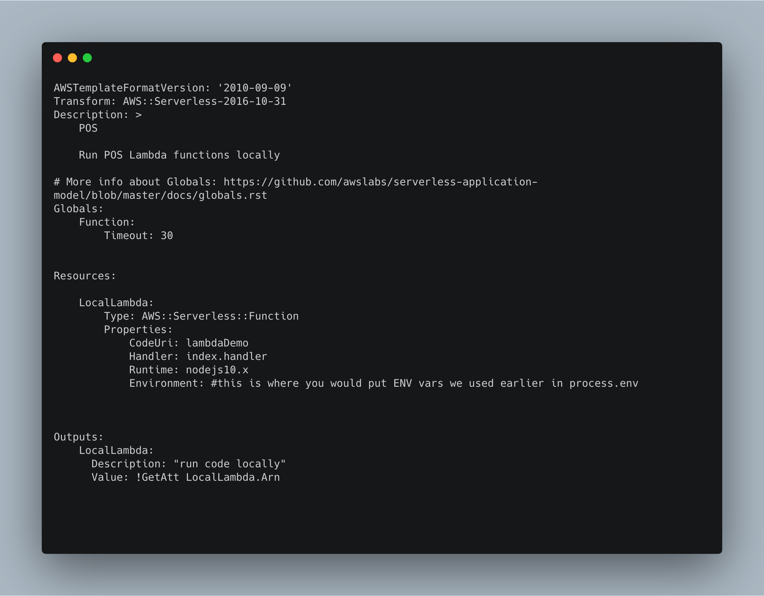

Slide 21
Lambda Layers
Include your layer ARN’s inside the resources section of your template.yml
Layers are reusable

Slide 22
Create debugging config in VS Code
Add debug configuration -> dropdown -> add new configuration
Config type is nodeJS
See repo for launch.json
One configuration item per function, matches 1-1 with template.yml entries

Slide 23
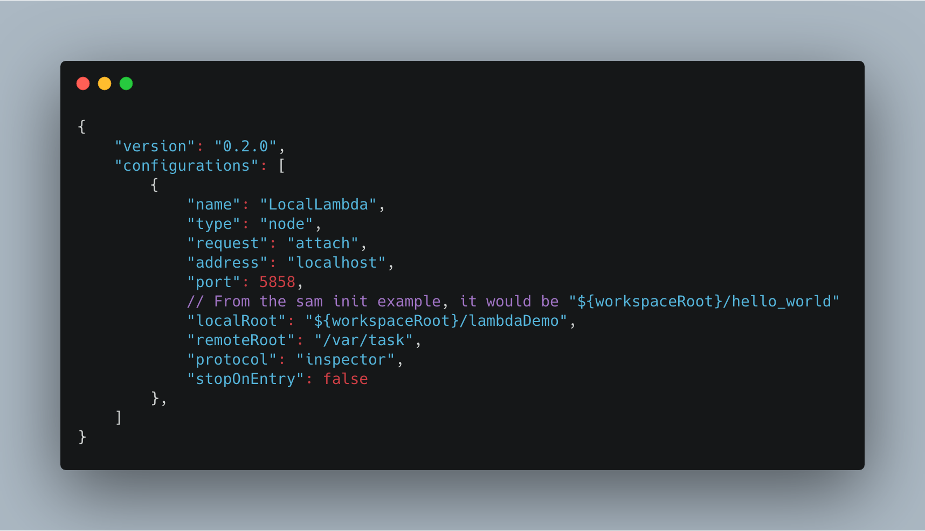

Slide 24
Test Events
Each function needs a test event
JSON file that matches test events from either dashboard or other AWS triggers
One test event per function

Slide 25
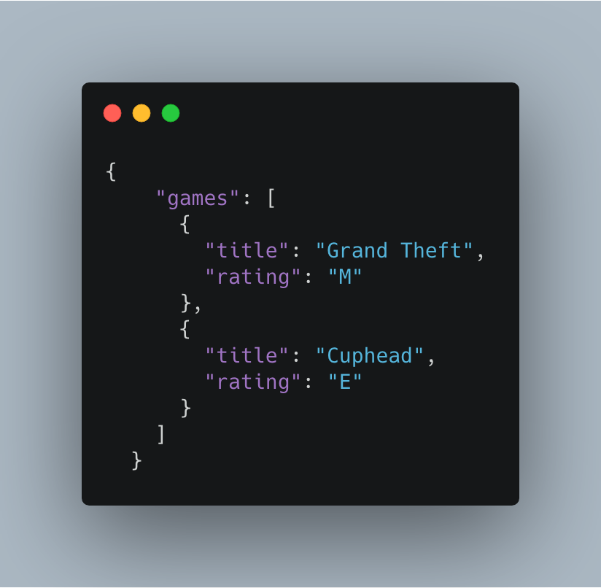

Slide 26
Running Lambda Locally
Bring it together: SAM->template.yml -> VS Code debug config -> test event
From the command line use SAM to trigger your function
Can run with or without the debugging
Use debugging flag --debug-port 5858 to connect to debugger
Without debug flag will execute your function similar to running in the dashboard
sam local invoke LocalLambda -e test-events/videogames.json --debug-port 5858

Slide 27
Debugging
If running with --debug-flag 5858 connect VS Code debugger
Debug menu -> select debug configuration -> Play
One to one map with template.yml
Breakpoints will stop code
Step in/over code
Evaluate Watch, Call Stack, and Debug console

Slide 28
Debug All the Things Demo
Run Lambda code locally with Debug

Slide 29
In Closing
More Lambda features
Applications
Monitoring
Code Deploy
Create triggers to use Lambda functions in other AWS services

Slide 30
Thanks!
Drop me a line:
chris@chrismitchellonline.com
Twitter: @motobreath
Github: https://www.github.com/motobreath
Blog: blog.chrismitchellonline.com

