Slide 1
Large Language Models: An Overview
~What is LLM ?~
2026/5/8 Motohisa Yamano s1320112

Slide 2



Definition of LLMs
LLM stands for Large Language Model.
It is an AI that statistically predicts subsequent tokens based on a prompt using neural-network weights.
The "Large" refers to the massive number of parameters in the network structure.
Answer
2026/5/8 Motohisa Yamano s1320112

Slide 3
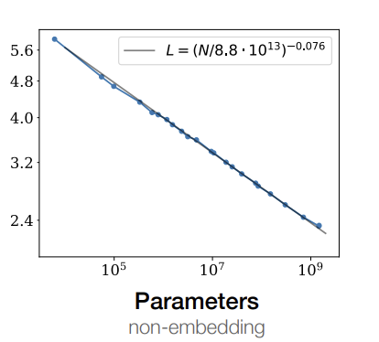

Definition of LLMs
[1] explains that by increasing the number of parameters and training data, recent language models began to show abilities that smaller models did not clearly have. This scaling is one reason why LLMs can handle a wide range of tasks.
The experiments in [2] suggest that model performance, measured by cross-entropy loss, improves predictably as the number of parameters increases. In particular, the relationship between loss and model size approximately follows a power law.
Upscaling the number of parameters in NN
From simple prediction tasks to complex reasoning-like behavior
Source: [2] Scaling laws for neural language models Figure1 Parameters(2020)
2026/5/8 Motohisa Yamano s1320112

Slide 4





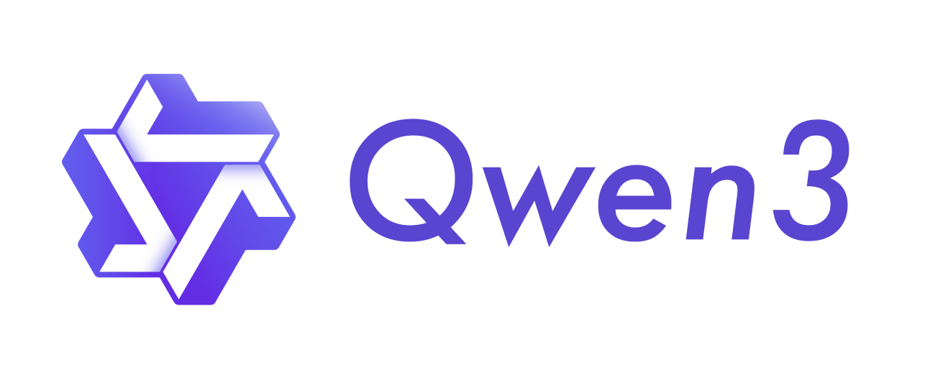
Representative Models
Closed / Commercial Services
Open-weight / Open-source Models
Example: GPTseries, Gemini series, Claude series
・Easy to use through web interfaces and APIs
・Model details and weights are generally not public
・Frequently updated by companies
Example: Phi-3, LLaMA 3.1, Qwen3
・Model weights may be available for download
・Useful for research, fine-tuning, and local deployment
・License and openness differ by model
Currently, there is a large number of language models, spanning a wide range of use cases and fine-tuned variants.
2026/5/8 Motohisa Yamano s1320112

Slide 5
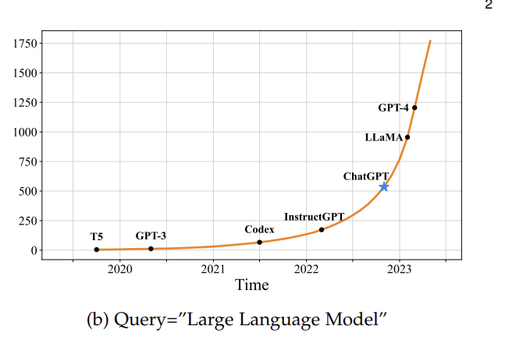
Factors Behind Its Recent Rise
Since the development of GPT-3, the number of papers containing the keyword “large language model” increased exponentially.
A sharp increase occurs after the release of ChatGPT: the average number of published arXiv papers that contain “large language model” in title or abstract goes from 0.40 per day to 8.58 per day.
Source: [1] A survey of large language models (b)Query = “Large Language Model” (2026)
2026/5/8 Motohisa Yamano s1320112

Slide 6


Factors Behind Its Recent Rise
Huge amounts of online data
Advances in GPU Computing
The spread of the Internet has created massive amounts of human-generated text data in natural language.
(e.g., GPT-3 was trained on filtered Common Crawl and other large text corpora [4].)
Advances in GPUs made large-scale parallel matrix operations practical, enabling the training of LLMs.
Model architecture
Accessibility / UX
The Transformer architecture, introduced in 2017, improved how models process relationships between tokens through attention mechanisms.
ChatGPT made LLMs accessible to general users through a simple chat interface, which accelerated public interest and adoption.
2026/5/8 Motohisa Yamano s1320112

Slide 7
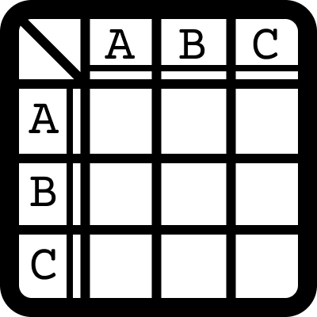
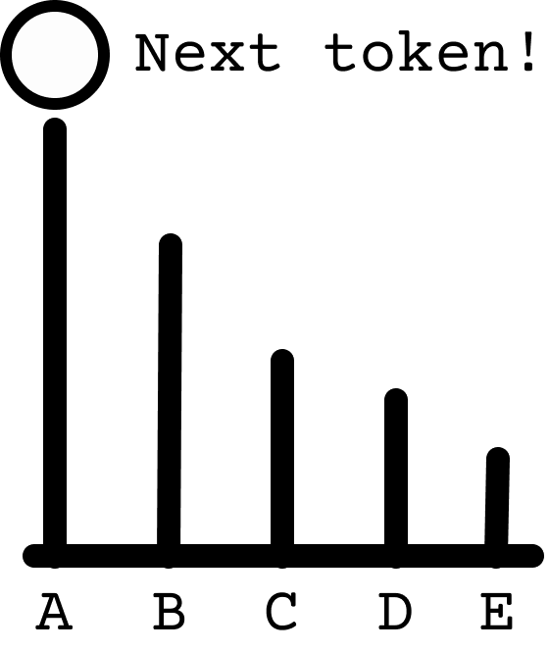
Core Concept
Attention is all you need!
1. Tokenizer
Deconstructs prompt into segments (tokens) based on model-specific rules.
["Attention", "is", "all", "you", "need", "!"]
2. Transformer Architecture
Utilizes the Attention Mechanism to weigh relationships between tokens.
Check Attention!
3. Language modeling head
Predicts the next token based on the probability distribution learned by the model.
4. Repeated Generation
and Repeat!
Repeat the above workflow until an EOS(End of Sequence) token is generated.
2026/5/8 Motohisa Yamano s1320112

Slide 8
Reference
[1] Zhao, W. X., Zhou, K., Li, J., Tang, T., Wang, X., Hou, Y., ... & Wen, J. R. (2023). A survey of large language models. arXiv preprint arXiv:2303.18223, 1(2), 1-124.
[2] Kaplan, J., McCandlish, S., Henighan, T., Brown, T. B., Chess, B., Child, R., ... & Amodei, D. (2020). Scaling laws for neural language models. arXiv preprint arXiv:2001.08361.
[3] Alammar, J., & Grootendorst, M. (2024). Hands-on large language models: language understanding and generation. " O'Reilly Media, Inc.".
[4] Brown, T., Mann, B., Ryder, N., Subbiah, M., Kaplan, J. D., Dhariwal, P., ... & Amodei, D. (2020). Language models are few-shot learners. Advances in neural information processing systems, 33, 1877-1901.
2026/5/8 Motohisa Yamano s1320112

