Slide 1
Abstract
This project studied how a company's IPO Exit Round and Operating Sector affect the stock price behavior after IPO. I specifically targeted companies that were VC-backed, head quartered in United States (US), and exited through IPO. This analysis was especially relevant in 2019 as we are anticipating many Unicorns to go public, after Lyft's poor and Beyond Meat's strong market debut.
Impact IPO Exit Round and Operating Sector on Stock Price Behavior
Process Outline
The key elements of the project was the use of CBInsight's Data Collection that provided access to the companies that fit the criteria above and Alpha Vantage's API that provided access to the daily stock prices of each company.
Then, I analyzed and grouped the companies together by:
Exit Round [Early Stage (Seed, Series A, B), Growth Stage (Series C-D), Late Stage (Series E-I)] and Sectors
ECON-UB.0232 Data Bootcamp
Professor: Michael Waugh
Investigator: Motoi Oyane

Slide 2
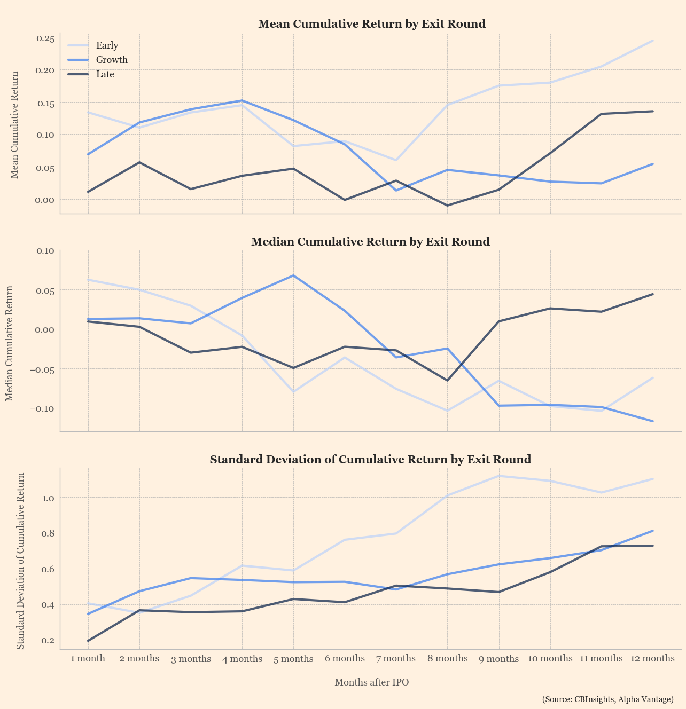
Cumulative Return over 12 months post-IPO,
By Exit Round
Although companies that exited in the Early Stage had the highest mean cumulative return, Growth Stage had the highest median and lowest volatility.

Slide 3
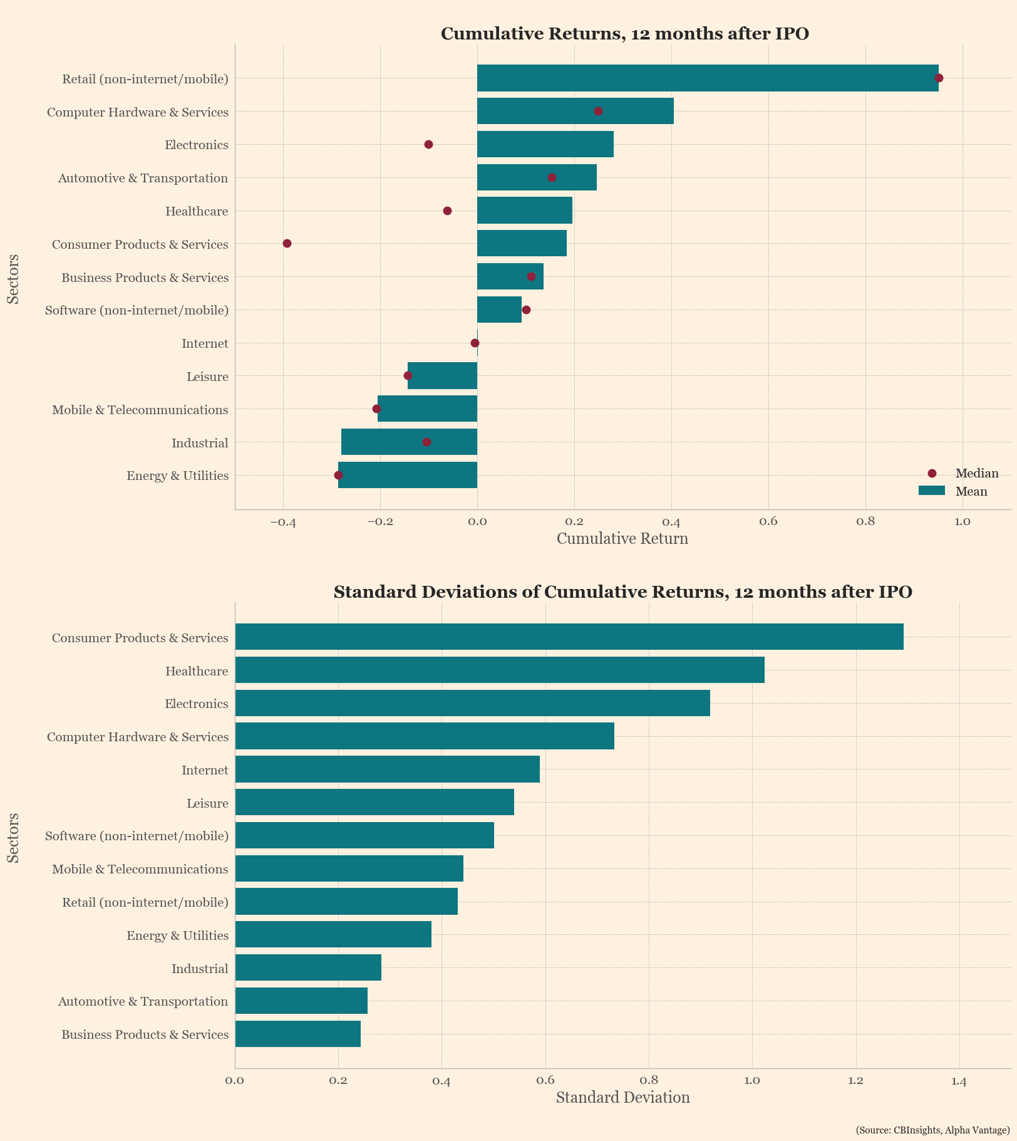
Cumulative Return
12th month post-IPO,
By Sector
Retail (non-internet/mobile) had the highest mean and median cumulative return and 5th lowest volatility.

Slide 4
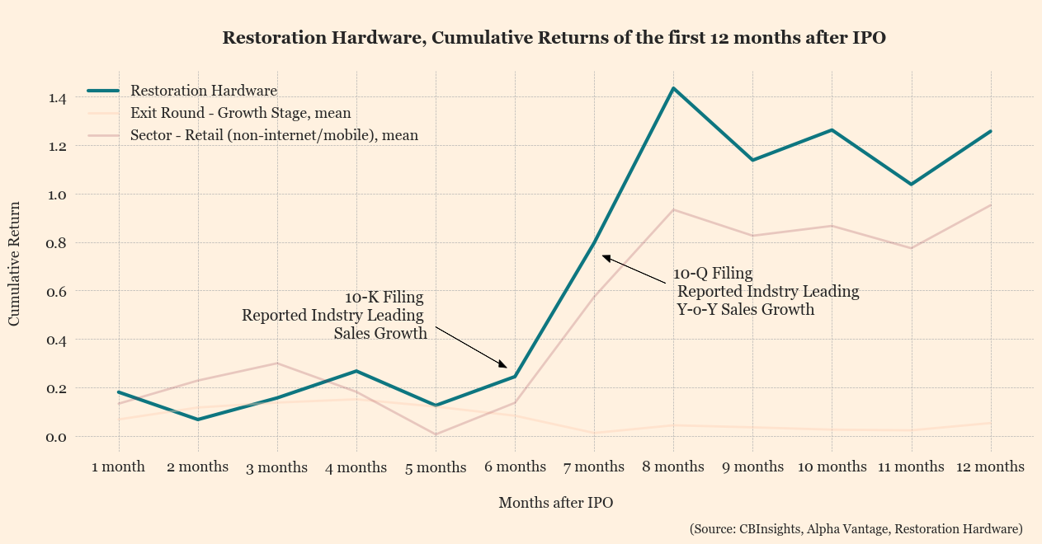
Restoration Hardware,
Cumulative Return over 12 months post-IPO
Restoration Hardware was
one of the companies that operated in the Retail
(non-internet/mobile) and exited in the Growth Stage.
It evidently had a cumulative return higher than the sector
and exit round mean.

