Slide 1

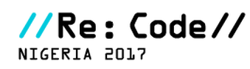
Mobile Banking for the UnBanked
Adedolapo Kayode Tewogbade

Slide 2

A Product to digitalize cash to low income earners as a means of social engineering to increase trust in Technology and drive the adoption of cashless transactions.

Slide 3



Mobile Banking Adoption
Lower Income Earners
High Income Earners
Market Sellers, Commercial Bus Drivers etc.
Bankers, Engineers etc.
This shows that mobile money services have not had any impact on the financial inclusion of the unbanked Nigerians so far

Slide 4
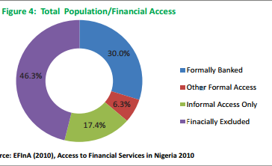
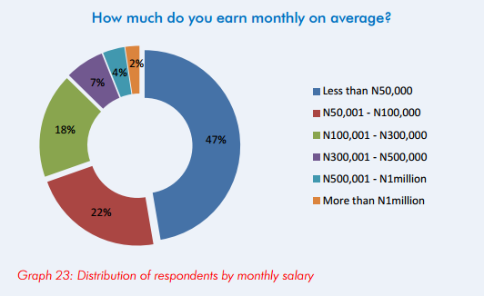
Market Size
Philips Consulting

Slide 5




Problem Solving Strategy/User Story
Has Unique Store Id with corresponding Product Images (0-9)
Has a ‘Kolo’ box that can recognize currency note and printed numbers
Can accept bot h cash and e-payment
MyBank automatically captures transactions and send notification to Mama Ojo
MyBank App helps Mama Ojo manage and Record Expense by Intelligently sensing when the Kolo Box is opened and asking what the money is meant for
With better managed books, mama ojo credit history is assesible making more credit worthy for Loans and business tools
Sola
Mama Ojo
Handles savings/ Collection from Mama Ojo
Access Bank
Have access to the credit history of their customer/potential
Enjoy encouraged savings since Mama Ojo and her Vendor is incentivised to use simplied e-payments(MyBankApp)
Agent

Slide 6
Benefits
Encourage the need to patronize low income earners
Cashless Transaction
Builds trust in technology
Have access to benefits
of owing a bank account
3. Tracking of financial transaction (income and Expenditure)
Sola
Mama Ojo
Job creation
Access Bank
Inclusion of the unbanked
Improves economic growth and wealth creation
Agent

Slide 7

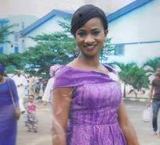
Team
Bolarinwa Motoni
Team Lead
Web/Software Application Developer
Adedolapo Kayode Tewogbade
Web/Business Dev.

Slide 8
Thank You

