Slide 1
Contents:
1. Problem Statement (Determining web traffic key indicators and performance metrics)
2. Data
3. Exploratory Data Analysis, cleaning, final data creation and preliminary insights
There are 117 unique authors, and 1435 Unique Tickers, with 2926 unique post_ids or articles.
To aid visualization ease, the only the top 10 categories in the following have been charted.
4. Visualization Insights (Module 1)
Authors:
Overall number of different tickers per author (Top 10 Authors vs Number of Unique Tickers) (Point 1 in Assignment)
Authors with the most overall pageviews (Top 10 Authors with the most views sum) - "Most popular authors all time" (Point 2 in Assignment)
Trending Most Popular Top 10 authors - (Top 10 Authors with the most Views new vis.)
Trending Most Engaging Top 10 authors - (Top 10 Authors with the most Minutes New Vis.)
Authors with the highest Conversion /Fan Base (Loyal readers) (Top 10 Authors with the most (Views ret. vis./Total Page views)) (Ratio 0.5)
Most Social Authors (Top 10 Authors with the highest Social Interactions)
SERP Ranking (Authors) (Top 10 Authors with the Highest Search Refs)
Topics the top 10 Authors cover (This is determined later using a clustering algorithm on the news articles/Unsupervised Topic Modelling) - Future Work
Top 10 Authors (Popularity by Device)
Tickers
Tickers with the most pageviews over time (Top 10 tickers with the most views sum) - "Most popular tickers all time" (Point 3 in Assignment)
Most engaging tickers (Top 10 tickers with the most Engaged mins sum) "Most engaging tickers all time" (Point 4 in Assignment)
Trending Most Popular Top 10 Tickers - (Top 10 Tickers with the most Views new vis.)
Trending Most Engaging Top 10 Tickers - (Top 10 Tickers with the most Minutes New Vis.)
Tickers with the highest Conversion /Fan Base (Loyal readers) (Top 10 Tickers with the most (Views ret. vis./Total Page views)) (Ratio 0.5)
Most Social Tickers (Top 10 Tickers with the highest Social Interactions)
SERP Ranking (Tickers) (Top 10 Tickers with the Highest Search Refs)
Topics the top 10 Tickers cover (This is determined later using a clustering algorithm on the news articles/Unsupervised Topic Modelling) - Future Work
Top 10 Tickers (Popularity by Device)

Slide 2
Contents: (Contd):
5. Module 2 Performance and Evaluation Metrics
Created a function which would populate a table with the following metrics for any author or Ticker (Takes Author or Ticker as input)
Traffic
Users - Total number of Unique Visitors
Pageviews - Total number of Page views
Engagement
Engaged Mins
Retention
Return Rate- New Vis/Returning vis
Retention Engagement - Minutes New Vis/Minutes Ret Vis
Discovery
Discovery Ratio - New Vis/Total Vistors
SERP Ranking
Search Refs/Other Refs
Discovery Engagement - Minutes New Vis/Engaged Mins
Loyalty
Loyalty Ratio - Returning Vis/Total Visitors
Loyalty Engagement - Minutes Ret.Vis/Engaged Mins
Social
Social Ref/Total Refs
Social Interactions
Device
Device Ratio - Desktop Views/Handheld views
Web-to-mobile - Website/AMP
Top 5 Topics
6. Module 3: Topic Modelling to Determine important "topics" (Group of words) in articles, Word Cloud Charts and Most Discussed Topics
7. Key Takeaway and Business Insights
8. Future Work

Slide 3
1. Problem Statement
The problem statement is to determine the web traffic key indicators and performance metrics.
Module 1: lists the various insights
Module 2: Generates the various Performance and Evaluation metrics for any Author or Ticker
Module 3: Runs a Unsupervised Topic Modelling on the news articles text to identify important "Topics" or Group of words to aid clustering and curated recommendations.
2. Data
Posts contains pageview stats, with the Post id serving as the article id
The first column in tickers.csv is the same post id.
The intention is to outerjoin the 2 dfs with a merge operation to include the Ticker (2nd column) in the ticker csv to the posts csv
The URLs do not work hence the titles have been used to run the Topic model.

Slide 4
3. Exploratory Data Analysis, Cleaning and Final data creation
Unique Authors | 117
Unique Tickers | 1435
Missing values in Tickers | 550
Unique Posts | 2926
Added to list all_authors
Added to list all_tickers (After removing the Null values)
Post the merge the outer_merged now serves as our final data table. We will determine the unique number of posts, tickers, authors and carry out the visualization on the same

Slide 5
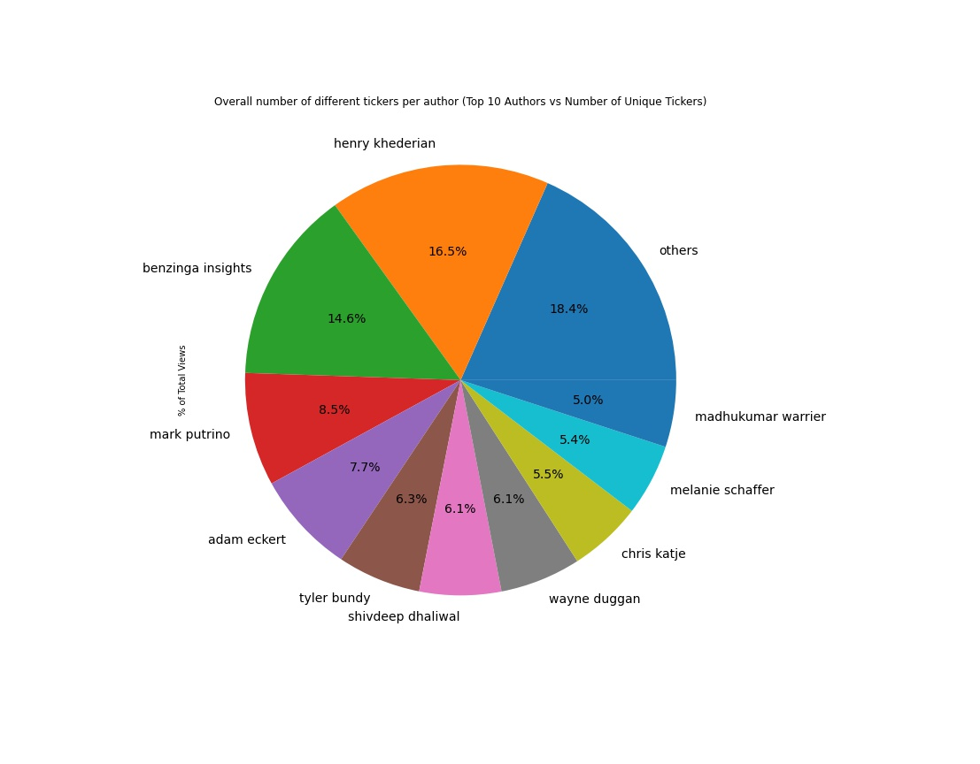
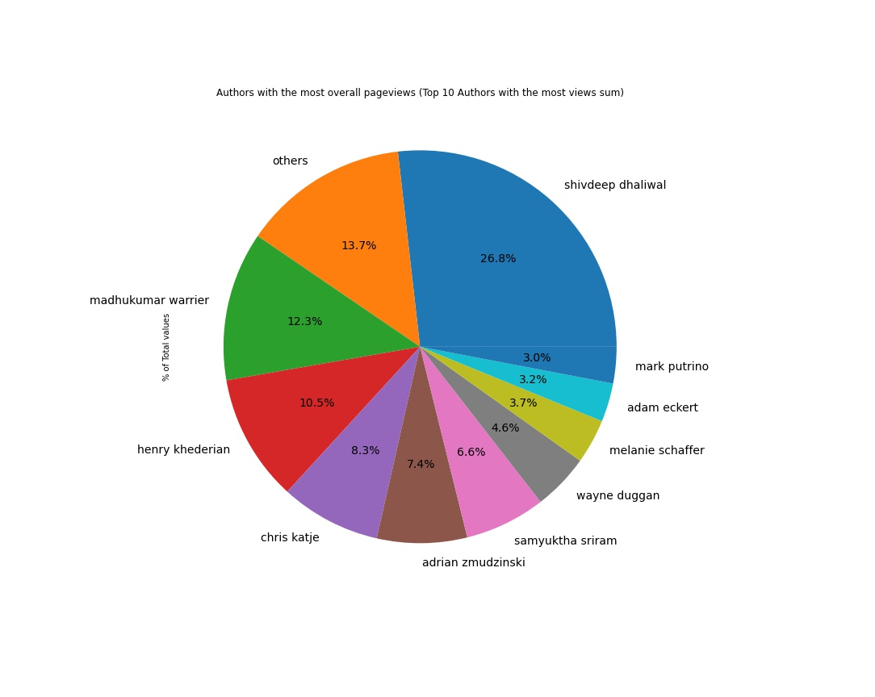
4. Visualization Insights
Author Insights

Slide 6
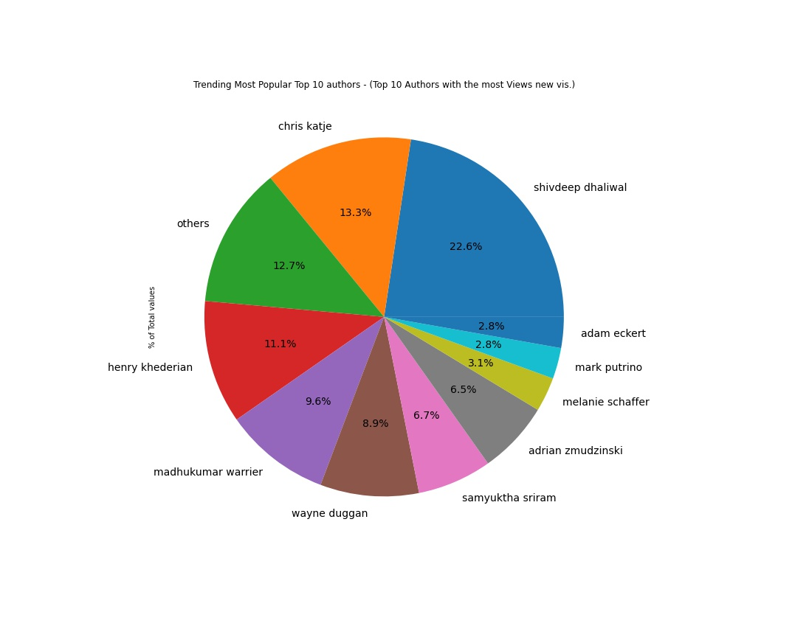
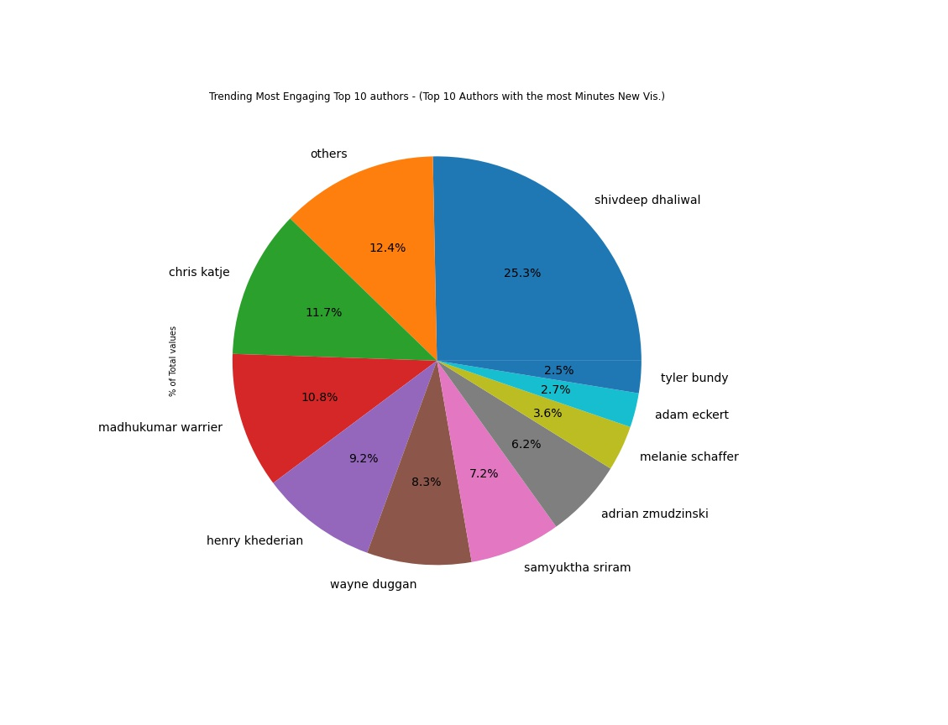
4. Visualization Insights
Author Insights

Slide 7
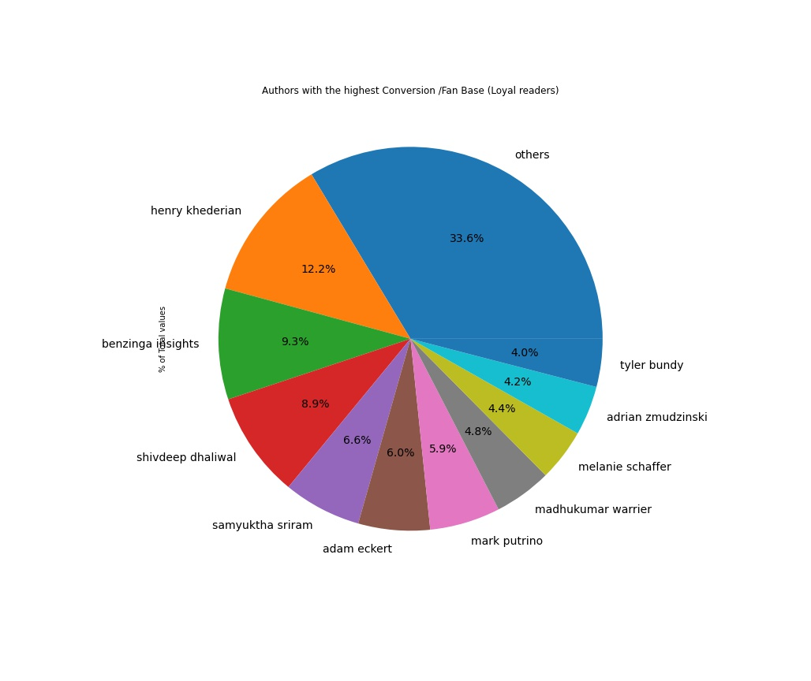
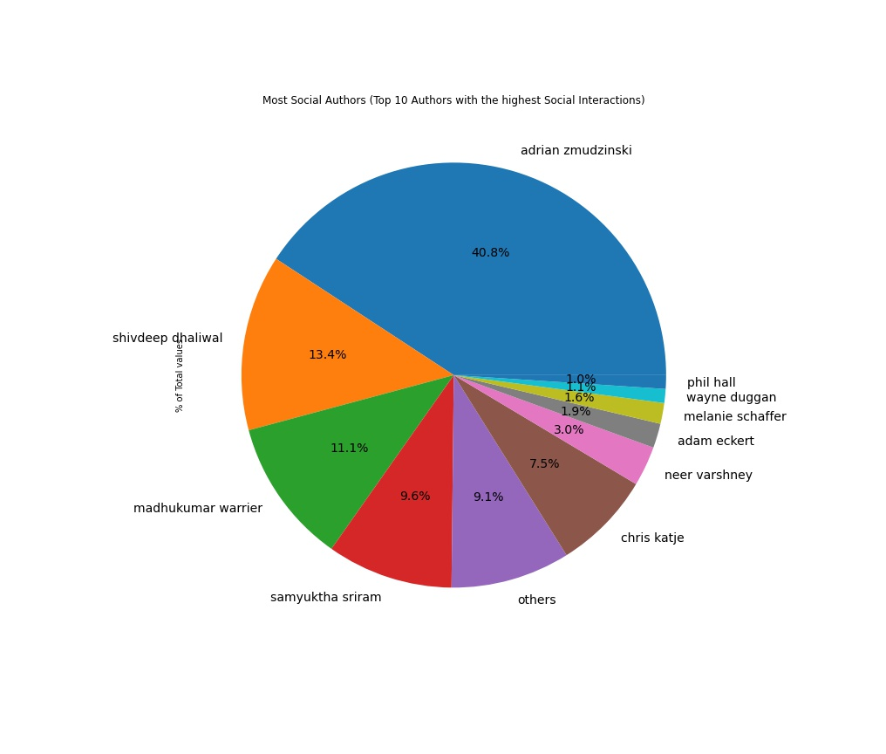
4. Visualization Insights
Author Insights

Slide 8
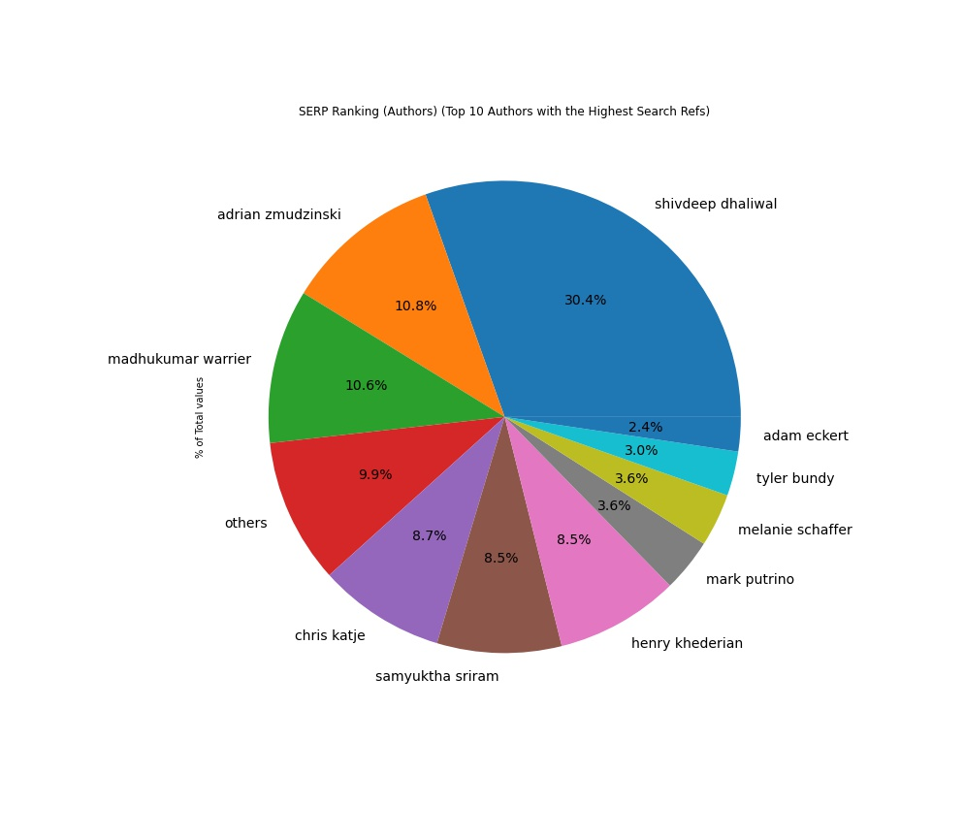
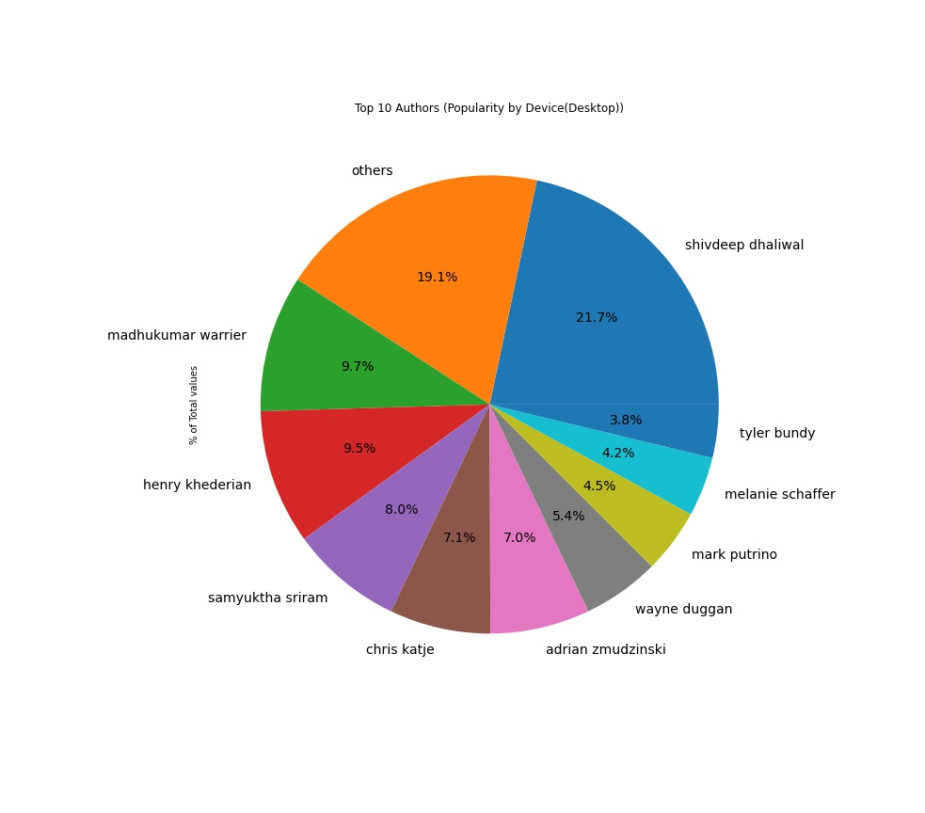
4. Visualization Insights
Author Insights

Slide 9
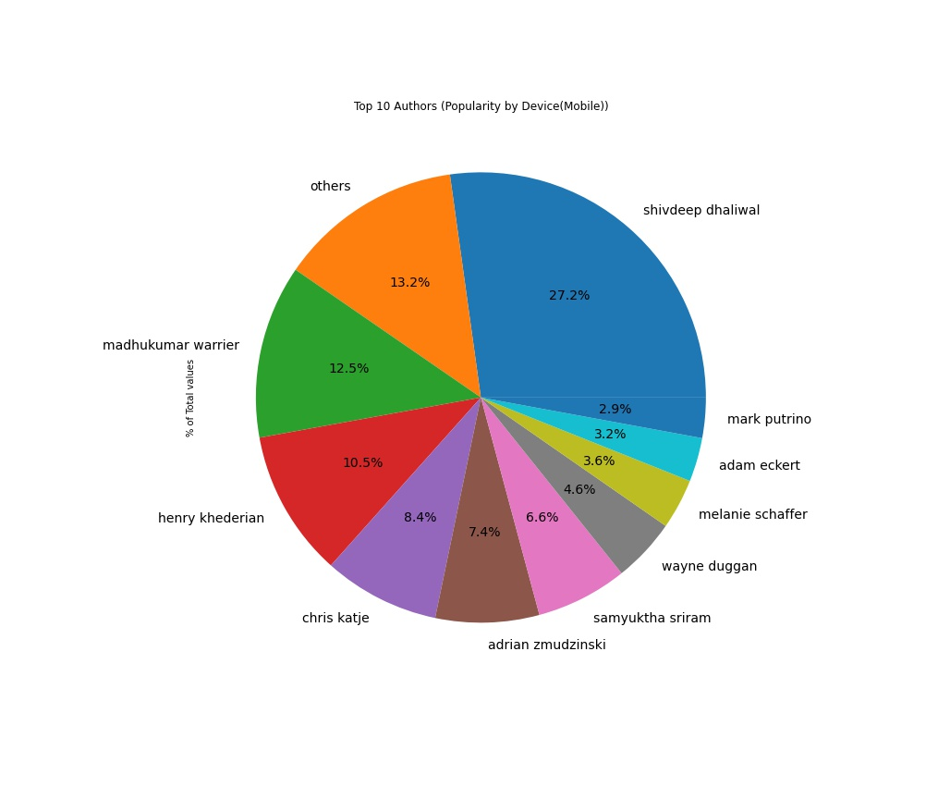
4. Visualization Insights
Author Insights

Slide 10
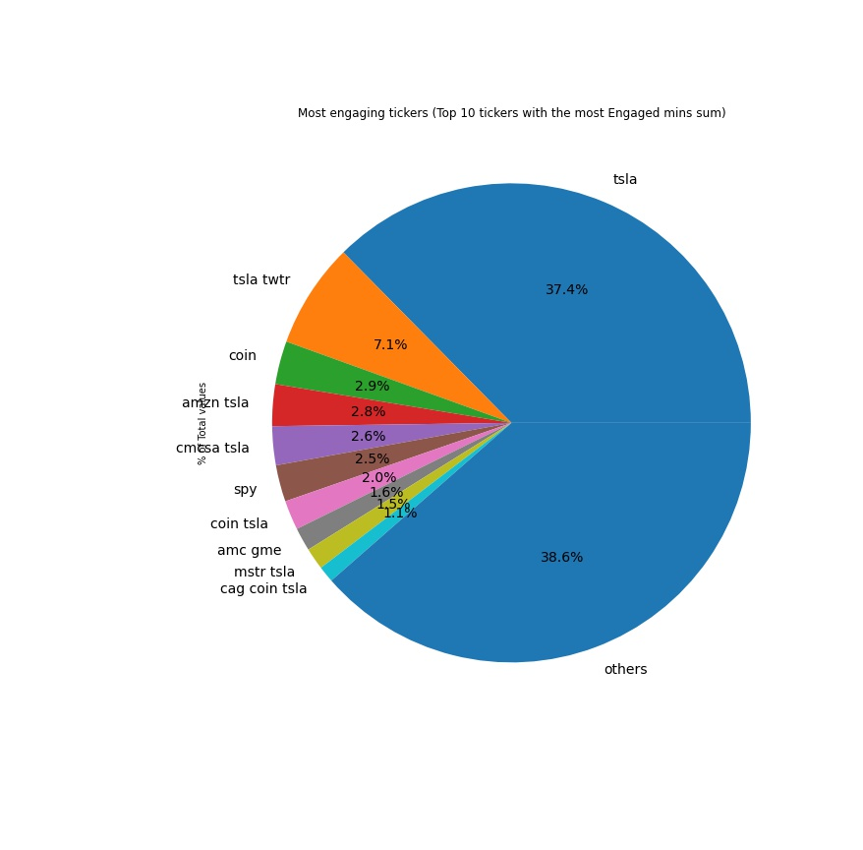
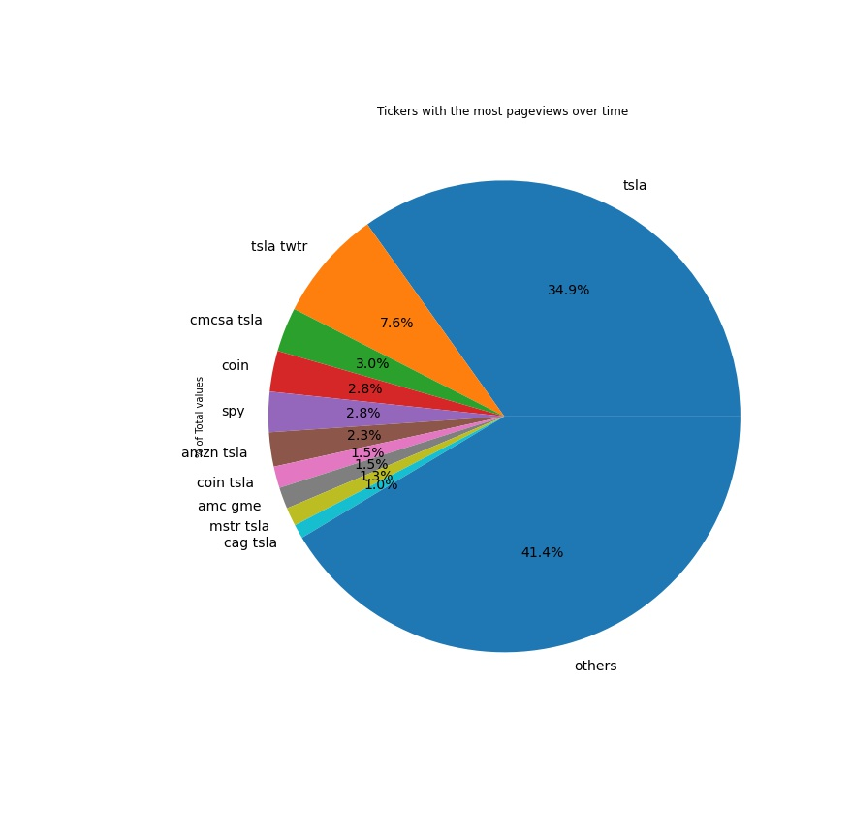
4. Visualization Insights
Ticker Insights

Slide 11
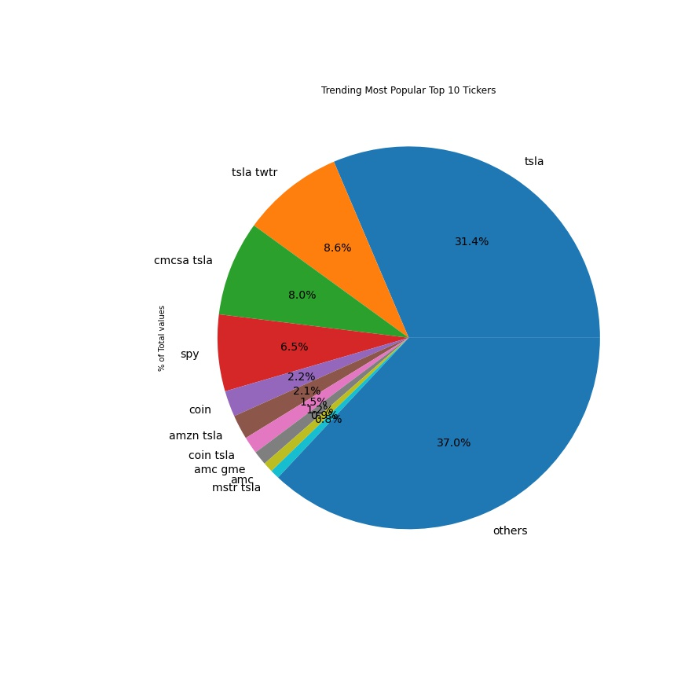
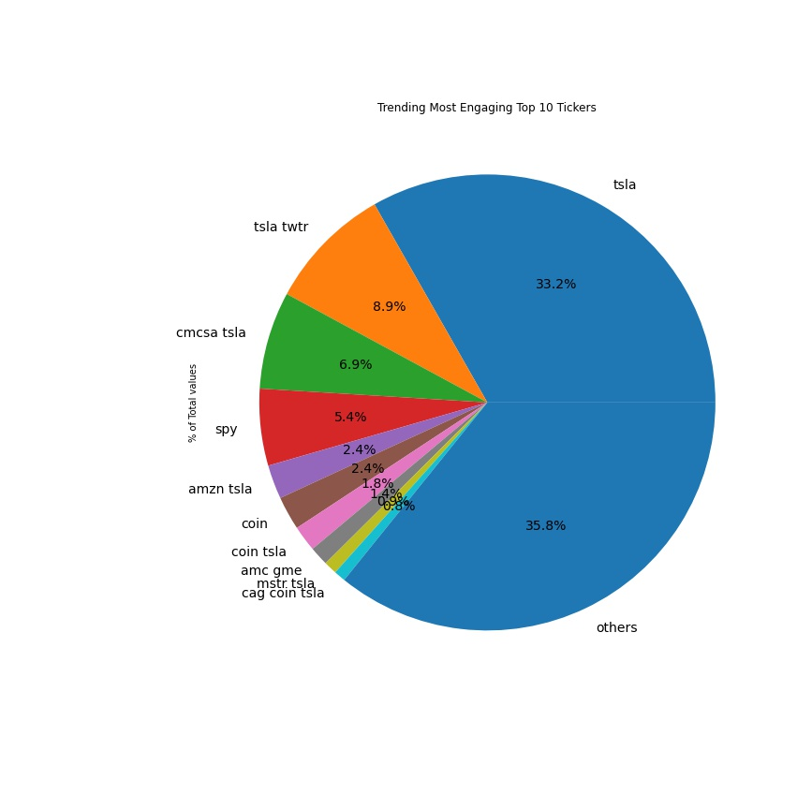
4. Visualization Insights
Ticker Insights

Slide 12
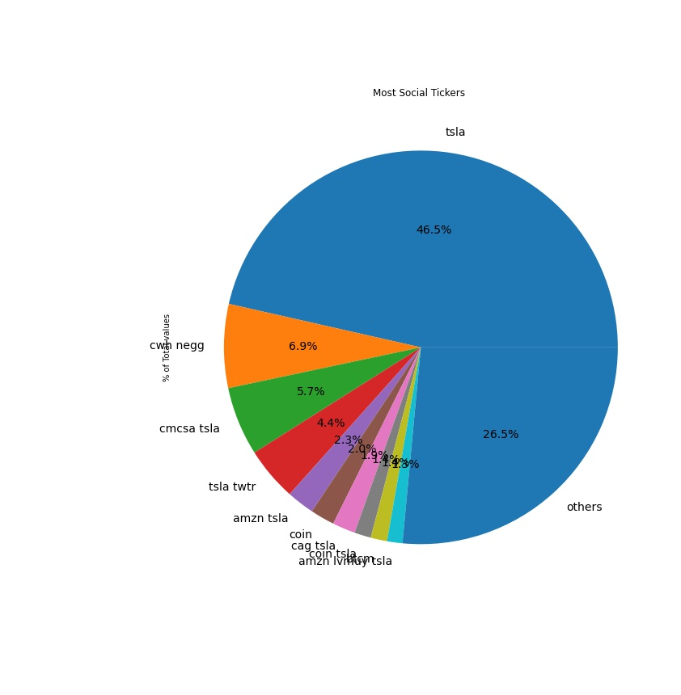
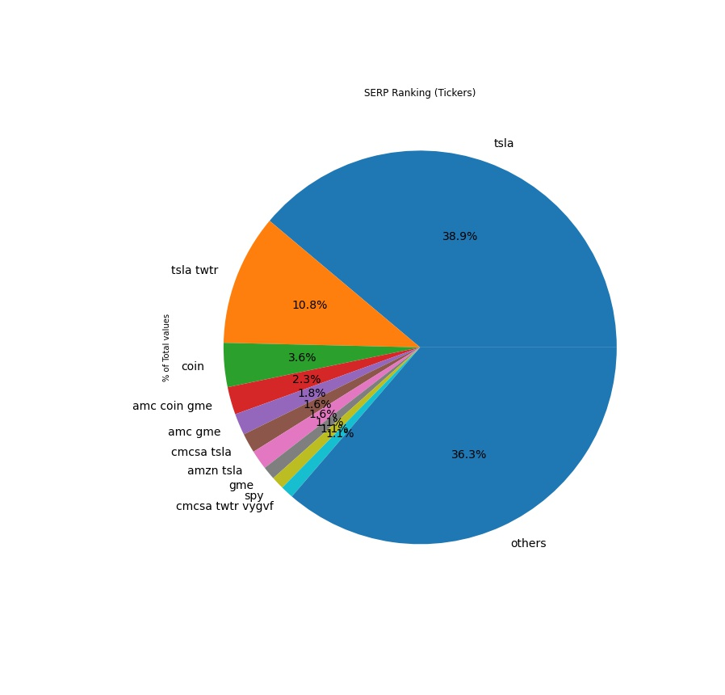
4. Visualization Insights
Ticker Insights

Slide 13
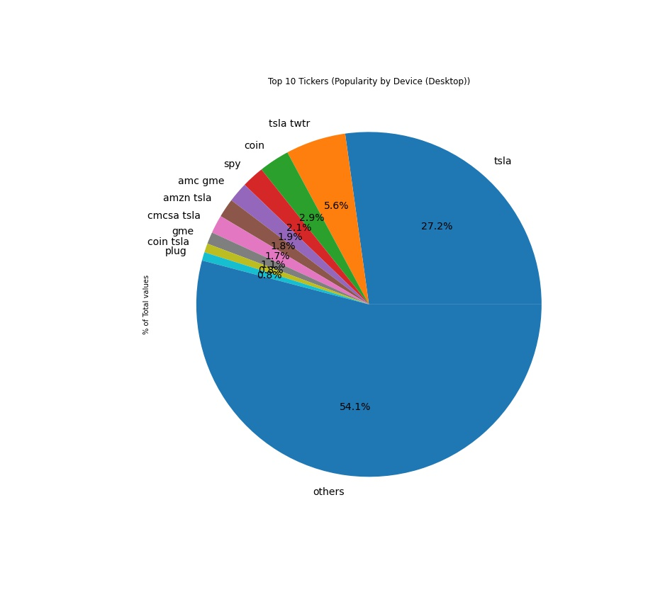
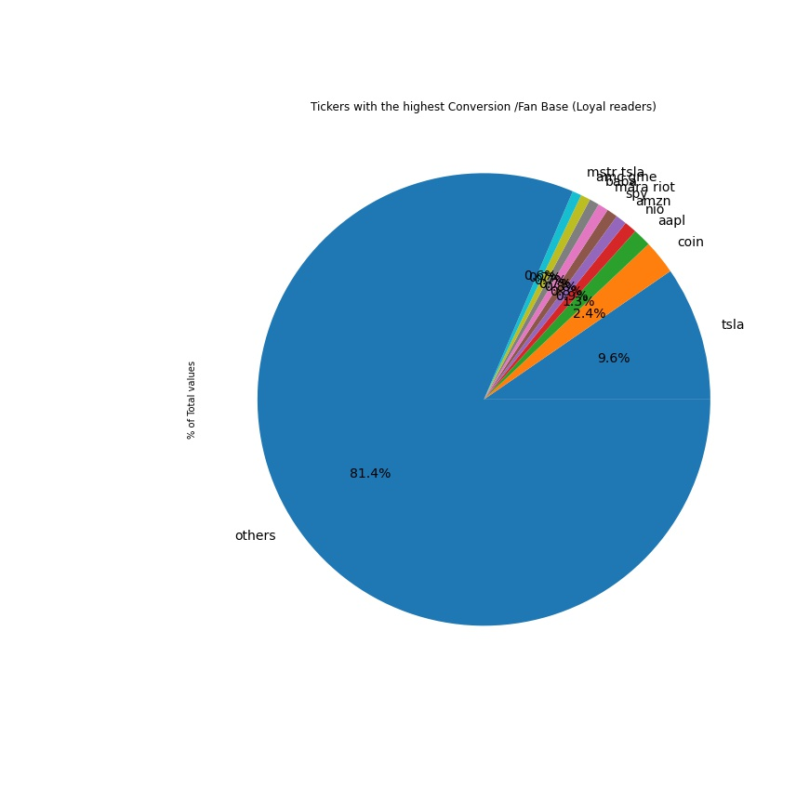
4. Visualization Insights
Ticker Insights

Slide 14
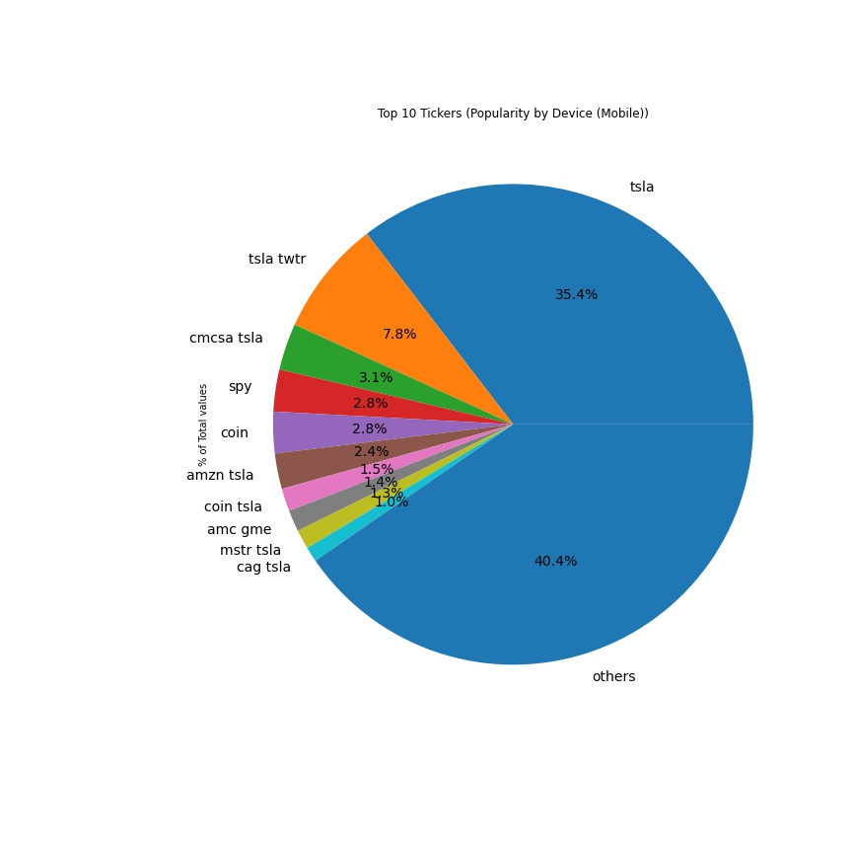
4. Visualization Insights
Ticker Insights

Slide 15
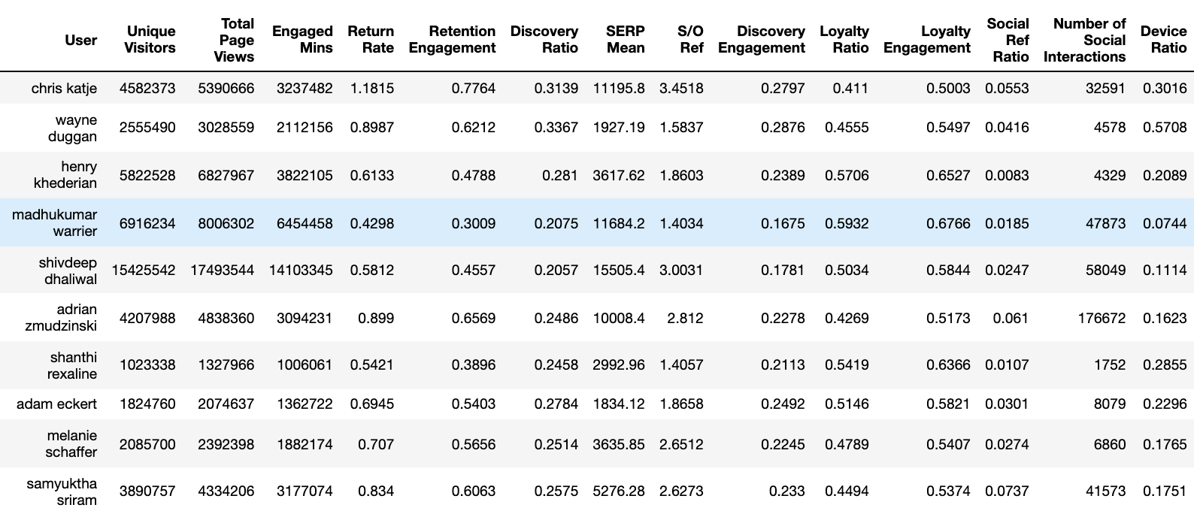
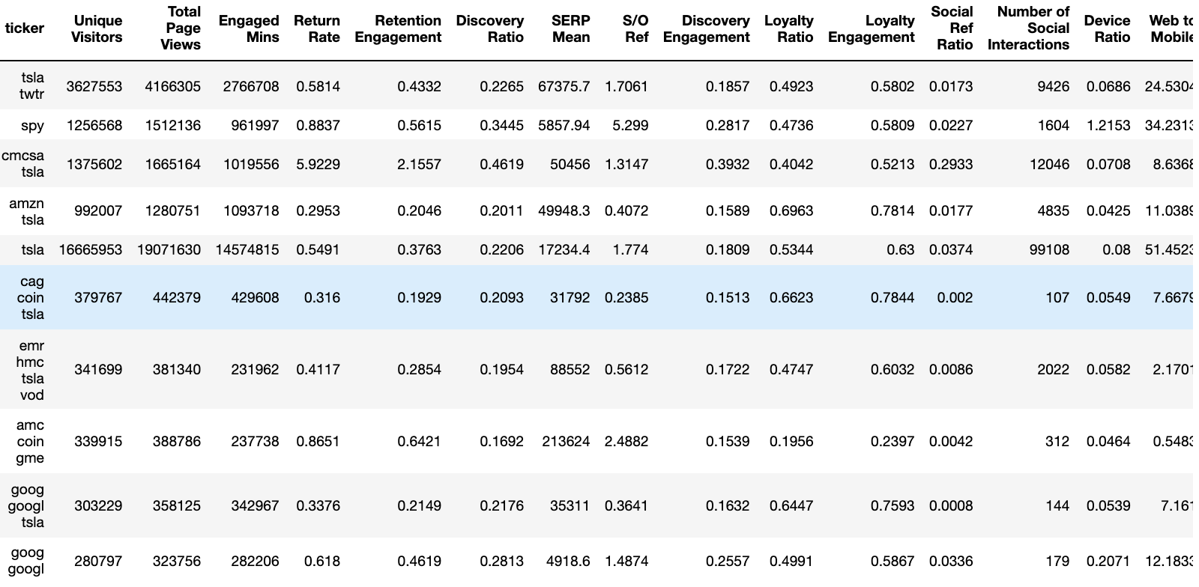
5. Module 2 Performance and Evaluation Metrics
Traffic |  | Engagement | Retention |  | Discovery |  |  |  | Loyalty |  | Social |  | Device |  | Topics
Users | Pageviews | Engaged Mins | Return Rate | Retention Engagement | Discovery Ratio | SERP Ranking | Search Ref Ratio | Discovery Engagement | Loyalty Ratio | Loyalty Engagement | Social Ref Ratio | Social Interactions | Device Ratio | Web – to - Mobile | Topics
Created a function which would populate above table with the following metrics for any author or Ticker (Takes Author or Ticker as input)
Author Metrics Table
Ticker Metrics Table
A excel (With 2 sheets), listing the below metrics for all of the 117 users and 1435 Tickers have been generated and attached with the email.

Slide 16
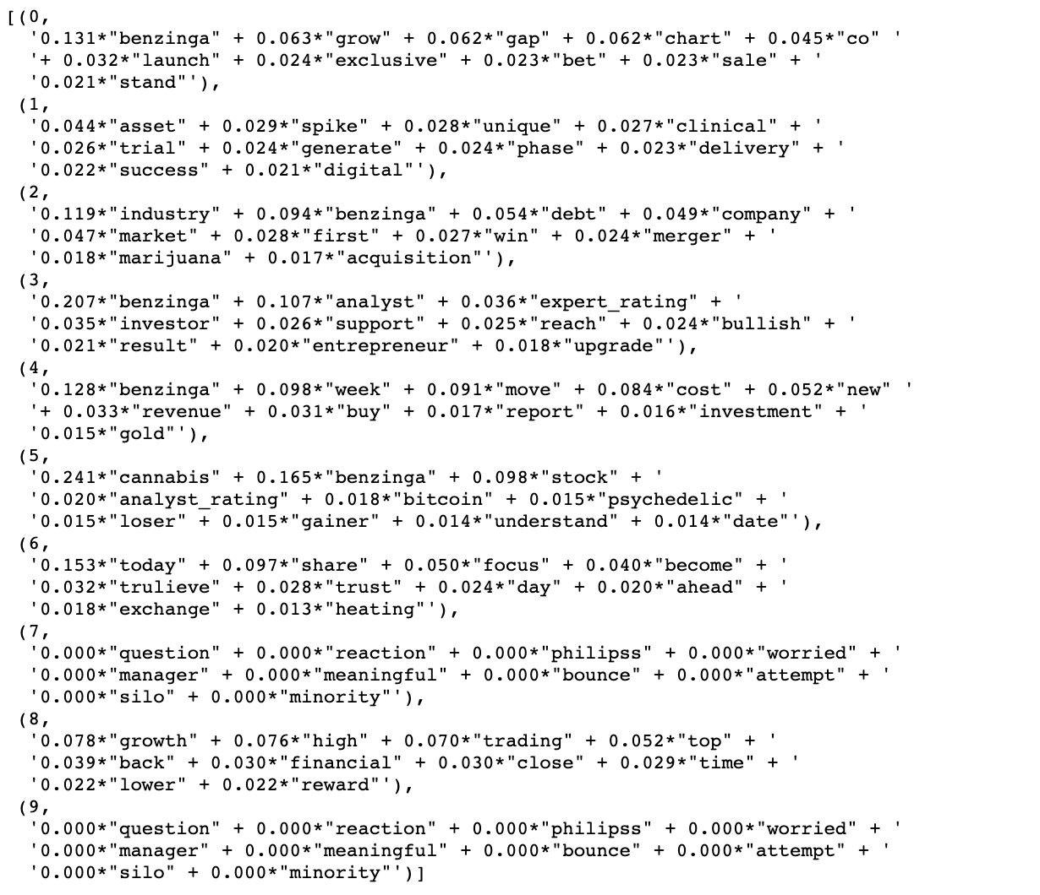
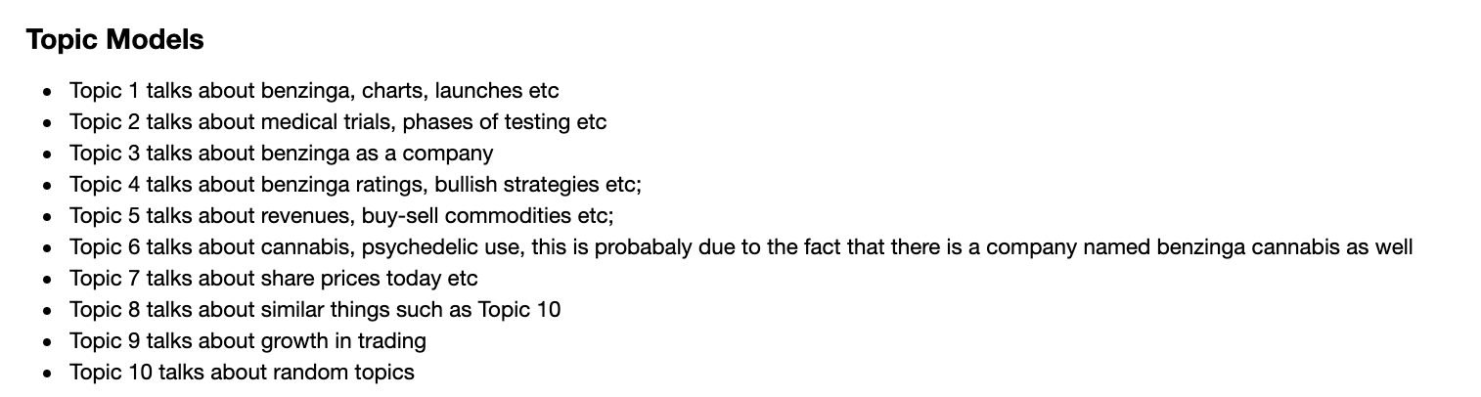
5. Module 3 Topic Models
Because the Topic modelling has been done on Titles and not text of the news, the quality of the topic models are significantly lower.. (Initial Run for 10 topics)

Slide 17
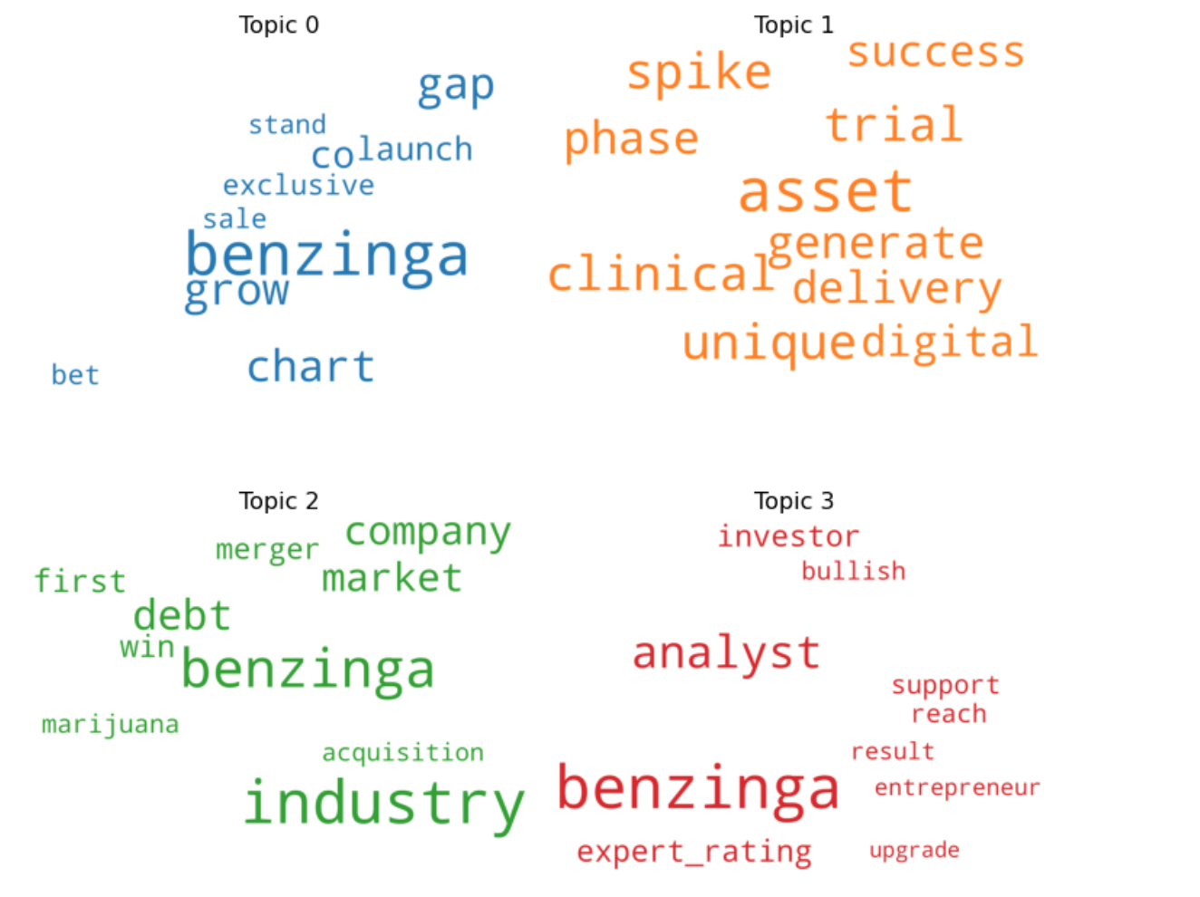
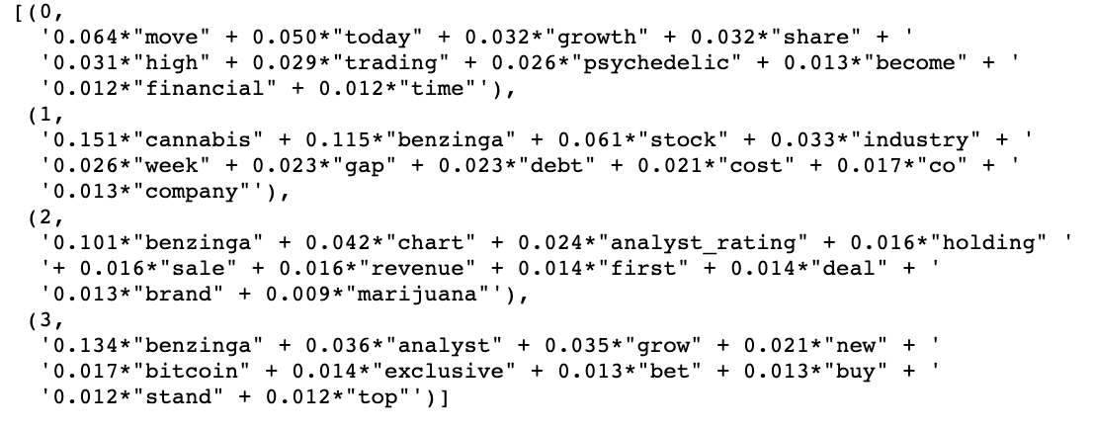
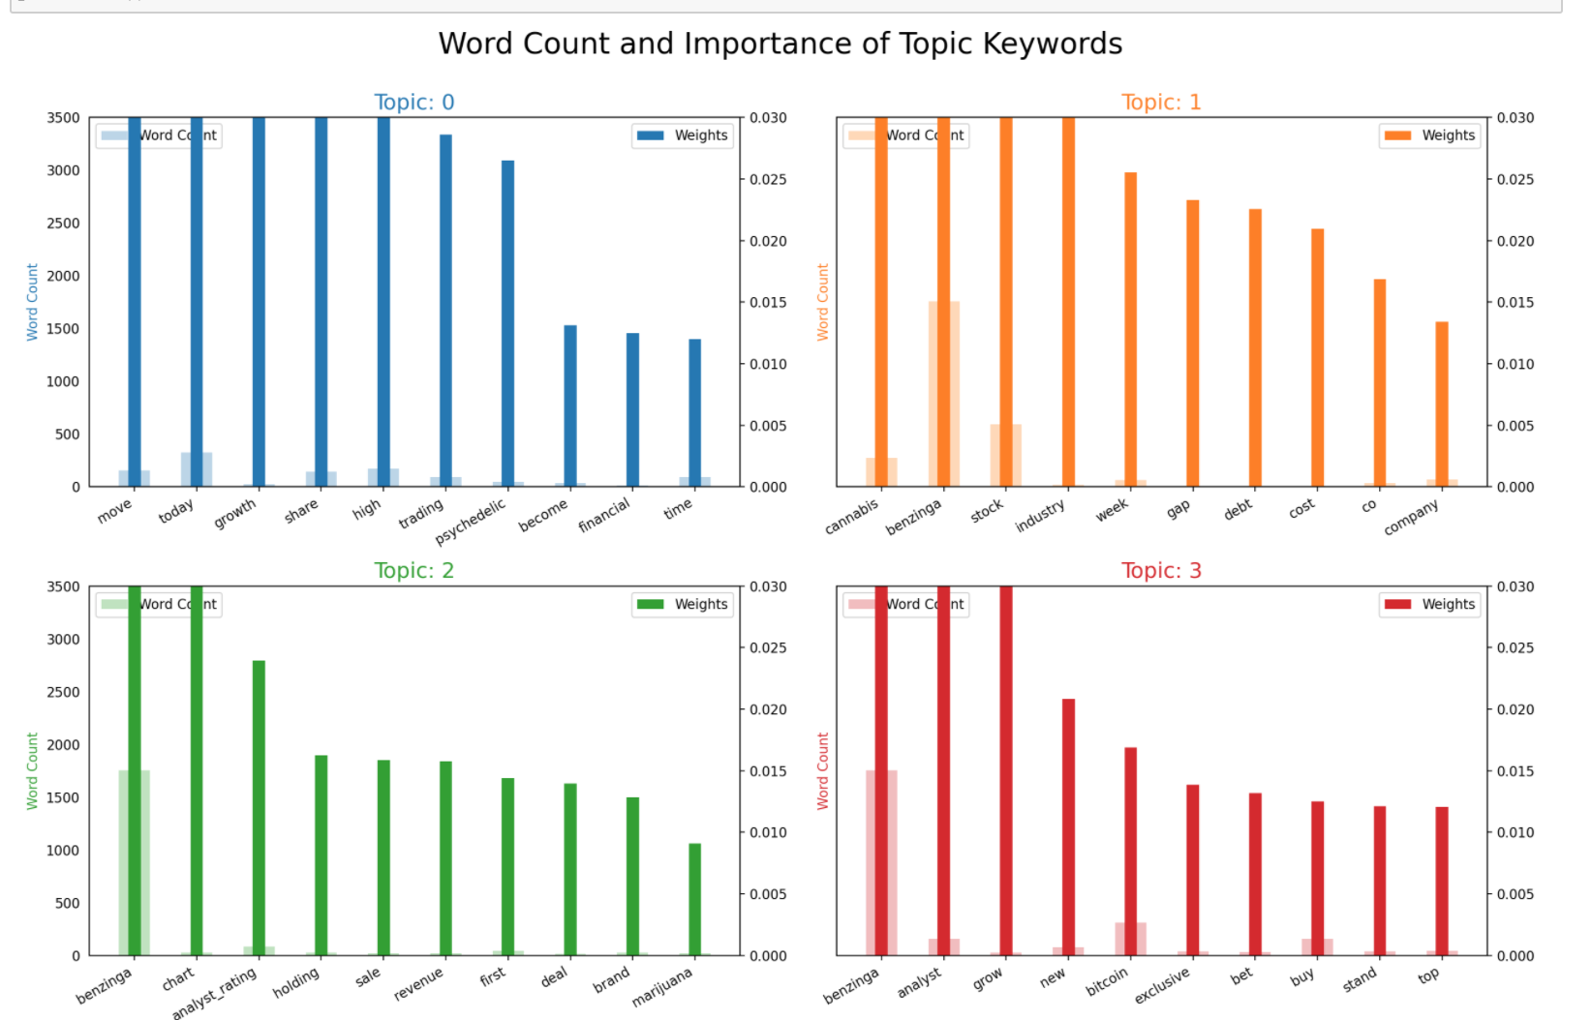
5. Module 3 Topic Models
Word Clouds
Final Run for 4 topics

Slide 18
7. Key Takeaway and Business Insights
The primary function here would be to focus on the news articles itself and generate "hot" topics that the users are interested in. Considering we would like to maximise the time users spend on the platform, personalised news recos would induce the users to explore more topics related to their interest.
Activities such as News article clustering, effective content evaluation metrics based on user feedback and clickstream analysis and tracing the impact of news articles on stock prices in general could be used. Additionally because users consume data from multiple news sources across the web, figuring how comprehensive our articles are when compared to the same topics on the web, would give more insight on the areas we need to improve in.
9. Future work.
With more time and data:
1) User Data, Because the current data set only has Author and Ticker aggregated data, incorporating user and session data would be key
2) Module 4; would be to Assign the Authors and tickers their dominant topics, so we know which authors write about topics exactly and can build a system to push relevant author feeds to relevant users
3) Time Series prediction to predict future page views given author and time
4) Text Summarization (like inshorts – a news app which gives condensed news analysis on topics) based on interests, so instead of browsing through multiple news articles in detail, a bullet point summary of "interesting" topics to the user could be generated

