Slide 1

By Fernando Diego Chino
Morgan Trembley

Slide 2

Our project is a user information guide on covid-19
Users can search covid-19 cases based on:
state, outcome, testing locations
Goal: to report cases with the help of the community thaT LIMITs possible misinformation
Industries like hospitals can report cases by the number of patients given, possible symptoms can be reported as covid-19.. etc.
Users can check the status of their specific city/county

Slide 3
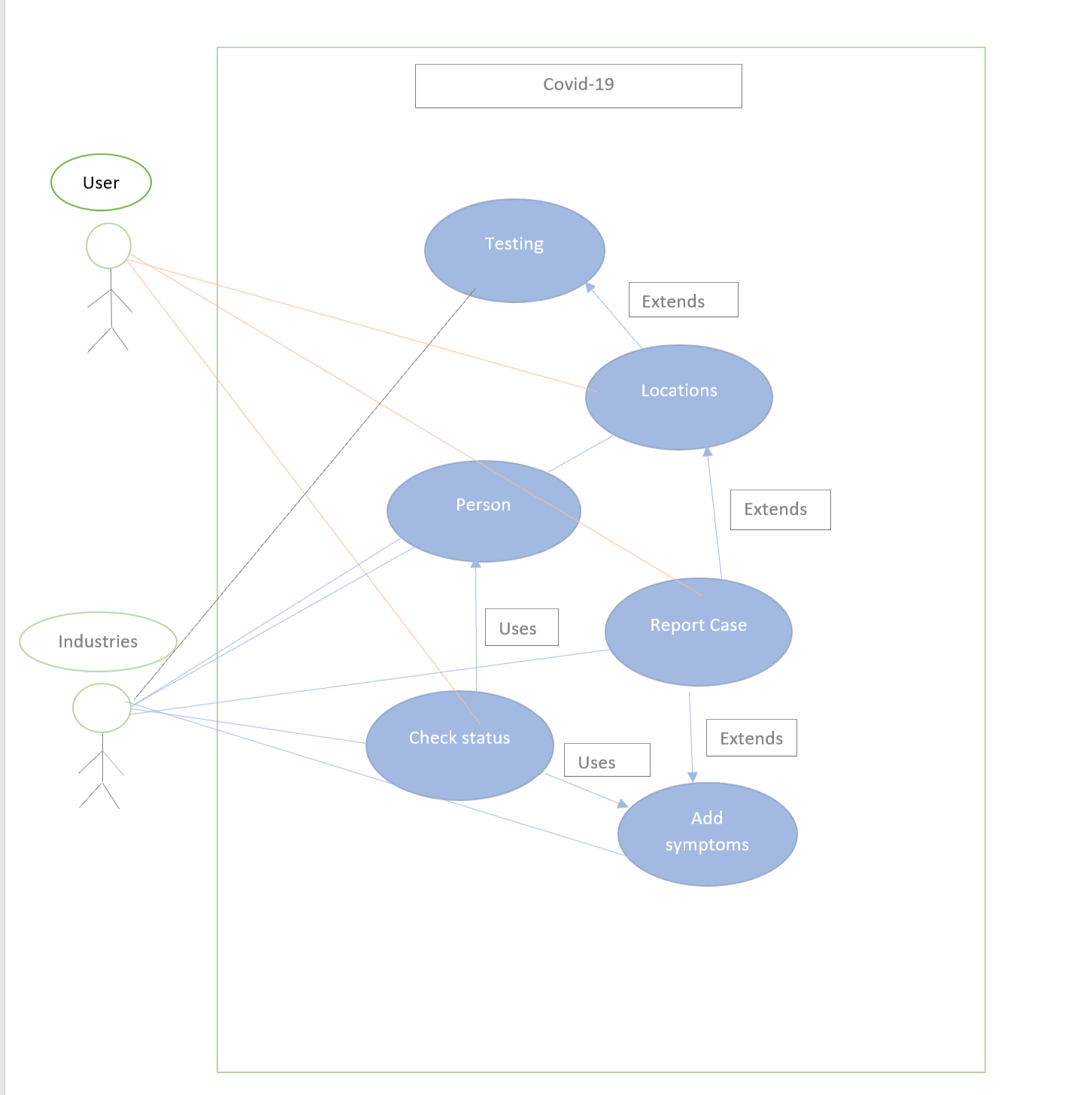
UML DIAGRAM

Slide 4
E/R DIAGRAM
Type
Units
TESTING
City
Result
Status
State
Test Availability
Symptom
Severity
Date
Days Positive
Country
LOCATION
RESULT
Red Flags
Symptoms
Outcome
Comments
Lockdown
Status
Requires Testing
Needs Hospital
Name
PERSON
Age Group
Hospital
Address
Name
Address
D.O.B
Doctors
Patients

Slide 5
Relational Schema
Hospital
h_name, h_address, h_doctors, h_patients, h_riskLevel
Outcome
o_caseID, o_dayspositive, o_comments, o_status
Location
l_city, l_country, l_state, l_lockdown
Person
p_name, p_address, p_dob, p_comment
Result
r_personID, r_caseID, r_date, r_result
Symptoms
s_caseID, s_symptom, s_severity
Testing
t_type, t_units, t_D.O.B
Needs Hospital
nh_address, nh_riskLevel, nh_symptom, nh_severity, nh_descision
Testing Availability
ta_personID, ta_type, ta_units, ta_comment, ta_givenTest

Slide 6
THANKS!

