Slide 1

By Fernando Diego Chino
Morgan Trembley

Slide 2

Our project is a user information guide on covid-19
Users can search covid-19 cases based on:
State Lockdown status, patient’s outcome, Types OF Testing
Goal: to report cases with the help of the community thaT LIMITs possible misinformation
Industries like hospitals can report cases by the number of patients given, possible symptoms can be reported as covid-19.. etc.
Users can check in their symptoms and summit their data where doctors can view/edit.

Slide 3

PROGRAMS USED

Slide 4
WHY?
-SQL:
Creates Database for us
Editing each data is easy to do
Used for labs/quizzes throughout the semester
Python:
Coding is more clean
Prior experience

Slide 5
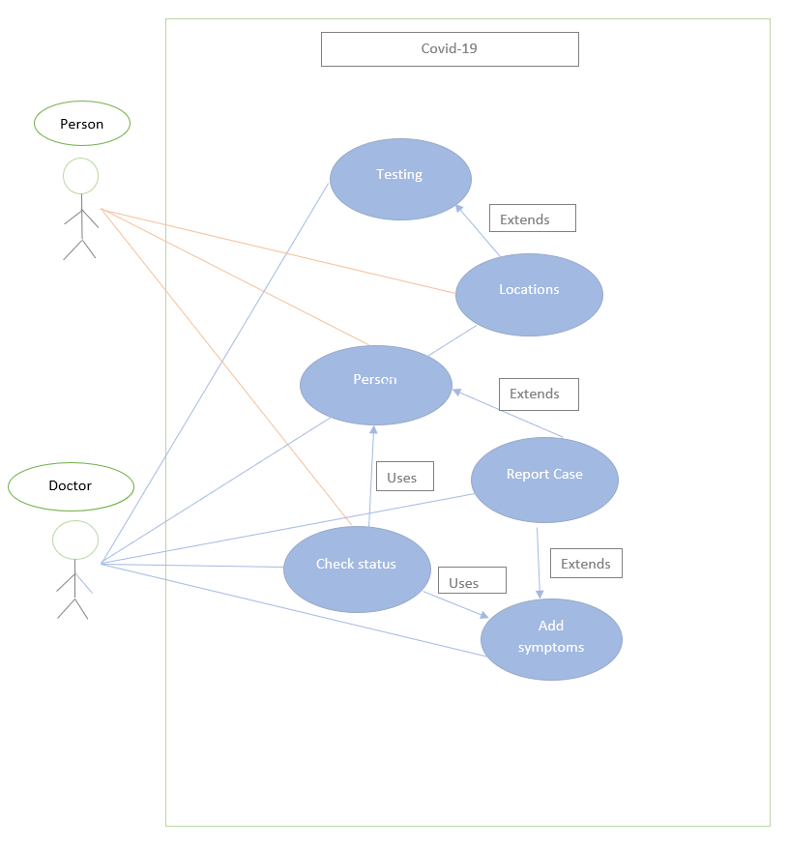
UML DIAGRAM

Slide 6
E/R DIAGRAM
Type
Units
Requests
TESTING
City
Result
Status
State
Test Availability
Symptoms
Severity
Date
Days Positive
Country
LOCATION
RESULT
Red Flags
Symptoms
Outcome
Comments
Lockdown
Status
Requires Testing
Needs Hospital
Name
PERSON
Age Group
Hospital
Address
Name
Address
D.O.B
Doctors
Patients

Slide 7
E/R DIAGRAM
Many-to-Many Relationships
Test Availability – People that get tested or Doctors giving the test can exchange information, create a new cases or whatever type of test is needed.
Needs Hospital – Doctors can decide if a patient with several symptoms such as: risk level, severity of their cases, etc. must arrive to a hospital.

Slide 8
Relational Schema
Hospitals
h_name, h_doctors, h_patients, h_riskLevel, h_address, h_comments
Outcome
o_caseID, o_dayspositive, o_status, o_comments,
Location
l_city, l_country, l_state, l_lockdown
Person
p_ID, p_name, p_address, p_dob, p_comment
Result
r_personID, r_caseID, r_date, r_result
Symptoms
s_caseID, s_symptoms, s_severity
Testing
t_type, t_units, t_requests
Needs Hospital
nh_caseID, nh_address, nh_riskLevel, nh_symptom, nh_severity, nh_decision
Testing Availability
ta_personID, ta_type, ta_units, ta_comment, ta_givenTest

Slide 9

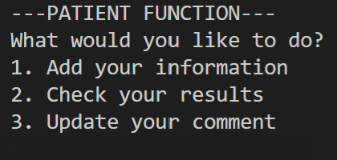
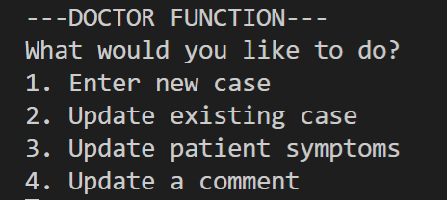
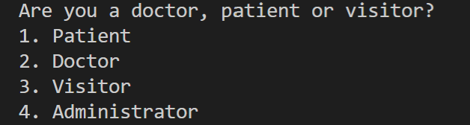
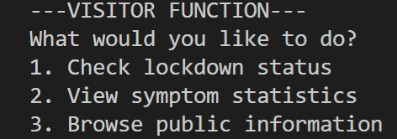
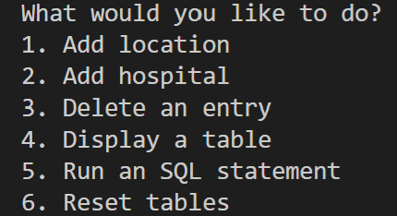
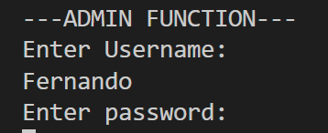
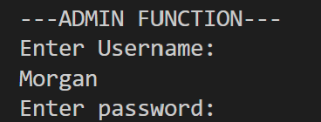
MENU STRUCTURE

Slide 10

Functions
Menu shows a list of individuals of who can access the database
Patients can add/check information and update change in behavior
Doctors can enter new cases and update each patient description
Visitors can view lockdown status and browse public info
Admin can add hospitals, location and tables that relates to COVID-19
Must enter correct credentials to make changes in admin

Slide 11
DEMO & GitHub
In our demo we are going to show how to:
Add a patient to the database
Doctor will update the case with patient ID
Check the patient’s results
Check the lockdown status of each State & City
View Symptom stats of each patient
Display basic information from the Visitor
Using numbers to input each command.
motrembley/databaseProject (github.com)

Slide 12
THANKS!

