Slide 1

By Fernando Diego Chino
Morgan Trembley

Slide 2

Our project is a user information guide on covid-19
Users can search covid-19 cases based on:
state, outcome, testing locations
Goal: to report cases with the help of the community thaT LIMITs possible misinformation
Industries like hospitals can report cases by the number of patients given, possible symptoms can be reported as covid-19.. etc.
Users can check the status of their specific city/county

Slide 3
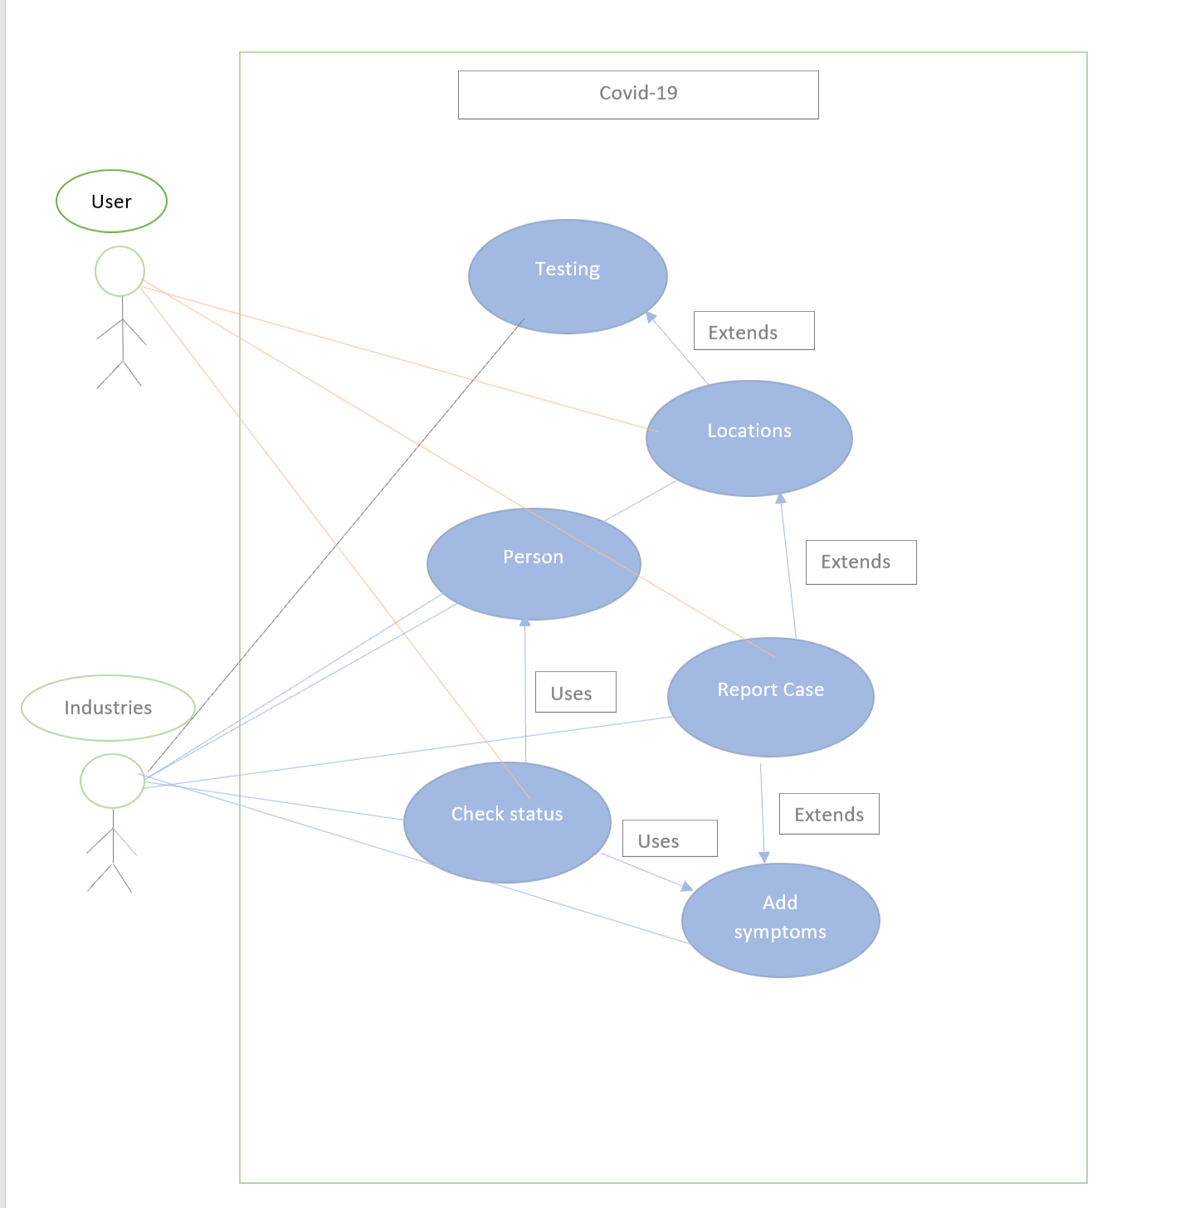
UML DIAGRAM

Slide 4
E/R DIAGRAM
Type
Units
TESTING
City
Result
Status
State
Test Availability
Symptom
Severity
Date
Days Positive
Country
LOCATION
RESULT
Red Flags
Symptoms
Outcome
Comments
Lockdown
Status
Requires Testing
Needs Hospital
PERSON
Age Group
Hospital
Address
Name
Address
D.O.B
Doctors
Patients

Slide 5
Relational Schema
Hospital
h_address, h_doctors, h_patients
Outcome
o_id, o_dayspositive, o_comments, o_status
Location
l_city, l_country, l_state, l_lockdown
Person
p_name, p_id, p_address, p_dob, p_lockdown
Result
r_id, r_date, r_result
Symptoms
s_id, s_symptom, s_severity
Testing
t_type, t_units

Slide 6
THANKS!

