Slide 1
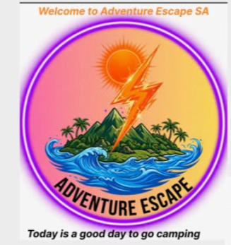
XHAW5112 group 9
Website presentation by Londiwe

Slide 2
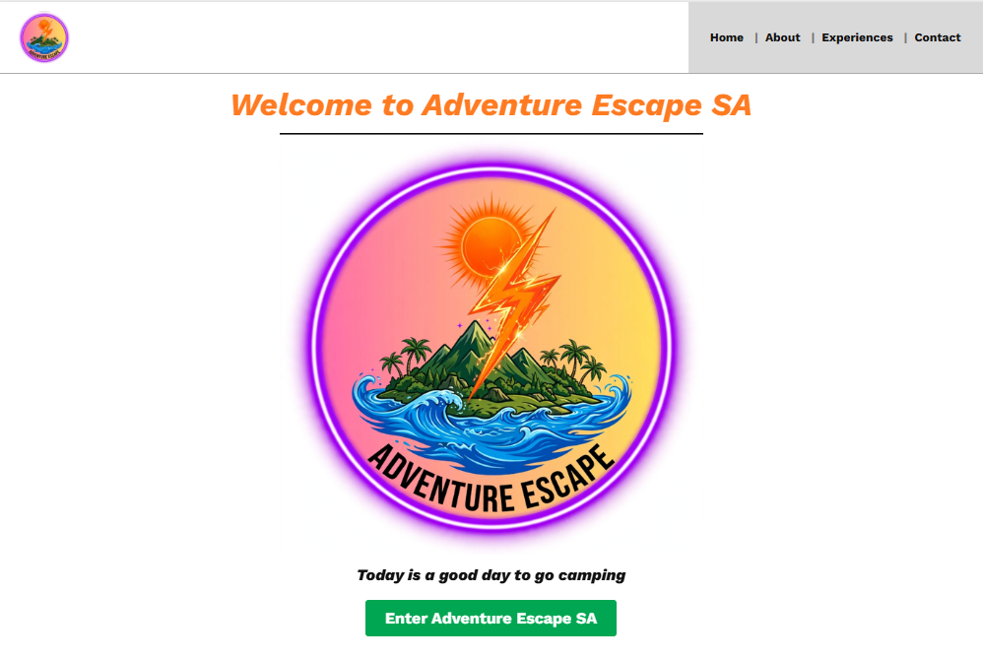
SLIDE 1: HOW OUR WEBSITE WORKS - ADVENTURE ESCAPE SA
Full User Journey - From Opening to Booking
STEP 1: SPLASH SCREEN
When user opens our Canva link https://adventure-escape.my.canva.site/adventure-escape-sa-website
They see splash screen with our final logo system - 3 green mountains #0B3D2E meaning Drakensberg, orange
sun #FF8C00 meaning December energy, blue waves meaning Western Cape beaches. Logo text: ADVENTURE
(bold, fun) + ESCAPE (light, getaway). This was improved from Phase 2 basic round gradient logo. Desktop 1440px
shows centered, mobile 390px shows same but scaled.
STEP 2: WELCOME / HOME PAGE (Z-Pattern Design)
Headline: "TODAY IS A GOOD DAY TO GO CAMPING" with real collage images - family hiking, braai, tent, ziplining - not X
placeholders like Phase 2. Below there are two main CTA buttons in orange #FF8C00: "View Packages" and "Book Now".
Navigation: Top bar green #0B3D2E with logo left, menu items Home | Packages | Calculate Fees | Contact, plus Book Now

Slide 3
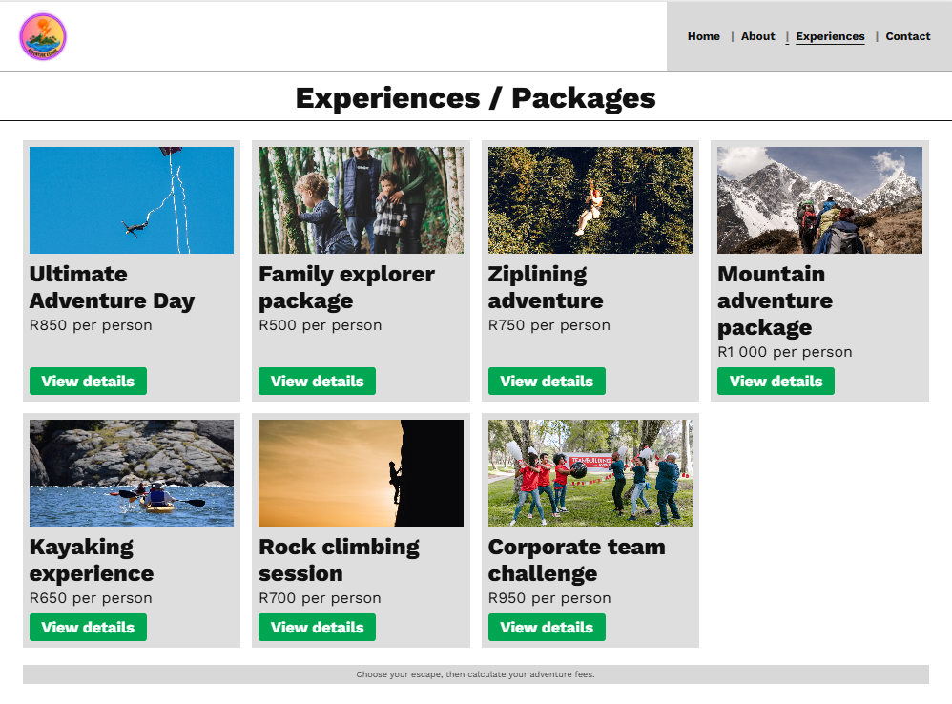
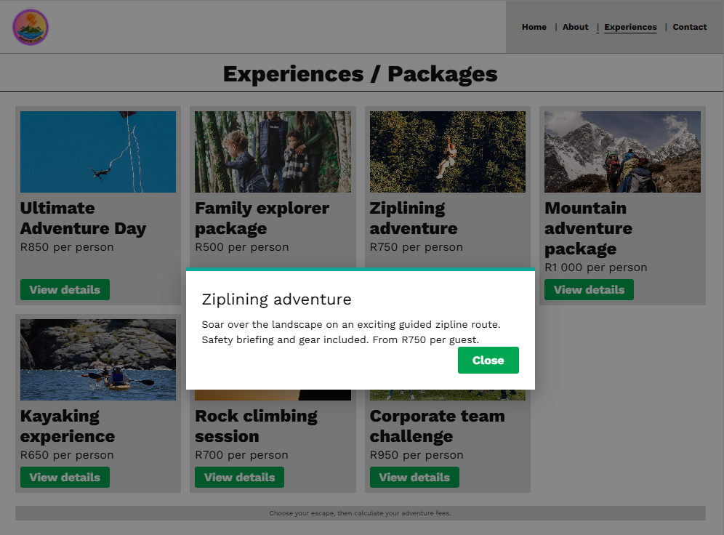

STEP 3: OVERVIEW PAGE - 7 PACKAGES (Grid System)
Shows 7 adventure packages as cards: 1. Hiking R500, 2. Kayaking R600, 3. Ziplining R750, 4. Rock Climbing R800, 5.
Camping R900, 6. Bird Watching R550, 7. Family Combo R1000. Each card has image, name, price, short description, and
"View Details" button orange. Layout: Desktop 3 cards per row, tablet 2 per row, mobile 1 column stacked vertically for thumb
scrolling. Hover effect: card lifts + shadow. This differs from Phase 2 which was only text list with no prices or images.
STEP 4: VIEW DETAILS MODAL (Explaining Activities)
When user clicks "View Details" on e.g. Ziplining, a popup modal opens explaining: "Ziplining is going down using a cable
from high mountain to low, safe harness, guide included, duration 30 mins, age 8+, what to bring". Price repeats R750 per
person. Has Close and "Add to Booking"

Slide 4
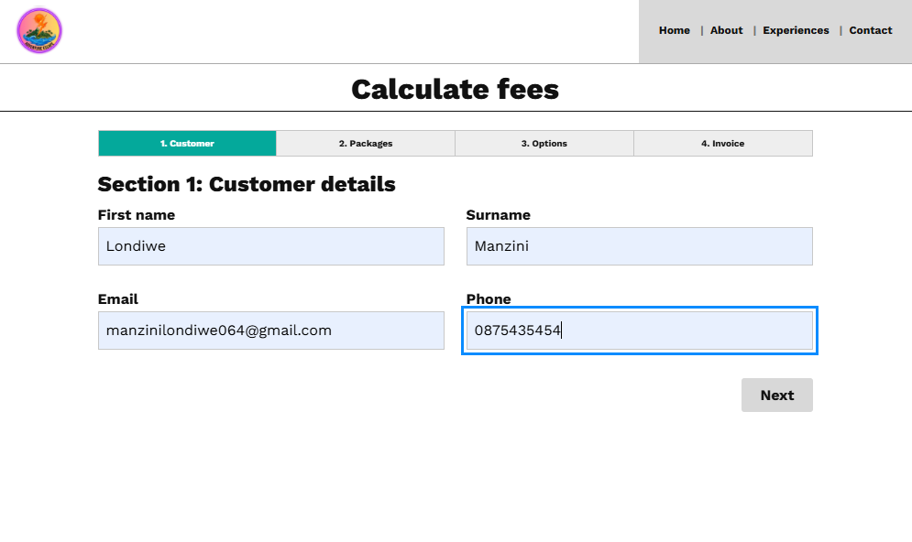
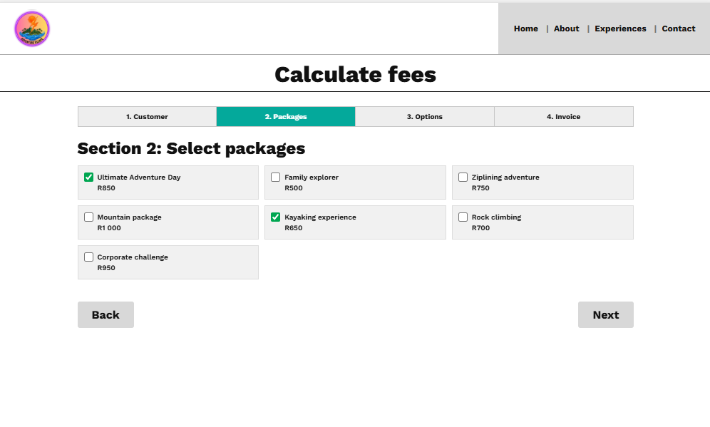
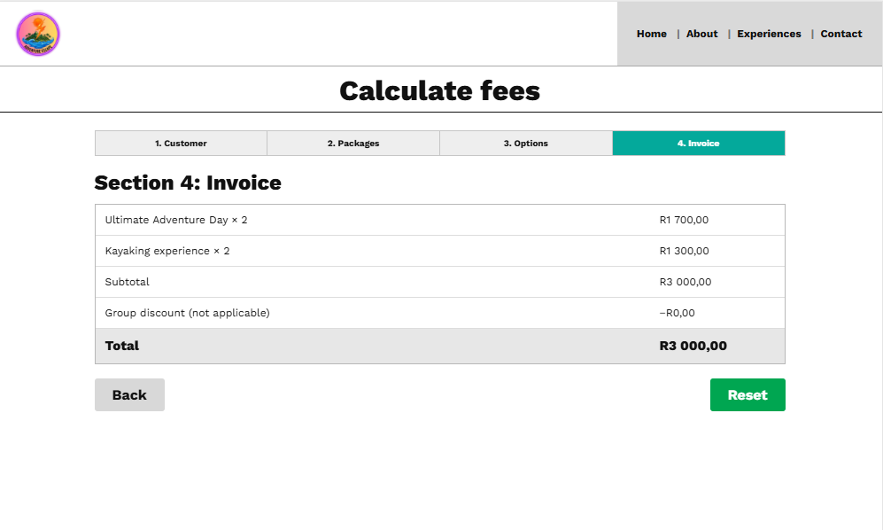
STEP 5: CALCULATE FEES / BOOKING PAGE (Core Functionality - Auto-Calculation)
This is biggest improvement from Phase 2 manual description to Phase 4 actual working system:
Section A - Customer Details:
Inputs: Full Name (text, required, validation letters only), Email (email format validation), Phone (SA format +27), Booking
Date (date picker default 2026/12/16 December family trip), Number of Guests (number input 1-20). All fields required
if empty shows red error "Please fill". Data saves to browser localStorage so if page refreshes, data stays.
Section B - Package Selection (Multi-select):
Checkboxes for all 7 packages - user can select multiple e.g. Hiking + Kayaking + Camping. Each checkbox shows price.
When selected, JS auto-adds to subtotal instantly. Old Phase 2: we just wrote "0% no discount, 5% etc" as notes.
Now system does it live.
Section D - Invoice / Auto-Calculation Logic:
System calculates automatically:
1. Subtotal = (Sum of packages selected + add-ons) x number of guests
Example: (Hiking R500 + Camping R900 = R1400) x 6 guests = R8400
2. Discount: IF guests >=5 THEN 10% discount ELSE 0%. So R8400 - 10% = R8400 - R840 = R7560
3. VAT: 15% of discounted amount = R7560 x 0.15 = R1134
4. TOTAL = R7560 + R1134 = R8694 (example you can show R5600 if fewer packages)
Shows breakdown clearly: Subtotal, Discount, VAT, TOTAL in bold green. Has Reset button to clear all, Submit button to confirm.

Slide 5
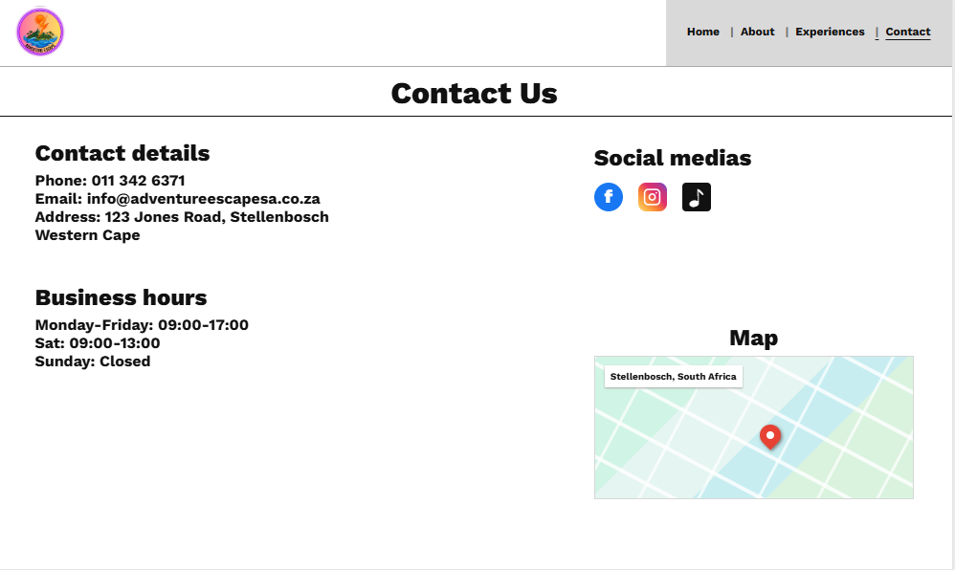
STEP 6: CONTACT & FOOTER*
Shows contact: info@adventureescape.co.za, phone, location Western Cape, social icons.
https://adventure-escape.my.canva.site/adventure-escape-sa-website
https://youtube.com/shorts/esK0U6mH3VU?si=mdxsyrfLYIUH7wCX

Slide 6
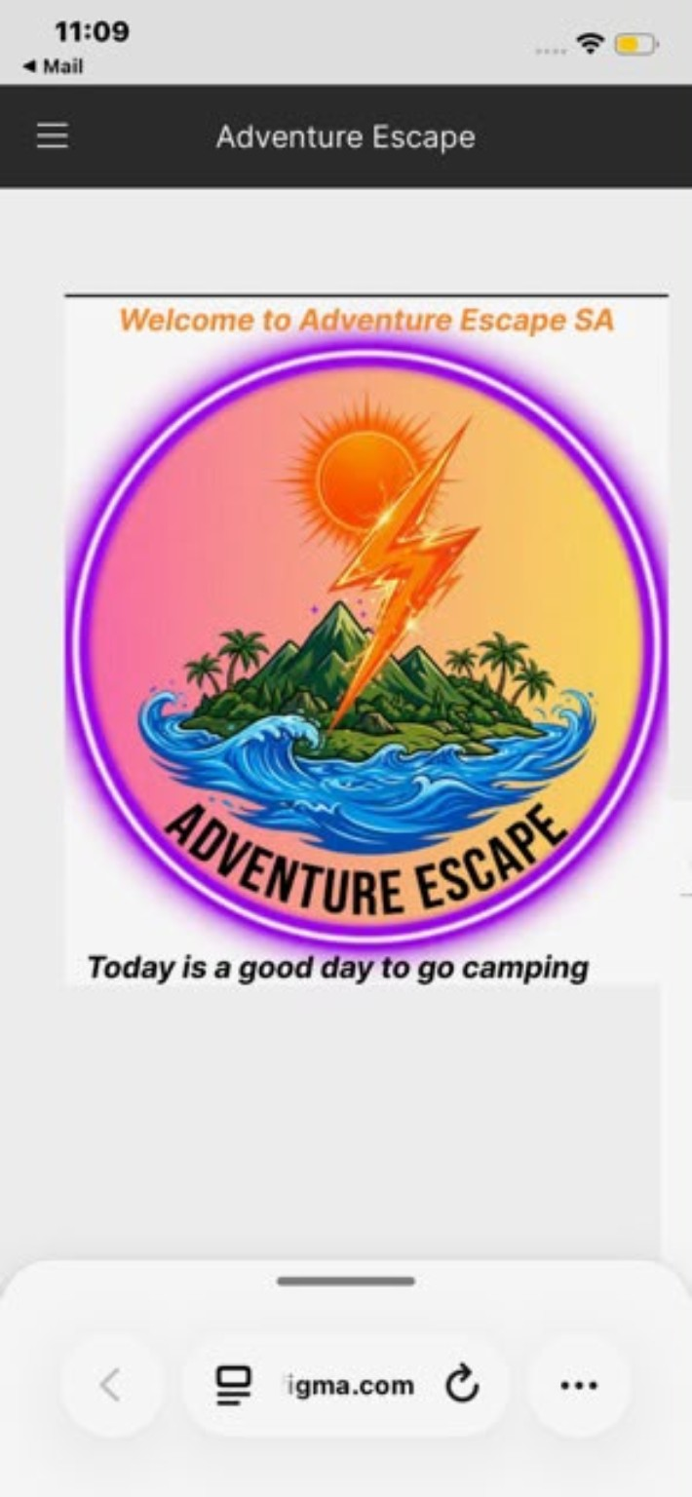
ADVENTURE
ESCAPE SA
Mobile-First Web App Design
User experience • Packages • Booking fee calculator
A walkthrough of the design, features and implementation
PRESENTATION

Slide 7
Branding & visual identity
A recognisable outdoor-adventure brand with an energetic, welcoming style.
The brand at a glance
• The circular logo combines a sun, lightning bolt, mountain landscape and ocean waves.
• Purple and orange create a bold, energetic identity.
• Green and blue connect the brand to nature, water and outdoor exploration.
• The slogan, “Today is a good day to go camping,” reinforces the escape-and-adventure theme.
ADVENTURE ESCAPE SA • MOBILE WEB APP
02

Slide 8
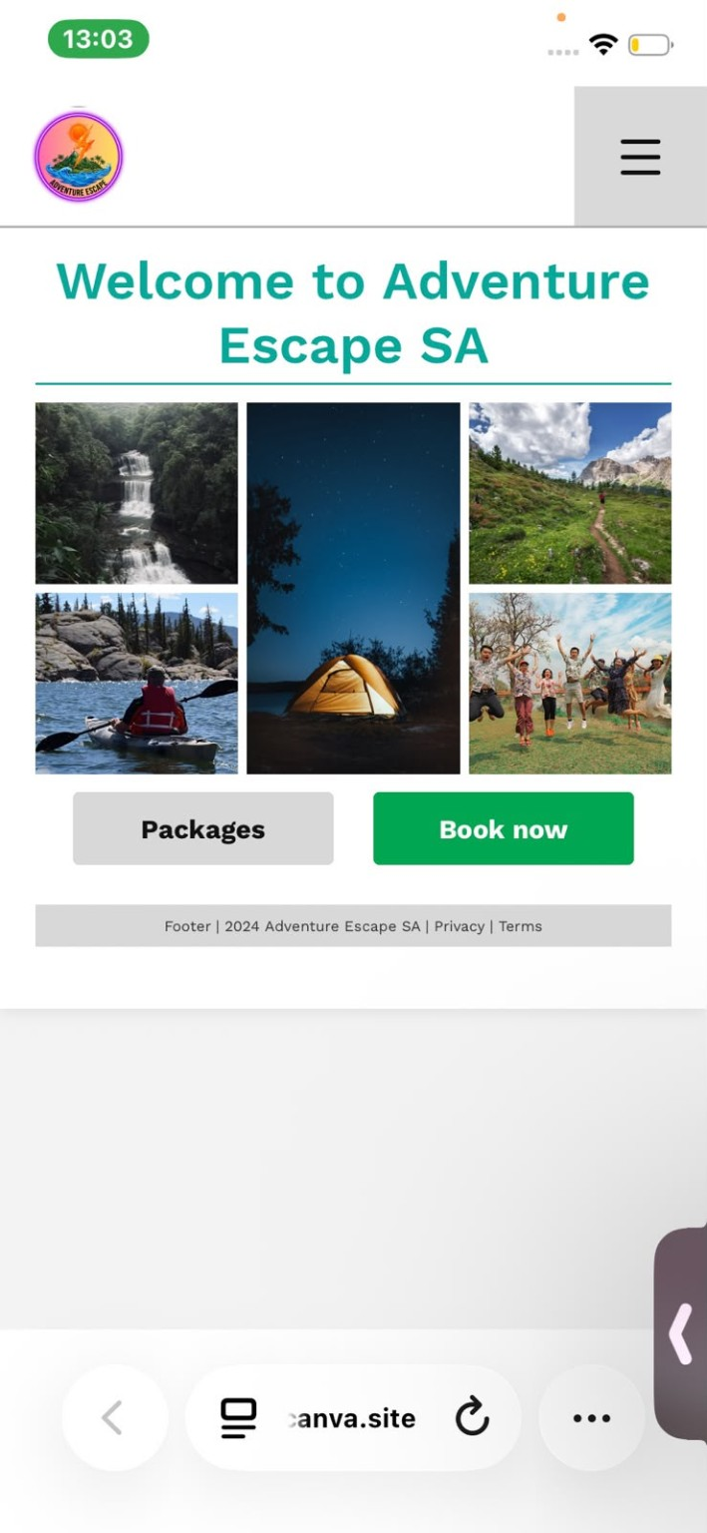
Home page: the starting point
The home page introduces the brand and directs visitors toward the main actions.
Key elements
• A prominent welcome heading introduces Adventure Escape SA.
• A photo collage gives visitors a quick view of outdoor activities.
• “Packages” helps users explore experiences and prices.
• “Book now” provides a direct path toward making a booking.
• A compact header and hamburger menu suit smaller screens.
ADVENTURE ESCAPE SA • MOBILE WEB APP
03

Slide 9
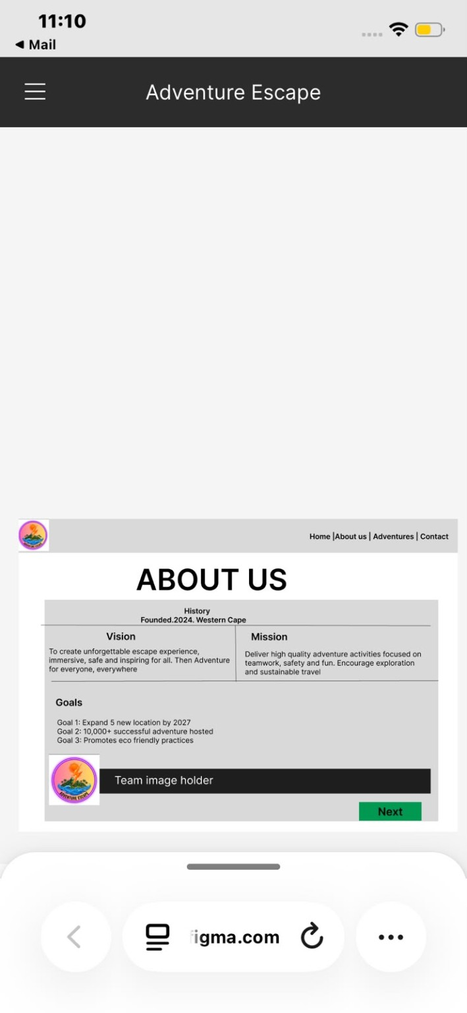
About us: purpose and direction
The About Us page explains what the business stands for and what it aims to achieve.
Business profile
• History: founded in 2024 in the Western Cape.
• Vision: create an unforgettable, immersive, safe and inspiring escape experience.
• Mission: provide quality adventure activities focused on teamwork, safety and fun.
• Goals: expand to five new locations by 2027, host 10,000+ successful adventures and promote eco-friendly practices.
ADVENTURE ESCAPE SA • MOBILE WEB APP
04

Slide 10
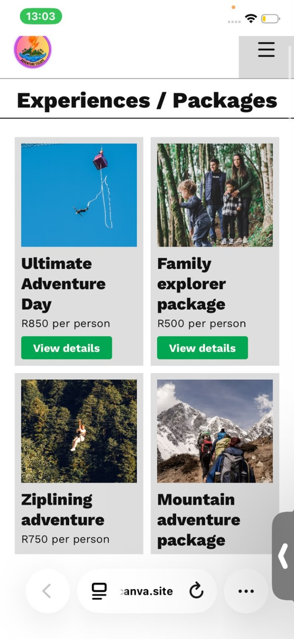
Experiences & packages
The packages page makes adventure options easy to browse and compare.
Example experiences shown
Ultimate Adventure Day
Family Explorer Package
R850 per person
R500 per person
Ziplining Adventure
Mountain Adventure Package
R750 per person
Price not visible in screenshot
“View details” buttons help users learn more before choosing a package.
ADVENTURE ESCAPE SA • MOBILE WEB APP
05

Slide 11
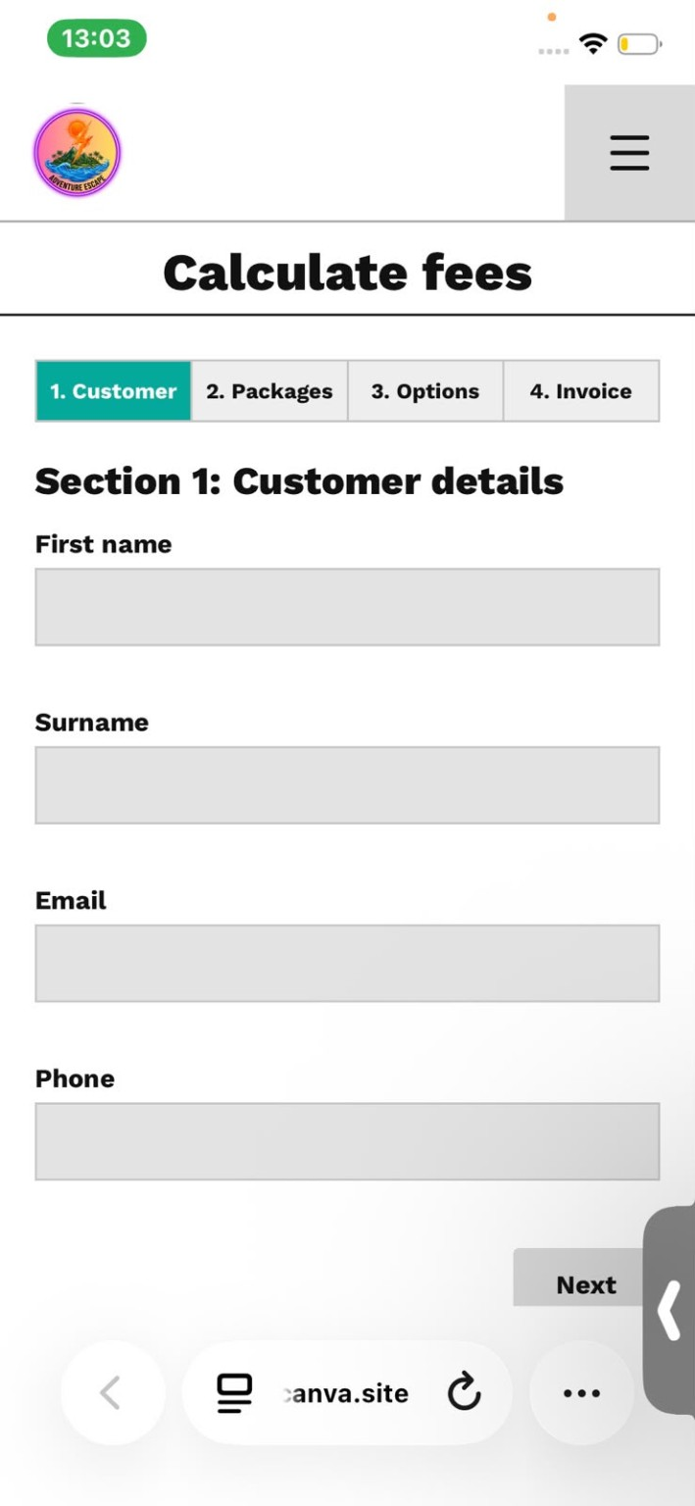
Calculate fees: guided booking flow
A step-by-step form collects booking details and helps users understand the cost.
Four-step process
01
Customer
First name, surname, email and phone number.
02
Packages
Choose the experience or package.
03
Options
Select any additional options relevant to the booking.
04
Invoice
Review the calculated total and invoice summary.
Design benefit: breaking the task into stages reduces cognitive load and makes the booking journey easier to follow.
ADVENTURE ESCAPE SA • MOBILE WEB APP
06

Slide 12
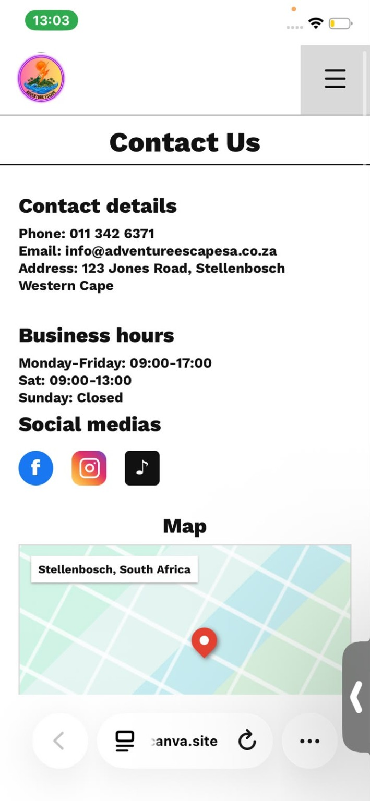
Contact us: trust and accessibility
The contact page brings essential business information into one place.
Contact details shown in the design
• Phone: 011 342 6371
• Email: info@adventureescapesa.co.za
• Address: 123 Jones Road, Stellenbosch, Western Cape
• Business hours: Monday–Friday, 09:00–17:00; Saturday, 09:00–13:00; Sunday closed.
• Social media icons and a map section support discovery and navigation.
Note: confirm the contact details and map location before publishing the live site.
ADVENTURE ESCAPE SA • MOBILE WEB APP
07

Slide 13
Design & implementation
The app is organised around clear navigation, reusable page sections and a guided booking flow.
Responsive layout
TypeScript & state
User-centred flow
• The screenshots show a mobile-first interface.
• Large buttons and stacked content support touch interaction.
• TypeScript can define routes and booking-field types.
• React state can track form values, selected packages and progress.
• Navigation separates information, packages and contact.
• The calculator guides users from details to invoice.
Good next steps: test the booking flow on different screen sizes, validate form inputs, and verify package prices and contact information.
08

Slide 14
Thank you
Adventure Escape SA
Questions?
“Today is a good day to go camping.”

