Slide 1
My digital songwriting partner
AI and lyric writing
Helen McCombie, Bureau de Traduction, UBO

Slide 2
Song lyrics
Aspects that generative AI might be able to help with
Word rhythm: Different lines of words with a repeated rhythm between lines, e.g. for a given melody
Singability & rhyme long vs. short sounds, phonetics
Originality: lexical unusualness, quirkiness of content, juxtaposition of ideas

Slide 3
Can Chat GPT generate lyrics to a given word rhythm?
Iambic parameter – 10 syllables (EN) or Alexandrin – 12 syllabes (FR)

Slide 5
Can Chat GPT track rhyme?

Slide 6
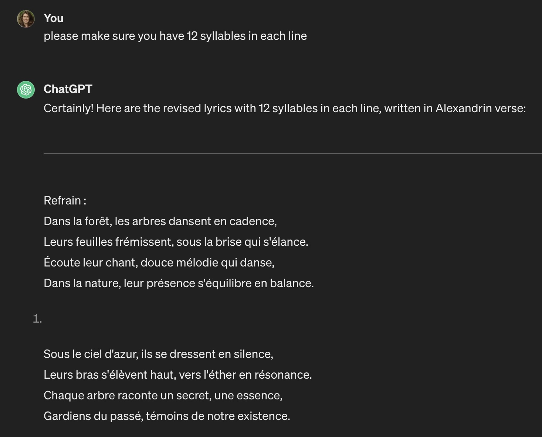
First request
A song about trees
Second request
Alexandrin verse
Chat GPT provided between 11 and 13 syllables per line
Third request
Make sure there are 12 syllables – success!

Slide 7
Can Chat GPT generate lyrics to a given word rhythm?
Iambic parameter (EN) or Alexandrin (FR) - You need to check up on Chat GPT
What if I give it my own rules?
Number of syllables and/or stress pattern

Slide 9
Can Chat GPT generate lyrics to a given word rhythm?
Iambic parameter (EN) or Alexandrine (FR) - most of the time
What if I give it my own rules?
Number of syllables – it works sometimes
Can Chat GPT ‘hear’? - its vocal input system is an add-on recognition system: it wasn’t trained on audio
Marking stress patterns and repeating them – it works sometimes
Conclusion: it was trained on text making it effectively ‘deaf’ but knows stress patterns in theory and can reproduce them if guided.

Slide 11
Research, free and commercial tools
Dedicated tools based on smaller specified corpera
Lyric Studio, Lyric Lab: Commercial Tools
Tools that specifically model on stress patterns and rhymes: ‘LyriSys’ (Watanabe et al. 2017) ‘Say what?’ (Ram et al. 2021)
Tools that can be made to imitate famous artists
Specifically in hip hop often the rhythm is irregular and created by the artist, sometimes in real time) but provides an opportunity for interaction (audio training)
Shimon the rapper (Savery et al. 2020)

Slide 12
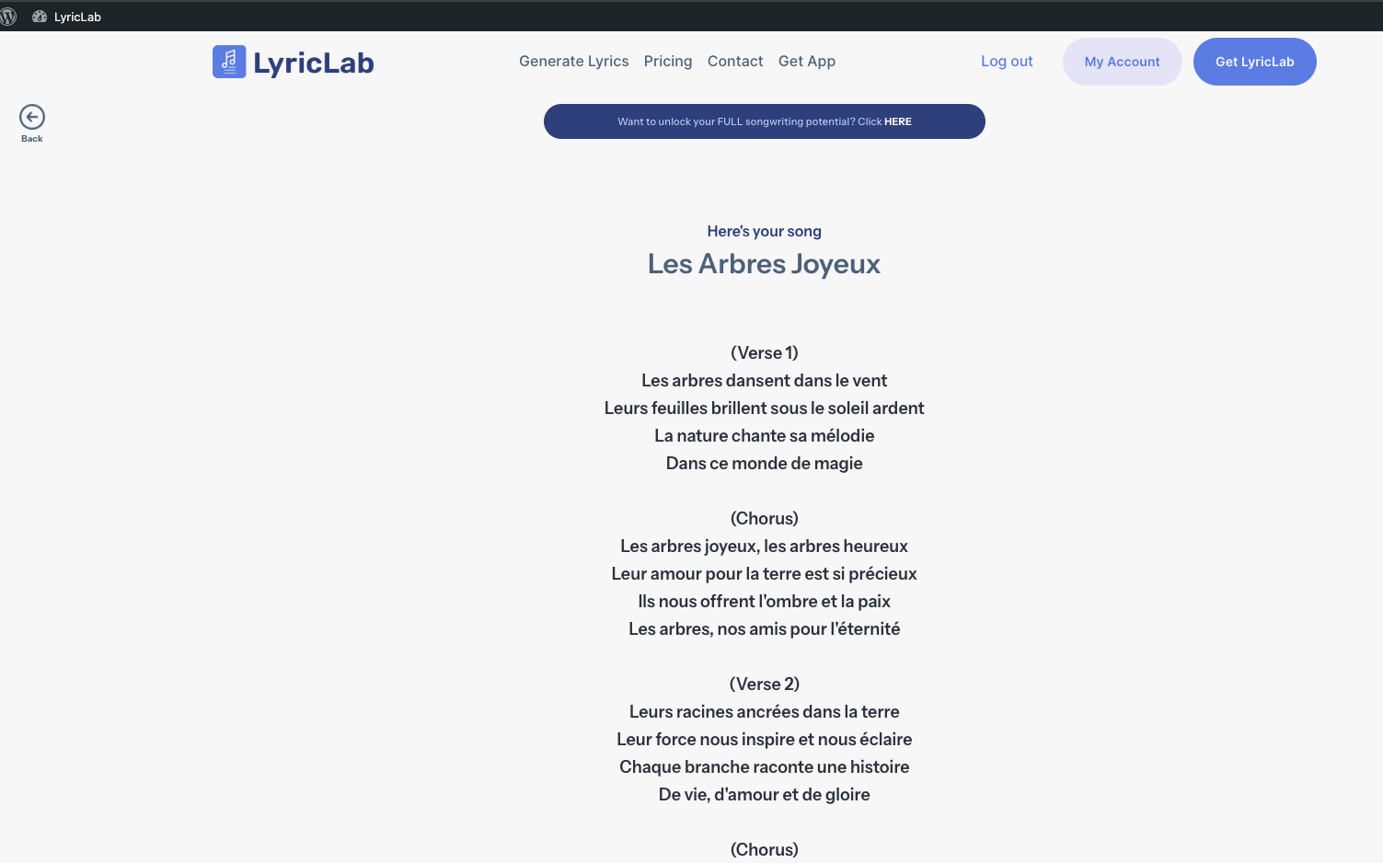

Slide 13
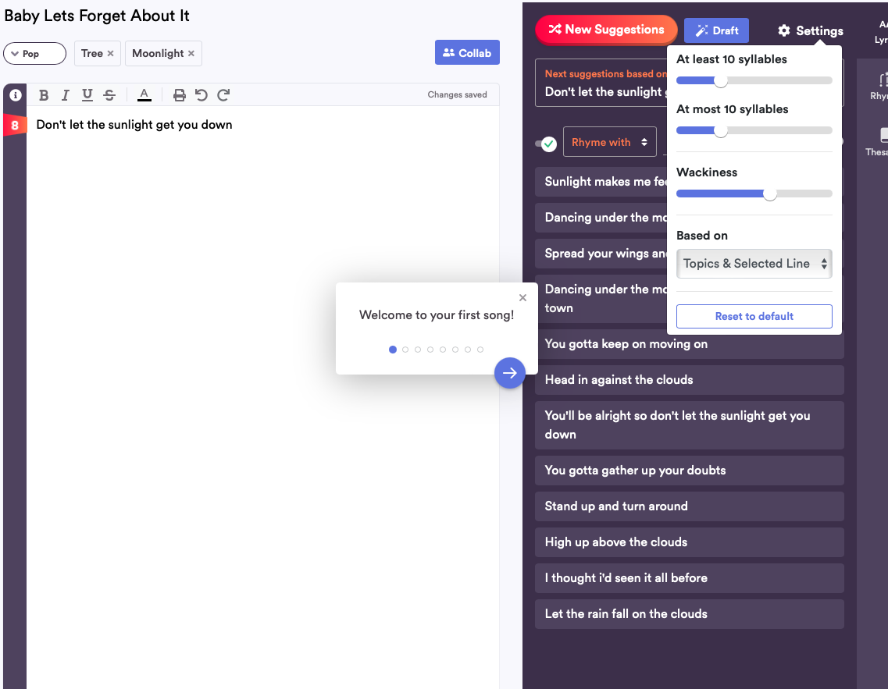

Slide 14
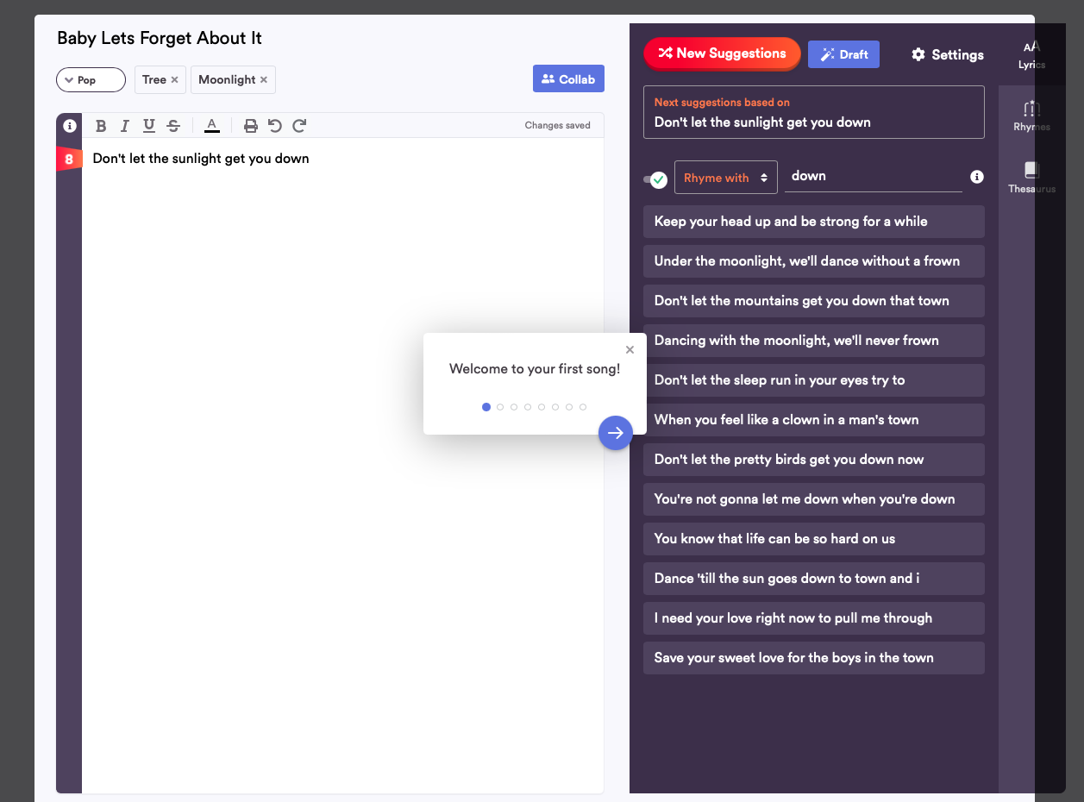

Slide 15
Originality
If you just ask it for lyrics is will produce something boring
If you asks for specifics it takes a step in the right direction

Slide 18
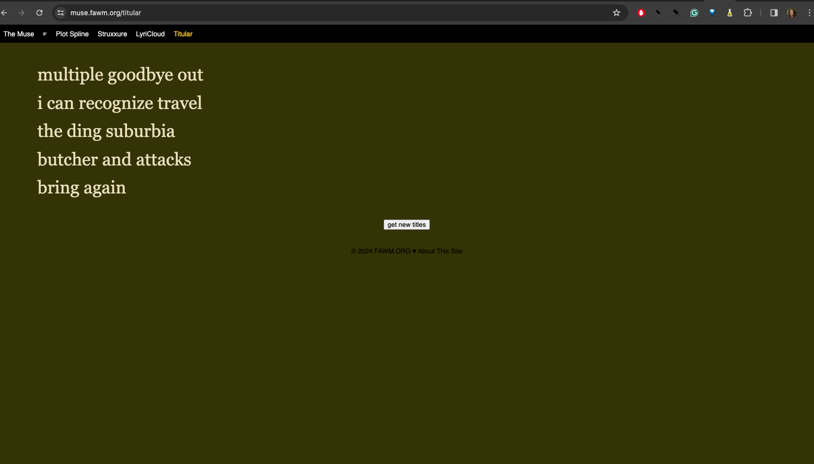
The titular tool, based on parts of speech templates and a corpus of song titles and lyrics collected on the web. Settles, 2010

Slide 19
Songwriters’ opinions on AI
FAWM (February Album Writing Month) online community
99% is of AI rubbish but the 1% inspired me
It’s great for writing fun nonsense
I don’t use it would because it would take away my fun
I don’t use it to write, I use it to get feedback on my work
I’m giving away discount codes for Lyric Studio
I created a bot to do just that

Slide 20
Websites & Bibliography
FAWM: Februry album writing month https://write.fawm.org
Commercial websites: Lyricstudio.net Lyriclab.net
Bit the Bot: https://poe.com/BitH_Bot (Based on Chat GPT 4)
Titular tool: muse.fawm.org/titular
Ram, N. et al. (2021) Say What? Collaborative Pop Lyric Generation Using Multitask Transfer Learning. In Proc. 9th Int Conf on Human-Agent Interactions (HAI ‘21) https://doi.org/10.1145/3472307.3484175
Settles, B (2010) Computational creativity tools for songwriters - Proceedings of the NAACL HLT 2010 Second Workshop on Computational Approaches to Linguistic Creativity 49-57 https://aclanthology.org/W10-0307.pdf
Watanabe, K. et al. (2017) Lyrisys: An interactive Support System for writing lyrics Based on Topic Transition. IUI 2017 http://dx.doi.org/10.1145/3025194
Savery, R et al. (2020) Shimon the Rapper: A real time system for human-Robot Interactive Rap Battles. Int. Conf. Innovative Computing and Cloud Computing 2020
https://doi.org/10.48550/arXiv.2009.09234

