Slide 1
RMI Example

Slide 2
About the project setup
The example is divided into three projects
Warehouse_client
Contains the code related to the client
Warehouse_common
Contains the code shared between server and client. It is imported by both the client project and the server project in order to compile
Warehouse_server
Contains the code related to the server

Slide 3
Running the example
To run the example
Setup rmiregistry location
Start rmiregistry
Start NanoHTTPD
Start Server
Start Client

Slide 4
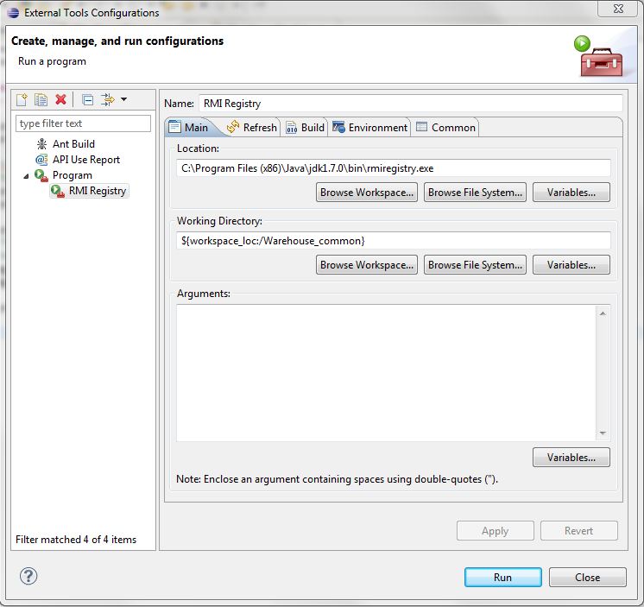
Setup rmiregistry location

Slide 5
Start rmiregistry
Click on the Eclipse external tools button
Run the RMI Registry setup created previously

Slide 6
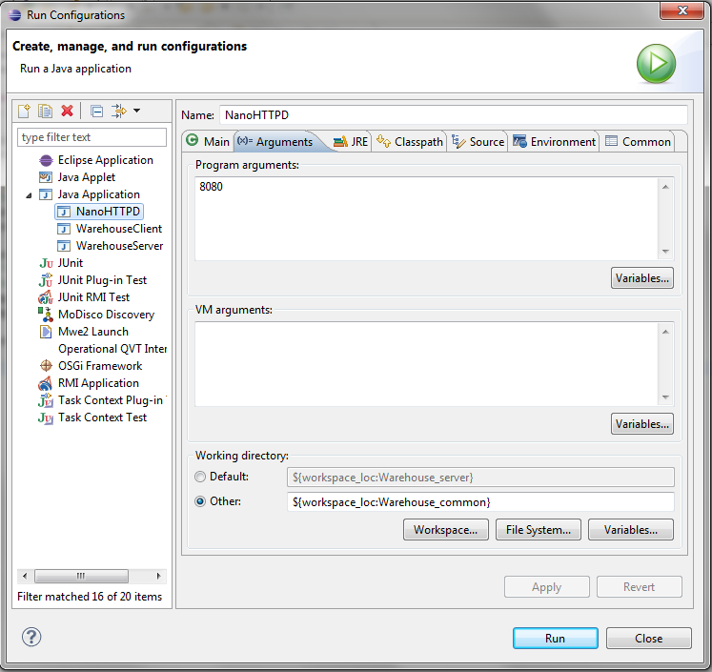
Start NanoHTTPD
Go to the run configurations menu and run NanoHTTPD
It runs on port 8080
To see if it is working just open a browser on http://localhost:8080

Slide 7
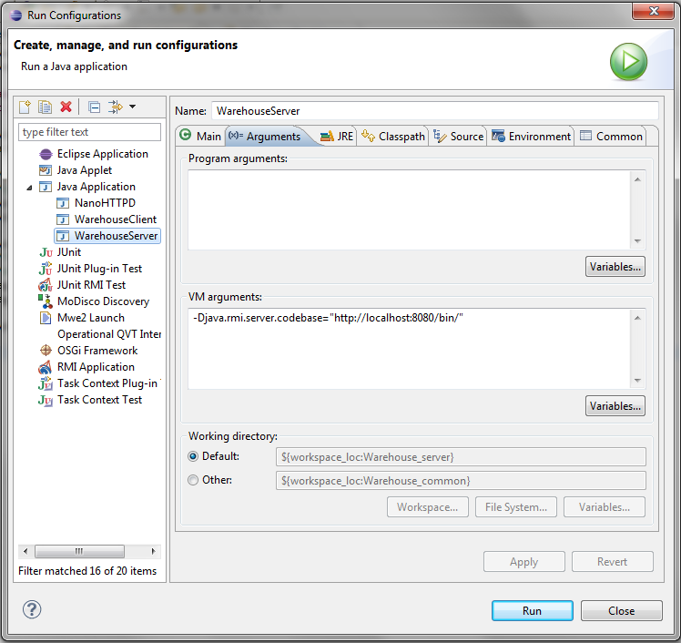
Start Server
Go to the run configurations and run WarehouseServer
The java.rmi.server.codebase property specifies where the remote interfaces can be found (Warehouse.class)
After starting the server you can see in the NanoHTTPD console the rmiregistry downloading Warehouse.class

Slide 8
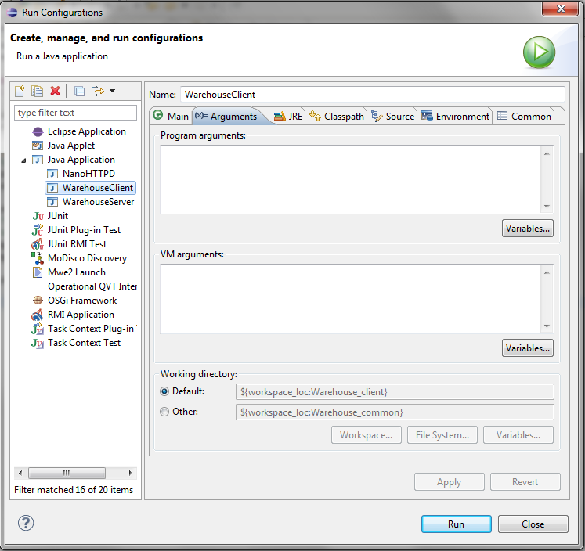
Start Client
Go to the run configurations and run WarehouseClient
No additional argument is needed

