Slide 1
RMI Example V2

Slide 2
RMI Example V2
The goal of this example is to show the Dynamic Class Loading feature of Java
The Book class in the Server is not in the compilation unit of the client and is downloaded at runtime using the java.rmi.server.codebase property

Slide 3
About the project setup
The example is divided into three projects
Warehouse_client
Contains the code related to the client
Warehouse_common
Contains the code shared between server and client. It is imported by both the client project and the server project in order to compile
Warehouse_server
Contains the code related to the server

Slide 4
Running the example
To run the example
Setup rmiregistry location
Start rmiregistry
Start NanoHTTPD COMMON
Start NanoHTTPD SERVER
Start Server
Start Client

Slide 5
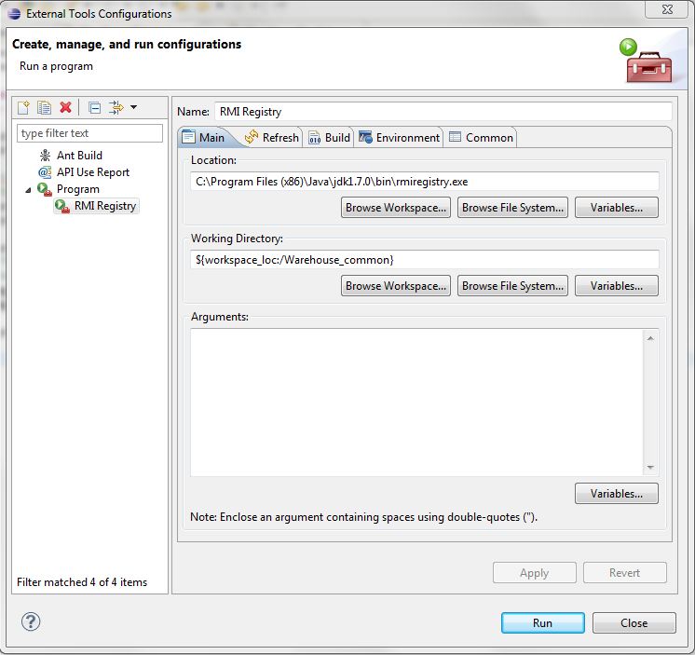
Setup rmiregistry location

Slide 6
Start rmiregistry
Click on the Eclipse external tools button
Run the RMI Registry setup created previously

Slide 7
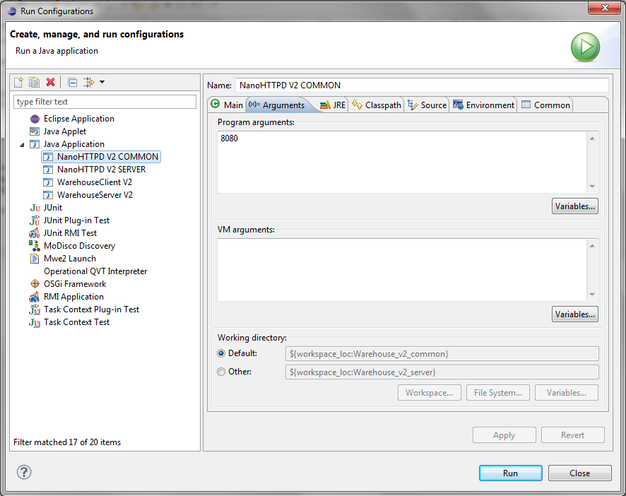
Start NanoHTTPD COMMON
Go to the run configurations menu and run NanoHTTPD COMMON
This code repository will be used by the RMI registry during the binding phase

Slide 8
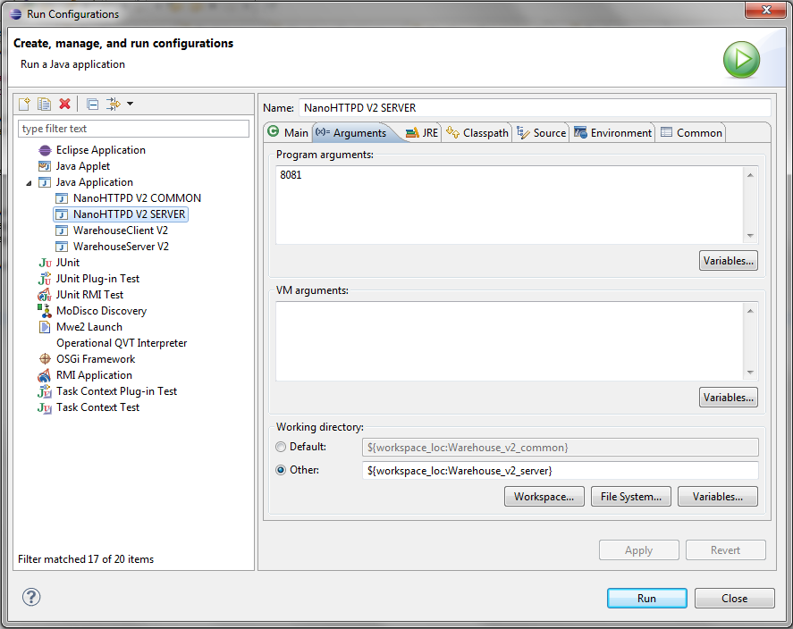
Start NanoHTTPD SERVER
Go to the run configurations menu and run NanoHTTPD SERVER
This code repository will be used by the Client to download the Book class

Slide 9
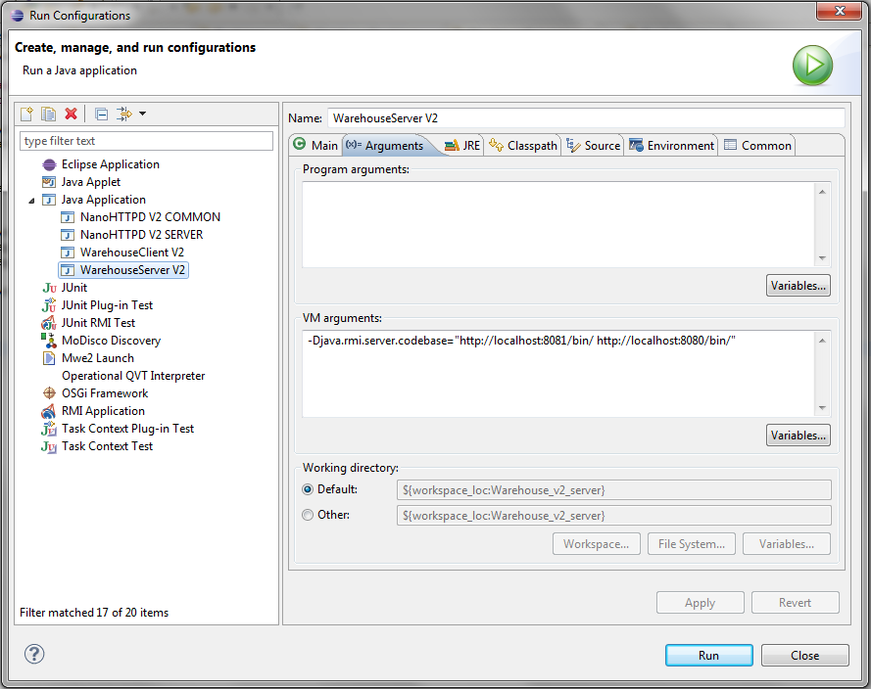
Start Server
Go to the run configurations and run WarehouseServer V2
This time we have two codebases where the code can be downloaded

Slide 10

Start Client
Go to the run configurations and run WarehouseClient V2
No additional argument is needed

