Slide 1
TASK 4:Data Storytelling & Statistical Validation
Name: Sathvika Moturi
Internship: Data Analytics
Internship Organization: ApexPlanet Software Pvt. Ltd.

Slide 2
Dataset Overview
Employee Dataset Attributes
Employee ID
Name
Age
Department
Salary
Experience Years
Performance Score
City
Dataset Size
Total Employees: 10
Departments: Sales, IT, HR, Finance
Objective: To analyze employee data and derive meaningful business insights through interactive dashboards and statistical analysis.

Slide 3
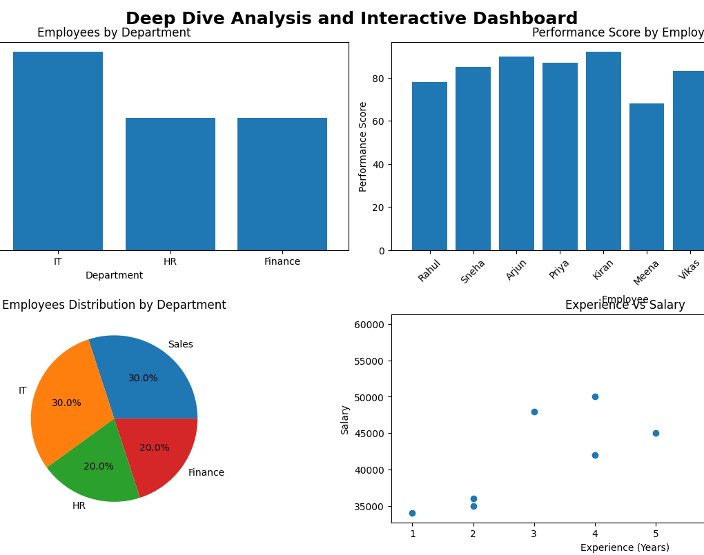
Dashboard Overview
Dashboard Components
Employees by Department
Performance Score Analysis
Department Distribution
Experience vs Salary Analysis

Slide 4
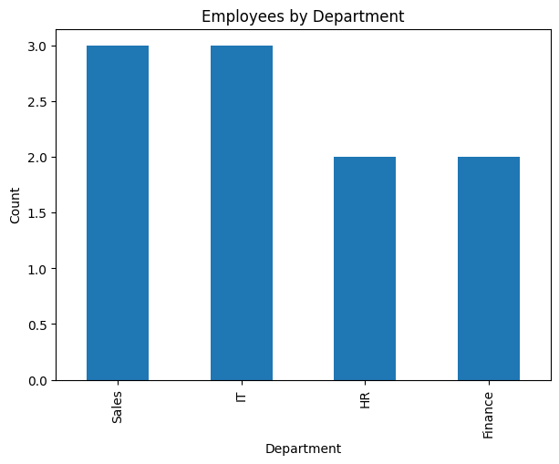
Department Analysis
Findings
Sales Department: 3 Employees
IT Department: 3 Employees
HR Department: 2 Employees
Finance Department: 2 Employees
Insight
Sales and IT departments have the largest workforce representation, accounting for 60% of total employees.

Slide 5
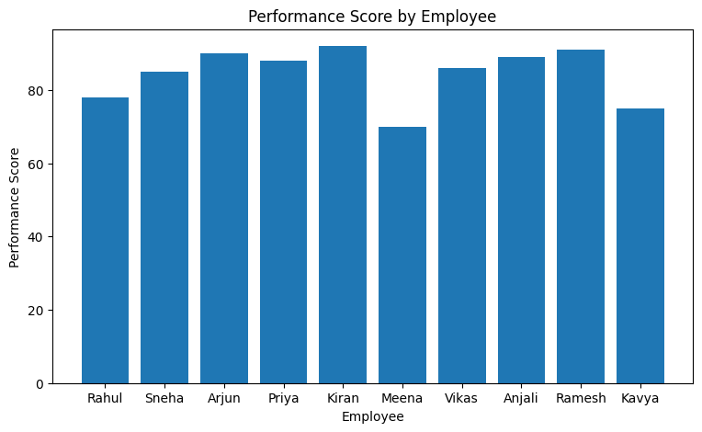
Employee Performance Analysis
Key Findings
Top Performers
Kiran – 92
Arjun – 90
Ramesh – 89
Improvement Opportunity
Meena – 68
Insight
Most employees scored above 80, indicating strong overall workforce productivity.

Slide 6
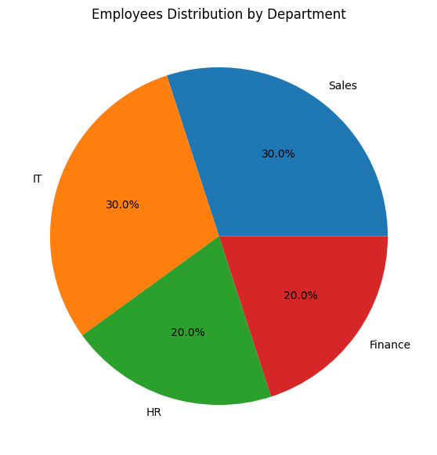
Workforce Distribution
Department Distribution
Department | Percentage
Sales | 30%
IT | 30%
HR | 20%
Finance | 20%
Insight
The workforce is fairly balanced across departments.

Slide 7
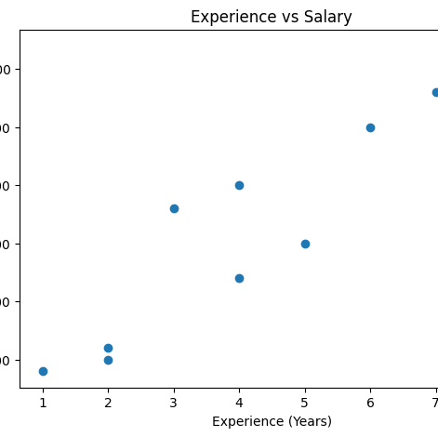
Experience vs Salary Analysis
Findings
Salary increases as experience increases.
Employees with 7–8 years of experience earn the highest salaries.
No major salary outliers detected.
Insight
A strong positive relationship exists between experience and compensation.

Slide 8
Statistical Validation & Key Business Insights
Business Hypothesis
Null Hypothesis (H₀)
Employee experience does not significantly affect salary.
Alternative Hypothesis (H₁)
Employee experience significantly
affects salary.
Statistical Test
Independent T-Test / Correlation Analysis
Purpose:
To validate the observed relationship between experience and salary.
Insight 1
Sales and IT are the largest departments.
Insight 2
Employee performance is generally high across the organization.
Insight 3
Experience strongly influences salary growth.
Insight 4
Top performers can serve as mentors for other employees.
Insight 5
Training initiatives can improve lower-performing employees.

Slide 9
Conclusion
The dashboard analysis reveals a productive workforce with balanced departmental distribution and a clear positive relationship between experience and salary. Data-driven decision-making can help improve employee performance, optimize compensation strategies, and support organizational growth.
Thank You

