Slide 1
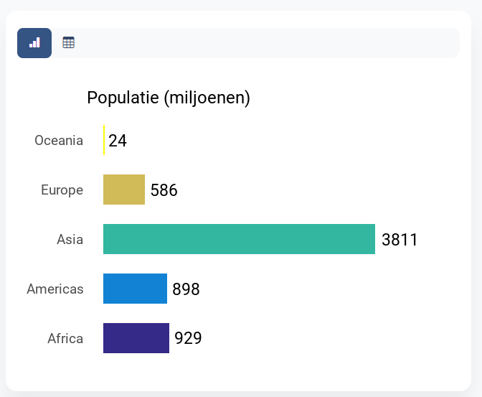
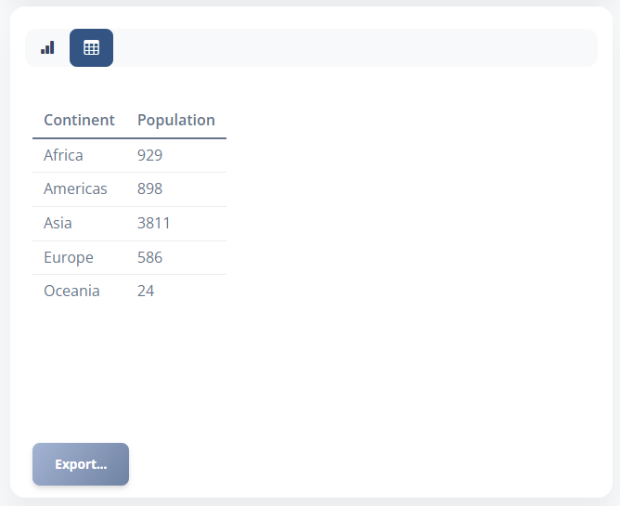
prepare_grouped_data
...
custom plot function
...
Raw data
Table data
Plot (PNG)
custom formatter function
Formatted
table data
'Plot widget'
Shiny module

