Slide 1
Let’s Code
An app which reminds a person to code everyday and build the habit of coding.
Group Members:
Kapil Motwani ( 19DCS067 )
Keval Lad ( 19DCS055 )
Ajay Pal ( 19DCS070 )

Slide 2
Table Of Contents
What is coding?
Why coding habit is important for anyone?
How our web application helps the user to develop the habit of coding?
Features which will be offered by our web application.
Technologies which we will use.
References

Slide 3
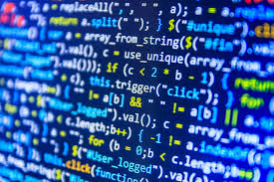
What is Coding?
Coding is what makes it possible for us to create computer software, apps and websites.
Your browser, your OS, the apps on your phone, Facebook, and this website – they’re all made with code.
Coding is done using various coding languages.

Slide 4
Why Coding habit is important?
Coding habit is important because coding skills comes with regular practice of various kinds of coding problems.
Both good and bad. But when you start adopting the right programming habits you can seriously boost your efficiency.
Not only will these good habits impact you, but most likely they will also impact the people around you.

Slide 5


Features of our Web Application
It will remind you everyday through email notification to code.
If you are a beginner then it will show you a pathway to become a pro coder from a noob coder.
Also it will be a really personalized web application which will suggest you problems according to your current level.
Also it will notify users about latest contests on different websites which is suitable for the users.

Slide 6
Technologies which we will use.
HTML , CSS , JavaScript for Frontend Development.
JavaScript for Backend Development.
Mongo DB for Database.

Slide 7


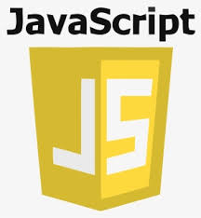
HTML , CSS, and JavaScript
An overview:
HTML provides the basic structure of sites, which is enhanced and modified by other technologies like CSS and JavaScript.
CSS is used to control presentation, formatting, and layout.
JavaScript is used to control the behavior of different elements.

Slide 8
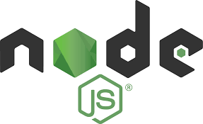
Node Js
We will use Node Js for Backend Development. It uses JavaScript as its scripting language.
Overview of Node Js
Node.js is an open source, cross-platform runtime environment for developing server-side and networking applications. Node.js applications are written in JavaScript, and can be run within the Node.js runtime on OS X, Microsoft Windows, and Linux.
Node.js also provides a rich library of various JavaScript modules which simplifies the development of web applications using Node.js to a great extent.

Slide 9

Mongo DB
MongoDB is a document-oriented database which stores data in JSON-like documents with dynamic schema.
It means you can store your records without worrying about the data structure such as the number of fields or types of fields to store values.
MongoDB documents are similar to JSON objects.

Slide 10
References
Html Documentation
Css Documentation
JavaScript Documentation
Mongo Database Documentation
Web Development Playlist on YouTube

Slide 11
Thank You

