Slide 1

Take some time out and read these beautiful words carefully.
Later, reflect on what you have just read.
Surely you will understand a lot of things…

Slide 2

First Lesson
... after some months at the faculty of medicine, the professor gave us a test.
Being a good student, I quickly answered all the questions… all, but the last: “What is the baptism name of the maid of our institute?

Slide 3
First Lesson
I handed over my test paper, leaving the last question unanswered. Just before the lesson ended, another student inquired if the last question would be marked.
“Certainly!", the professor replied. “You will meet many people in your life. All of them will have some degree of importance.

Slide 4
First Lesson
They will deserve your attention, even if it is a simple smile or a simple hello".
I never forgot this lesson… and went on to learn that the baptism name of our maid was Marianna.

Slide 5

Second Lesson
On a rainy, tempestuous night a “coloured” woman was standing on the roadside.
Her car had broken down and she desperately needed help.
Wet to her core, she signalled to the passers by.

Slide 6
Second Lesson
A white young man, as if unaware of the racial conflicts that tore apart America in the 60s, stopped to help her.
He conducted her to a safe place, called a mechanic and hailed a taxi for her. The woman seemed too much in a hurry, but did not forget to thank him and take down his address on a piece of paper.

Slide 7
Second Lesson
Seven days had already passed when someone knocked at the door of the young man.
To his enormous surprise, it was a courier with a huge packet to deliver – a big colour TV along with a note: “Many thanks for helping me on the road that night.

Slide 8
Second Lesson
The rain had completely drenched me and my soul when you appeared.
Thanks to you I was able to reach my dying husband just in time.
God bless you for having helped me.
Sincerely,
Mrs. King Cole"

Slide 9

Third Lesson
Sometime ago, when the ice-creams were not so expensive, a ten-year old boy went to an ice-cream parlour. While sitting at the table, he asked the waitress, “How much does a Sundae cost?” “50 cents,” she replied.
The boy took out his money from the pocket and began counting it.

Slide 10
Third Lesson
“Well, how much does a simple ice-cream cost?".
There were other people waiting to be served, so the waitress began to get a little impatient.
"35 cents!" she replied abruptly. The boy counted his money again and said: “Please get me a simple ice-cream!"

Slide 11
Third Lesson
The waitress served him the ice-cream and his bill. The boy ate his ice-cream, paid his bill at the cash counter and left.
When the waitress went to clean the table she began to cry… for there, in the corner of the plate, were 15 cents… her tip.
The boy took a simple ice-cream instead of a Sundae so he could leave a tip for her.

Slide 12

If you have never experienced the danger of war or the solitude of imprisonment, the agony of torture and hunger, you are much ahead of the 500 million people who live in this world.

Slide 13
If you have food in your refrigerator, clothes to wear, a roof on your head and a place to sleep, you are richer than the 75% of the people who live on this Earth.

Slide 14
If you can go to your place of worship without being threatened, arrested, tortured or killed, you are luckier than the 3000,000,000 persons of this world.

Slide 15
If you have money in your bank account and your wallet and some loose change in some little box, you are one of the world’s 8% well-to-do population.

Slide 16
If you are able to read this message, you have just received a double blessing…
one, someone is thinking about you…
two, you are not one of those 2000,000,000 people who are illiterate!

Slide 17
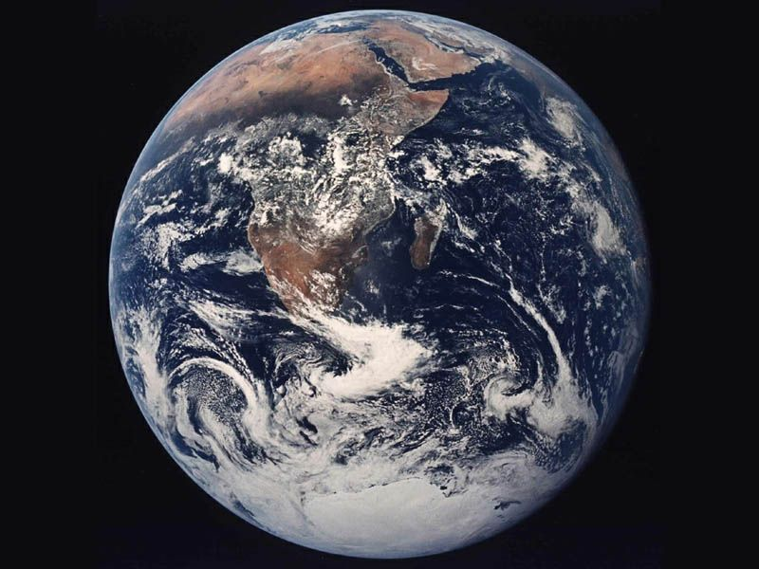
Somebody said at some time:
Work as if you have no need of the money.
Love as if nobody ever made you suffer.
Dance as if nobody is watching you.
Sing as if nobody is hearing you.
Live as if the Paradise were on this Earth.

Slide 18

If you like this email send it to all you consider your FRIENDS
Brighten up someone’s day!
If you don’t forward it... nothing will happen, or better, nothing drastic will happen... this is just one of those opportunities that lose themselves in our daily routine…
The only thing that WILL happen is that it will bring a smile on the face of all who receive it... if you do forward it!

Slide 19
Now, you can do two things:
1) Throw this e-mail
or...
2 ) Send it to all the people whom you consider important… including the one who sent it to you.
I hope you choose the second option!
Have a Nice Day!

