Slide 1
Data-based Prediction System Cancer research as a case study
By Uria Noiman and Mordechai Ben Zecharia
Supervisor - Professor Avi Rosenfeld
06/2018

Slide 2
Executive Summary
Who? Health systems around the world
What? Streamline the ability to predict disease among patients
Why? Early detection significantly increases the chances of survival
How? Build Data-based models that enable high accuracy prediction
Workflow
Challenges
Conclusions
End
Executive Summary
Beginning
Machine Learning
User Interface

Slide 3



Challenges

Slide 4
Challenges
How to prepare the initial data so it can be analyzed?
Is it possible to find the main attributes and classify with high probability?
How to implement the prediction system to find the best results?
How to build the prediction system in a generic manner that enables implementation in a wide range of fields?
Workflow
Executive Summary
Conclusions
End
Challenges
Beginning
Machine Learning
User Interface

Slide 5
Workflow
Pre-Processing
Feature Analysis
Machine Learning
User Interface
Results
Challenges
Executive Summary
Conclusions
End
Workflow
Beginning
Machine Learning
User Interface
Notes:
Software preface includes: configuration, feature selection, model selection. Data mining includes: training, testing, best model, chart. User interface includes: website, user form, data entry, results. The 3 middle stages are for both Python and Weka.

Slide 6
Pre-Processing

Slide 7
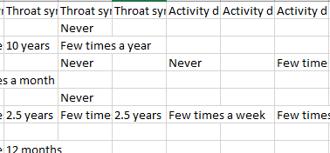
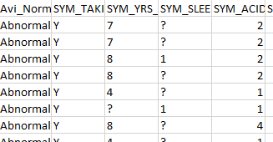
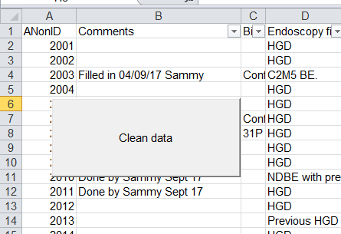

Data Cleaning
Tables formats
Cleaning the data
VBA code
Challenges
Executive Summary
Conclusions
End
Workflow
Beginning
Machine Learning
User Interface

Slide 8

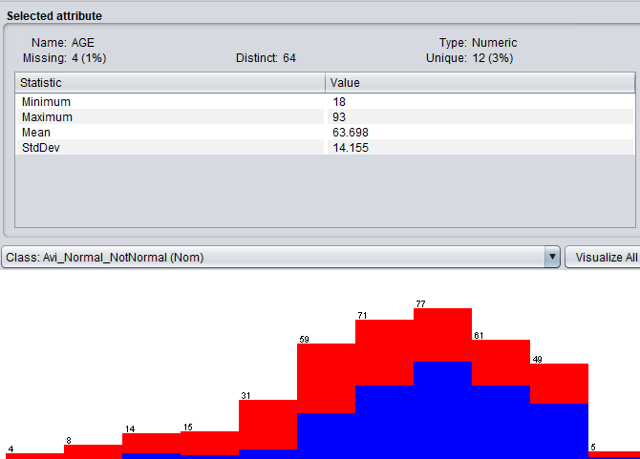

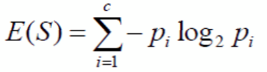
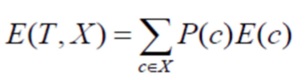
Feature Analysis
Logistic regression
Information Gain > 0.01
T – target value, X – attribute
Challenges
Executive Summary
Conclusions
End
Workflow
Beginning
Machine Learning
User Interface

Slide 9


Data Pre-Processing for Python
CSV -> Pandas DataSet (X_set , Y_set ,original_headers)
Label Encoding
Imputing Null - “Mean”
Challenges
Executive Summary
Conclusions
End
Workflow
Beginning
Machine Learning
User Interface

Slide 10
Machine learning

Slide 11


Infrastructure
GitHub Version Control
Ipython script console
Jupyter notebook
Challenges
Executive Summary
Conclusions
End
Machine Learning
Beginning
Workflow
User Interface

Slide 12
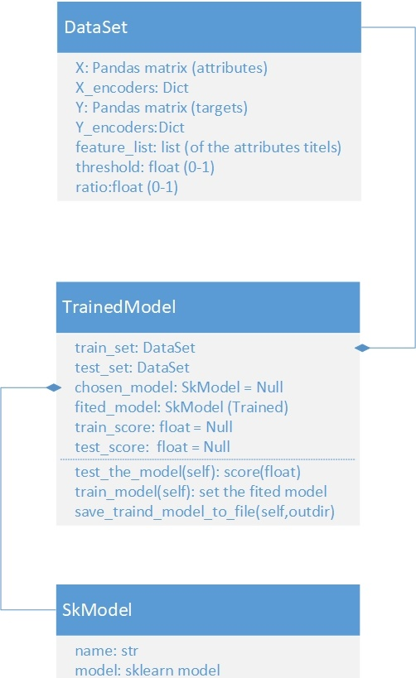

Software Design & Concepts
End to end system
Generic and reusable solution
Decision support system
Configurable
Logging for analysis

Slide 13

Algorithm Stages Stage 1/3 – Feature Selection
Using feature selection algorithm to get the feature score (Chi^2, F Score, Mutual Info)
Analyze increasingly large sets of features
First the highest score, then the 2 highest, etc.
Implement the same feature selection on the test set
Challenges
Executive Summary
Conclusions
End
Machine Learning
Beginning
Workflow
User Interface

Slide 14
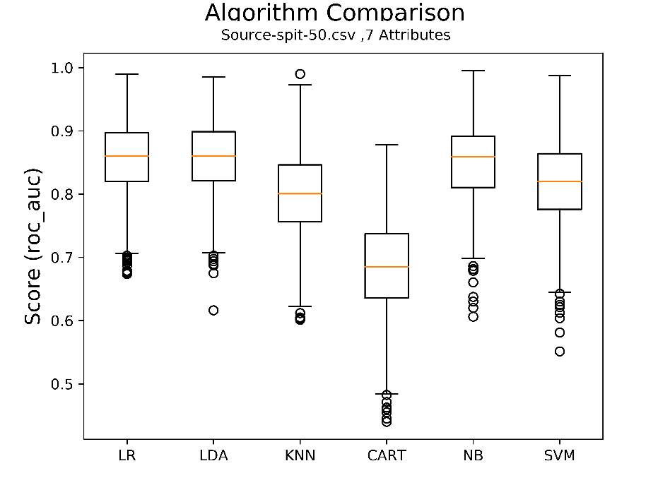
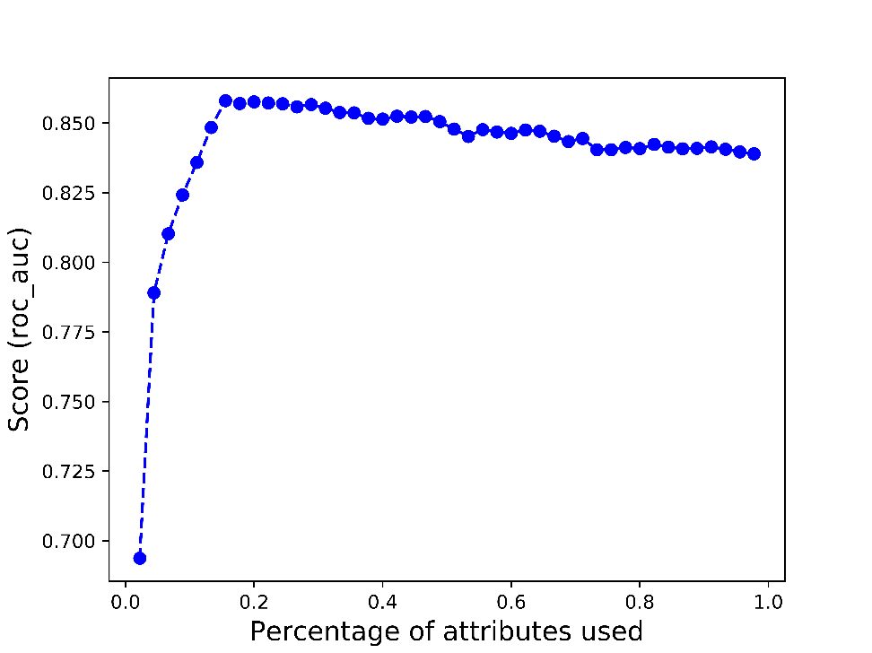
Algorithm Stages Stage 2/3 – Training
Working with given model list
Cross validation using chosen score method and repeat parameter (using multiprocessing)
Produce model compare box chart
Save the best one
Produce Attributes ratio vs. Score chart
Challenges
Executive Summary
Conclusions
End
Machine Learning
Beginning
Workflow
User Interface

Slide 15


Algorithm Stages Stage 3/3 – Testing
When we have suitable testing set
Testing the “best” model of the training data set on a suitable testing set
Saving the best trained model objects to files
Challenges
Executive Summary
Conclusions
End
Machine Learning
Beginning
Workflow
User Interface

Slide 16
Results

Slide 17
Results comparing, Weka vs. Python
Challenges
Executive Summary
Conclusions
End
Machine Learning
Beginning
Workflow
User Interface

Slide 18
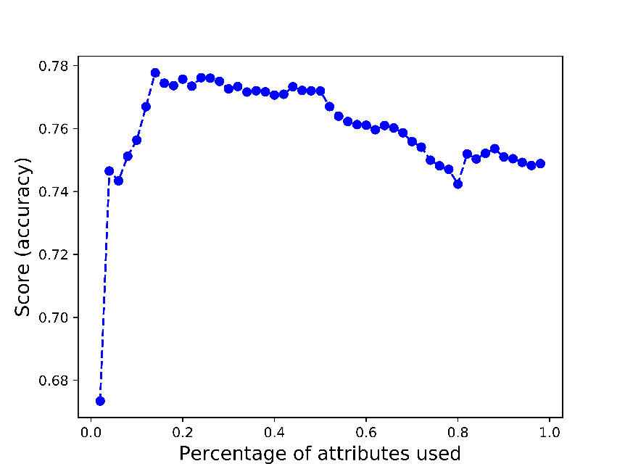
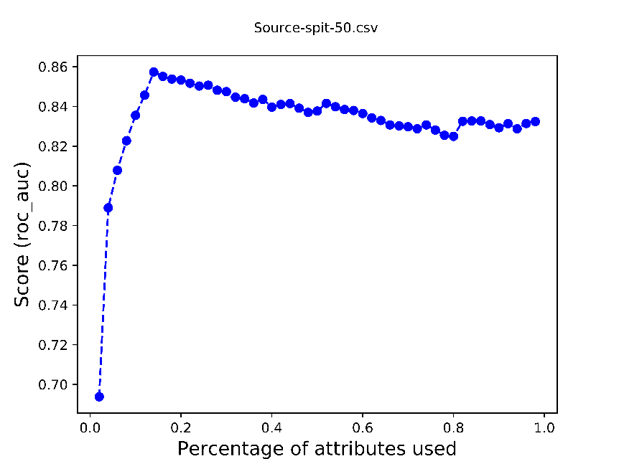
Attributes ratio vs. Score chart, Weka vs. Python
For Spit file

Slide 19
Feature Selection comparing, Weka vs. Python
For Spit file
Challenges
Executive Summary
Conclusions
End
Machine Learning
Beginning
Workflow
User Interface

Slide 20
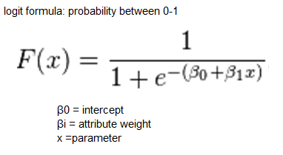

Logistic formula
For Spit file
Challenges
Executive Summary
Conclusions
End
Machine Learning
Beginning
Workflow
User Interface

Slide 21
User Interface

Slide 22
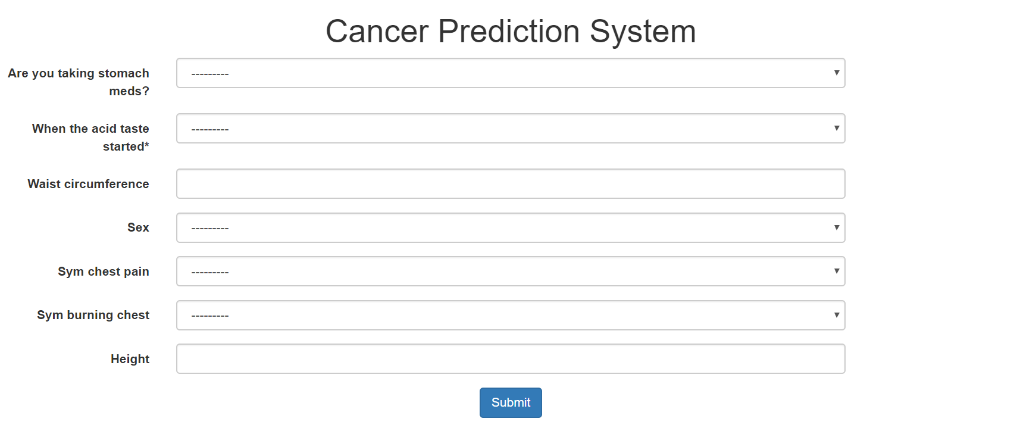



Web Prediction System
Python Django framework
JS, JQuery, Bootstrap, Ajax calls
Using the best model of each set
Show the prediction probability and model score for given form
Challenges
Executive Summary
Conclusions
End
User Interface
Beginning
Workflow
Machine Learning

Slide 23
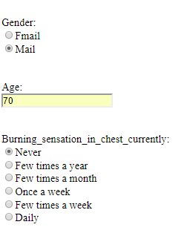
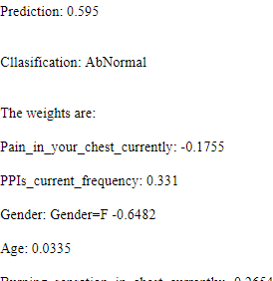
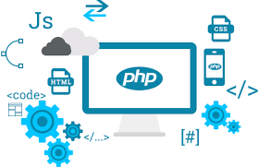
User interface HTML+PHP based website implementing the logit formula
Input Output
Challenges
Executive Summary
Conclusions
End
User Interface
Beginning
Workflow
Machine Learning

Slide 24
Conclusions

Slide 25
Conclusions
It is possible to classify with high accuracy based on those databases
It is possible to find key parameters with high effect on the classification type
It is reasonable to assume the system will work for other fields
An article should be published based on this results
Challenges
Executive Summary
User Interface
End
Conclusions
Beginning
Workflow
Machine Learning

Slide 26


