Slide 1



AdventureWorks_Report_backup
View in Power BI
Last data refresh:
7/2/2020 12:39:17 AM Eastern Standard Time
Downloaded at:
7/2/2020 12:44:58 AM Eastern Standard Time

Slide 2
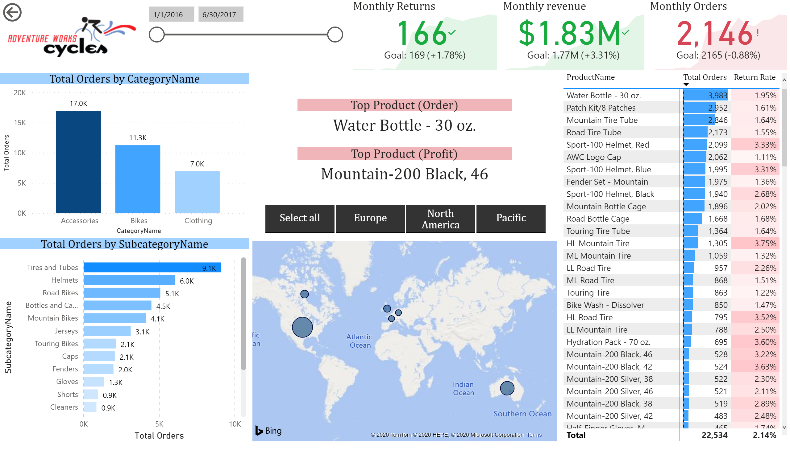

Slide 3
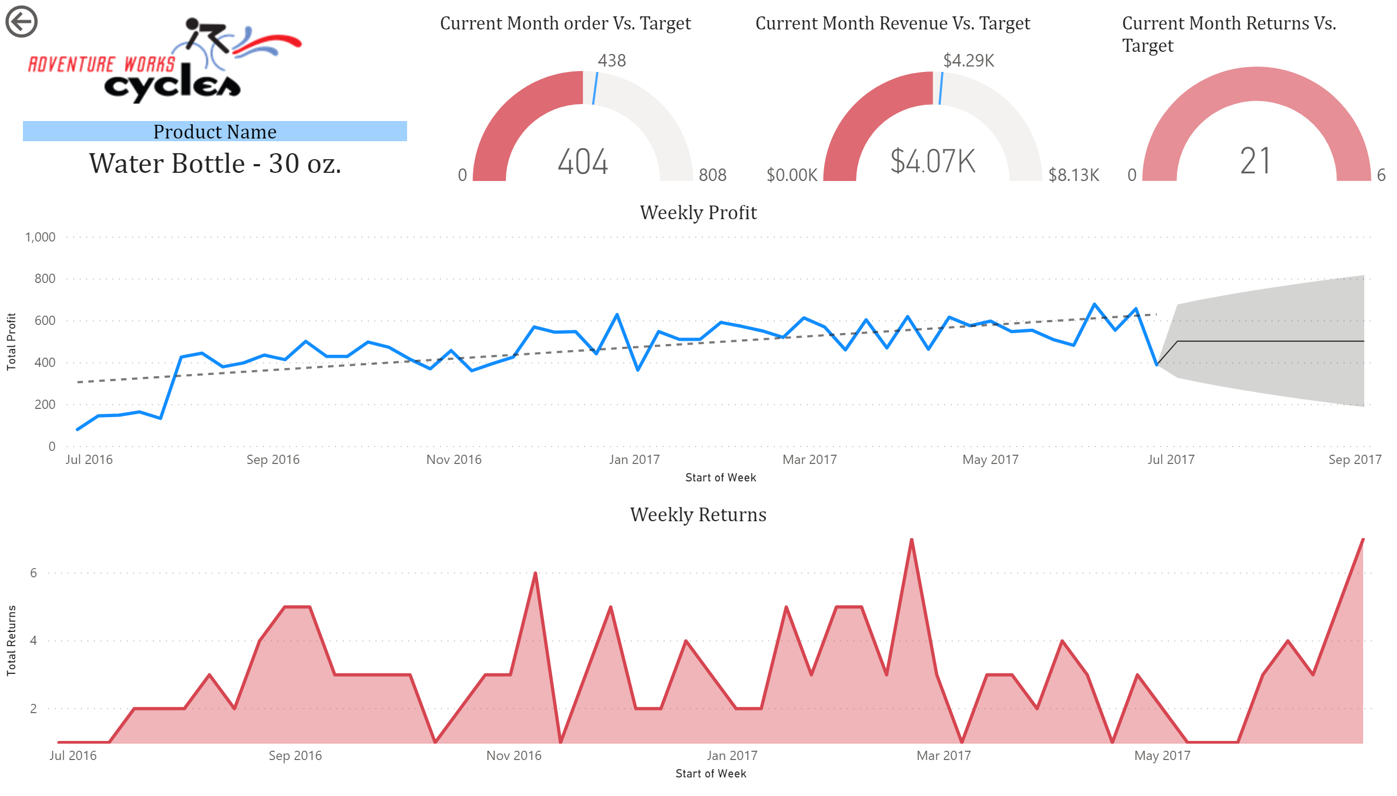

Slide 4
