Slide 1
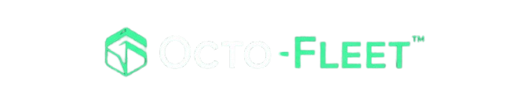
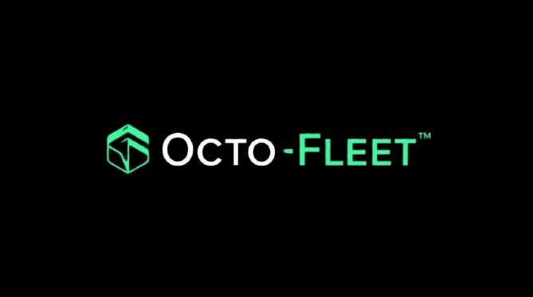
HYBRID DIGITAL TWIN
FOR PREDICTIVE MAINTENANCE
A low-cost web-based monitoring platform for 3d printing using digital twin technology for predictive maintenance

Slide 2
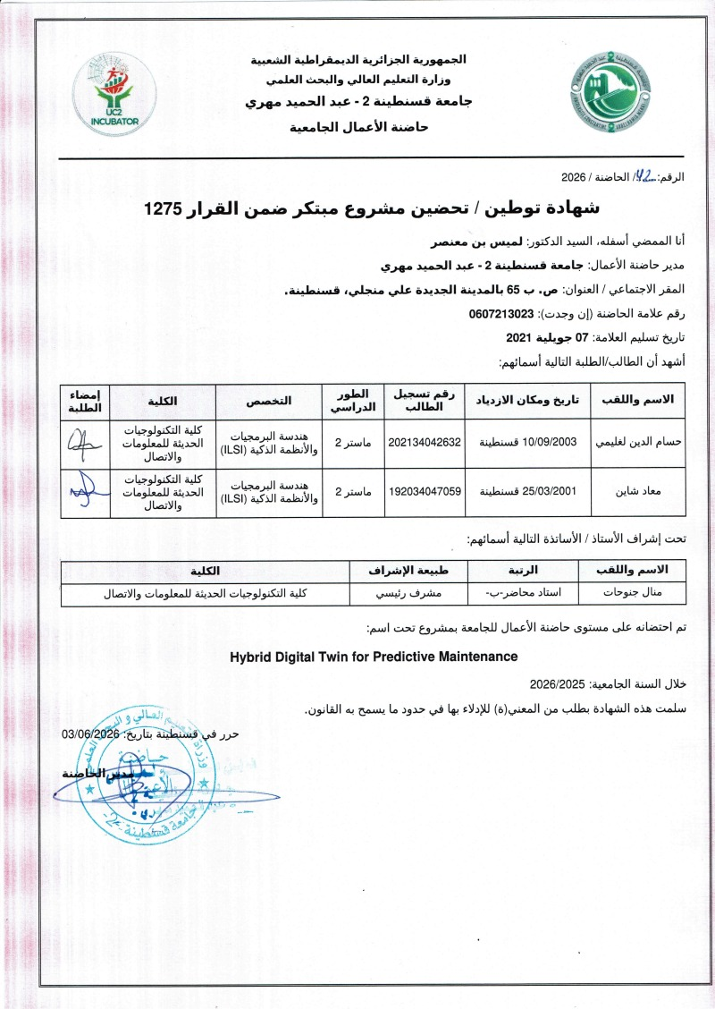
شهادة التوطين
[ Attestation Domiciliation Placeholder ]

Slide 3
OVERVIEW
TABLE OF CONTENTS
01
Problem Statement
07
Project Growth
02
Proposed Solutions
08
Costs
03
Added Value
09
Future Prospects
04
Innovation
10
Screenshots
05
Business Model Canvas
11
Our Team
06
Clients

Slide 4
01 — PROBLEM
FDM Problem
Every day, makers, engineering labs, and small businesses use FDM 3D printers to create prototypes, functional parts, and small production runs. However, printer failures remain a common problem. Unexpected breakdowns, failed prints, material waste, and machine downtime can lead to lost time and higher costs.
Most users still rely on reactive maintenance, meaning they only address problems after a failure occurs. This happens because desktop 3D printers often lack monitoring tools, and users have little visibility into the condition of their printers while a print is running.
As a result, makers, laboratories, and small businesses need a simple solution that can monitor printer health in real time, detect potential issues early, and help prevent failures before they happen. This would reduce downtime, minimize waste, and allow users to print with greater confidence and reliability.

Slide 5
01 — PROBLEM
FDM Problem
>20%
Common Failure Modes
Nozzle Clogging
Failure rate in real-world FDM use
Most critical failure mode
Overheating / Heat Creep
34%
Fan failure → fire risk
The current reactive maintenance model leads to costly downtime, wasted filament, and lost productivity. The blank area on the right suggests a space for proposing a predictive monitoring solution to address these specific failure modes.
Average material waste per failed print
Layer Shifting
Belt slippage, missed steps
Bearing Wear
Zero
Vibration increase over time
Monitoring built into most desktop printers
Belt Breakage
Detectable via vibration trends
Reactive maintenance = expensive downtime, wasted filament, lost productivity

Slide 6
02 — PROPOSED SOLUTION
Introducing Octo-Fleet
A web-based Hybrid Digital Twin platform for predictive maintenance of FDM 3D printers, built on top of OctoPrint.
"Octo" from OctoPrint · "Fleet" for multi-printer management
Real-Time Monitoring
Intelligent Failure Detection
Live machine data such as vibration, temperature, extrusion state in synchronized time with low latency
Multi-stage analysis pipeline for early anomaly detection and fault identification.
Browser-Native Dashboard
Low-Cost Hardware
No installation needed. Interactive 3D printer visualization runs in any web browser on the local network.
Affordable external sensor kit. No firmware modifications required.

Slide 7




03 — Added Value
Added Value
No firmware changes needed & affordable hardware makes predictive maintenance accessible to labs and businesses.
Health monitoring shows each machine’s condition instantly
Cost savings of
ruined prints, wasted filament
, hardware maintain cost
Fault alerts map directly to clear maintenance steps

Slide 8

04 — Innovation
Innovation
Octo-Fleet is the first 100% Algerian hybrid digital twin for predictive maintenance of FDM 3D printers. It combines live 3D visualization with smart failure detection inside a web browser. No installation & No firmware changes.
The system works from day one and gets smarter with every print. Low-cost hardware makes predictive maintenance accessible to labs, makerspaces, and small businesses. Alerts are reliable and easy to understand so no unnecessary warnings or confusing data.
With proven accuracy and less unplanned downtime, Octo-Fleet lets you print with confidence, save filament, and keep your machines running longer.

Slide 9
05 — Business Model Canvas
Business Model Canvas
KEY PARTNERS
KEY ACTIVITIES
VALUE PROPOSITION
CUSTOMER SEGMENTS
▸ Algerian universities / MESRS
▸ Sensor data acquisition
▸ 60–80% downtime drop
▸ Primary: universities & labs
▸ Digital twin modeling
▸ Saves costly filament
▸ Secondary: industrial SMEs
▸ Local 3D printer distributors
▸ ML failure prediction
▸ No cloud dependency
▸ Tertiary: print service bureaus
▸ Marlin/Klipper communities
▸ Pilot site deployments
▸ Low hardware cost
▸ Multi-Language support
▸ Sensor & edge hardware vendors
KEY RESOURCES
▸ Digital Twin AI engine
▸ Agnostic sensor layer
▸ FDM & ML expert team
COST STRUCTURE
REVENUE STREAMS
▸ Core team salaries & local server | Hardware sensor kits & travel | R&D fleet testing
▸ Annual subscriptions (per site) | Hardware kit & installation fees | Bank virement & "bon de commande"

Slide 10

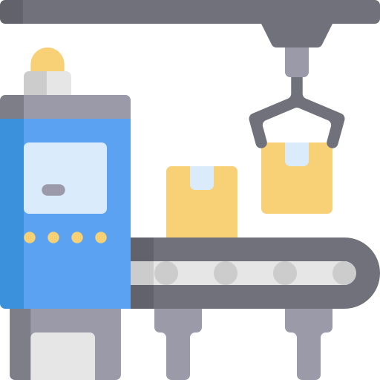



06 — Clients
Clients
Octo-Fleet serves anyone who relies on FDM 3D printers for work, research, or personal projects.
Individuals
Small print farms
Prototyping studios
Universities
& Laboratories &
Technical schools
Industrial
SMEs

Slide 11
07 — Project Growth
Project Growth
Now
Phase 2
Phase 3
Vision
Prototype
Multi-Printer Fleet
Cloud & Scale
Industry 4.0 Platform
Single BCN3D+ printer
Support stack of printers
Cloud-sync dashboard
Compatibility with any FDM printer
Ready from the start
Fleet health overview
Closed-loop auto-correction
Automated notifications
Web dashboard deployed
Amelioration predictive system
Auto-adjust
Part health monitoring
Low-cost installation
Vision-based monitoring
SaaS model for SMEs
Open-source community
Long-term: expand to SLA, SLS, and other manufacturing equipment — the first Algerian IIoT monitoring platform

Slide 12
08 — Costs
Costs
Administrative fees
Office rental
Legal & admin fees
IT tools & licenses
Technology infrastructure
Software development
Third-party services
Testing & calibration
Sensor kit hardware
Marketing
Ads
University events
Tech conferences

Slide 13
09 — Future Prospects
Future Prospects
M A R K E T P O T E N T I A L
Academia & Research Labs
Industrial SMEs
Regional Expansion
Universities in Algeria with FDM printers
SMEs in Algeria using 3D printing
wilayas targeted in 5 years
Partner with MESRS to deploy in engineering faculties and maker labs nationwide.
Provide affordable predictive maintenance to small manufacturers, prototyping shops, and local print farms..
First 100% Algerian IoT monitoring platform. Scalable to other technologies, and broader manufacturing equipment.
Target: launch in Algiers → expand to 58 wilayas in 5 years → become the first Algerian IIoT platform

Slide 14
Several Screenshots
USER APPLICATION

Slide 15
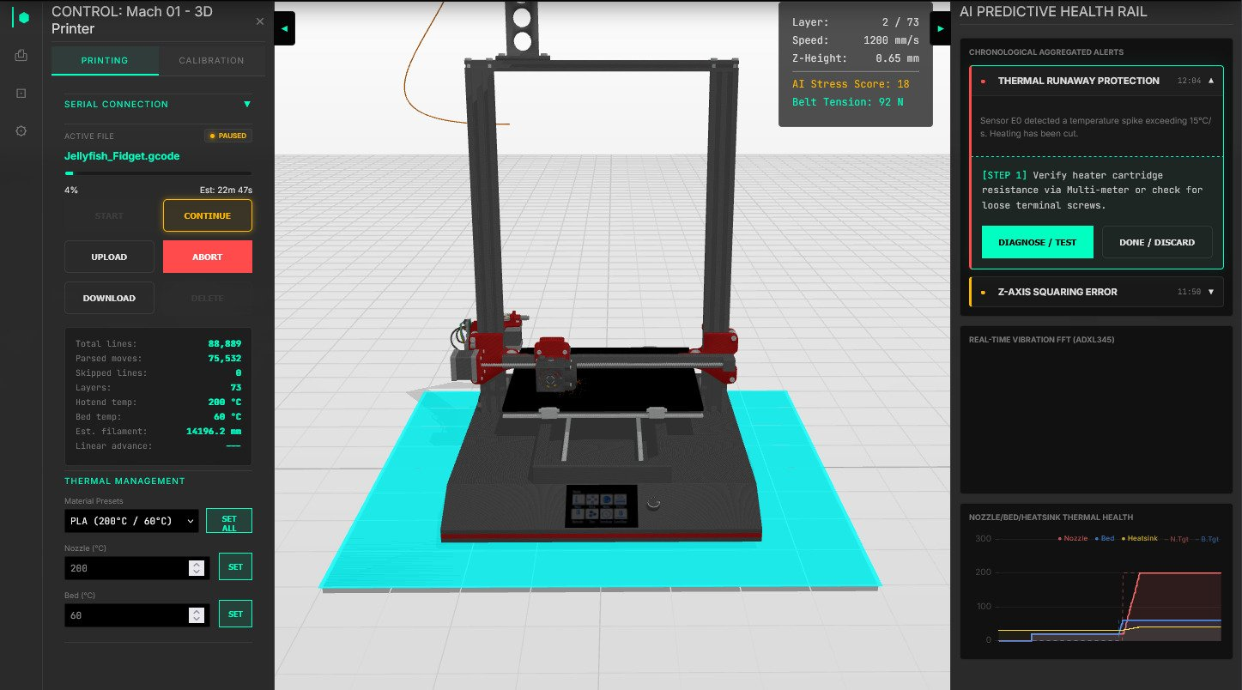
10 — SCREENSHOTS
Real-Time 3D Digital Twin Web Dashboard
◀ Printer Control Panel
Live 3D Twin Model ▲
AI Health Rail ▶

Slide 16
10 — SCREENSHOTS
Real-Time 3D Digital Twin Web Dashboard
Printer Control Panel
Start, stop, or upload a print. Monitor progress, estimated time, and filament usage
Print Status
Current and total layers
Real-time print speed
Current nozzle height
◀ Printer Control Panel
Live 3D Twin Model ▲
AI Health Rail ▶

Slide 17
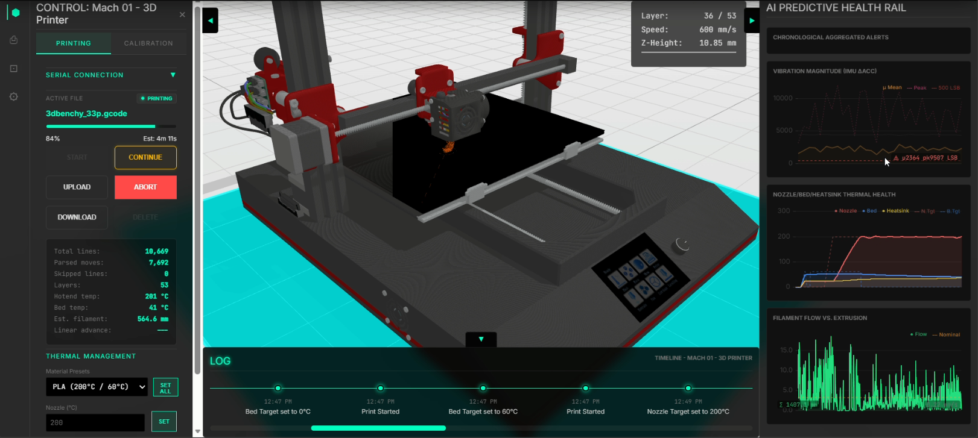
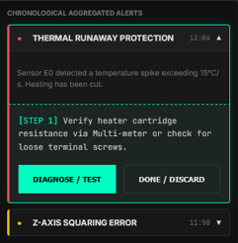
10 — SCREENSHOTS
Real-Time 3D Digital Twin Web Dashboard
Real-Time Alerts
Actionable warnings
Vibration Monitoring
Live graph showing printer vibration patterns
Thermal Health
Live temperature readings for nozzle, bed, and heatsink. Spot overheating before it fails.
Filament Flow
Actual filament usage compared to expected extrusion. Detects clogs or slipping immediately.
◀ Printer Control Panel
Live 3D Twin Model ▲
AI Health Rail ▶

Slide 18
10 — SCREENSHOTS
Real-Time 3D Digital Twin Web Dashboard
Live 3D Printer Model
What happens on the real printer happens on screen so instantly in 3D from any angle
◀ Printer Control Panel
Live 3D Digital Twin Model ▲
AI Health Rail ▶

Slide 19
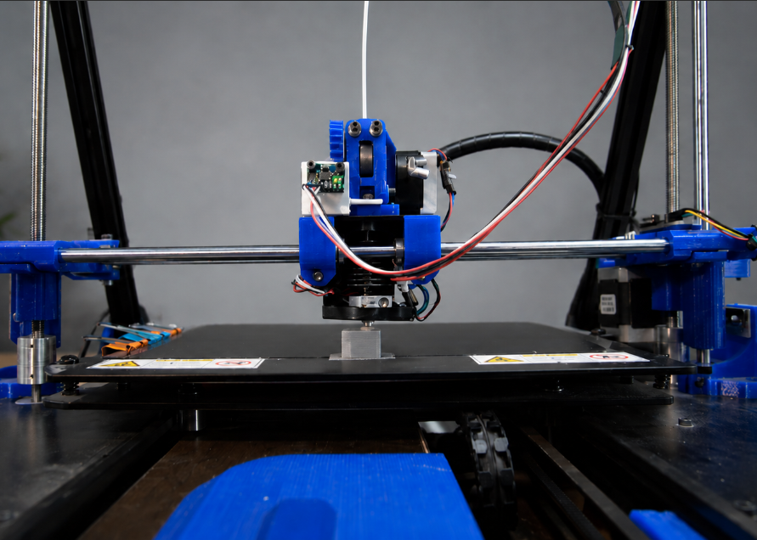
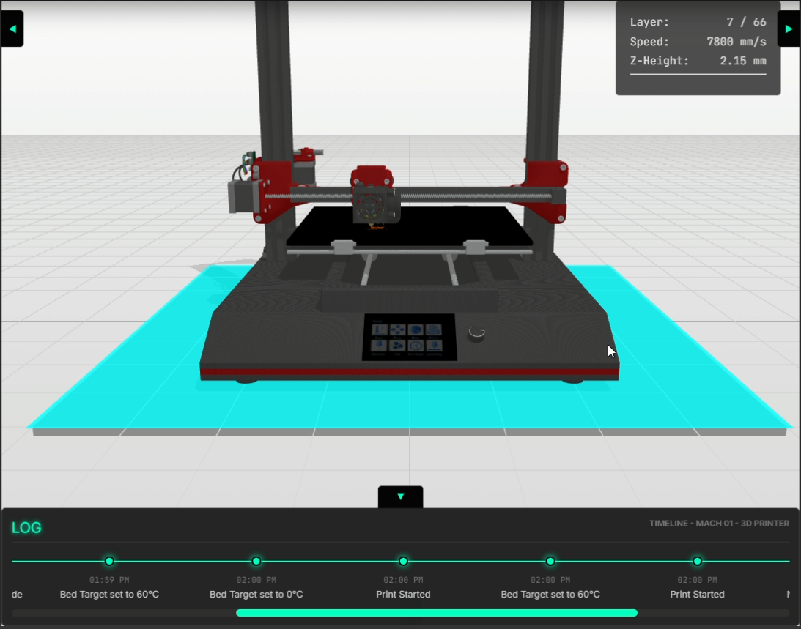
10 — SCREENSHOTS
Live 3D Printer Monitoring
Live Dashboard shows synchronization between Physical Printer and 3D Digital Twin Model
[ Screenshot Placeholder ]
[ Screenshot Placeholder ]
Physical Printer
Digital Twin

Slide 20
11 — OUR TEAM
University, Labels & Team
🏛 University of Abdelhamid Mehri — Constantine 2
🏆 Label
Faculty NTIC · Dept. Fundamental Computing (IFA)
Option: Software Engineering & Smart Systems (ILSI) · Master's Thesis 2026
University of Constantine 2
incubator
L
D
C
LEGHELIMI Houssem eddine
DR. DJENOUHAT Manel
CHAIN Mouadh
Developer
Supervisor
Developer
Master 2 — Computer Science
System architecture & ML pipeline
Doctorate — Lecturer-Researcher
University of Constantine 2
Master 2 — Computer Science
IoT, sensors & web dashboard

Slide 21
Thank You
Octo-Fleet
Hybrid Digital Twin for Predictive Maintenance
University of Constantine 2 · NTIC Faculty · June 2026

