Slide 1
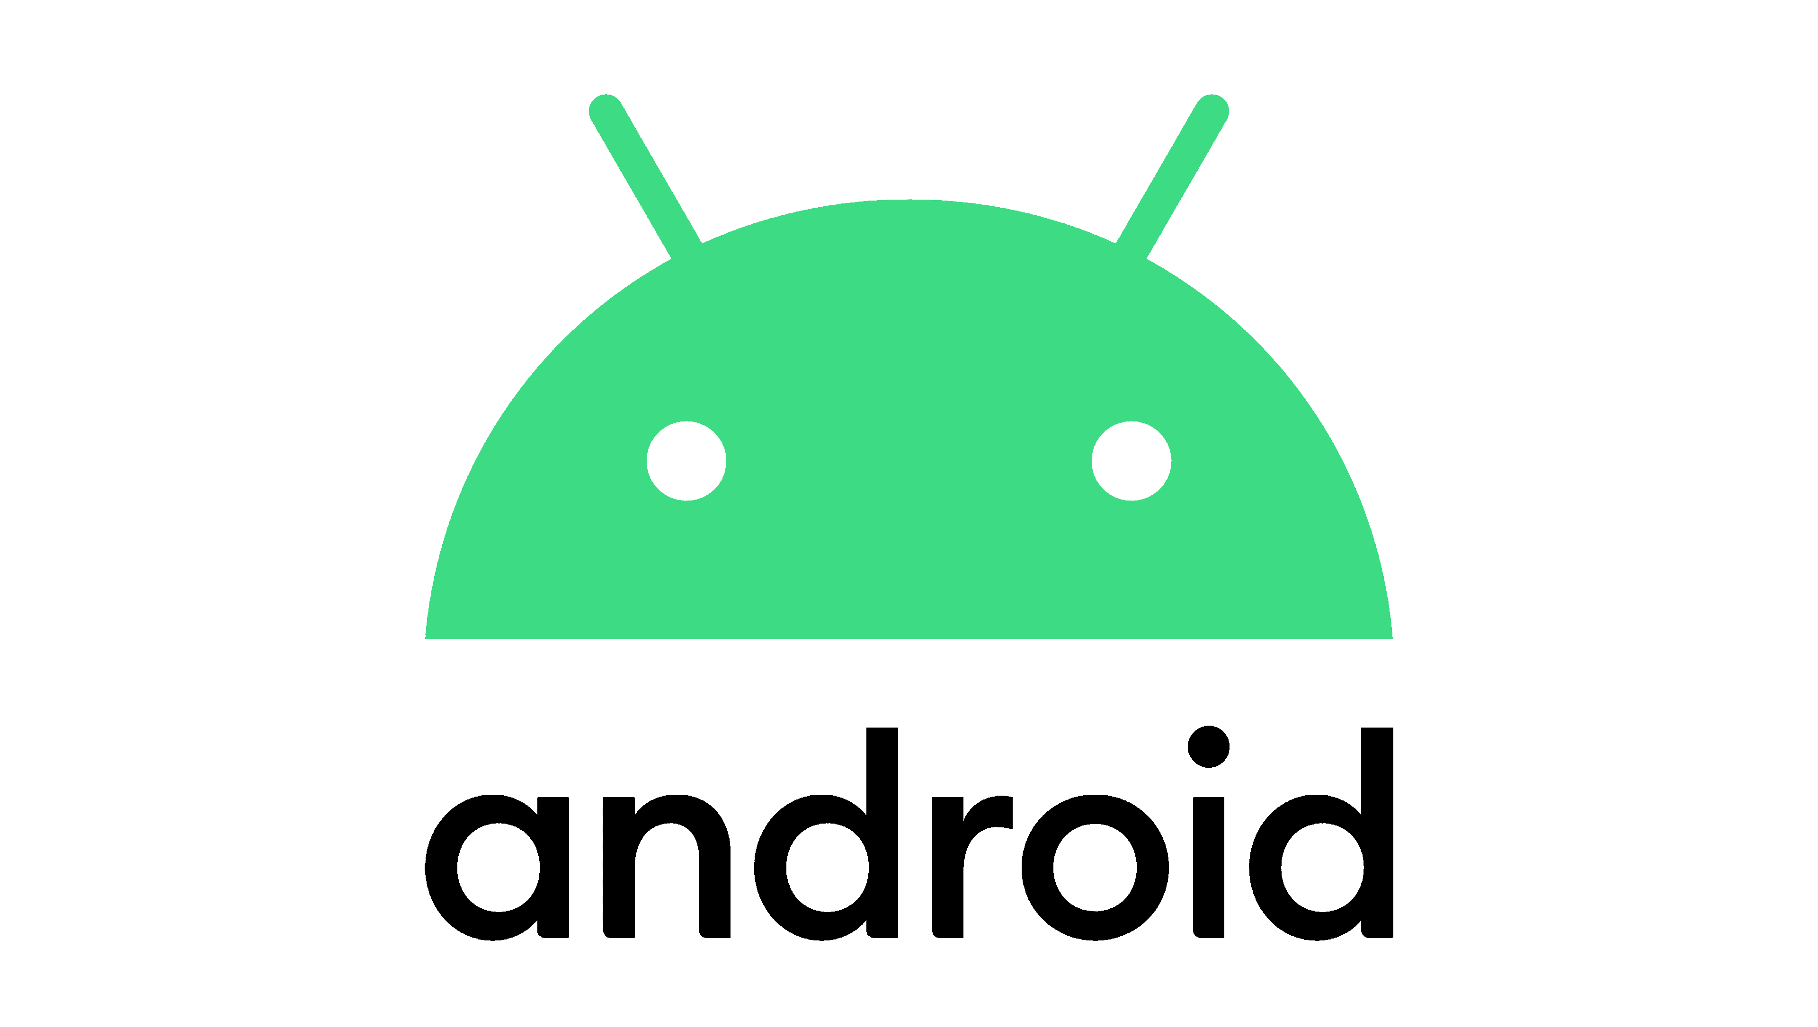
2 500 000 000
Android is the most popular operating system in the world, with over:
billion active users spanning over 190 countries.

Slide 2
Android Native App developement
BY ANDROID LAB
INTRODUCTION TO ANDROID

Slide 3
Table of contents
01
02
03
04
Android Overview
Android Stack
Android SDK
Android Studio
05
Android Apps
How Android looks from the insid
System apps
User apps
Building our app
Develop
run & debug
testing and monitoring
Introduction to android
user interaction and sensors
Versions
Developement tools
Libraries
Virtual devices
Documentation

Slide 4
Android
Is a Mobile Operating System based on a modified version of the LINUX KERNEL.
It is free and open-source software. It’s source code is know as Android Open Source Project (AOSP).
In October 2003 Andy Rubin, Rich Miner and Nick Sears, founded android and began as a project of the American Technology Company Android Inc. To develop an Operating system fir Digital Cameras.
In 2004 the Project changed to become an Operating System for Smartphones.
in August 2005 , GOOGLE acquired Android. Since then it is in the subsidiary of GOOGLE.
in 2007 Google Announces the developement of Android OS.
In September 2008, HTC launched the first Commercial Android device with Android Version 1.6
Currently Android is Owned by GOOGLE.

Slide 5
Android Stack
System Apps
User Apps
Android Api Framework (SDK)
Native C/C++ Libraries
Android Runtime
Hardware Abstraction
Layer (HAL)
Linux Kernel

Slide 6
Android SDK

Slide 7
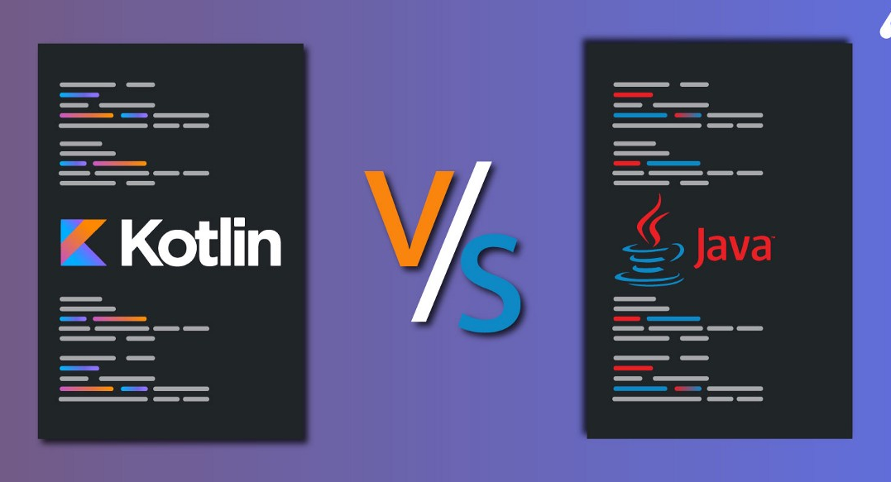
Programming languages:
Android SDK

Slide 8
Question 1 : native app dev vs cross plateform app dev
Questions

Slide 9
Question 2 : Android vs IOS Dev
Questions

Slide 10
Question 3 : Android vs Web Dev
Questions

Slide 11
Android Studio

Slide 12
Thanks!
Do you have any questions?
EMAIL : m_keziz@estin.dz

