Slide 1
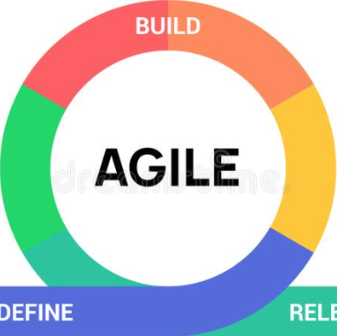
Agile Methodology
Presented by:
Abdelati Moufid

Slide 2
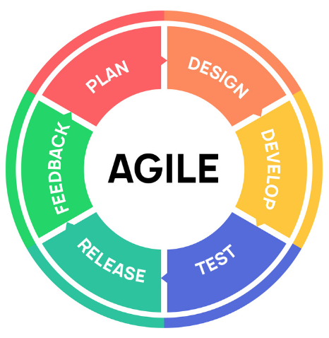
Contents
Definition
Manifesto
Characteristics
Existing Methods
Agile’s Rise
Advantages
Disadvantages
Summary

Slide 3
Definition
1

Slide 4
Agile is an iterative approach to project management and software development that helps teams deliver value to their customers faster and with fewer headaches. Instead of betting everything on a "big bang" launch, an agile team delivers work in small, but consumable, increments..

Slide 5
Manifesto
2

Slide 6
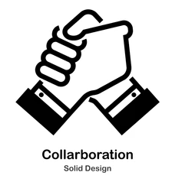


Manifesto
Individuals & Interactions.
Working Software
Customer Collaboration
Responding to Change

Slide 7
Characteristics
3

Slide 8
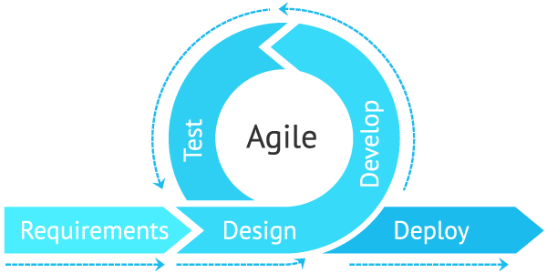

Slide 9
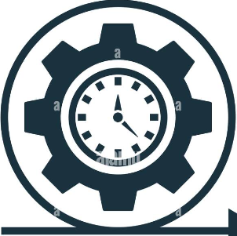
Characteristics of Agile Software Development
Agile development releases and fixed-length iterations.
Small teams.
Changing requirements.
Changing techniques.
Lean Development e Crystal.
Relative estimation.

Slide 10
Existing Methods
4

Slide 11
Existing Methods of Agile
Extreme Programming.
Agile Unified Process.
Scrum.

Slide 12
Agile’s Rise
5

Slide 13
Agile’s Rise
Serialized Process.
Planning far in advance.
Lack of Visibility.
Project Timeline.
Static Requirements.

Slide 14
Advantages
6

Slide 15
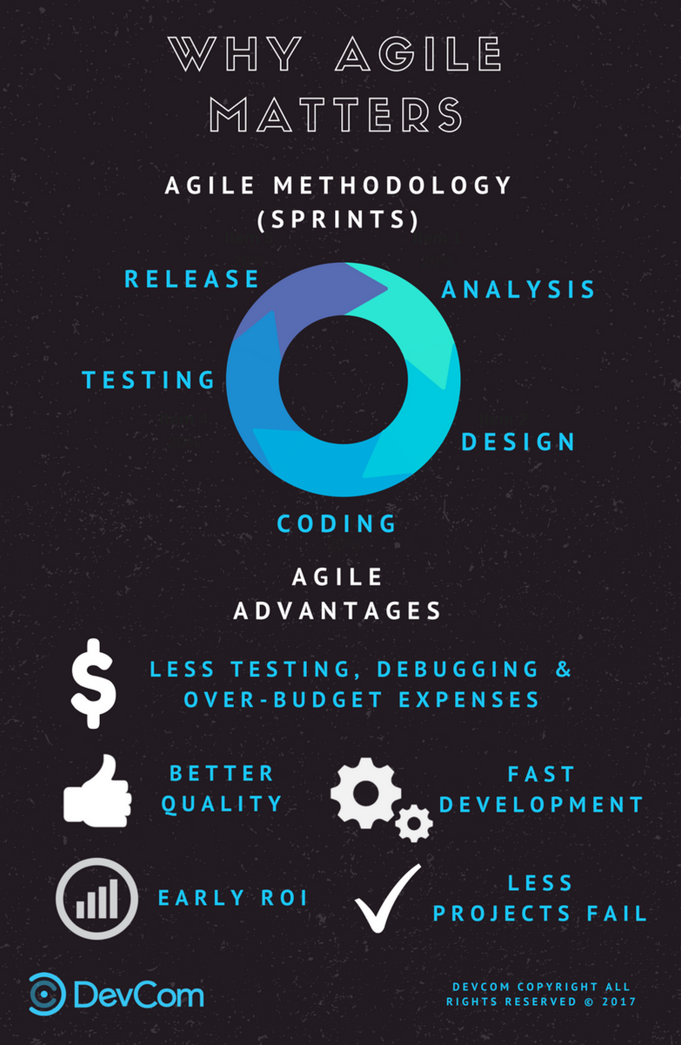

Slide 16
Advantages
Superior Quality Product.
Customer Satisfaction.
Better Control.
Improved Project Predictability.
Reduced Risks.
Early and Predictable Delivery.
Improves Quality

Slide 17
Disadvantages
7

Slide 18
Disadvantages
Poor Resource Planning.
Limited Documentation.
Fragmented Outputs.
No Finite End.
Difficult Measurement.

Slide 19
Summary
8

Slide 20
Summary
Agile methodologies are not best suited for all projects. When communication between the developer and the customer is tough, or when the development team does not have experienced developers, Agile Methodologies will not give the best results. These methodologies exhibit optimal results when there is a strong communication process between the developer and the customer, and the development team compromises skilled team members. When there is a chance for misunderstanding the accurate customer requirements, or when the deadlines and budgets are tight, then Agile methodologies are the most optimal approach for a business solution.

Slide 21
Thanks!

