Slide 1

Chapter 1:
Introduction_
Understanding Arguments
Instructor: Dr. Amina Gaye
E-mail: amina.gaye@uam.edu.sn
Semester: 1
Academic Year:
Year:

Slide 2
Chapter 1 Objectives
Week 2
Focus on Writing
1. Understand the purpose of argument
3. Create good thesis statements
4. Understand your audience
Grammar for writing & Vocabulary in context

Slide 3
Getting Started
Work in pairs and discuss.
1) What does arguing mean to you?
3) Do you argue a lot?
3) When and where do you usually argue?

Slide 5
Remember!
An argument is not a quarrel
An academic argument is not a fight
Argument is not propaganda
To be suitable for argument, your research question must be debatable
It is a mistake to think that all arguments have just 2 sides. To thoroughly examine the issue, you would have to consider it from a number of angles.
An argument takes a stand and presents evidence that helps to convince people to accept the writer’s position.

Slide 6
What is an Argumentative Essay?
The purpose of an argumentative essay is to present well-reasoned conclusions in order to persuade the audience to accept or at least seriously consider a point of view.

Slide 7
Why assign an argument in college?
To encourage you to develop and defend a position on a topic
To help you learn to look closely at your own and other people’s ideas
To give you the tools you need to convince others of the validity of your ideas
To help you learn to mediate or resolve conflicting points of view

Slide 8
Writing an argument
Think about what makes the issue you have chosen a good or bad thing? Right or wrong?
What makes it important? (i.e. so what? Why does it matter?) = impact
In the debate about the topic, what positions are the various experts arguing? What convinces you, and why? Where would YOU sit in the debate, between 0 and 10?
(Of course, your position will shift as you research)
Take a stand and clarify your thesis statement.

Slide 9
BRAINSTORMING A TOPIC

Slide 10
Criteria
Difference between a topic and an issue Ex: Education Women and college (Should women go to college?)
For this assignment, you need to choose an issue
The issue needs to be controversial (debatable)

Slide 11
Examples of controversial issues
Should women go to college?
Should animals be kept in cages?
Should the minimum wage in Senegal be raised?

Slide 12
Activity 1
In groups, brainstorm ideas for a controversial issue.
Think about your community (family, class, neighborhood, etc.)
Think about something you would like to change in your community
If possible, think about something related to your field of study (economy, finance, business, etc.)

Slide 13
WRITING A THESIS STATEMENT

Slide 14
What is a thesis statement?
  A sentence in the opening paragraph of the essay, which tells the reader the main idea of the paper overall.
  For an argumentative essay, it is a statement which expresses the writer’s position on a specific issue or topic. It is basically the answer to your research question.
  It is also an arguable claim and should have an antithesis, in other words, a statement which states the opposite point of view.
  THESIS: University campuses should go ‘green’
  ANTITHESIS: University campuses should not go ‘green’. (Exact Opposite)

Slide 15
Narrowing Down Your Thesis
Ex: Drug use is detrimental to society.
What is included in the category ‘drugs’?
Medication?
Illegal?
Recreational?
In what ways are drugs detrimental?
Economy to decline?
Cause death?
Violence?
Change the moral climate?
What does the author mean by society?
Adults?
Children?
Young people?

Slide 16
Effective Thesis Statement
An effective thesis statement should not be too broad, too narrow or vague. It has to be specific.
Drug use is detrimental to society.
Illegal drug use is detrimental because it encourages gang violence. (More manageable)
Formula:
Thesis = Subject + Opinion

Slide 17
Identifying a good thesis statement
  Good thesis statements should ANSWER YES to the following questions:
  Does it have an arguable conclusion which reasonable people could disagree with?
  Is the assertion more than simply your opinion?
  Is it specific rather than vague? Appropriate scope? (It must be clearly expressed without ambiguity)
  Does it give the reader a guide / map to the argument or organization of your essay?
  Is it written in the 3rd person? (not the 1st person ‘I’ or ‘me’)

Slide 18
Activity 1
Which of these sentences follow the criteria for effective THESIS STATEMENTS?
‘Practice with Persuasive Thesis Statements’

Slide 19
Activity 2
Look at these thesis statements. See handout (identifying TS Problems)
-What is the problem with them?
-Rewrite them to improve their persuasiveness.

Slide 20
Homework
Create a thesis statement for next class to share on the discussion board for feedback.
Each student to give feedback to at least 2 students.
Identify one strength and one area to work on that is evident from the feedback received.

Slide 21
Understanding the audience…
In most cases, assume that the reader is skeptical; meaning they have open minds but still need to be convinced.
Since your topic is controversial, you should assume that some of your readers will not support your position (and may be hostile to it).
Your goal is to make the reader more receptive towards your position or at least to get them to admit that you have a good case even though they may disagree with you. Convince those who are neutral.

Slide 22
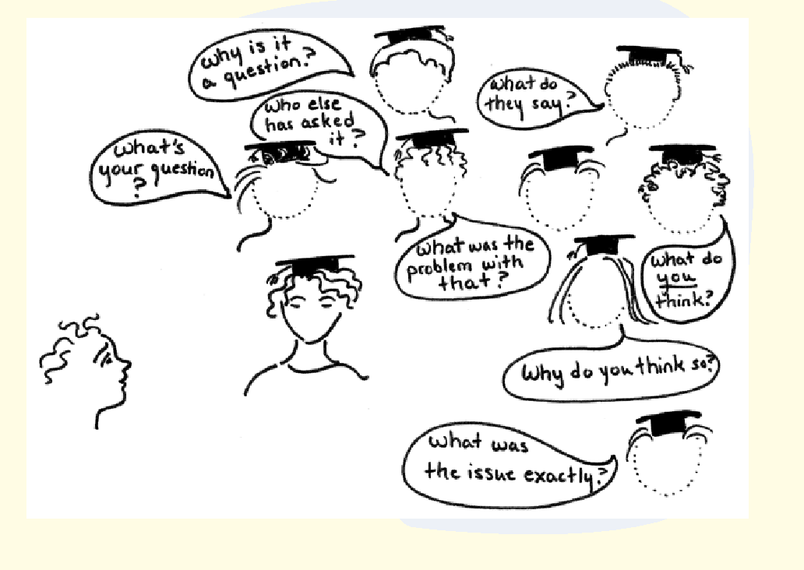

Slide 23
Considering your audience
Ask yourself how will/might your audience respond to your thesis statement?
Practice activity 1: How different audiences might respond
List the different audiences you are trying to convince
Divide them into 3 groups (positive, neutral, hostile)
Thesis Statement: ----------------------------------
What argument do you plan to put in each category to convince that target audience?

Slide 24
Gathering Evidence
You NEED to collect evidence. You will use both facts and opinions to support your points and build a convincing argument.
-Therefore, knowing and understanding the difference is important.
FACT – Is a statement that can be verified or checked (proven to be true).
OPINION – Is a personal judgement. Opinions are subjective and can be debated. However, the value of different people’s opinions can vary. The more knowledgeable a writer, the more credible his/her opinion.

Slide 25
Kinds of Evidence
FACTS
Drexel University has solar-powered recycling and litter receptacles.
Cambridge University has had a top 5 QA ranking for the last 10 years.
SUPPORTED OPINIONS
The University encourages students to live a ‘green’ lifestyle but does little to help them achieve this. It has no separate waste bins for paper, plastic and bottles.
UNSUPPORTED OPINIONS
Sustainability should be a top priority on university campuses.
Climate change is not taken seriously by many countries & their governments.

Slide 26
Evaluating Evidence From Sources
  Remember the sources used to support your main points must be reliable and therefore need to be evaluated according to the CRAAP criteria:
  C = Currency (when was it published / how old is it?)
  R = Relevance (how related is it to your topic?)
  A = Authority (what qualifications does the writer have?)
  A = Audience (who is it written for)
  P = Purpose (why was it written?)
  Use reliable sources: FCHS library databases, Google scholar, etc.

Slide 27
Activity 2
What evidence might you use to support your thesis statement?
Ensure it is:
Accurate= from reliable sources
Relevant= applies to the topic under discussion
Representative = fair range of sources
Sufficient = enough facts, statistics, etc.

Slide 28

Any Questions???

Slide 29
Reference
Kirszner, L.G.; S. Mandell. (2011). Practical Argument. Boston Bedford/St. Martin’s.

