Slide 1
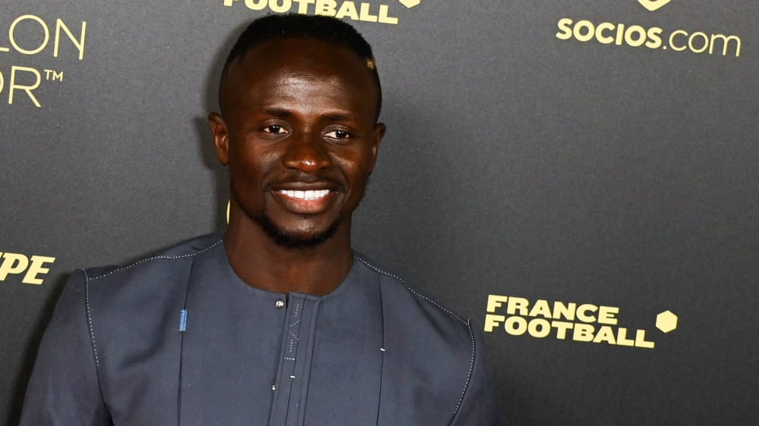
Sadio Mane’s Success Story
Plan
Abdoulahi Top
Mouhamed Samb
Papa Gaydel Gaye
Henry Moustapha Ngom

Slide 2
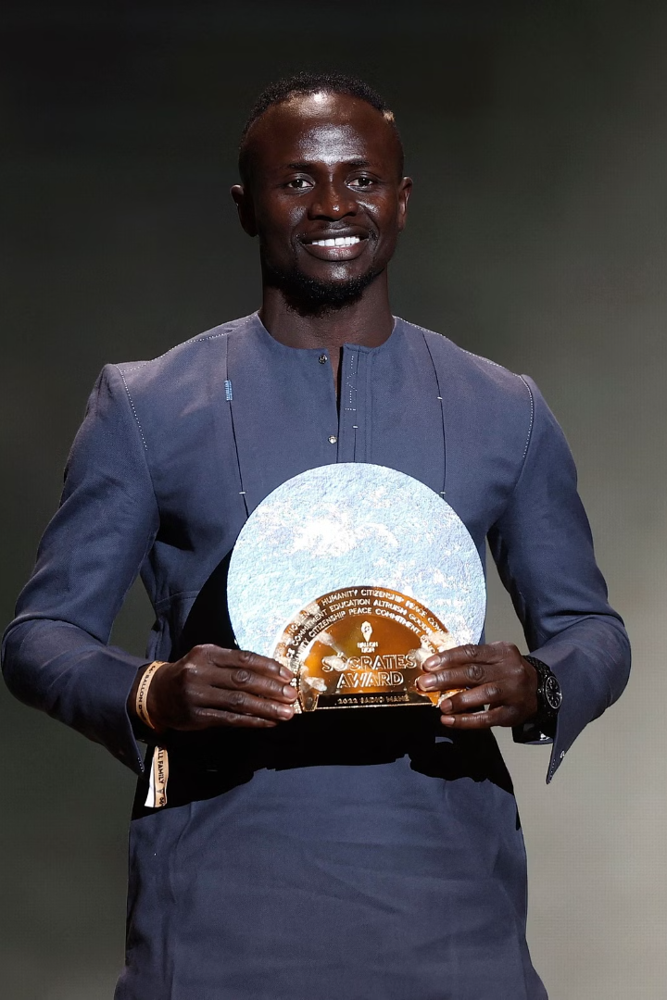
Sadio Mane: From Bambali to Global Icon
The story of Sadio Mane is an epic of talent, perseverance, and generosity. From a remote village in Senegal, he conquered Europe's stadiums. He inspired a generation through exceptional talent. He showed unwavering commitment to his community. His journey illustrates how passion and hard work can transform dreams.

Slide 3
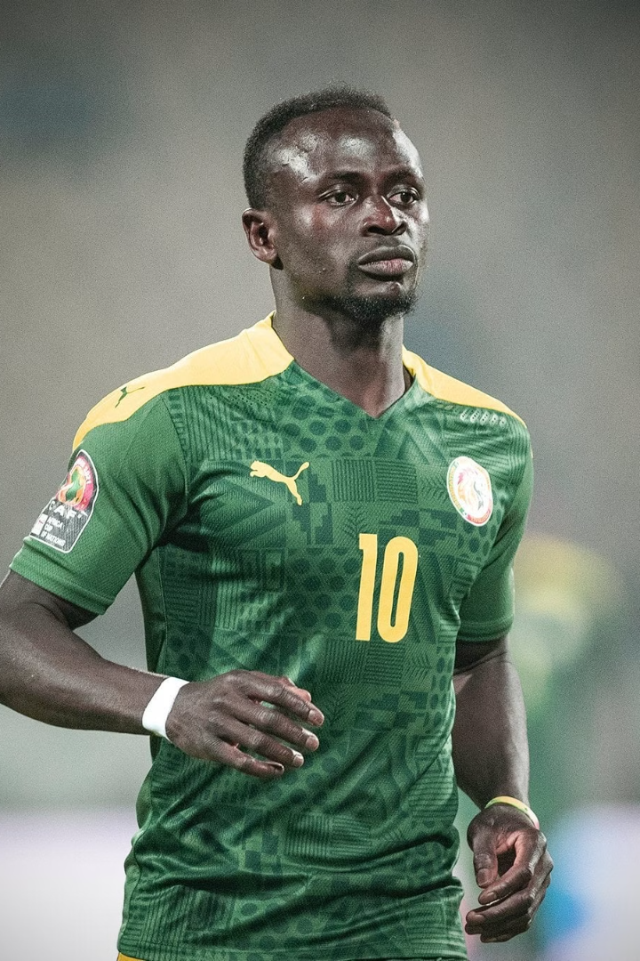
Youth and Dreams Forged in Senegal
Humble Beginnings
Passion for Football
Born in Bambali, Senegal, Mane grew up in a religious household.
His love for the game started from a young age, playing barefoot.
Leaving for Dakar
At 15, he left his village for Dakar to pursue his dream.

Slide 4
Beginning of the European Adventure
FC Metz
Red Bull Salzburg
In 2011, Mane joined FC Metz in France. This marked his start in European football.
In 2012, he transferred to Red Bull Salzburg. Here, his potential truly exploded.
Despite challenges at Metz, his talent shone. At Salzburg, he became a key player. He contributed to a historic double, winning the league and cup.

Slide 5
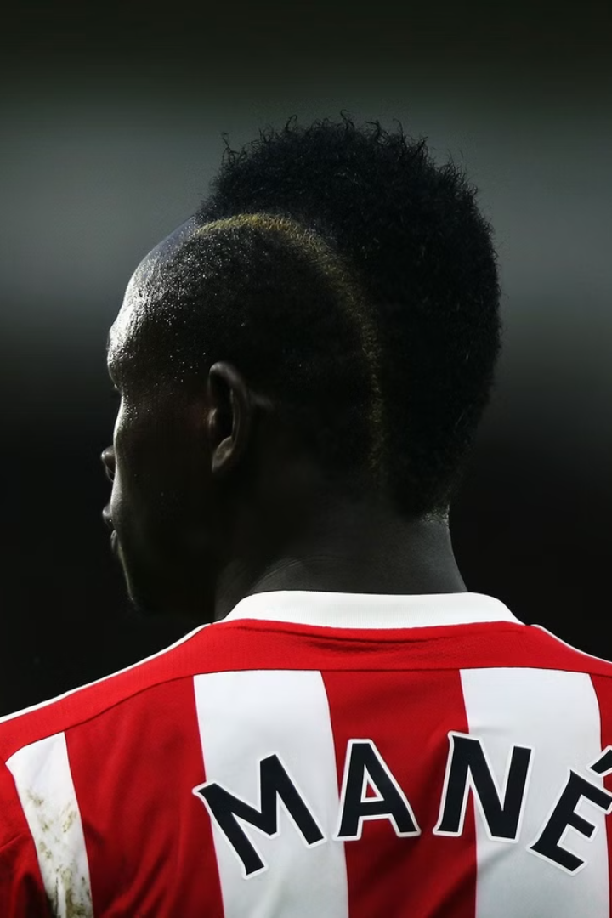



Breakthrough in the Premier League
Blistering Speed
Dazzling Dribbling
Crucial Goals
Mane joined Southampton in 2014. His impact was immediate. He set a Premier League record with a hat-trick in 2 minutes and 56 seconds. He became one of the league's most exciting players.

Slide 6
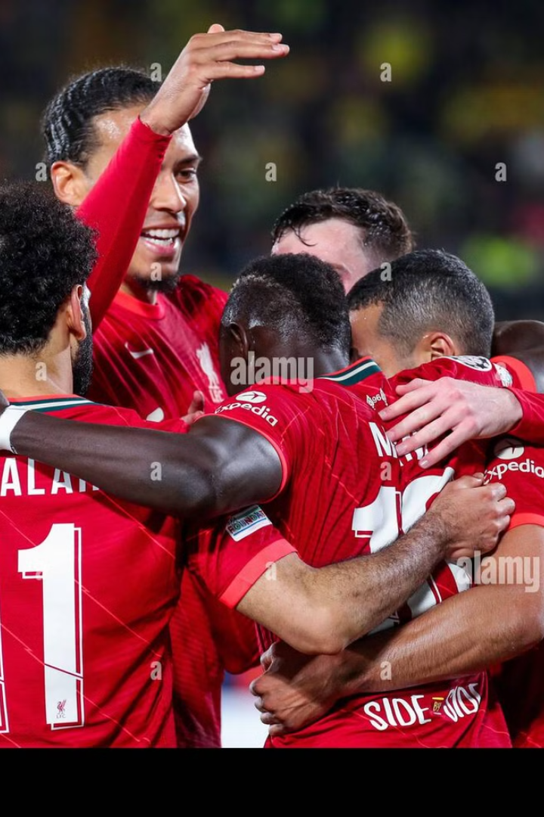



Legend of Anfield
Formidable Trio
Formed with Salah and Firmino, named the "Fab Three".
Premier League Title
Won in 2019-2020, ending a 30-year wait.
Champions League Victory
Won in 2019 against Tottenham.

Slide 7
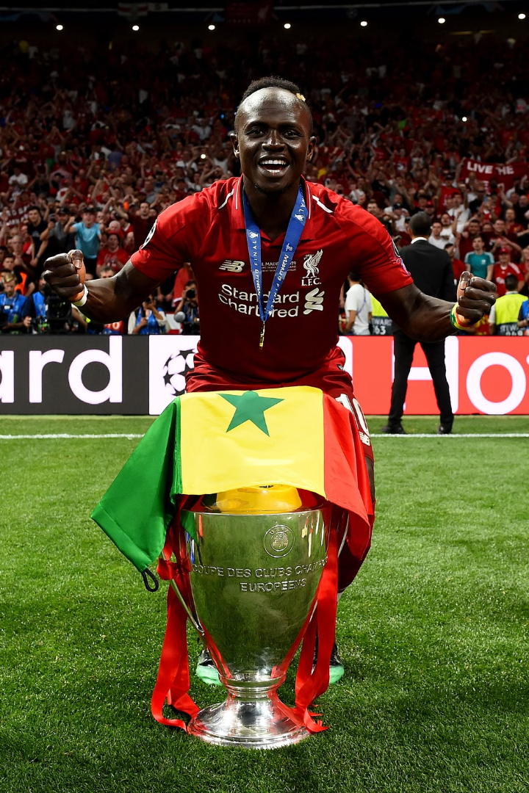
Trophies and Recognition
Club
Competition
Year
Red Bull Salzburg
Austrian Bundesliga
2013-2014
Liverpool
Premier League
2019-2020
Liverpool
UEFA Champions League
2018-2019
Bayern Munich
Bundesliga
2022-2023
Mane's career is marked by numerous trophies. He won the African Footballer of the Year twice. He has been selected multiple times in the PFA Team of the Year. He led Senegal to its first Africa Cup of Nations victory.

Slide 8
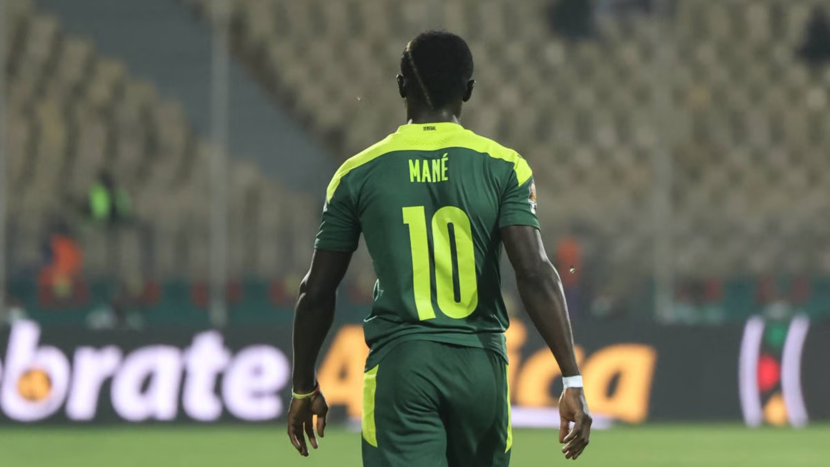
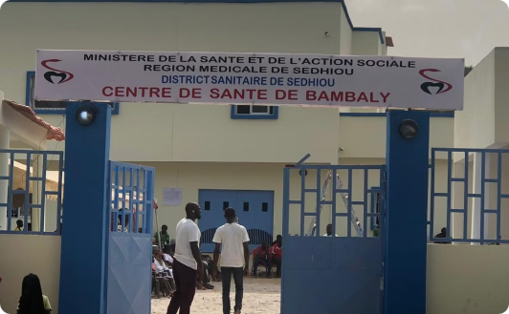

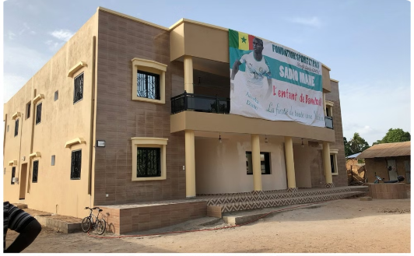

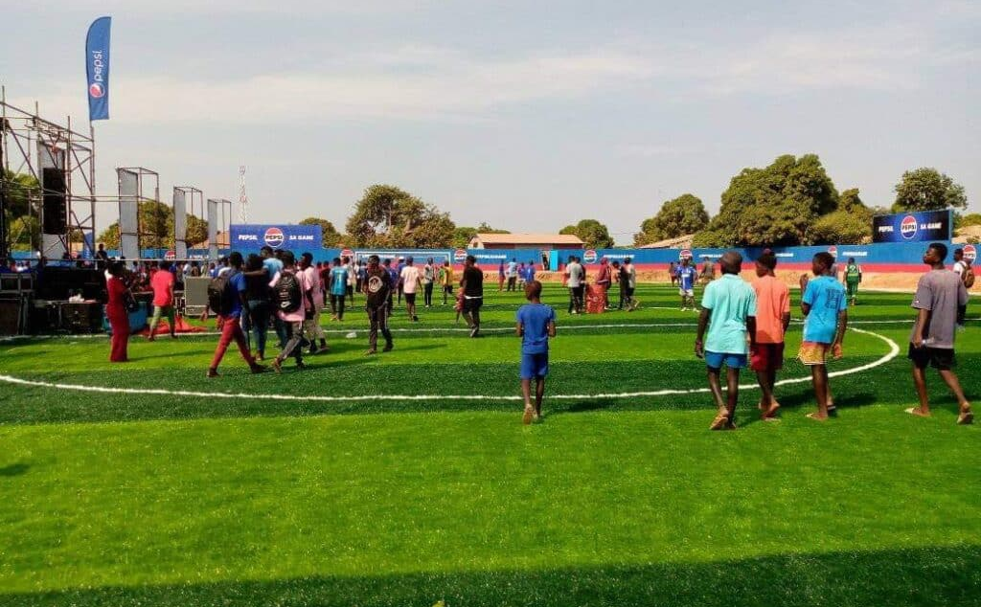

Beyond the Pitch: A Philanthropic Heart
Built a School
Donated to build a school in Bambali.
Built a Hospital
Offered funds for a hospital.
Built a Stadium
Built a mini-football stadium.

Slide 9
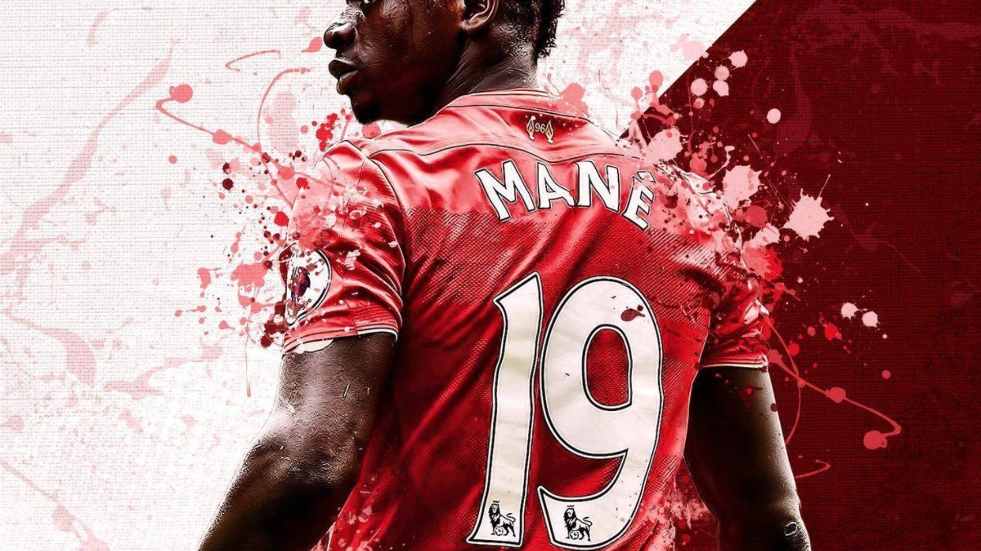



A Beacon of Hope
National Pride
2
Impacts national pride in Senegal.
Inspiration
1
Inspires young African players.
Global Role Model
3
Breaks barriers for African players.
Sadio Mane is an inspiration for young African players. His success has a profound impact on national pride. His humility makes him a global role model. His legacy is one of excellence and generosity.

Slide 10
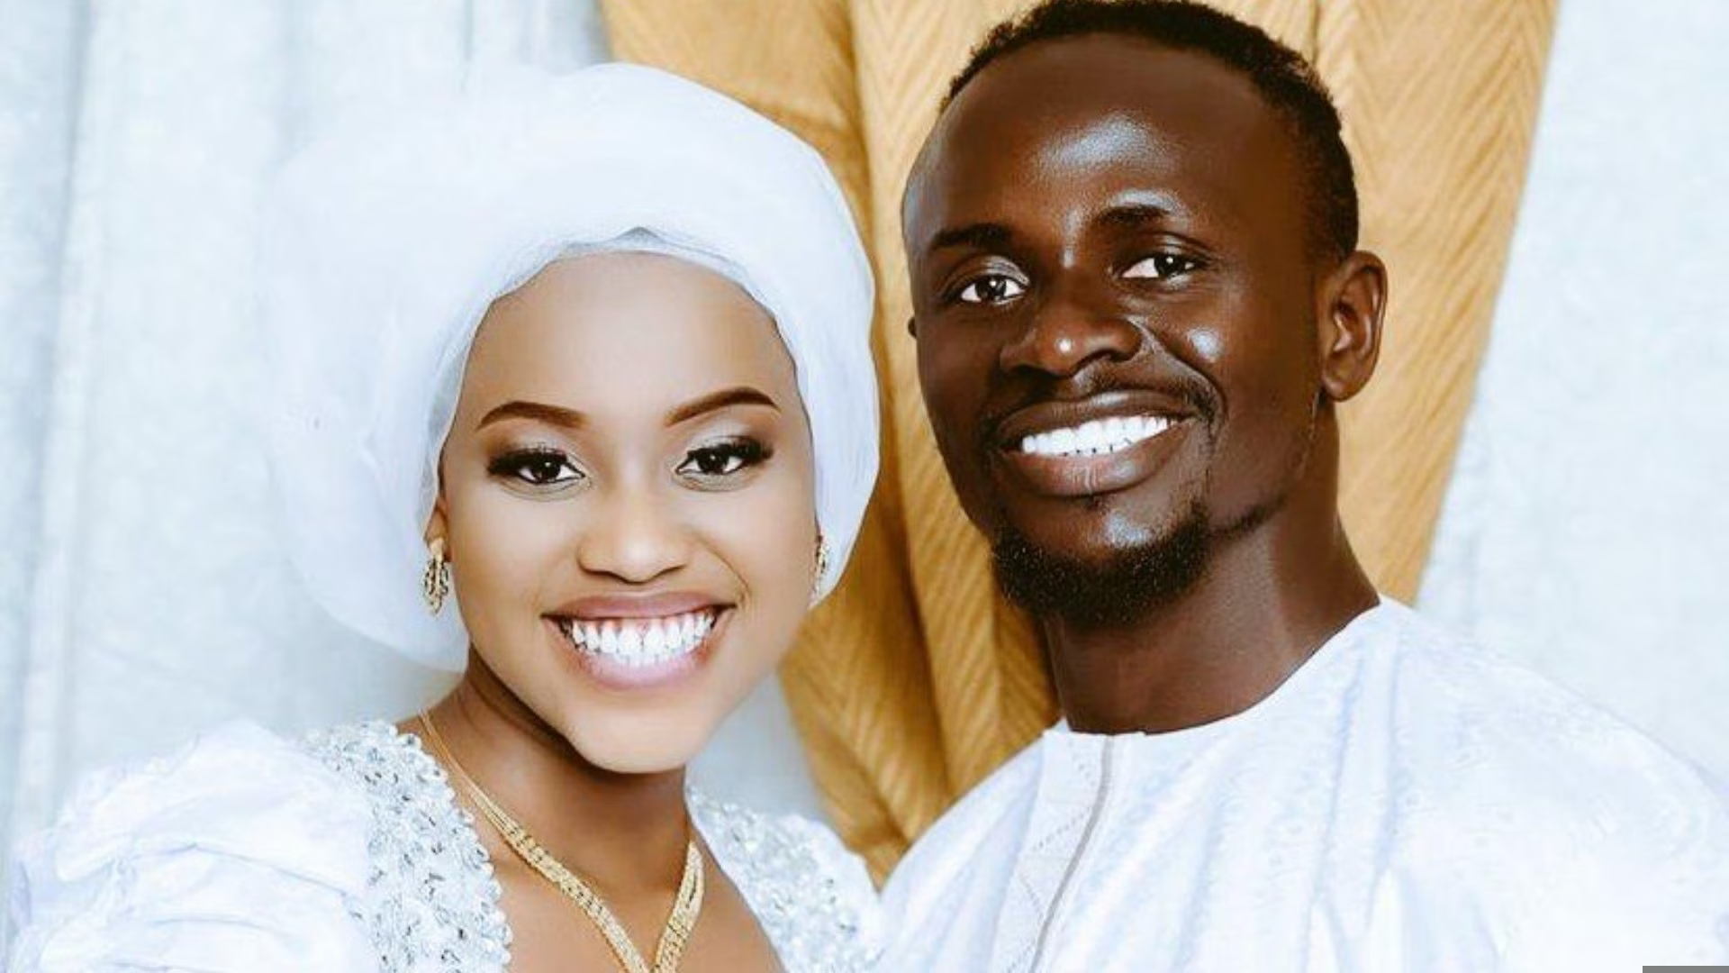
Thanks...

