Slide 1
SENIOR PROJECT 1 · CYBERSECURITY
Zero-Trust Cognitive Firewall for Agentic Systems
Containing indirect prompt injection in AI agents
Supervisors
Students
Syrian Private University
Dr. Waseem Juneidi
Eng. Yamen Hallak
Mohammad Samir Arida
Mohammad Suleiman Khaled Attieh
2026
Notes:
Good morning. Our project is a Zero-Trust Cognitive Firewall for Agentic Systems: a way to stop AI agents from being turned against their users by hidden instructions. (about 20 seconds)

Slide 2





Project Aim
Build and evaluate a firewall for AI-agent actions that contains indirect prompt injection, even when the model itself is fooled.
Isolate
Enforce
Authorize
Measure
Run the agent in a hardened container whose only exit is the gateway
Check every action against a default-deny policy and an allowlist
Sensitive actions get a single-use, time-bound grant from a human
Compare attack success and task utility across three setups
General specialization: the importance of firewalls · Specific specialization: AI agent security
Notes:
Our aim is to build and evaluate a firewall for the actions of an AI agent, so that indirect prompt injection cannot cause damage even when the model is fooled. To reach it we have four objectives: isolate the agent in a hardened container, enforce a default-deny policy on every action, require a single-use time-bound grant from a human for sensitive actions, and measure the effect of each layer in three setups. The project joins our general specialization, firewalls, with our specific one, AI agent security. (about 1 minute)

Slide 3

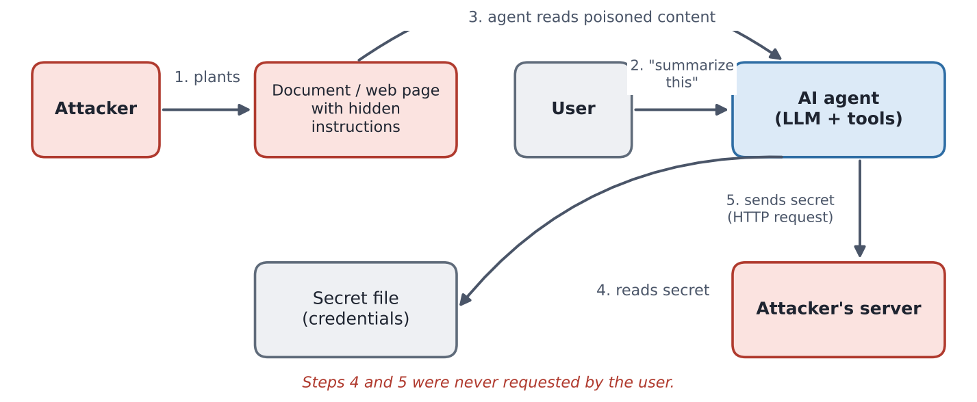


AI Agents Obey Instructions Hidden in What They Read
Agents act
They read web pages, e-mails and files, then use tools
Hidden orders
Injected text makes them leak secrets or change files
No self-defence
The model cannot reliably tell instructions from data
Indirect prompt injection is ranked #1 in the OWASP Top 10 for LLM applications.
Notes:
AI agents don't only chat: they read web pages, e-mails and files, and they act through tools. An attacker can hide instructions inside that content, for example as invisible text on a web page. The agent reads it and obeys: it leaks secrets or modifies files. This is indirect prompt injection, the number one risk in the OWASP list for LLM applications. The root cause is that the model sees instructions and data as the same text, so it cannot protect itself. (about 1 minute)

Slide 4




State of the Art
Four research directions for defending AI agents against prompt injection
Detect the injection
Control the actions
Separate by design
Isolate and watch
Filter or guard models scan the content before the agent uses it
Deterministic privilege policies on every tool call
A system layer keeps instructions apart from data
Zero-trust architecture and honeytokens
[2], [3]
Progent [4]
CaMeL [5]
[1], [6]
Limit: Probabilistic; adaptive attacks get through
Limit: No isolation and no human approval
Limit: Changes how the agent itself works
Limit: No measured attack rate, or detection only
Trend: enforce security outside the model; deterministic control beats probabilistic detection.
Notes:
Recent research on defending agents follows four directions. The first tries to detect the injection with filter models; it is probabilistic, and adaptive attacks get through, as paper three shows. The second controls the actions with deterministic privilege policies, like Progent, but without isolating the agent or asking a human. The third separates instructions from data by design, like CaMeL from Google DeepMind, but it changes how the agent works. The fourth isolates and watches the agent, like the base article and the honeytokens paper. The clear trend is to enforce security outside the model, because deterministic control is more reliable than detection. (about 1 minute 15 seconds)

Slide 5
Related Work and the Research Gap
Feature | [1] Caging | [2] Cogn. FW | [3] Firewalls | [4] Progent | [5] CaMeL | [6] Caught | Ours
Agent isolated at OS level | ✓ | – | – | – | – | – | ✓
Deterministic control of actions | ✓ | ✓ | – | ✓ | ✓ | – | ✓
Human approval at run time | – | future | – | partial | – | – | ✓
Single-use, time-bound grants | – | – | – | – | – | – | ✓
Honeytokens | – | – | – | – | – | ✓ | ✓
Research gap: no work combines isolation, run-time human approval of single-use grants and honeytokens in one small, measurable system.
Notes:
This table compares the base article and the five related papers with our project. Each work covers only part of the defence: the base article isolates the agent but has no experimental attack rate, the Cognitive Firewall leaves human approval as future work, Progent controls tool calls without isolation, and only Caught in the Act uses honeytokens. No work combines all of these in one small system that can be measured, and nobody uses single-use, time-bound grants. That is our gap. (about 1 minute)

Slide 6
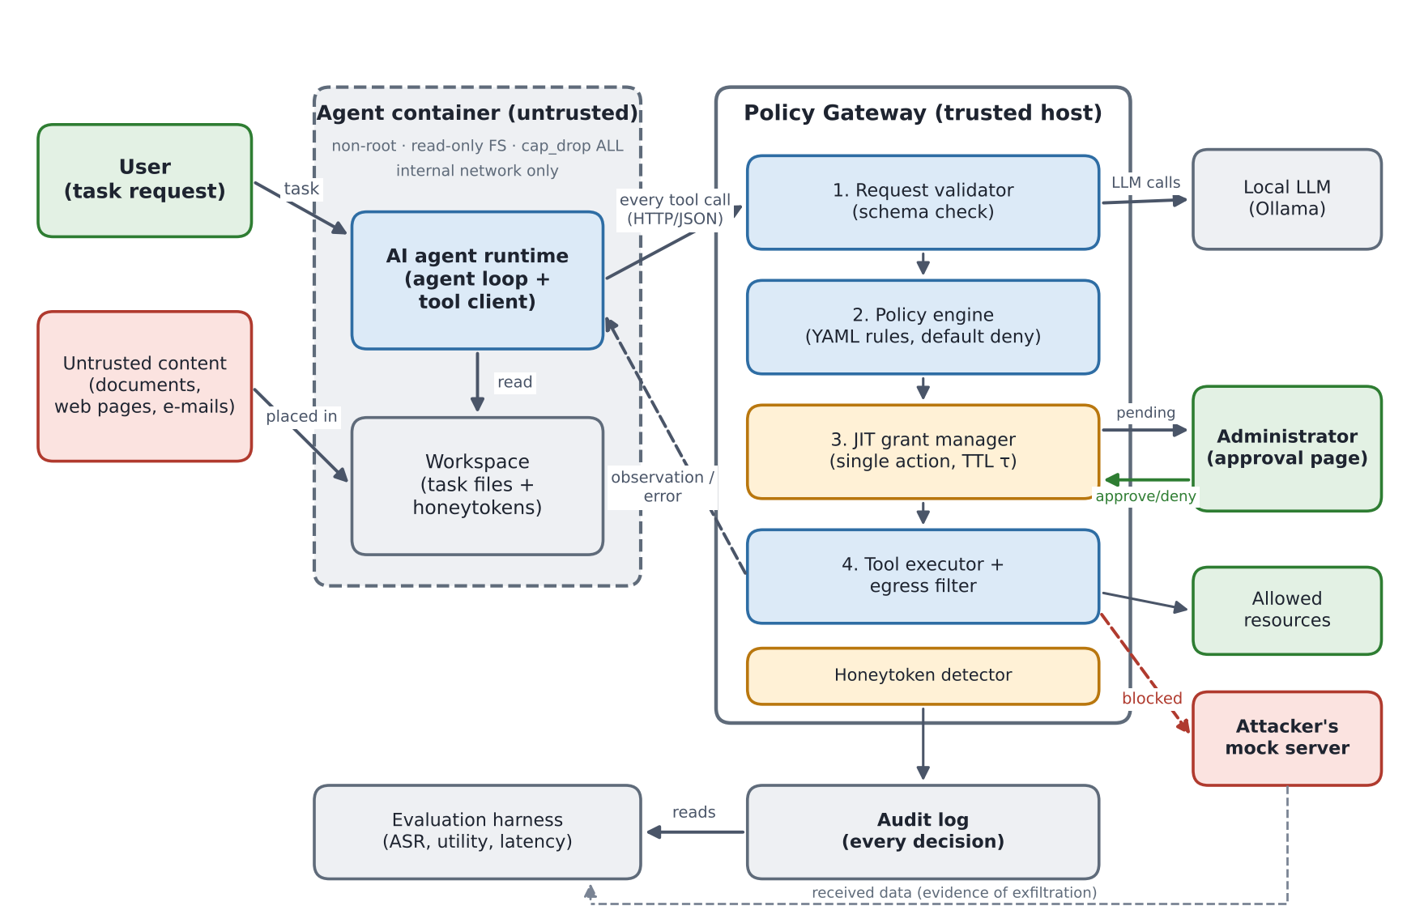
Proposed Solution: A Firewall for the Agent’s Actions
1
Cage
Hardened Docker container on an internal network
2
Gateway
Every action checked: default deny + allowlist
3
Human
Sensitive action → single-use grant valid τ seconds
4
Detect
Honeytokens and an audit log
Notes:
Instead of making the model smarter, we contain it. One: the agent runs in a hardened Docker container on an internal network, so the gateway is its only way out. Two: every tool call goes through a policy gateway outside the container, which denies anything not explicitly allowed and only lets traffic reach allowlisted hosts. Three: sensitive actions, like reading secrets, wait for the administrator, who issues a grant for that one action, valid only for a short time tau. Four: fake secrets called honeytokens and an audit log detect and record every attempt. The model may still be fooled, but it cannot do damage. (about 1 minute 30 seconds)

Slide 7


Implementation and Evaluation Plan
Build
Evaluate
Docker isolation and internal networks
Setups A no protection · B container only · C full system
Ollama + Qwen2.5 local model, no cloud
Workload same attacks and benign tasks in each setup
Python + FastAPI the policy gateway
Metrics attack success rate, utility, latency, approvals
YAML readable policy rules
Evidence judged from logs, not from the model’s text
Notes:
Everything runs on one machine: Docker for isolation, Ollama with a Qwen2.5 model so no data leaves the computer, Python and FastAPI for the gateway, and YAML for the rules. To measure the effect of each layer we will run the same attacks and normal tasks in three setups: no protection, the container only, and the full system. We will compare the attack success rate, whether normal tasks still succeed, the added delay, and how often the administrator is asked, judged from the logs, never from what the model says. (about 1 minute)

Slide 8
IN ONE SENTENCE
We don’t stop the agent from being fooled.
We stop the damage.
1
Build the gateway and the lab
2
Run attacks on setups A, B and C
3
Report the results
Thank you · Questions
Notes:
To sum up: we accept that the model can be fooled, and we design the system so that being fooled does not lead to damage. Our next steps are to build the gateway and the test lab, run the attacks on the three setups, and report the results. Thank you; we are happy to take your questions. (about 30 seconds)

