Slide 1

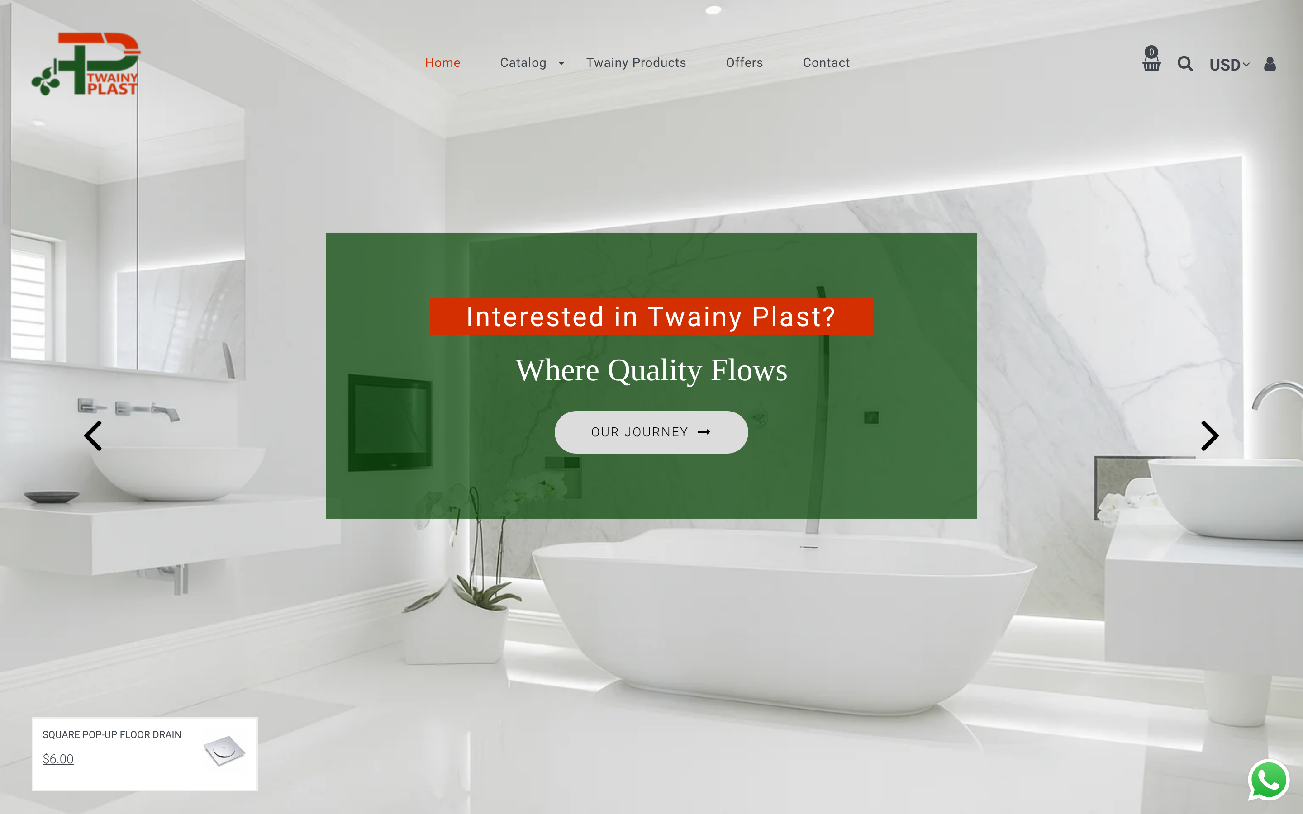
From Visitors to Customers
A Social Media & Digital Growth Strategy for Twainy Plast Sanitary
اختار بثقة · Choose with Confidence
twainyplast.com, launched October 2026
MKT 843 Strategic Social Media Management · Dr. Kiray Khoury · LAU AKSOB MBA
Project plan · October 2026 · Team: [names]
Notes:
Introduce the client, a family-run Lebanese sanitary-ware and plumbing retailer that has just launched its Shopify store, and the project question: how do we turn visitors into customers?

Slide 2






Project plan at a glance
01
02
03
The problem
Objectives
Statistics
Visitors arrive, nobody buys
What success means in 4 weeks
Real Shopify launch data
04
05
06
Competitors
Brainstorm & mind map
Strategy & roadmap
Three rivals and the audit framework
Ideas, priorities, strategy map
Campaign, creatives, KPIs, timeline

Slide 3
The problem: visitors arrive, but nobody buys
Twainy Plast launched twainyplast.com in October 2026 with 175 products: mixers, LED mirrors, WCs, basins, showers and pumps.
252
1.1%
People are visiting, but in the first week no visitor bought anything. Social media is not yet run as a sales channel, and shoppers have little reason to trust a new online store.
sessions in launch week
of sessions add to cart
0
91%
RESEARCH QUESTION
How can Twainy Plast use targeted social content, customer trust and an easier buying journey to turn website visitors into paying customers?
completed orders
of traffic is direct; 6% from social
Source: Shopify Analytics, Oct 7–21, 2026
Notes:
Launch week is an early baseline. We will investigate the reasons before claiming any cause.

Slide 4




Project objectives
Main objective: build a measurable path from social media attention to paying customers, from 0 orders to a tested, repeatable sales engine in 4 weeks.
Convert
Attract
Engage
Trust & tracking
10 online orders + 8 WhatsApp-assisted orders
1,000 Lebanese sessions from campaign links
25,000 reach · engagement rate ≥ 3% by reach
GA4 + Pixel live · 10 genuine Google reviews · reply in < 1 h
Baseline: 0 orders
Baseline: 120 Lebanon sessions in 14 days
Baseline: social sends 6% of traffic
Baseline: no tracking, 0 reviews
Targets are 4-week test targets (Oct 29 – Nov 25), not forecasts. They will be revised after week 1 using real costs and margins.

Slide 5
Statistics: the drop-off happens before the cart
*Oct 21 is a partial day. Source: Shopify Analytics.
1.1%
session → cart rate: interest isn’t turning into intent
1 / 0
checkouts / orders: too few to judge checkout, so we test it
Oct 16–17
peak days (62 and 58), after links were shared, then the traffic fades

Slide 6
Statistics: who visits, and from where
Traffic is mostly links shared on WhatsApp. Social sends just 16 sessions (Facebook 9, Instagram 7).
40% of sessions come from the US, likely bots, testing or the diaspora, so KPIs use Lebanon only.
High desktop share is unusual for Lebanese shoppers, which also points to testing. Content will be built mobile-first.

Slide 7
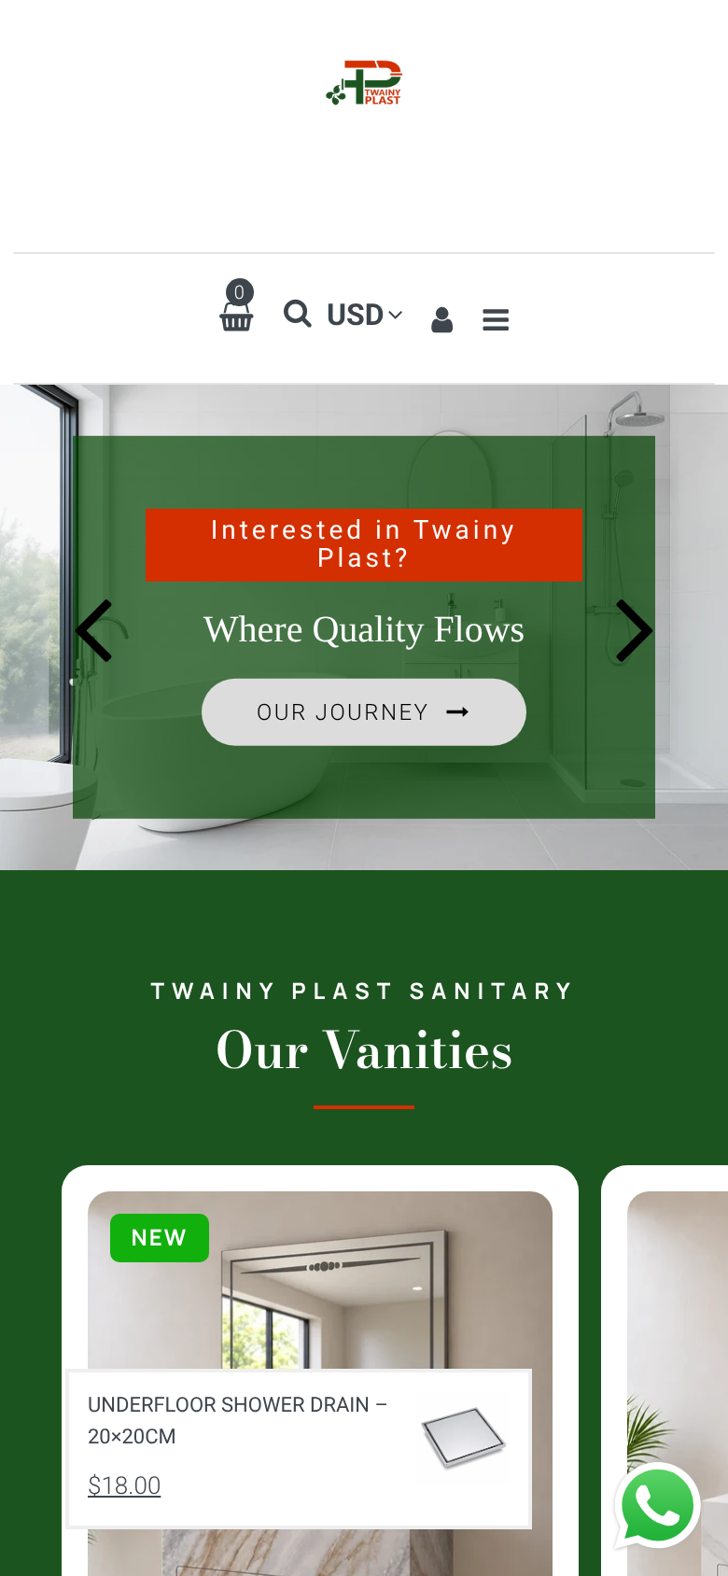
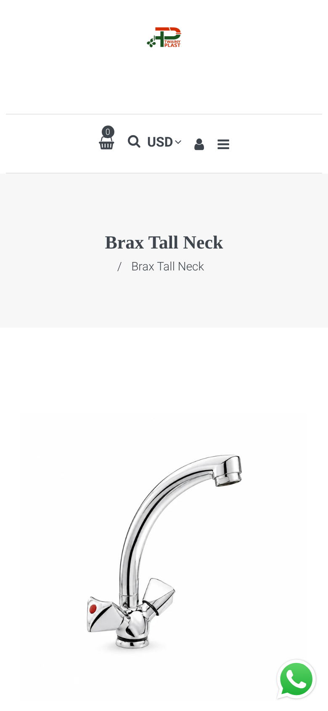


Website audit: strong look, weak path to purchase
WhatsApp button and clear USD prices already in place
Hero CTA says "Our Journey", not "Shop"
On mobile, the logo and menu use the first screen; price sits below the fold
Main product images are AI renders, not real photos
Duplicate titles and numeric URLs (/products/2-1)
Delivery and payment terms are hidden until checkout
Desktop homepage
Mobile home
Mobile product page
Takeaway: fix the trust and clarity gaps first (real photos, a delivery and payment bar, a "Shop" call to action, an "Ask before ordering" link on WhatsApp). Paid traffic sent to the current pages would mostly be wasted.

Slide 8
Research: competitors & customers
Who else competes for the same renovation budget, and who exactly we are selling to

Slide 9

Three competitors to audit
Direct
Direct
Direct (trade)
Builders Sal
Arcom Group Sarl
Chromotech Sarl
Location: Bauchrieh, Metn
Sells: Baths, showers, toilets and taps
Why it matters: An established showroom brand selling the same bathroom range to homeowners
Instagram / Facebook: to verify
Location: Baabda · Sin El Fil · Verdun · Zahle
Sells: Ceramics and sanitary-ware wholesaler, founded 2016
Why it matters: A multi-branch wholesaler with retail points, the closest match to Twainy’s mixed model
Instagram / Facebook: to verify
Location: Hadath · Sin El Fil
Sells: Sanitary ware and plumbing items
Why it matters: A plumbing-led supplier competing for plumbers and contractors (persona 2)
Instagram / Facebook: to verify
Source: Kompass Lebanon business directory. Social accounts and engagement are still to be verified (Oct 22–24). The brief asks for 1 indirect competitor, so if the owner names a home-improvement retailer, it replaces Chromotech.

Slide 10
Competitor social audit framework
Metric (last 30 days, same-day collection) | Twainy Plast | Builders Sal | Arcom Group | Chromotech
Platforms active (IG / FB / TikTok) | IG + FB (not yet active) | to collect | to collect | to collect
Posts per month · format mix | ≈ 0 | to collect | to collect | to collect
Engagement rate = avg. interactions ÷ followers | n/a | to collect | to collect | to collect
Share of voice (posts and engagement) | ≈ 0% | to collect | to collect | to collect
Prices shown in posts? | Yes, on the website | to collect | to collect | to collect
Delivery and payment explained? | Only at checkout | to collect | to collect | to collect
Purchase path · test-DM reply time | Website + WhatsApp | to collect | to collect | to collect
Comment sentiment (last 50 comments) | n/a | to collect | to collect | to collect
Gap hypothesis to test: few local sellers show prices, delivery terms and fit guidance online. Twainy can own "clear and honest".

Slide 11


Two target personas (to validate with interviews)
Rania, 34
Hassan, 45
Homeowner renovating her bathroom
Plumber / small contractor
Goal: Buy online with confidence
Goal: Request a quote on WhatsApp
“I can see it’s pretty, but will it fit my sink, and will it actually arrive?”
“Just tell me if you have it, the price today, and when I can pick it up.”
Where
Greater Beirut / Mount Lebanon, middle income
Where
Store district and nearby areas, self-employed
Platforms
Instagram first, Facebook groups, WhatsApp
Platforms
WhatsApp first, Facebook, YouTube/TikTok how-tos
Active
13:00–14:00 and 21:00–23:00
Active
06:30–08:00 and 20:00–22:00
Formats
Reels, before/after carousels, saved guides
Formats
Price lists, WhatsApp catalogue, short demos
Pains
Fit, quality from photos, delivery risk
Pains
Stock checks, changing prices, slow replies

Slide 12
Ideation: brainstorm & mind map
From many ideas to a focused, evidence-based strategy

Slide 13


Brainstorming: 16 ideas across 4 themes
Build trust
Help people choose
Make buying easy
Reach the right people
Real photos of the 6 hero products
Mixer fit guide: 3 things to measure
Delivery and payment bar on product pages
Geo-targeted $200 Meta test
Meet-the-family store Reel
Mirror size guide drawn to scale
"Ask before ordering" WhatsApp link
Google Business Profile + maps
Genuine Google reviews after delivery
Send a photo, we tell you what fits
Free-delivery offer with clear terms
Plumber WhatsApp price list
Show packing and delivery
Weekly Q&A from real questions
Mobile checkout test order
Influencer or TikTok push
Dashed note = parked for later (low fit or capacity). All other ideas feed the campaign. Generated from the team session plus the store data.

Slide 14
Prioritising ideas: impact vs effort
High impact ↑
Quick wins: do first
Big bets: plan carefully
Decision
Week 0: finish all quick wins before any ad money is spent.
Weeks 1–4: the big bets (Reels, fit guides, $200 test) become the campaign.
Parked: TikTok gets a free repost test in week 4 only. Paid influencers and LinkedIn are out of scope.
WhatsApp ask link
3 Reels
Delivery bar
$200 paid test
Real photos
Fit & size guides
GBP + reviews
Fill-ins: do when time allows
Park
Hashtag sets
TikTok push
Weekly Q&A
Paid influencers
LinkedIn
Low effort ← → High effort

Slide 15
Strategy mind map
Real photos & store
Genuine reviews
People, not renders
Trust
Rania: homeowner
Hassan: plumber
Lebanon geo only
4 pillars
3 Reels · 5 posts
AR + EN captions
Audience
Content
Visitors → Customers
GA4 + Pixel + UTMs
CAC · ROAS · CR
Weekly review
Instagram + Facebook
WhatsApp Business
Google profile · website
Measurement
Channels
Delivery & payment bar
Clear offer
Checkout test
Conversion
Ethics runs through every branch: consent and privacy, honest offers, genuine reviews, and no sensitive ad targeting.

Slide 16
Strategy: "Choose with Confidence"
اختار بثقة · a 4-week campaign, Oct 29 – Nov 25, 2026

Slide 17




Channel ecosystem: every channel has one job
Discover
Consider
Convert
Retain
Instagram Reels
Facebook
Google Maps & Search
Carousels & guides
Story highlights
Reviews · product pages
Website checkout
WhatsApp: ask, then order
Clear offer & terms
WhatsApp broadcasts
Review requests
Plumber price list
Instagram
Primary: Rania’s platform; Reels reach non-followers
Facebook
Same ads account; already sends the most social sessions
WhatsApp Business
Hassan’s tool: advice, quotes, assisted orders
Google Business Profile
"Near me" searches, maps, reviews
Deferred
TikTok (repost test in week 4) · LinkedIn (excluded)

Slide 18
4-week campaign and content pillars
Week 1
Week 2
Week 3
Week 4
Oct 29 – Nov 4
Nov 5 – Nov 11
Nov 12 – Nov 18
Nov 19 – Nov 25
Establish trust
Help people choose
Encourage purchase
Proof and improvement
Reel 1: meet the store · how-to-order post · Google profile launch
Reel 2: 3 things to check · mixer and mirror guides · A/B ad test
Offer post · Reel 3: click to door · retargeting
Customer story · Q&A · review requests · re-cut the best Reel
35%
Choose Right
25%
Inside Twainy
20%
Real Homes
20%
Order Easy
Education: fit, size, comparisons
People, store, packing, delivery
Genuine reviews and installed projects
Offers, prices, how to order
Rhythm: 3 feed posts/week (IG + FB) · Stories 3–5 days/week · 1 WhatsApp broadcast · 1 Google post. Posting times start at 13:00 and 21:00 (plumbers 08:00) and are re-set from Insights after week 1.

Slide 19
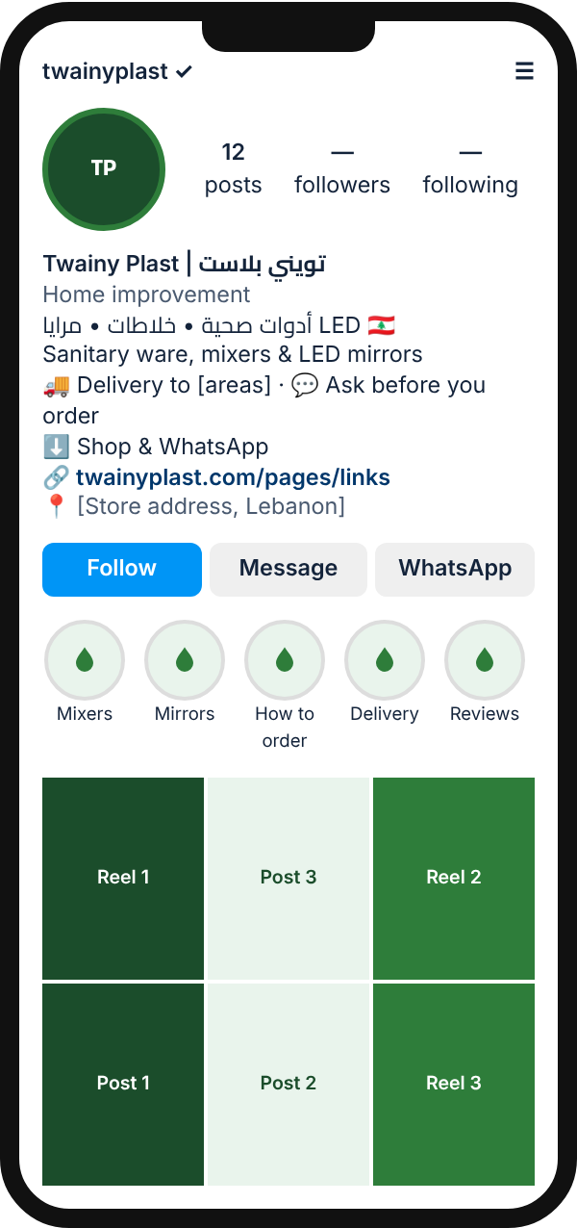
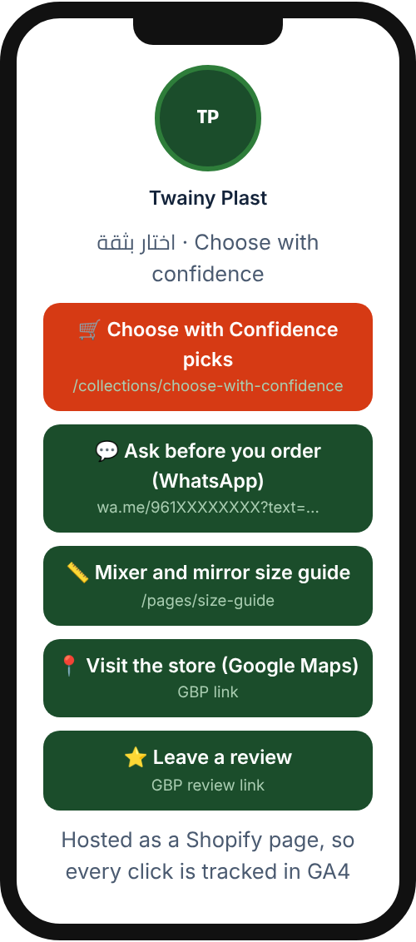
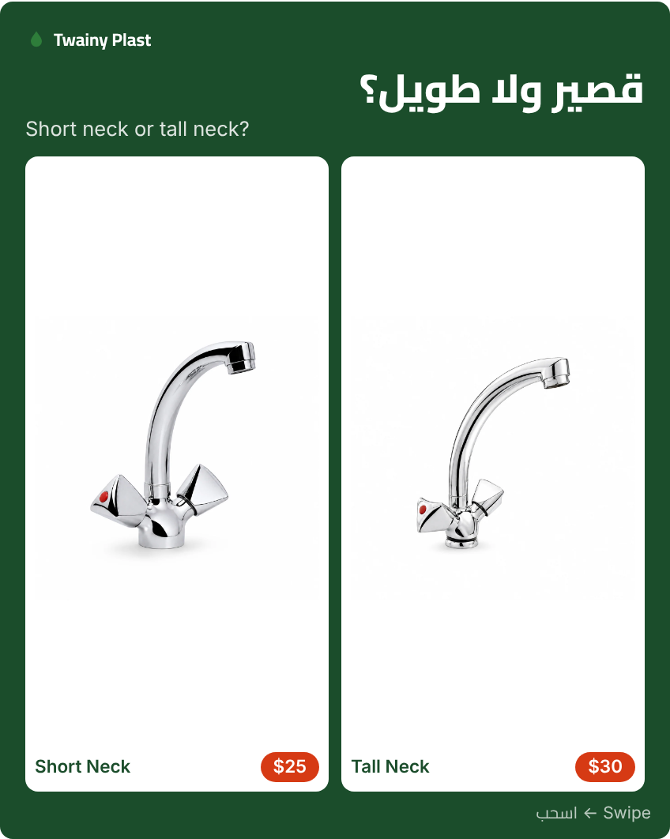
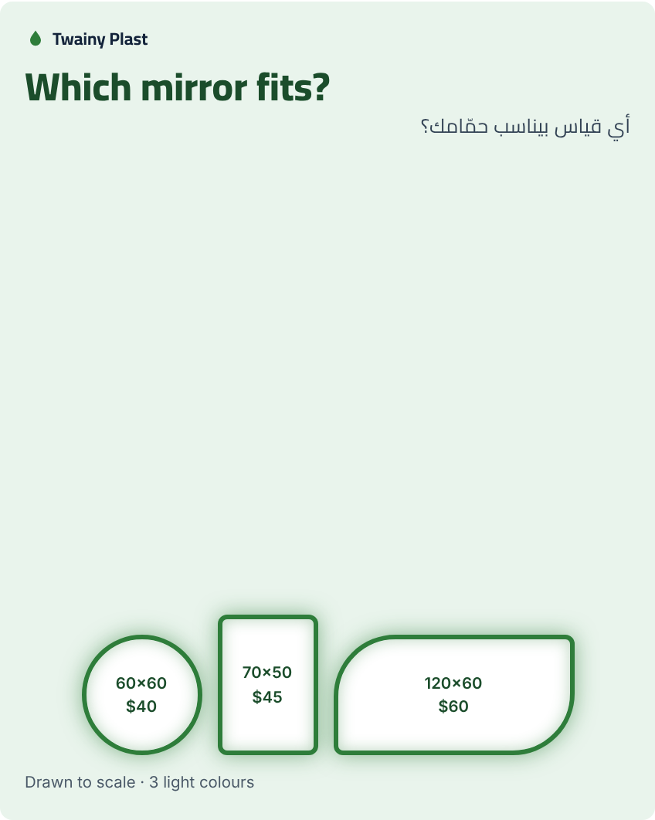

Creative preview: profile mockups and posts
Post 5: Campaign offer
Post 1: Short vs Tall Neck
Post 2: Mirror size guide
Instagram profile
Link-in-bio page
Five static posts and carousels in total (plus a how-to-order FAQ and a customer story). Renders shown here will be replaced by real product photos before launch.

Slide 20
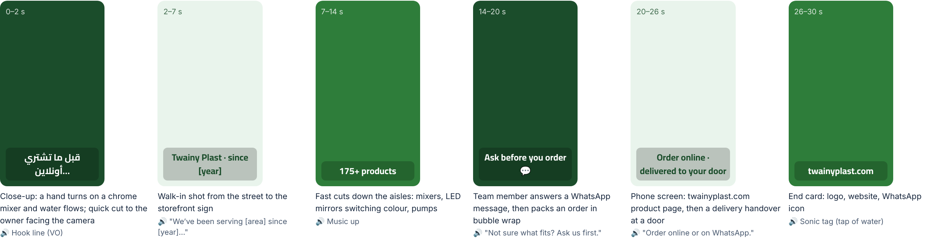
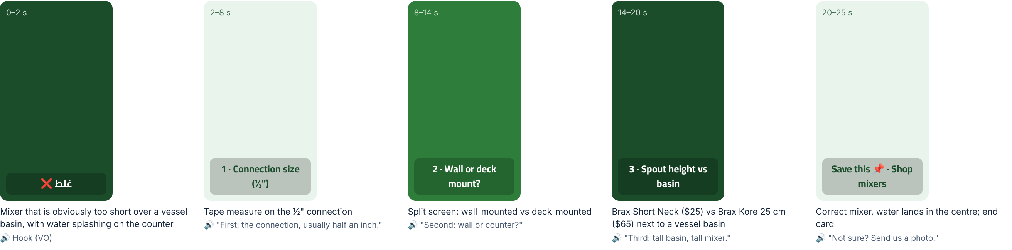
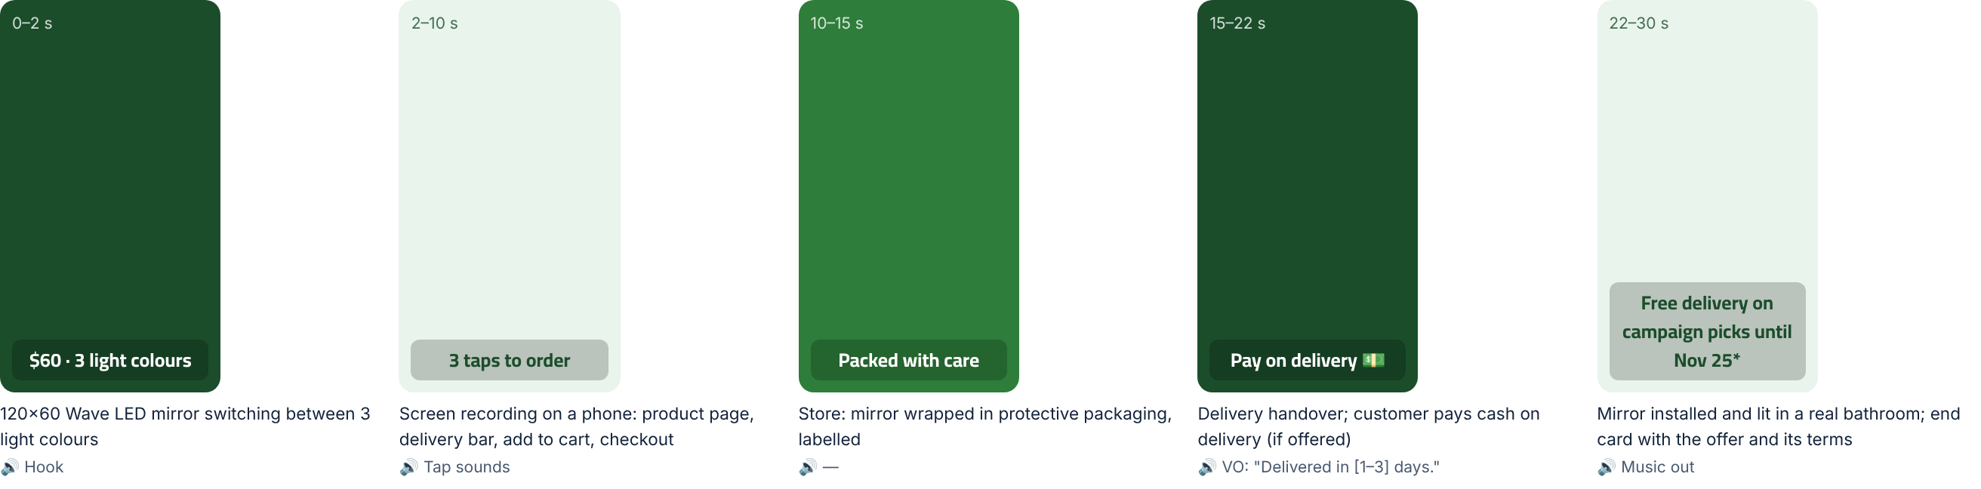
Short-form video: 3 Reel storyboards
Reel 1 · Week 1
Meet Twainy Plast
Hook: “Before you buy a faucet online… meet who’s selling it.”
Reel 2 · Week 2
3 things to check before buying a mixer
Hook: “This is why your new mixer doesn’t fit.”
Reel 3 · Week 3
From click to your door
Hook: “Ordering a mirror online in Lebanon? Watch this.”

Slide 21
$200 paid test and KPI targets
KPI | Formula / tool | Baseline | 4-week target
Lebanon sessions | GA4 + Shopify | 120 / 14 days | 1,000
Engagement rate by reach | interactions ÷ reach | — | ≥ 3%
Link CTR | clicks ÷ impressions | — | ≥ 1%
Add-to-cart rate | cart sessions ÷ sessions | 1.1% | 4%
Conversion rate | orders ÷ sessions | 0% | 1% (~10 orders)
CAC | spend ÷ new customers | — | ≤ $20
ROAS | revenue ÷ ad spend | — | ≥ 2.5
Reply time | median first response | — | < 1 hour
Planning scenario: 18 orders × $45 → ROAS 4.0×, yet about −$11 short of break-even at a 30% margin. It turns positive with repeat buyers, so a high ROAS alone does not mean profit.

Slide 22
Project roadmap: Oct 22 → Dec 3, 2026
Wk of Oct 19
Wk of Oct 26
Wk of Nov 2
Wk of Nov 9
Wk of Nov 16
Wk of Nov 23
Wk of Nov 30
1 · Brief & consent
2 · Research: audit, interviews
3 · Store fixes + GA4/Pixel
4 · Content production
5 · Campaign wk 1–2
6 · Campaign wk 3–4 (offer)
7 · Paid test $200
8 · Analysis & final deck
9 · Weekly reviews (Wed)
Brief due
Launch
Presentation 1
Presentation 2

Slide 23
Roadmap phases and deliverables
0
1
2
3
Phase 0 · Oct 22 – 28
Phase 1 · Oct 29 – Nov 11
Phase 2 · Nov 12 – 25
Phase 3 · Nov 25 – Dec 3
Prepare
Trust & choice
Convert & prove
Measure & present
Brief + owner consent
Competitor audit · 10–12 interviews
Mobile checkout test order
Real photos, delivery bar, WhatsApp link
GA4, Pixel, UTMs live
Reel 1 + Reel 2
Guides and FAQ carousels
Google profile launch
A/B ad test ($100)
Offer post + Reel 3
Scale the winner + retarget ($100)
Customer story, Q&A
Review requests
Compare against the baseline
ROI, CAC, ROAS model
Recommendations
Executive pitch + Q&A
Deliverable: Validated personas + a store ready to sell
Deliverable: Engaged audience + winning ad creative
Deliverable: First orders, reviews, measured CAC
Deliverable: Final deck + recommendations

Slide 24
Next 7 days
Oct 22
Submit the brief and the signed owner consent
Oct 22
Screenshot and save the Shopify launch baseline
Oct 23
Run one real mobile test order (then refund it)
Start from evidence, then spend
Oct 22–24
Audit the 3 competitors; book the interviews
Oct 25–28
Real photos, delivery bar, GA4 and Pixel, then shoot Reel 1
Thank you · شكراً

