Slide 1

XACML and Discovery Services
04 / 21 / 2011
GREYC Laboratory
Jérôme Le Moulec
Jacques Madelaine
Adrien Laurence

Slide 2
XACML Generalities
XACML (eXtensible Access Control Markup Language) :
    declarative access control policy language
    implemented in XML
    Current version : 2.0 (February 2005)
    Draft XACML 3.0 in April 2009

Slide 3
XACML Components
PAP: Policy Administration Point - Point which manages policies
PDP: Policy Decision Point - Point which evaluates and issues authorization decisions
PEP: Policy Enforcement Point - Point which intercepts user's access request to a resource and enforces PDP's decision.
PIP: Policy Information Point - Point which can provide external information to a PDP, such as LDAP attribute information.

Slide 4
XACML Policies
Policy: comprises four main components:
  a target;
  a rule-combining algorithm-identifier;
  a set of rules;
  obligations.
Policy Set: comprises four main components:
  a target;
  a policy-combining algorithm-identifier;
  a set of policies;
  obligations.

Slide 5
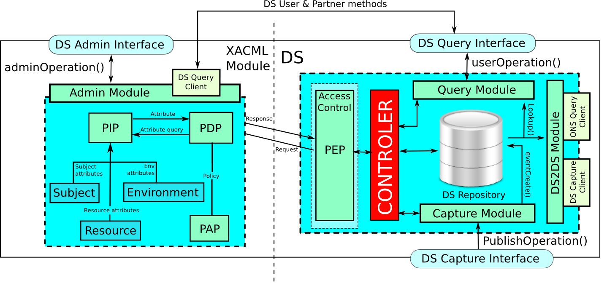
DS architecture using XACML
Two different applications
    XACML module → process XACML requests using policy repository;
    DS core → create and send XACML request and process DS requests.
Connected over the IP network;
    DS application → send XACML request to the XACML module;
    XACML module → send back ACCEPT or DENY.

Slide 6
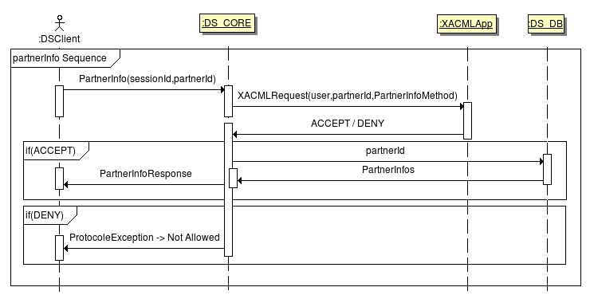
DS XACML request processing
User call PartnerInfo method on the DS application;
DS application send corresponding XACML request to the XACML application;
XACML application process the request with the corresponding XACML policy file and send back ACCEPT or DENY as response;
DS application process the PartnerInfo method and send back the result or throw a protocolException

Slide 7
XACML for DS access control

Slide 8
XACML Policies for DS access control
DS User Group :
  a set of method signature
  a set of users
  a set of resource filters (Query & Capture)
Partner access control :
  a set of DS user groups

Slide 9
XACML Policies for DS access control
Policy (A DS USER GROUP) comprises four main components:
  a target → a set of method signature
  a rule-combining algorithm-identifier → group-rule
  a set of rules
    One associating users to this group (RuleID=UserGroup)
    Four specifying filters (only for query and capture modules).
  Obligations. → currently not used.
Policy Set (PARTNER ACCES CONTROL) comprises four main components:
  a target
    moduleID (Query, Capture or Admin);
    partnerID : owner of the policy.
  a policy-combining algorithm-identifier → permit-overrides
  a set of policies → user group definitions
  obligations → currently not used.

Slide 10
XACML PolicySet for DS AC
A policy file describes :
The module (QueryModule,CaptureModule,AdminModule) depending on the file location.
A list of policies defining a user group list.
<PolicySet PolicySetId="epcistest" PolicyCombiningAlgId="permit-overrides">
<Target>
<!-- MODULE AND OWNER POLICY -->
</Target>
<Policy>
<!-- A GROUP DEFINITION -->
</Policy>
<Policy>
<!-- AN OTHER GROUP DEFINITION -->
</Policy>
...
</PolicySet>

Slide 11
XACML PolicySet Target for DS AC
The header defining the owner of the policy and to wich module it is applyed
<PolicySet policySetId="epcistest" PolicyCombiningAlgId="permit-overrides">
<Target>
<Subjects> <!-- MODULE -->
<SubjectMatch MatchId="string-equal">
<SubjectValue DataType="string">QueryModule</AttributeValue>
<SubjectAttributeDesignator AttributeId="subject-id" DataType="string"/>
</ResourceMatch>
</Subjects>
<Resources> <!-- RESSOURCE OWNER -->
<Resource>
<ResourceMatch MatchId="string-equal">
<AttributeValue DataType="string">producer1</AttributeValue>
<ResourceAttributeDesignator AttributeId="owner-id" DataType="string"/>
</ResourceMatch>
</Resource>
</Resources>
<Actions/>
</Target>
... <!-- POLICYSET CONTENT -->
</PolicySet>

Slide 12
XACML Policy for DS AC
The Policy entity defines a user group. It contains :
A list of methods in the target. The access rights for these methods are provided by filter rules.
A rule called 'UserGroup' containing the user/profile id that will be able to use the methods given in the target.
Four other rules used to allow filters for this group (BizStep,EPC,EventClass and EventTime) just for Query and Capture module xml files.
<Policy PolicyId="group_name" RuleCombiningAlgId="group-rule">
<Target>
<Subjects/>
<Resources/>
<Actions>
<!-- Action list concerned by this policy (ex: userUpdate) -->
</Actions>
</Target>
<Rule RuleId="UserGroup" Effect="Permit">...</Rule> <!-- user list -->
<Rule RuleId="BizStep" Effect="Permit">...</Rule> <!-- BizStep filter list -->
<Rule RuleId="EPC" Effect="Permit">...</Rule> <!-- EPC filter list -->
<Rule RuleId="EventClass" Effect="Permit">...</Rule> <!-- Event class list -->
<Rule RuleId="EventTime" Effect="Permit">...</Rule> <!-- Event time list -->
</Policy>

Slide 13
XACML POLICY METHOD FILTER
<Policy PolicyId="test_env_gp" RuleCombiningAlgId="group-rule">
<Target>
...
<Actions>
<Action>
<ActionMatch MatchId="string-equal">
<AttributeValue DataType="string">eventCreate</AttributeValue>
<ActionAttributeDesignator AttributeId="action-id" DataType="string"/>
</ActionMatch>
</Action>
<Action>
<ActionMatch MatchId="string-equal">
<AttributeValue DataType="string">eventLookup</AttributeValue>
<ActionAttributeDesignator AttributeId="action-id" DataType="string"/>
</ActionMatch>
</Action>
</Actions>
</Target>
<!-- rules -->
</Policy>

Slide 14
XACML QUERY POLICY
The UserGroup rule associating user2 and user3 in a same group :
<Rule RuleId="UserGroup" Effect="Permit">
<Target/>
<Condition FunctionId="global-permit-one-deny">
<Apply FunctionId="string-equal">
<Apply FunctionId="string-one-and-only">
<SubjectAttributeDesignator AttributeId="user-id" DataType="string" />
</Apply>
<AttributeValue DataType="string">user2</AttributeValue>
</Apply>
<Apply FunctionId="string-equal">
<Apply FunctionId="string-one-and-only">
<SubjectAttributeDesignator AttributeId="user-id" DataType="string"/>
</Apply>
<AttributeValue DataType="string">user3</AttributeValue>
</Apply>
</Condition>
</Rule>

Slide 15
XACML QUERY POLICY
The BizStep restriction and EPC restriction rules :
<Rule RuleId="BizStep" Effect="Permit">
<Target/>
<Condition FunctionId="global-permit-one-deny">
<Apply FunctionId="string-equal">
<Apply FunctionId="string-one-and-only">
<ResourceAttributeDesignator AttributeId="bizStep-id" DataType="string"/>
</Apply>
<AttributeValue DataType="string">urn:epcglobal:cbv:bizstep:com</AttributeValue>
</Apply>
</Condition>
</Rule>
<Rule RuleId="Epc" Effect="Permit">
<Target/>
<Condition FunctionId="global-deny-one-permit">
<Apply FunctionId="unicaen:revert-regexp-string-match">
<Apply FunctionId="string-one-and-only">
<ResourceAttributeDesignator AttributeId="epc-id" DataType="string" />
</Apply>
<AttributeValue DataType="string">urn:epc:id:sgtin:1\.2\..*</AttributeValue>
</Apply>
</Condition>
</Rule>

Slide 16
Method defined for access control
Admin methods |  | Capture methods | Query methods
userInfo partnerInfo createPartnerGroup addPartnerToGroup addBizStepRestriction addEPCRestriction addEPCClassRestriction addTimeRestriction addUserPermission switchBizStepPolicy switchEPCPolicy switchEPCClassPolicy switchTimePolicy removeBizStepRestriction removeEPCRestriction removeEPCClassRestriction removeTimeRestriction removeUserPermission deletePartnerGroup removePartnerFromGroup | updateGroupName switchUserPermissionPolicy savePolicyPartner updateAdminGroupName createAdminPartnerGroup deleteAdminPartnerGroup addAdminPartnerToGroup removeAdminPartnerFromGroup switchAdminUserPermissionPolicy removeAdminUserPermission addAdminUserPermission saveAdminPolicyPartner partnerUpdate userCreate userUpdate userLookup userDelete partnerDelete | eventCreate voidEvent multipleEventCreate | partnerInfo eventLookup eventInfo

Slide 17
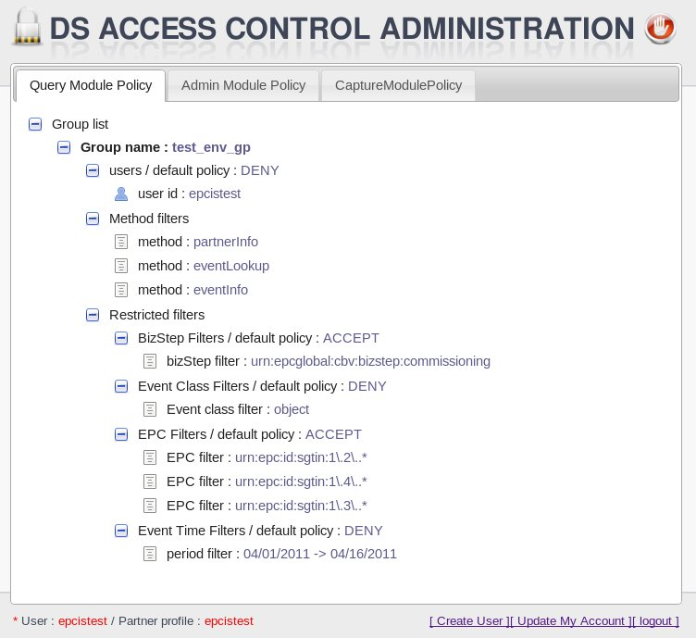
XACML Policies exemple

Slide 18
XACML Requests

Slide 19
XACML Requests
The PEP component creates XACML requests. An XACML request comprises three parts :
Subject : the user who wants to process the given action and the corresponding module.
Ressource:
* The information about the policies' owner that will be processed for this request.
* epc, bizStep, eventTime and eventClass for Query and Capture modules
Action: the method name that needs an explicit access to be executed.
<Request>
<Subject>
... <!-- who makes the query ? -->
</Subject>
<Resource>
... <!-- ressource definition -->
</Resource>
<Action>
... <!-- method name -->
</Action>
</Request>

Slide 20
XACML Request - subject
Example of Subject sent by user8 in the capture module:
<Request>
<Subject SubjectCategory="access-subject">
<Attribute AttributeId="module-id" DataType="string">
<AttributeValue>Capture</AttributeValue>
</Attribute>
<Attribute AttributeId="user-id" DataType="string">
<AttributeValue>user8</AttributeValue>
</Attribute>
</Subject>
<Resource>
... <!-- ressource definition -->
</Resource>
<action>
... <!-- method name -->
</action>
</Request>

Slide 21
XACML Request Resources for DS AC
Example of the resource definition for an “eventCreate” processed by a user of the producer1 profile:
...
<Resource>
<Attribute AttributeId="resource-id" DataType="string">
<AttributeValue>DSevent</AttributeValue>
</Attribute>
<Attribute AttributeId="owner-id" DataType="string">
<AttributeValue>producer1</AttributeValue>
</Attribute>
<Attribute AttributeId="epc-id" DataType="string">
<AttributeValue>urn:epc:id:sgtin:1.2.3</AttributeValue>
</Attribute>
<Attribute AttributeId="eventTime-id" DataType="dateTime">
<AttributeValue>1970-01-01T01:00:08+01:00</AttributeValue>
</Attribute>
<Attribute AttributeId="bizStep-id" DataType="string">
<AttributeValue>bizStep1</AttributeValue>
</Attribute>
<Attribute AttributeId="eventClass-id" DataType="string">
<AttributeValue>ObjectEvent</AttributeValue>
</Attribute>
</Resource>
...

Slide 22
XACML Request - action
The corresponding action definition:
<Request>
<Subject SubjectCategory="access-subject">
... <!-- who makes the query ? -->
</Subject>
<Resource>
... <!-- ressource definition -->
</Resource>
<Action>
<Attribute AttributeId="action-id" DataType="string">
<AttributeValue>eventCreate</AttributeValue>
</Attribute>
</Action>
</Request>

Slide 23
USE CASES

Slide 24
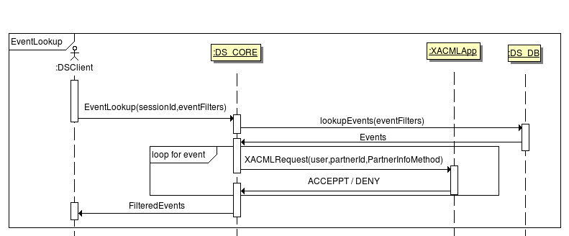
DS EventLookup processing
XACMLRequest(user,partnerId,evt,eventLookup)

Slide 25
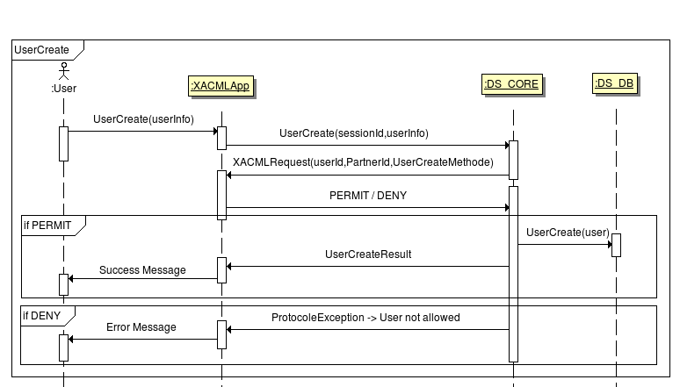
DS UserCreate processing
XACMLRequest(user,partnerId,userCreateMethod)

