Slide 1

TACITES
Lot 3a2
Network and Middleware Security
09/06/2011
Adrien Laurence : adrien.laurence@unicaen.fr

Slide 2
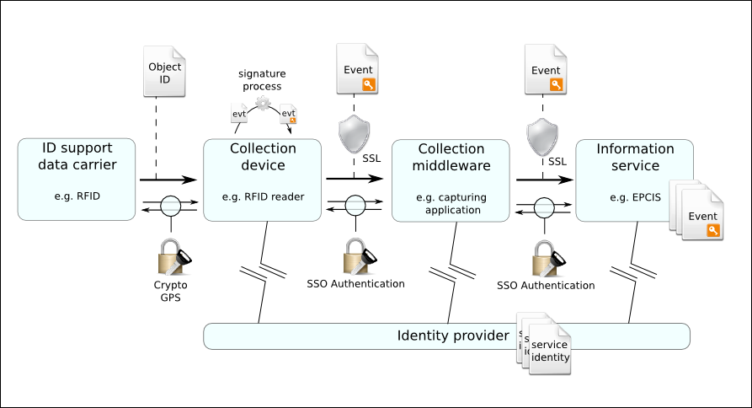



TACITES Lot 3a2 network and middleware Security
- General architecture -
integrity
confidentiality
authentication

Slide 3
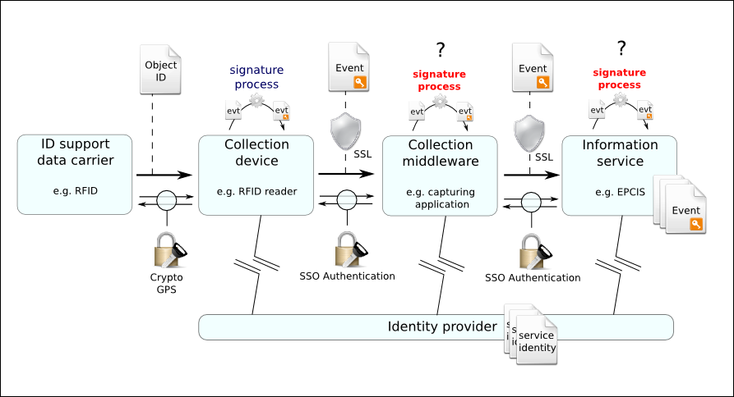
TACITES Lot 3a2 network and middleware Security
- general architecture – alternative -
  Digital signature in each component ?
    Sign message with or without previous signatures ?
    Has to be inside events.
      How to store signatures in events ?
      Signature can't be processed in external generic component (the signature component has to know about the format of the event)

Slide 4
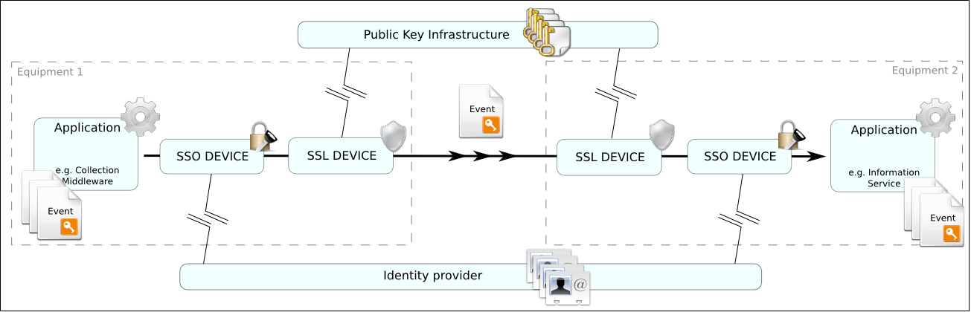
TACITES Lot 3a2 network and middleware Security
- Security components -
SSO Device (Single Sign On Device) enables applications to mutually authenticate (CAS, Shibboleth, LASSO)
  Uses identity provider
  May be disconnected from identity provider.
SSL Device (Security Service Layer Device) enables applications to communicate through a secured Chanel (SSH, Apache2 SSL/TLS , VPN, IPSEC + DNSSEC)
  Provides bilateral authentication
  Uses PKI for encryption.
  May be disconnected from the PKI.

Slide 5
TACITES Lot 3a2 network and middleware Security
- Security component technologies -
SSO implémentations :
  Shibboleth :
    Web single sign-on across or within organizational boundaries.
    A standards based, open source software package.
    Allows sites to make informed authorization decisions for individual access of protected online resources in A privacy-preserving manner.
    Provides federation mechanisms.
  CAS (Central Authentication Service) :
    "Single Sign-on for the Web"
    Developed by JA-SIG in an open-source, collaborative manner.
    Beneficial where applications share a set of common users.
    Similar to the Shibboleth but :
      vastly simpler to set up
      lacks a number of broader features like federated trust and authorization infrastructure.
  LASSO :
    A free software C library.
    Implements the Liberty Alliance standards.
    Defines processes for federated identities, single sign-on and related protocols.
    Built on top of libxml2, XMLSec and OpenSSL.
    Licensed under the GNU General Public License (with an OpenSSL exception).

Slide 6
TACITES Lot 3a2 network and middleware Security
- Security component technologies -
Secured transport layer technologies :
  Stunnel / Openvpn :
    Virtual Private Network (VPN).
    Secured tunneling applications.
    Can be used to send any kind of network traffic securely.
  Apache2 SSL/TLS encryption :
    Provides strong cryptography for the Apache webserver.
    Use Secure Sockets Layer (SSL v2/ v3 ) and Transport Layer Security (TLS v1) protocols.
    Use Open Source SSL/TLS toolkit OpenSSL.
    Only used to send HTTP(S) traffic.
  IPSEC (Internet Protocol Security) + DNSSEC :
    Is a protocol suite for securing Internet Protocol (IP) communications.
    Protects any application traffic across an IP network.
    Applications do not need to be specifically designed to use IPsec.
    It authenticate and encrypte each IP packet of a communication session.
    Includes protocols for establishing mutual authentication between agents at the beginning of the session And negotiation of cryptographic keys to be used during the session.
    Hard to set up in an open network with a large set of computers and servers.
    Involve setting up DNSSEC (public keys are stored in the DNS).
  SSH :
    Allows data to be exchanged using a secure channel between two networked devices.
    Uses public-key cryptography to authenticate the remote computer.

Slide 7
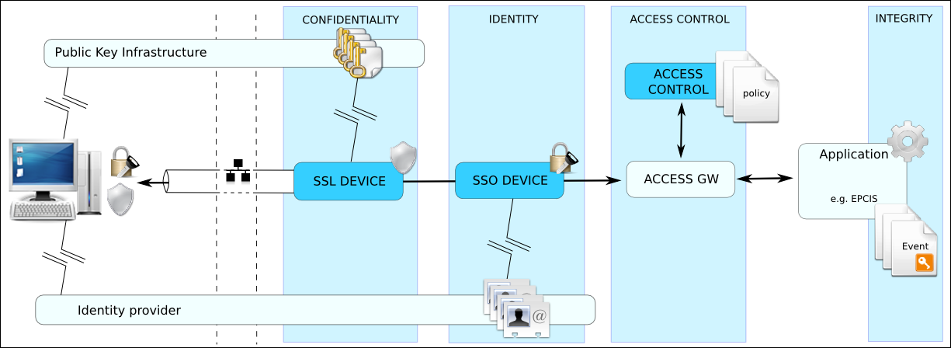
TACITES Lot 3a2 network and middleware Security
- Security layer & access control -
Access Control Layer : Enable service provider to restrict access to the data.
  Using access gateway (implementing application protocol) that forwards messages and filters responses. → Non normative component
  Accessible through normalized protocol (e.g XACML)
Integrity support : digital signature that enforces data integrity. (GPS,DSA,EC-DSA,RSA ...)

Slide 8
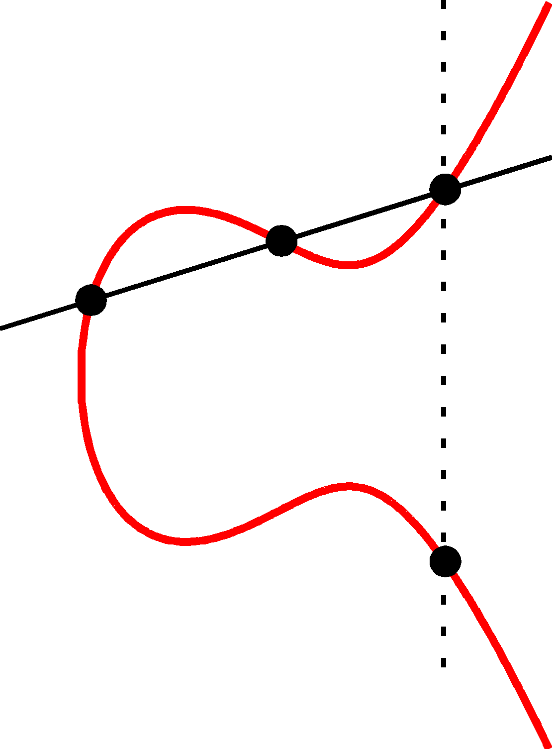
TACITES Lot 3a2 network and middleware Security
- Which technologie for signature ? -
GPS [Girault-Poupard-Stern JoC06]
  Classical construction (authentication + Fiat-Shamir).
  Fast signing process with fast modular arithmetic.
  Support elliptic curves.
  The security relies on the Discrete Log with Small Exponent problem.
  Even faster with "coupons".
  1024 bits.
Alternatives :
  standards : (EC)DSA (US), Esign (Japan).
  RSA-PSS.
  Short signatures (elliptic curves + pairing). 160 bits
    Supports batch verifications
  Bernstein's signatures. QUICKLY

Slide 9
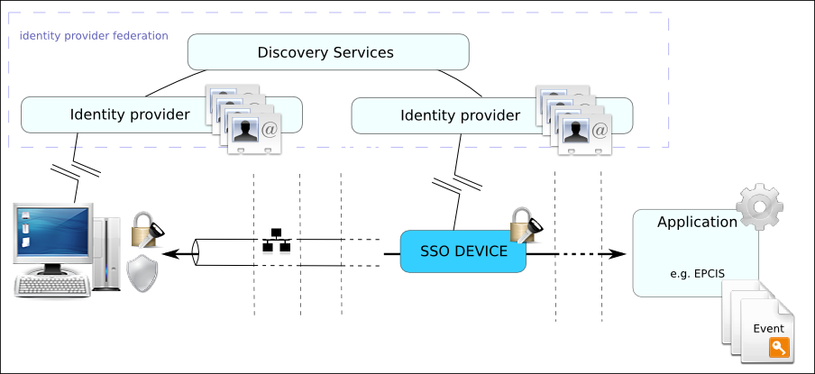
TACITES Lot 3a2 network and middleware Security
- Identity federation -
Identity Provider Federation : Connect several identity provider using discovery services mechanisms (e.g. Shibboleth).

