Slide 1

Intelligent ids
Using an autoencoder (with dropout)-based anomaly detection model

Slide 2

IDS
Analyse and monitor network traffic for attacks using a known cyberthreat to infiltrate or steal data from your network.
Comparing the current network activity to a known threat database to detect several kinds of behaviours (security policy violation, malware, port scanners…).
Does not take action on its own. Requires a human or other system to look at the results.

Slide 3
Ai in cybersecurity
Artificial Intelligence can help to:
Identify threats.
Find links between potential risks fast.
Eliminate human error from the process.
AI is trained to process large amounts of data, for example, new stories and blogs, meaning that it has a better comprehension of cyber threats.

Slide 4
Intelligent IDS
We will be creating an anomaly-based detection model for our IDS, with python.
Using an autoencoder with dropout to improve the performance of our model.

Slide 5
Libraries
Numpy: a library for Python, adding support for large, multi-dimensional arrays and matrices, along with a large collection of high-level mathematical functions to operate on these arrays
1
Pandas: library written for the Python programming language for data manipulation and analysis.
2
Matplotlib: A plotting library for the Python programming language and its numerical mathematics extension NumPy.
3
Keras: A neural-network library, designed to enable fast experimentation with deep neural networks.
4
Tensorflow: A library for dataflow and differentiable programming across a range of tasks. It is a symbolic math library, and is also used for machine learning applications such as neural networks.
5
Notes:
Scikit-learn

Slide 6
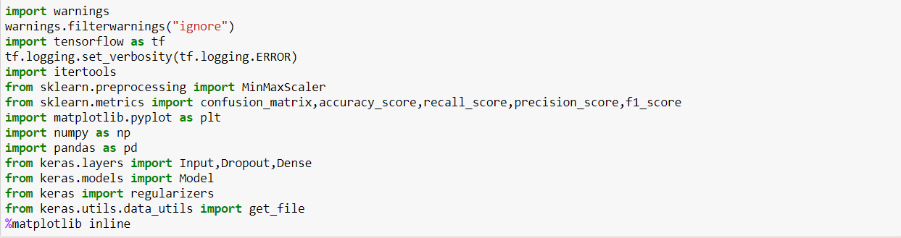
Importing the libraries

Slide 7
Dataset
We will be using the NSL-KDD dataset:
A benchmark for ML based intrusion detection.
Suffers from class imbalance.
Another issue is that this dataset is unrealistic.
Our autoencoder based approach attempts to overcome these problems.
Notes:
Class imbalance in NSL-KDD:
it suffers from several inefficiencies such as class imbalance, where for instance in the NSL-KDD training dataset only 0.04% of the samples belong to the u2r attack type making it severely underrepresented, the case is similar for the r2l and probe attack types whereas the majority of attack records are representing the DDOS attack type, this fact made it difficult for classifiers to detect these underrepresented types resulting in poor accuracy
Unrealistic:
in reality most traffic in a network is benign and only a small percentage might be malicious, while in the NSL-KDD training set for example, attack samples compose 80% of the entire dataset which makes the models trained using this dataset ineffective in real life situations.

Slide 8
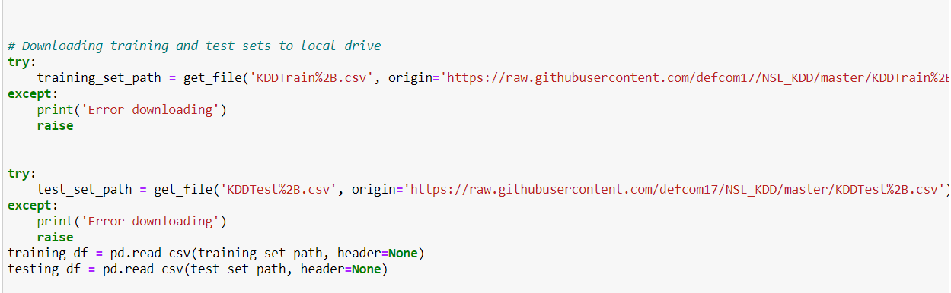
Importing the dataset

Slide 9

Steps:
Data Preprocessing
Preparing the features
Building and training the model
Evaluating the model
1
2
3
4

Slide 10

Step 1: DATA PREPROCESSING

Slide 11
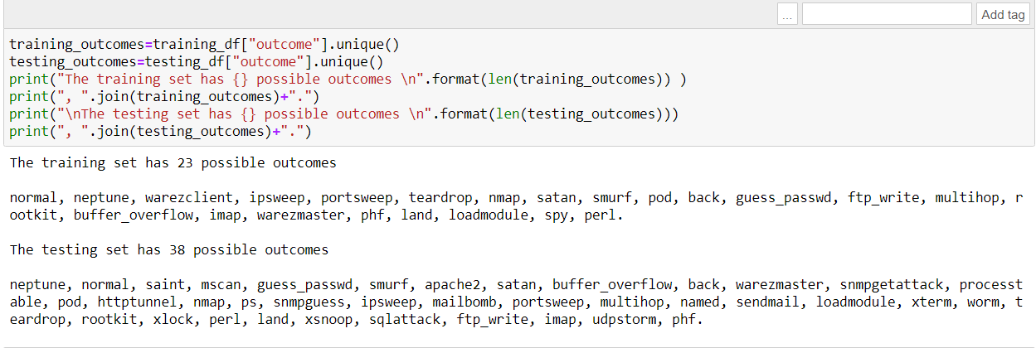
The testing set has an additional 15 attack types that are not available in the training data.
So we decided to classify every attack under more general labels.

Slide 12
Extracting the labels
The 38 attack types available in the dataset will be clustered into four general attack types:
Denial of service attacks
Remote to Local attacks
User to Root
Probe attacks

Slide 13
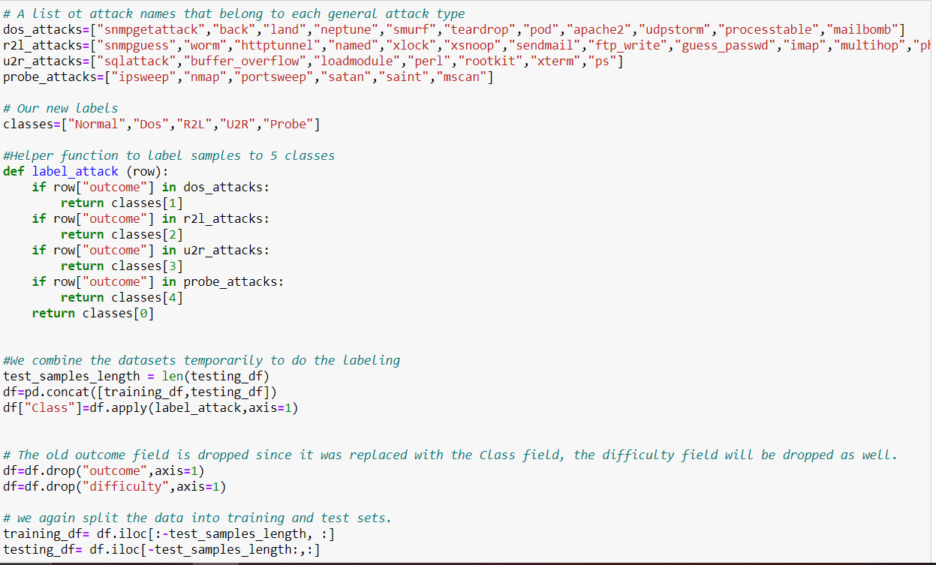
In this section, we replaced the current outcome field with a Class field that has one of the following values :Normal, Dos, R2L, U2R and Probe

Slide 14
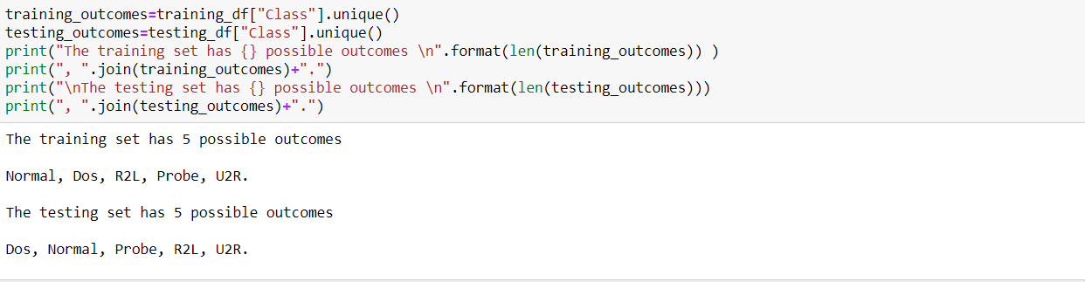
The new outcomes:

Slide 15
Step 2: preparing the features

Slide 16
Preparing the features
For continuous features, we use the MixMaxScaler, provided by the scikit-learn library, we only allow the scaler to fit the training set values then we use it to scale both the training and testing sets.
As for the discrete features, we use one hot encoding.

Slide 17

Min-max scaler
The MixMaxScaler is probably the most famous scaling algorithm and it follows the following formula for each feature:
Basically, it shrinks the range such that it is now between 0 and 1 (or -1 or 1 if there are negative values)
Notes:
When training machine learning algorithms, one of the techniques that will speed up your trainings is if you scale your features.
Scaling in general: Feature Scaling or Standardization: It is a step of Data Pre Processing which is applied to independent variables or features of data. It basically helps to normalise the data within a particular range. Sometimes, it also helps in speeding up the calculations in an algorithm.

Slide 18
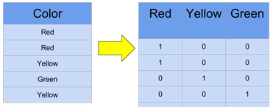
One hot encoding

Slide 19
Extracting the training and the testing values
X: the features of the training dataset
Y: the classification of the training dataset
X_test: the features of the testing dataset
Y_test: the classification of the testing dataset
Y0: the classification of the training dataset to one of two possible labels: 0 for normal traffic and 1 for an attack
Y0_test: the classification of the testing dataset to one of two possible labels: 0 for normal traffic and 1 for an attack

Slide 20
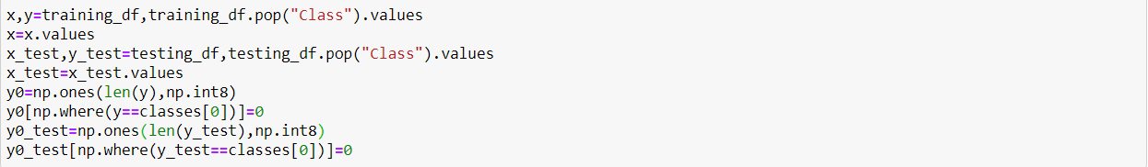
Extracting the training and the testing values (code)

Slide 21
Step 3: Building and training the model

Slide 22
The model
To avoid:
Imbalance of samples representing each attack type in the training data.
Model’s inability to learn about new attacks.
=> We present an approach that utilizes autoencoders and reconstruction error to detect anomalies.

Slide 23
Autoencoder

Slide 24
autoencoder:
Autoencoders take any input, compress it and use it to reconstruct what the input was.
X goes into hidden layer h: h=f(x)
And comes out as reconstruction r: r=g(h)
The autoencoder is good when r is close to x.
H should have some limitations so that it pulls out important details about x, without keeping all the information x provided.

Slide 25
autoencoder:
We will be building something called an undercomplete autoencoder, which means we shrink the hidden layer so that it can’t store the same amount of info that the input gives us.
We force the autoencoder to find the most import features of the data we feed it.
We do this to denoise noisy data.

Slide 26
Dropout

Slide 27
Dropout:
It refers to « ignoring » units during the training of a certain set of neurons which is chosen at random.
We need dropout to avoid overfitting.
=> Dropout is an approach to regularization in neural networks which helps reducing interdependent learning amongst the neurons.
Notes:
Reguralization: avoiding overfitting by adding a penalty to the loss fct
Overfitting: In statistics, overfitting is "the production of an analysis that corresponds too closely or exactly to a particular set of data, and may therefore fail to fit additional data or predict future observations reliably".

Slide 28
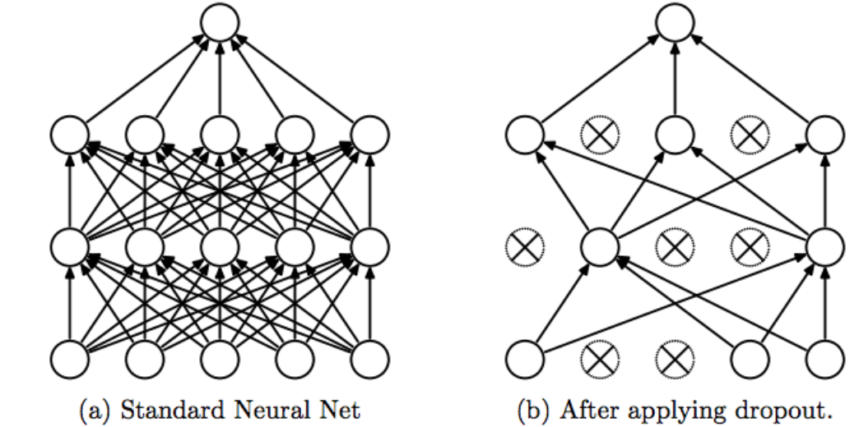
Dropout:
Notes:
Some observations:
Dropout forces a NN to learn more robust features that are useful in conjunction with many different random subsets of the other neurons.
Dropout roughly doubles the number of iterations required to converge. However, training time for each epoch is less.
With N hidden units, each of which can be dropped, we have 2^N possible models. In testing phase, the entire network is considered, and each activation is reduced by a factor p.

Slide 29
Building and training the model
In order to avoid the imbalance of the samples representing each attack type in the training data, and to avoid the model’s inability to learn about new attack types by observing existing ones, we present an approach that utilizes autoencoders and reconstruction error to detect anomalies.
The model is trained for 10 epochs using an Adam optimizer with a batch size of 100, furthermore we held out 10% of the normal training samples to validate the model.
Notes:
The model is trained for 10 epochs using an Adam optimizer with a batch size of 100, furthermore we held out 10% of the normal training samples to validate the model.
Epoch:
The number of epochs is a hyperparameter that defines the number times that the learning algorithm will work through the entire training dataset.
One epoch means that each sample in the training dataset has had an opportunity to update the internal model parameters. An epoch is comprised of one or more batches. For example, as above, an epoch that has one batch is called the batch gradient descent learning algorithm.
Batch:
The batch size is a hyperparameter that defines the number of samples to work through before updating the internal model parameters.
Think of a batch as a for-loop iterating over one or more samples and making predictions. At the end of the batch, the predictions are compared to the expected output variables and an error is calculated. From this error, the update algorithm is used to improve the model, e.g. move down along the error gradient.

Slide 30
Step 4: Evaluating the model

Slide 31
Evaluation
To evaluate our model, we calculated the following metrics:
Accuracy
Recall
Precision
F1 Score
Detection Rate for each of the five possible labels

Slide 32

Thank you!

