Slide 1
SB Perpetual Litmus Test
Initially [x] = 0, [y] = 0
Thread 0 | Thread 1
…
(i₀₀): [x] ← n + 1 | (i₁₀): [y] ← m + 1
(i₀₁): reg₀_0 ← [y] | (i₁₁): reg₁_0 ← [x]
buf₀[n] ← reg₀_0 | buf₁[m] ← reg₁_0
mfence | mfence
…
SB Litmus Test
Initially [x] = 0, [y] = 0
Thread 0 | Thread 1
(i₀₀): [x] ← 1 | (i₁₀): [y] ← 1
(i₀₁): reg₀_0 ← [y] | (i₁₁): reg₁_0 ← [x]
Write in perpetual
format
Enclose in loop
construct
Litmus test
sb_perpetual_thread0.s
sb_perpetual_thread1.s
Write in target
assembly language
// harness
initialize();
parallel {
if (thread_id == 0) {
synchronization_barrier();
sb_perpetual_Thread0(N,buf0);
}
if (thread_id == 1) {
synchronization_barrier();
sb_perpetual_Thread1(N,buf0);
}
}
countCounter = COUNT(N, buf0,buf1);
countHeuristic = COUNTH(N, buf0,buf1);
Write in perpetual
format
int COUNT(N,buf0,buf1){
count=0;
for(n=0; n<N; n++)
for(m=0; m<N; m++)
if(buf₀[n] <= m && buf1[m] <= n)
count++;
return count;
}
Target Outcome
reg₀_0 = 0 && reg₁_0 = 0
buf₀[n] <= m && buf₁[m] <= n
Generate outcome
counter
Generate heuristic
outcome counter
int COUNTH(N,buf0,buf1){
count=0;
for(n=0; n<N; n++)
if(buf1[buf0[n]] <= n)
count++;
return count;
}

Slide 2
Target Outcome
reg₀_0 = 0 && reg₁_0 = 0
Write in perpetual
format
Write in heuristic
format
p_out₀(n, m, buf₀[], buf₁[]) = buf₀[n] <= m && buf₁[m] <= n
p_out_h₀(n, buf₀[], buf₁[]) = buf₁[buf₀[n]] <= n
Generate
outcome counter
Generate heuristic
outcome counter
COUNT(N,buf0,buf1){
counts={0};
for(n=0; n<N; n++)
for(m=0; m<N; m++)
if(buf₀[n] <= m && buf1[m] <= n)
counts[0]++;
return counts;
}
COUNTH(N,buf0,buf1){
counts={0};
for(n=0; n<N; n++)
if(buf1[buf0[n]] <= n)
counts[0]++;
return counts;
}

Slide 3
Litmus test
Target Outcome
SB Litmus Test
Initially [x] = 0, [y] = 0
Thread 0 | Thread 1
(i₀₀): [x] ← 1 | (i₁₀): [y] ← 1
(i₀₁): reg₀_0 ← [y] | (i₁₁): reg₁_0 ← [x]
reg₀_0 = 0 && reg₁_0 = 0
Write in perpetual
format
Write in perpetual
format
buf₀[n] <= m && buf₁[m] <= n
SB Perpetual Litmus Test
Initially [x] = 0, [y] = 0
Thread 0 | Thread 1
…
(i₀₀): [x] ← n + 1 | (i₁₀): [y] ← m + 1
(i₀₁): reg₀_0 ← [y] | (i₁₁): reg₁_0 ← [x]
buf₀[n] ← reg₀_0 | buf₁[m] ← reg₁_0
mfence | mfence
…
Generate outcome
counter
int COUNT(N,buf0,buf1){
count=0;
for(n=0; n<N; n++)
for(m=0; m<N; m++)
if(buf₀[n] <= m && buf1[m] <= n)
count++;
return count;
}
Generate heuristic
outcome counter
Enclose in loop
construct
Write in target
assembly language
int COUNTH(N,buf0,buf1){
count=0;
for(n=0; n<N; n++)
if(buf1[buf0[n]] <= n)
count++;
return count;
}
sb_perpetual_thread0.s
sb_perpetual_thread1.s
Generate outcome
counter
// harness
initialize();
parallel {
if (thread_id == 0) {
synchronization_barrier();
sb_perpetual_Thread0(N,buf0);
}
if (thread_id == 1) {
synchronization_barrier();
sb_perpetual_Thread1(N,buf0);
}
}
countCounter = COUNT(N, buf0,buf1);
countHeuristic = COUNTH(N, buf0,buf1);
Generate heuristic
outcome counter

Slide 4
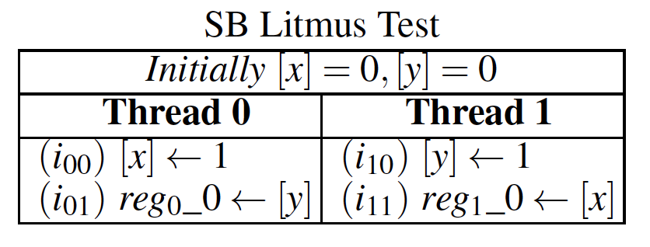
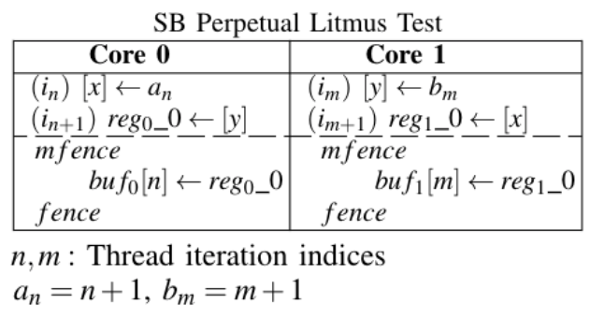

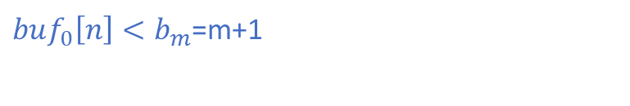
Outcome
under test
$${load from y in i}_{01}<{store to y in i}_{10}$$
Reg₀_0 =0 /\ Reg₁_0 = 0
$${load from x in i}_{11}<{store to x in i}_{00}$$
Mapping
Test
Mapping
Outcome
$buf_{0}\left[n\right]<b_{m}$=m+1
$$buf_{1}\left[m\right]<a_{n}=n+1$$

Slide 5
fr
fr
i₀₀
i₁₀
po
po
i₀₁
i₁₁
MP Litmus Test
Initially [x] = 0, [y] = 0
Thread 0 | Thread 1
Synchronize Threads
(i₀₀): [x] ← 1 | (i₁₀): reg₁_0 ← [y]
(i₀₁): [y] ← 1 | (i₁₁): reg₁_1 ← [x]
Determine Outcome
sb
Initially [x] = 0, [y] = 0
Thread 0 | Thread 1
(i₀₀): [x] ← 1 | (i₁₀): [y] ← 1
(i₀₁): reg₀_0 ← [y] | (i₁₁): reg₁_0 ← [x]
lb
Initially [x] = 0, [y] = 0
Thread 0 | Thread 1
(i₀₀): reg₀_0 ← [y] | (i₁₀): reg₁_0 ← [x]
(i₀₁): [x] ← 1 | (i₁₁): [y] ← 1
podwr001
Initially [x] = 0, [y] = 0, [z] = 0
Thread 0 | Thread 1 | Thread 2
(i₀₀): [x] ← 1 | (i₁₀): [y] ← 1 | (i₂₀): [z] ← 1
(i₀₁): reg₀_0 ← [y] | (i₁₁): reg₁_0 ← [z] | (i₂₁): reg₁_0 ← [x]
Litmus Test Loop Body (sb)
Initially [x] = 0, [y] = 0
Thread 0 | Thread 1
barrier | barrier
(i₀₀): [x] ← 1 | (i₁₀): [y] ← 1
(i₀₁): reg₀_0 ← [y] | (i₁₁): reg₁_0 ← [x]
buf₀[n] ← reg₀_0 | buf₁[m] ← reg₁_0
mfence | mfence
zero out [x], [y] | zero out [x], [y]
Perpetual Litmus Test Loop Body (sb)
Initially [x] = 0, [y] = 0
Thread 0 | Thread 1
(i₀₀): [x] ← n + 1 | (i₁₀): [y] ← m + 1
(i₀₁): reg₀_0 ← [y] | (i₁₁): reg₁_0 ← [x]
buf₀[n] ← reg₀_0 | buf₁[m] ← reg₁_0
mfence | mfence

Slide 6
Original Outcome | reg₀_0 = 0 && reg₁_0 = 0 | reg₀_0 = 0 && reg₁_0 = 1
1) Happens-before edges | i₀₀ → i₀₁ (po), i₁₀ → i₁₁ (po), i₀₁ → i₁₀ (fr), i₁₁ → i₀₀ (fr) | i₀₀ → i₀₁ (po), i₁₀ → i₁₁ (po), i₀₁ → i₁₀ (fr), i₀₀ → i₁₁ (rf)
2) Replace registers | buf₀[n] = 0 && buf₁[m] = 0 | buf₀[n] = 0 && buf₁[m] = 1
3) Replace integer values | buf₀[n] = m && buf₁[m] = n | buf₀[n] = m && buf₁[m] = n + 1
4) Turn to inequalities | p_out₀(n, m, buf₀[], buf₁[]) = buf₀[n] <= m && buf₁[m] <= n | p_out₁(n, m, buf₀[], buf₁[]) = buf₀[n] <= m && buf₁[m] >= n + 1
Original Outcome | reg₀_0 = 1 && reg₁_0 = 0 | reg₀_0 = 1 && reg₁_0 = 1
1) Happens-before edges | i₀₀ → i₀₁ (po), i₁₀ → i₁₁ (po), i₁₀ → i₀₁ (rf), i₁₁ → i₀₀ (fr) | i₀₀ → i₀₁ (po), i₁₀ → i₁₁ (po), i₁₀ → i₀₁ (rf), i₀₀ → i₁₁ (rf)
2) Replace registers | buf₀[n] = 1 && buf₁[m] = 0 | buf₀[n] = 1 && buf₁[m] = 1
3) Replace integer values | buf₀[n] = m + 1 && buf₁[m] = n | buf₀[n] = m + 1 && buf₁[m] = n + 1
4) Turn to inequalities | p_out₂(n, m, buf₀[], buf₁[]) = buf₀[n] >= m + 1 && buf₁[m] <= n | p_out₃(n, m, buf₀[], buf₁[]) = buf₀[n] >= m + 1 && buf₁[m] >= n + 1
Original Outcome | reg₀_0 = 0 && reg₁_0 = 0 | reg₀_0 = 0 && reg₁_0 = 1
… | … | …
4) Turn to inequalities | buf₀[n] = m && buf₁[m] <= n | buf₀[n] = m && buf₁[m] >= n + 1
5) Substitute | p_out_h₀(n, buf₀[], buf₁[]) = buf₁[buf₀[n]] <= n | p_out_h₁(n, buf₀[], buf₁[]) = buf₁[buf₀[n]] >= n + 1
Original Outcome | reg₀_0 = 1 && reg₁_0 = 0 | reg₀_0 = 1 && reg₁_0 = 1
… | ... | …
4) Turn to inequalities | buf₀[n] = m + 1 && buf₁[m] <= n | buf₀[n] = m + 1 && buf₁[m] >= n + 1
5) Substitute | p_out_h₂(n, buf₀[], buf₁[]) = buf₁[buf₀[n] - 1] <= n | p_out_h₃(n, buf₀[], buf₁[]) = buf₁[buf₀[n] - 1] >= n + 1
SB Litmus Test
Initially [x] = 0, [y] = 0
Thread 0 | Thread 1
(i₀₀): [x] ← 1 | (i₁₀): [y] ← 1
(i₀₁): reg₀_0 ← [y] | (i₁₁): reg₁_0 ← [x]

Slide 7
Litmus Test
Converter
Weak Outcome Detector
Parser
Weak Outcome Count
Perpetual Threads
Harness
Output Log

Slide 8
Converter
Harness
Litmus test
Test Conversion
Perpetual Litmus Test
Test Execution
In-memory test results
Outcomes of interest
Outcome Conversion
Outcome counter
Outcome counting
# occurrences of outcomes of interest (counter)
Heuristic outcome counter
Heuristic outcome counting
# occurrences of outcomes of interest (heuristic)

Slide 9
Litmus testing
Thread 0 | Thread 1
… | …
Iter n | Iter n
Iter n + 1 | Iter n + 1
Iter n + 2 | Iter n + 2
… | …
Frames to consider
Iter n | …
Iter n | Iter n - 1
Iter n | Iter n
Iter n | Iter n + 1
Iter n | …
Perpetual litmus testing
Thread 0 | Thread 1
… | …
Iter n | Iter m
Iter n + 1 | [Other work]
Iter n + 2 | Iter m + 1
… | …
Frames to consider
Iter n | Iter n

Slide 10
Concurrent Program
Thread 0 | Thread 1
L₀ | L₁
S₀ | S₁
Concurrent Program
Possible SC Orderings
Additional TSO Orderings:
Possible SC Orderings
S₀ reordered after L₀
L₀ |  | L₀ |  | L₀ |  | L₁ |  | L₁ |  | L₁
S₀ |  | L₁ |  | L₁ |  | S₁ |  | L₀ |  | L₀
L₁ |  | S₀ |  | S₁ |  | L₀ |  | S₁ |  | S₀
S₁ |  | S₁ |  | S₀ |  | S₀ |  | S₀ |  | S₁
Thread 0 | Thread 1
S₀ | S₁
L₀ | L₁
S₀ |  | S₀ |  | S₀ |  | S₁ |  | S₁ |  | S₁
L₀ |  | S₁ |  | S₁ |  | L₁ |  | S₀ |  | S₀
S₁ |  | L₀ |  | L₁ |  | S₀ |  | L₁ |  | L₀
L₁ |  | L₁ |  | L₀ |  | L₀ |  | L₀ |  | L₁
L₀ |  | L₀ |  | L₀ |  | L₁ |  | L₁ |  | L₁
S₀ |  | S₁ |  | S₁ |  | S₁ |  | L₀ |  | L₀
S₁ |  | S₀ |  | L₁ |  | L₀ |  | S₁ |  | S₀
L₁ |  | L₁ |  | S₀ |  | S₀ |  | S₀ |  | L₁
time
time
time
S₁ reordered after L₁
Additional TSO Orderings:
S₀ |  | S₀ |  | S₀ |  | L₁ |  | L₁ |  | L₁
L₀ |  | L₁ |  | L₁ |  | S₁ |  | S₀ |  | S₀
L₁ |  | L₀ |  | S₁ |  | S₀ |  | S₁ |  | L₀
S₁ |  | S₁ |  | L₀ |  | L₀ |  | L₀ |  | S₁
None
time
S₀ reordered after L₀ and S₁ reordered after L₁
L₀ |  | L₀ |  | L₀ |  | L₁ |  | L₁ |  | L₁
S₀ |  | L₁ |  | L₁ |  | S₁ |  | L₀ |  | L₀
L₁ |  | S₀ |  | S₁ |  | L₀ |  | S₁ |  | S₀
S₁ |  | S₁ |  | S₀ |  | S₀ |  | S₀ |  | S₁
time

Slide 11
