Slide 1
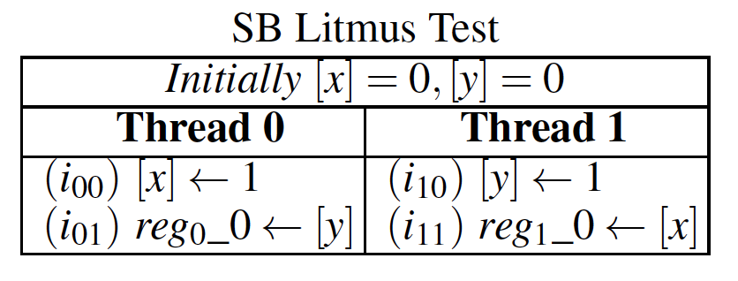
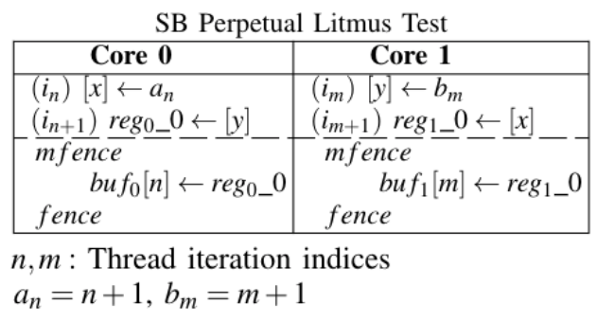
int checker(N,buf0,buf1){
sum=0;
for(n=0; n<N; n++)
for(m=0; m<N; m++)
if(buf0[n] < m+1)
// condition 1
if(buf1[m] < n+1)
// condition 2
sum++;
return sum;
}
int heuristic(N,buf0,buf1){
sum=0;
for(n=0; n<N; n++)
if(buf1[buf0[n]] < n+1)
sum++;
return sum;
}
Checker
Compiler
x86
Converter
Assembly
Files
// harness
initialize();
sb_perpetual_Thread0(N,buf0);
sb_perpetual_Thread1(N,buf1);
synchronization_barrier();
outcomesChecker = checker(buf0,buf1);
outcomesHeuristic = heuristic(buf0,buf1);

Slide 2




Outcome
under test
$${load from y in i}_{01}<{store to y in i}_{10}$$
$${load from x in i}_{11}<{store to x in i}_{00}$$
Reg₀_0 =0 /\ Reg₁_0 = 0
Mapping
Test
Mapping
Outcome
$buf_{0}\left[n\right]<b_{m}$=m+1
$$buf_{1}\left[m\right]<a_{n}=n+1$$

Slide 3
fr
fr
i₀₀
i₁₀
po
po
i₀₁
i₁₁

Slide 4
Weak Outcome Detector
Litmus Test
Converter
Parser
Weak Outcome Count
Perpetual Threads
Harness
Output Log

Slide 5
Converter
CheckerDetector
Execution Analysis
Conversion to Perpetual Litmus Tests
Log Parsing
Litmus Test
Heuristic Detector
Outcome Count
Condition & Heuristic extraction
Outcome detection
(a) Checker
(b) Heuristic
Harness
Mapping to target hardware
Perpetual Threads
Initialization/Register & Buffer allocation
In-memory
Execution Log
Perpetual test executable
Run on target hardware

