Slide 1
GENETIC INHERITANCE ANALYSIS
MOUKTHIKA MUTHUKRISHNAN
19PW16

Slide 2
List Of Classes and relations among them
Base class
Base class
Parent
RatioandProb
Public Inheritance
Derived class
Chromosome
Friend class
Population
Allele
Data Member

Slide 3

Gene: Protein which codes for a trait.
ALLELE: Different froms of a trait. Eg:- Eye colour gene can have different forms like blue, grey, brown eyes. Symbols can be used for representing alleles.
Dominant allele:- The trait which expresses itself.
Bb-> B-Brown eyes b- blue eyes
If the person has brown eyes, ‘B’ is dominant and ‘b’ is recessive.
Chromosome: Thread like structure containing genetic information.

Slide 4
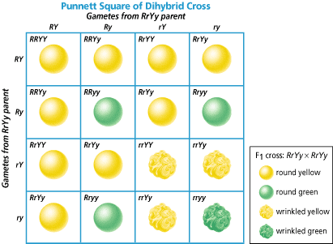
DIHYBRID CROSS
Dihybrid cross is a cross between two observed traits, from each parent.
Punnette Square:
Used to predict the genetic composition of the offsprings of a particular cross or breeding experiment.

Slide 5
POPULATION
CHROMOSOME
1 | 0 | 1 | 0
GENE
1 | 0 | 1 | 0

Slide 6
m
f
Crossover point: 3
1
0
1
0
1
0
1
1
1
0
1
1
1
0
1
0
Eye color
Hair color
Metabolism
Hair type
Rejected
Fit num=2
Fit num=3
Selected because of higher fitness number
GENERATION: 1
GENERATION:2

Slide 7
Crossover point:2
NEWLY INPUTTED
1
1
1
1
0
0
1
1
1
0
1
1
0
1
1
1
MAXIMUM POSSIBLE FITNESS LEVEL IS ACHIEVED!!
LOOP TERMINATES
GENERATION:3

Slide 8
CONCEPTS USED: -
Operator overloading
Vectors
Inheritance
Friend Class
Exception Handling
File Pointers

