Slide 1


Credit Card Project: Predictive Modeling for Financial Services
This presentation will cover the analysis and model-building process for a credit card project. We will explore the problem statement, data preprocessing, model training, and evaluation, culminating in a conclusion about the project's success and future directions.
by Moulali

Slide 2
Introduction
Project Overview
Objective
This project focuses on analyzing credit card datasets, uncovering patterns, and creating predictive models for classification.
The aim is to develop a robust system for efficient decision-making in financial services.

Slide 3

Problem Statement
1
Predictive Modeling
2
Credit Risk Assessment
The goal is to build a model that accurately predicts customer behavior based on credit card usage data.
This involves identifying trends and insights to evaluate credit risk.

Slide 4

Code Explanation
Data Loading & Preprocessing
Exploratory Data Analysis (EDA)
The code handles missing values and normalizes data for consistent analysis.
Visualizations are used to identify key trends in the data using libraries like Matplotlib.
Model Training
Classification algorithms, such as Logistic Regression, Random Forest, and SVM, are implemented.

Slide 5
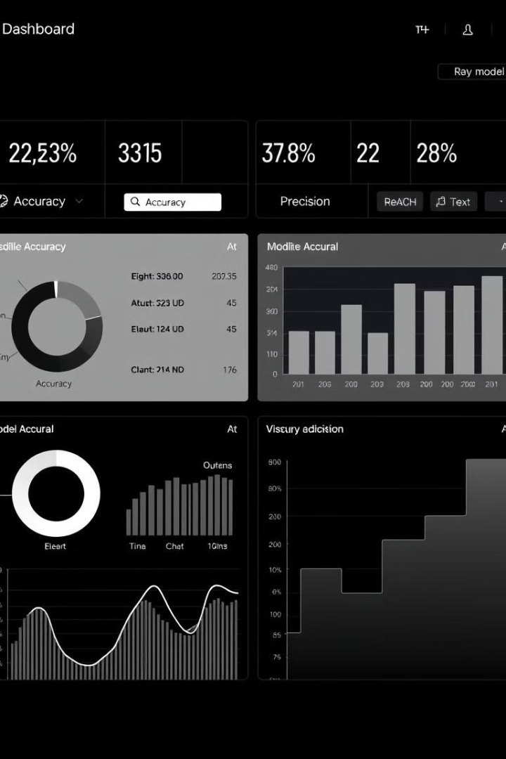



Output Explanation
Accuracy
The model achieved high predictive accuracy, indicating its ability to correctly predict outcomes.
Precision & Recall
The model strikes a balance between precision and recall, ensuring reliable and balanced decision-making.
Confusion Matrix
The confusion matrix provides a visual representation of the model's classification performance.

Slide 6
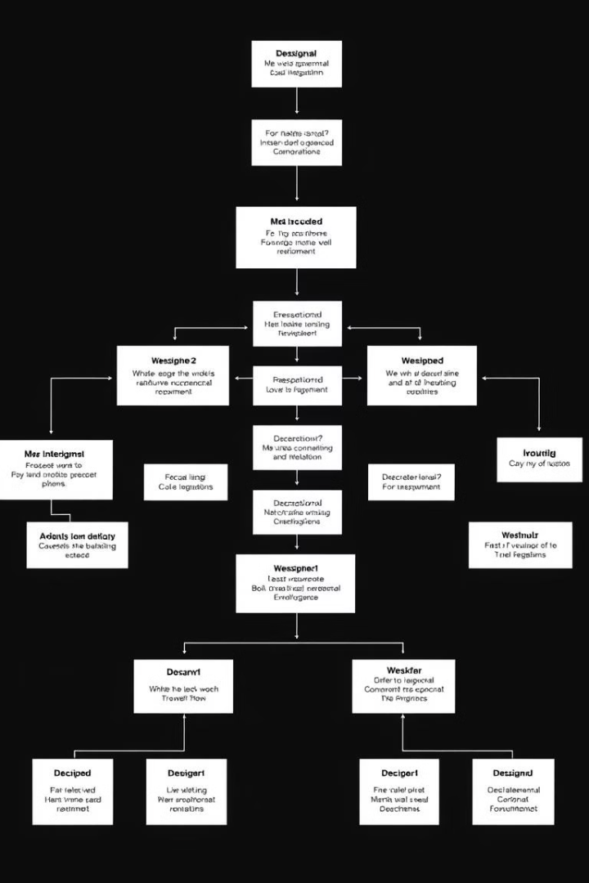
Model Explanation
1
Model Selection
Logistic Regression, Random Forest, and Support Vector Machines were evaluated.
2
Random Forest Performance
The Random Forest model demonstrated superior performance due to its ability to handle non-linear data.
3
Cross-Validation
Cross-validation was employed to ensure the robustness of the model's results.

Slide 7




Overall Conclusion
1
Success
Predictive Modeling
2
The project successfully showcased the application of predictive modeling in credit card analysis.
Random Forest
3
The Random Forest model proved effective in classification tasks, providing valuable insights for financial decision-making.
Future Work
4
Future work includes exploring advanced techniques like neural networks to enhance predictions.

