Slide 1
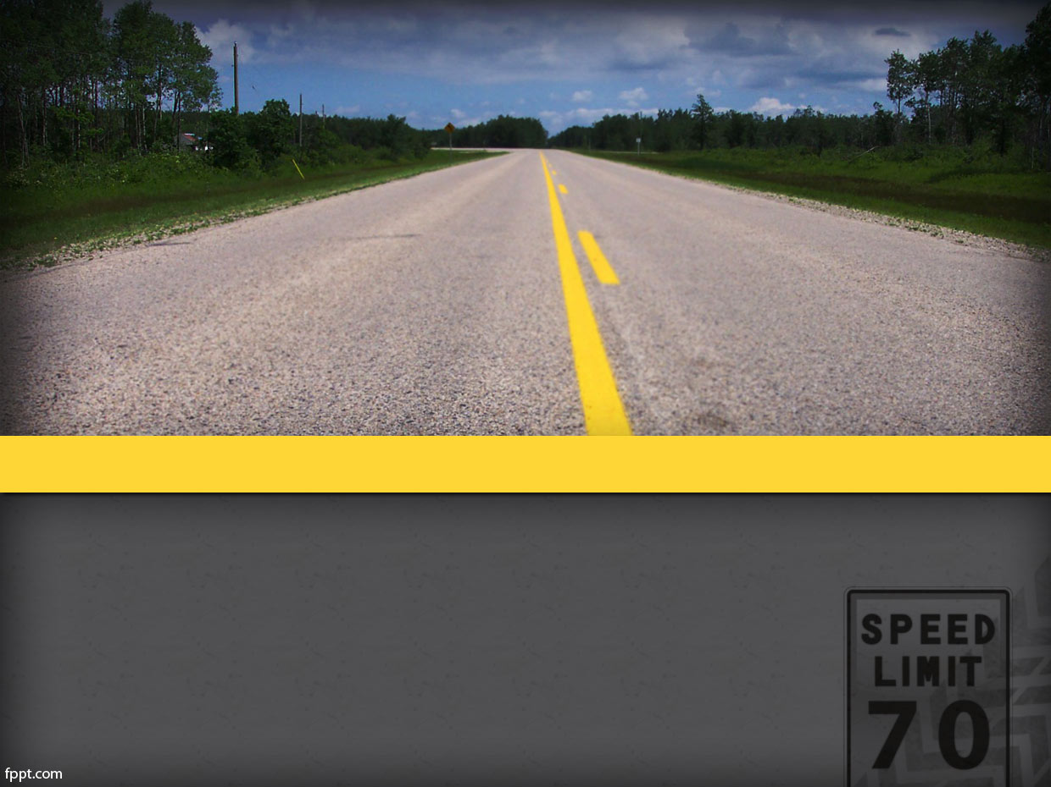
Vehicle Speed Controller
Course NO. : CSE 3200
Course Title : System Development Project

Slide 2
Supervised by:
Md. Shamimur Rahman
Lecturer
Department of Computer Science & Engineering
Khulna University of Engineering & Technology
Presented by:
Name : Tasmia Tahnim Name : Md. Main Uddin Munna
Roll : 1507085 Roll : 1507087
Section : B Section : B

Slide 3
Introduction
Road accident is one of the biggest problem in our country.
The annual wastage occasioned by traffic accidents is estimated to be in the order of 2 to 3 percent of the GDP.
Each year there are at least 3,000 fatalities and 3,000 grievous.
One of the major reason is reckless driving and over speeding by the driver.
And also while driving the driver may not focus on the speed limit written on the small pillar.

Slide 4
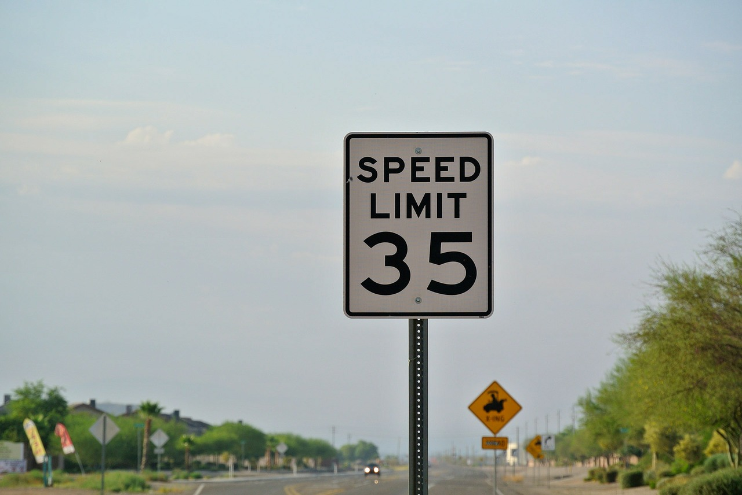
Introduction

Slide 5
Project Details
In this project we want to notify the driver about the speed limit of the road through digital process.
As well as we are forcing the driver to follow the Speed Limit of a certain road.

Slide 6
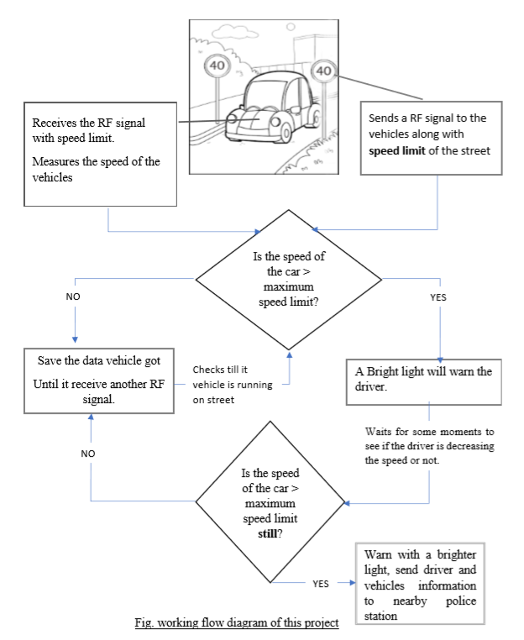

Slide 7
Project Details
Road Side Unit transmits the maximum speed limit of the road continuously.
Every vehicles will be provided with a module that measures the speed of that car. And receives transmitted data and displays it along with measured data.
The speed of the car is compared with the speed limit of the car. If the speed exceed the maximum speed limit it warns driver by displaying a massage and lighting a bright light.

Slide 8
Project Details
It will wait for some moment to check if driver is decreasing the speed or not. If not another bright light will be lit up so warn the driver again. A message will be send to nearby police station along with the driver’s license and vehicle’s number.

Slide 9
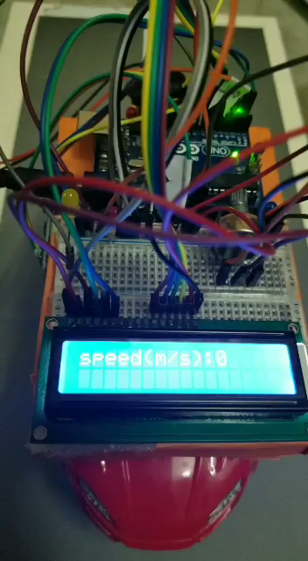
Project Details

Slide 10
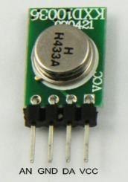
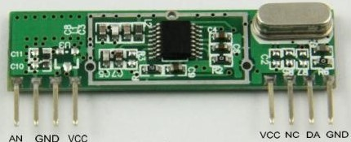
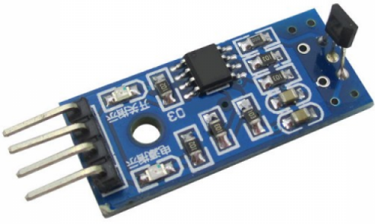
Required Hardwares
433 MHz RF Transmitter
433 MHz RF Receiver
Hall effect module
LM393

Slide 11
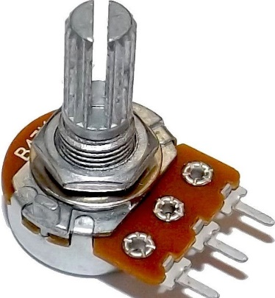
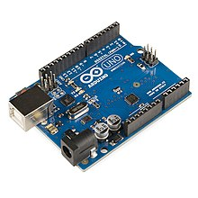
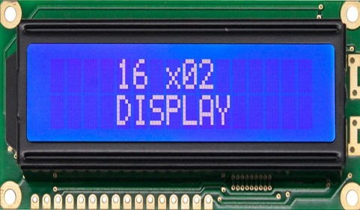
Required Hardwares
Arduino UNO
LCD monitor
10k Potentiometer

Slide 12

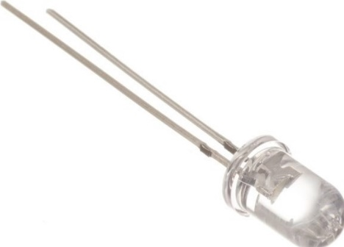
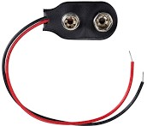
Required Hardwares
Arduino UNO
9V Battery
9V Battery Clipper

Slide 13
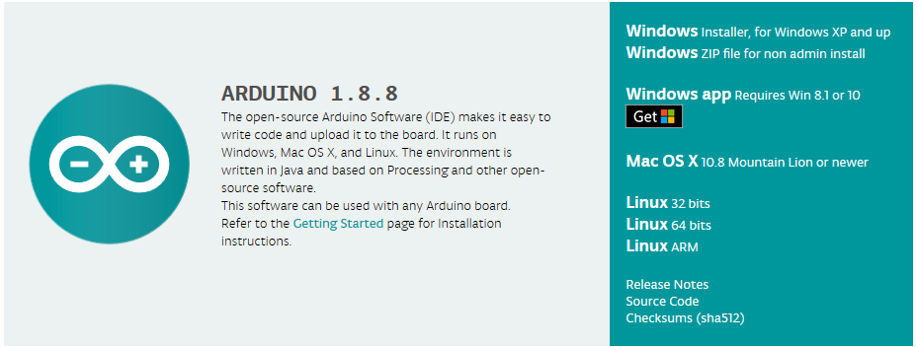
Required Software

Slide 14
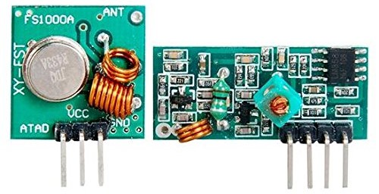
Components required
RF modules:
A 433 MHz RF transmitter and receiver is used for communication between a vehicle and a roadside pillar RF signals travel in the transmitter and receiver even when there is an obstruction. It operates at a specific frequency of 433MHz.
in this project a 3 pin RF module is used as there is no need of any encoder and decoder in sending the secrete information.
transmitter
Receiver

Slide 15

Components required
A Hall effect sensor:
is a transducer that varies its output voltage in response to a magnetic field. In this project a linear hall effect sensor is used. It can detect a magnetic field when a north pole is near. Advantages of this sensor is that it does not need a south pole to make it’s voltage neutral again. It is easy to use.
hall effect module lm393

Slide 16
Problems have been faced
There are various types of Hall effect sensors. At first we bought a latching hall effect without knowing these facts. It did not work.
- Linear Hall effect sensor ‘LM393’ is used.
We wanted to use raspberry pi for this project but there is rarely any library for RF communication.
- We used Arduino.

Slide 17
Problems have been faced
Hall effect sensor works using interrupts. Some features (e.g. serial communication) of the Arduino could not be used because of it.
- We avoided using serial communication commands like serial.begin(), serial.print();
Arduino cannot connect to a network alone, it needs a Wi-Fi module. Used ESP8266 esp-01 to connect arduino to a network to solve this problem. But it still didn’t work.

Slide 18
Advantages
This project will keep driver always conscious about speed limit.
Decreases the rate of Road Accident.
“Not sufficient traffic police” problem can be partially solved.
This project is less expensive.
Authority can change the speed limit for any certain time.

Slide 19
Limitations
RF signal can be obstructed by any Aluminum plate.
At present the project is less secured.
This project includes two types of expenses. - The road side unit module. - The module in the vehicles.

Slide 20
Future Plan
A camera can be added to the module in the car, when car is exceeding the speed limit, it will capture a photo of the driver and send it to police station. Thus if it check if it is the driver whose information is sending to the police station.
We can vibrate the driver’s seat continuously for exceeding the speed limit. That will mentally force him to control the speed.
Road side unit can send the area’s postal code with the speed limit. So device in the vehicle can send the message to the police station in that postal area.
Even it may sense the activity of the driver and also all the people in the vehicle, so that many more crime can be identified and get immediate help.

Slide 21
Conclusion
Though it may seem to be smaller project, but it may be proved as a good system for a country like Bangladesh. It does not reduce the speed of a vehicle, it mentally forces a driver to keep the speed below the maximum speed limit.
In future this project can be extended more and more if more time and resource could have been applied to it. So this project can add a new dimension in our country’s traffic system.

Slide 22
References
Arduino RF Communication Tutorial
https://www.instructables.com/id/Arduino-RF-Communication-Tutorial/
Arduino + Hall effect sensor (measuring speed of rotation) http://academicfox.com/arduino-hall-effect-sensor-measuring-speed-of-rotation/
Speedometer Using Arduino and Processing https://www.instructables.com/id/Speedometer-Using-Arduino-and-Processing/
Arduino LCD Tutorial https://howtomechatronics.com/tutorials/arduino/lcd-tutorial/

Slide 23
References
Fan RPM With Internal Hall Effect Sensor and Arduino (Intro to Hardware Interrupt and LCD Display) https://www.instructables.com/id/Fan-RPM-With-Internal-Hall-Effect-Sensor-and-Ardui/
Arduino lesson – Hall Effect Sensor module http://osoyoo.com/2017/07/28/arduino-lesson-hall-effect-sensor-module/
Various Hall Effect Sensors http://adam-meyer.com/arduino/Various_Hall_Effect_Sensors
Inexpensive 433 MHz RF Modules with Arduino https://www.youtube.com/watch?v=b5C9SPVlU4U&t=914s

Slide 24
References
Print string and integer LCD https://arduino.stackexchange.com/questions/19234/print-string-and-integer- lcd
Adafruit_ESP8266 https://github.com/AllAboutEE/Adafruit_ESP8266/tree/master
How to control an LCD Display – Arduino Tutorial http://smartmicrocontroller.com/how-to-control-an-lcd-display-arduino-tutorial/
Date sheet for linear hall effect sensor SS49E http://files.amperka.ru/store-media/products/troyka-hall-sensor/media/SS49e_Hall_Sensor_Datasheet.pdf

Slide 25
References
Date sheet for linear hall effect sensor SS49E http://files.amperka.ru/store-media/products/troyka-hall-sensor/media/SS49e_Hall_Sensor_Datasheet.pdf
How to Send an Email using ESP8266 Wi-Fi Module? https://www.electronicshub.org/send-an-email-using-esp8266/#comments

Slide 26
Thank you…

