Slide 1
IBM University Engagement Project Submission
“Exploring the Power of Agentic AI with IBM Granite and IBM Bob”

Slide 2

Travel Planner Agent
Domain of Project – Travel and Tourism
Student Name | Recent Passport Photo | Email ID | Mobile number [WhatsApp]
Mouli Bhattacharjee |  | mouli200six@gmail.com | 9242290733
Recommended font style and size: Font Style: Arial Font Size (Heading): 28
Font Size (Content): 20

Slide 3
Problem Statement - Travel Planner Agent
The Challenge
Planning trips involves managing destinations, transport, accommodation, budgets, activities, weather, and schedules from multiple sources. Travelers often struggle to find reliable, personalized, real-time information and adapt plans to changing conditions.
The Objective
Build an AI-powered Travel Planner Agent that provides personalized and intelligent trip planning. The solution should:
Personalized Planning – Create plans based on budget, dates, interests, and preferences.
AI Itinerary Generation – Generate optimized day-by-day travel itineraries.
Real-Time Information – Provide weather, maps, transport, accommodation, and attraction data.
Smart Optimization – Adjust plans based on time, distance, budget, and weather.
AI Travel Assistant – Allow users to modify and manage trips using natural language.
Multi-Agent System – Include specialized agents for destinations, itinerary, transport, accommodation, weather, and budget.
IBM Granite Integration – Use the IBM Granite model through watsonx within the available 40 IBM Cloud credits.
.

Slide 4
Proposed Solution -
Proposed Solution: AI-Powered Travel Planner Agent
The proposed solution is a web-based AI Travel Planner Agent that provides personalized, efficient, and end-to-end trip planning.
Key Features:
Personalized Planning – Plans trips based on budget, dates, interests, and preferences.
AI Itinerary Generation – Creates optimized day-by-day travel plans.
Smart Recommendations – Suggests destinations, attractions, transport, and accommodation.
Real-Time Information – Uses weather, maps, routes, and location data.
Budget Management – Estimates expenses and suggests cost-effective options.
Plan Optimization – Adjusts schedules based on time, distance, budget, and weather.
Simple Deployment – Self-contained frontend runs on GitHub Pages, with an optional Flask backend for local use.
Workflow:
User Input → AI Analysis → Itinerary Generation → Recommendations → Optimization → Save & Manage Trip

Slide 5
Technology Used
IBM Bob platform -For designing and orchestrating multi-agent workflows visually
IBM Grainte model - “ibm/granite-4-h-small" For natural language understanding, reasoning, and personalization
IBM Cloud – It provides the infrastructure to build, deploy, and scale the Nutrition Agent efficiently. IBM Cloud enables a reliable, secure, and scalable environment for deploying the Nutrition Agent.
IBM Watsonx.ai - For model deployment, embeddings, and AI governance

Slide 6
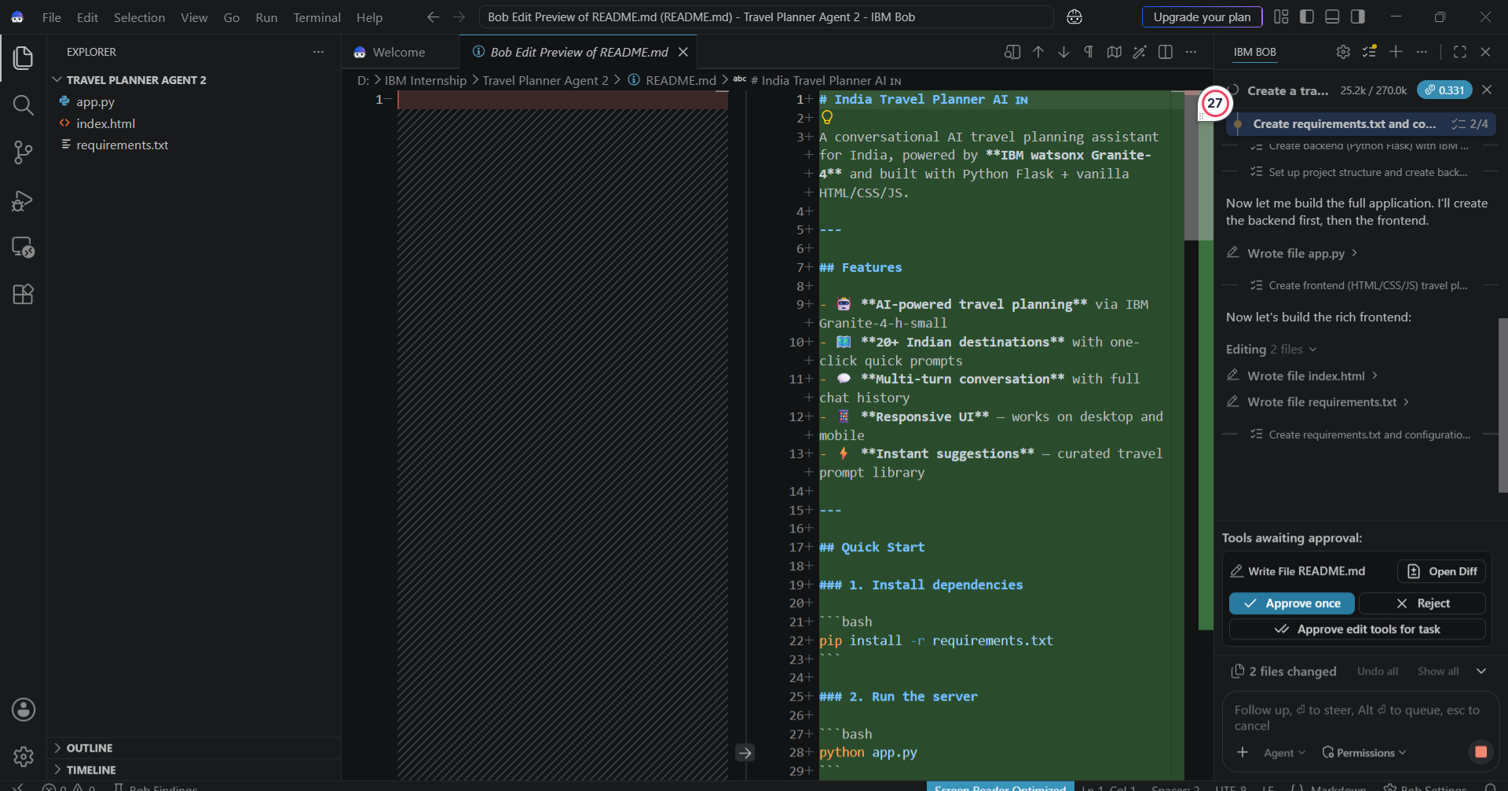
Required Files created using IBM bob -

Slide 7
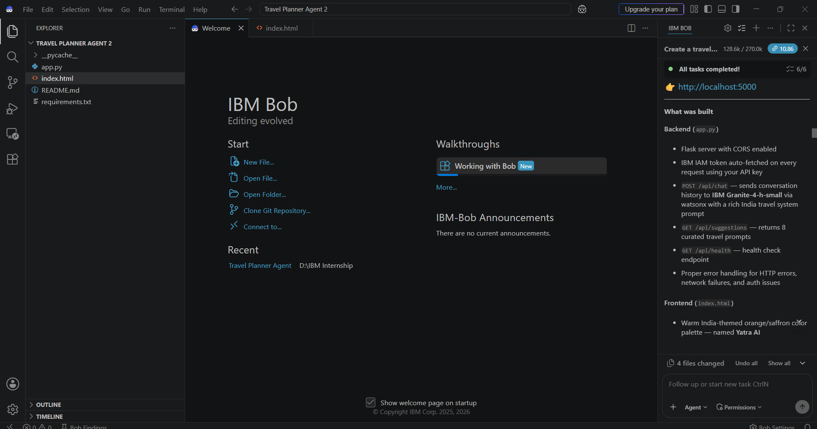
IBM Bob Screenshots:

Slide 8
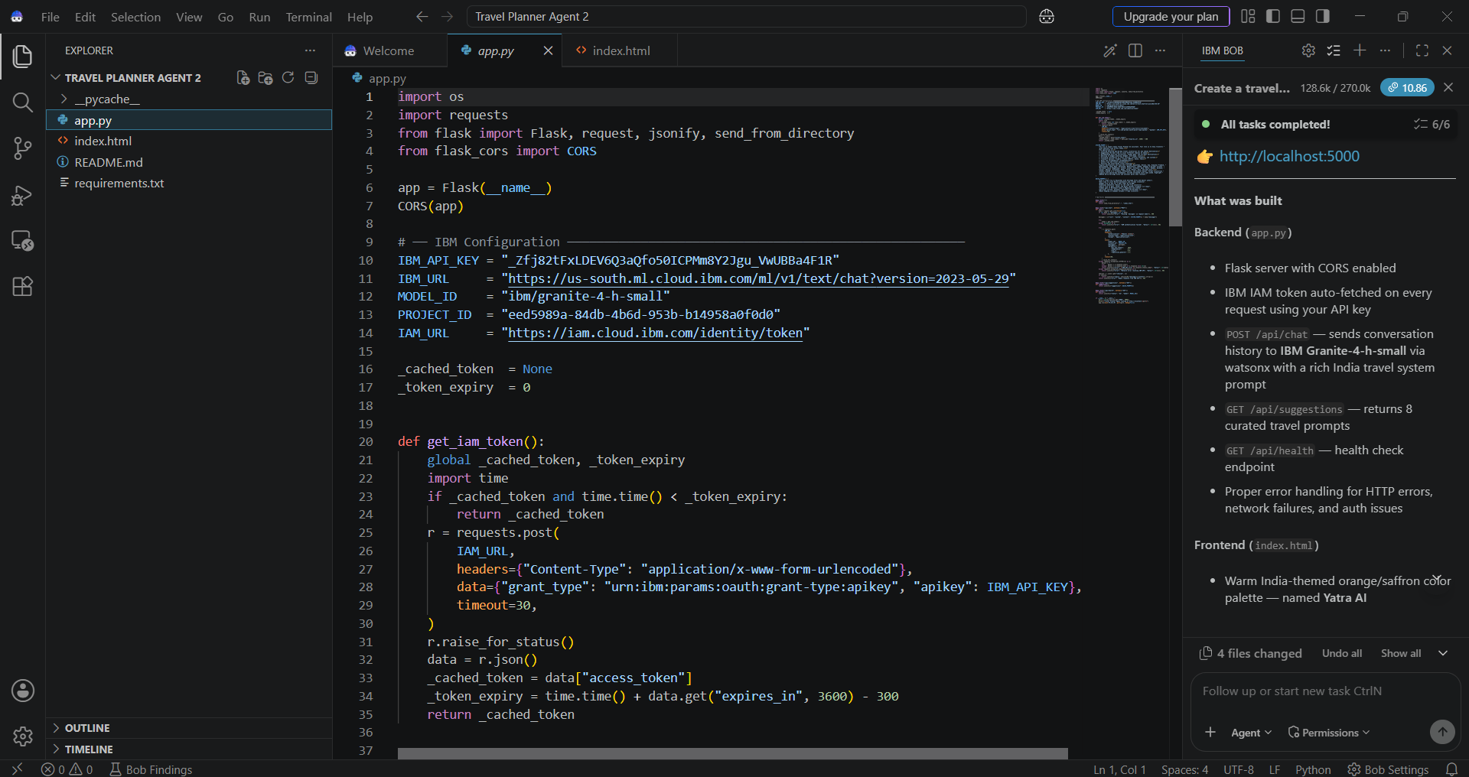

Slide 9
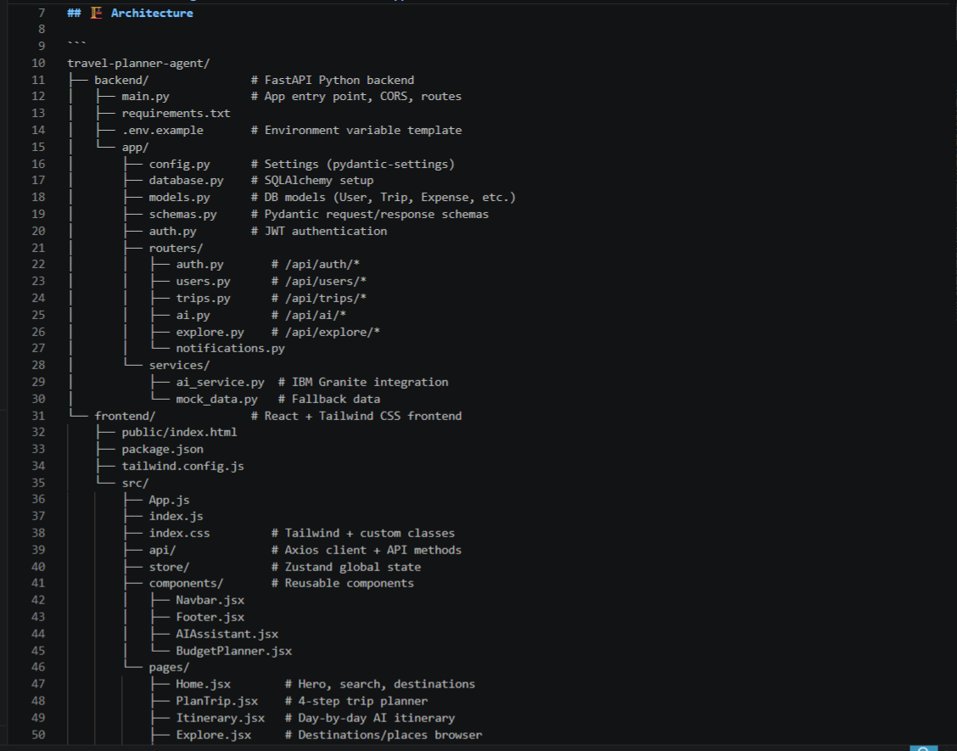
Architecture blueprint for IBM bob:

Slide 10

Role of Agentic AI in the solution
Role of Agentic AI in Travel Planner Agent
Agentic AI enables the Travel Planner Agent to function as an intelligent, autonomous system rather than a simple chatbot. Using IBM watsonx.ai and IBM Granite models, it coordinates multiple specialized agents to provide personalized and efficient travel planning.
Each agent performs a specific role—such as recommending destinations, generating itineraries, finding transport and accommodation, checking weather, and managing budgets—while working collaboratively. This multi-agent approach ensures efficient task execution and better travel decisions.
Agentic AI provides context awareness, understanding user preferences such as budget, travel dates, interests, and travel style to generate tailored recommendations. It also supports real-time adaptation, updating travel plans based on changes in weather, schedules, routes, or user requirements.
Additionally, agents communicate with each other, enabling better coordination, optimization, and decision-making throughout the trip planning process.
Overall, Agentic AI makes the system proactive, personalized, adaptive, and goal-driven, acting as a smart digital travel assistant that simplifies the complete travel planning process.

Slide 11
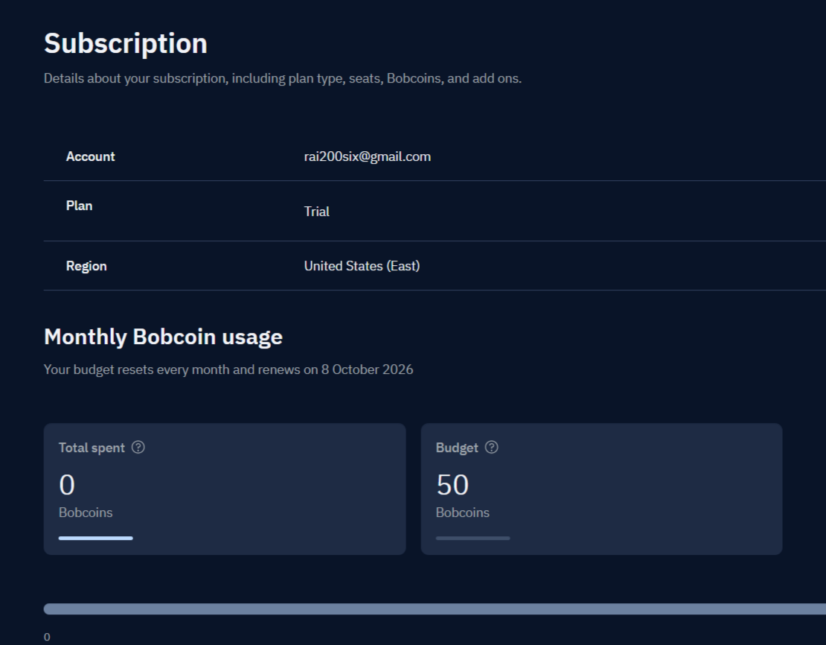
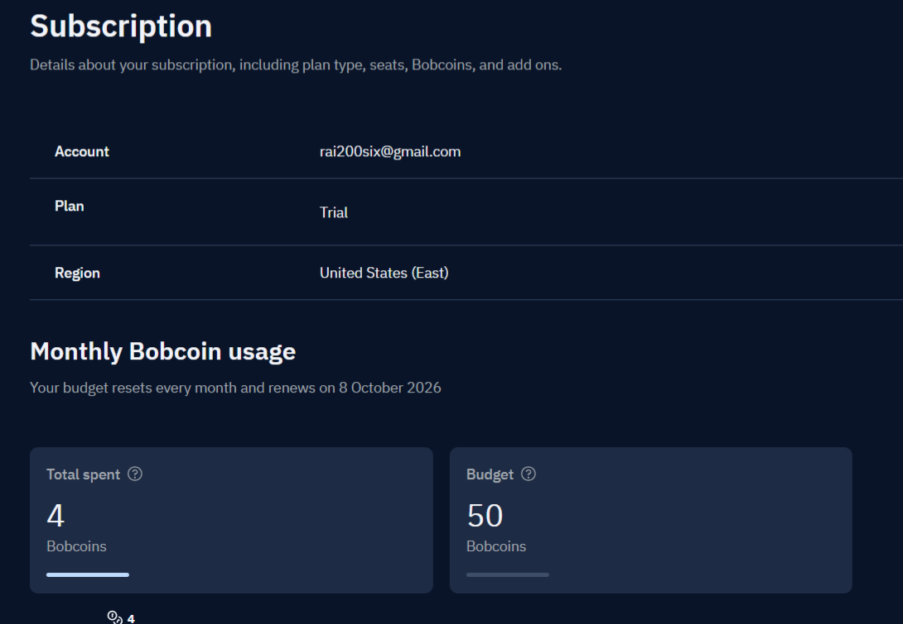
Token Usage
Before Prompt
After the Prompt
·
·
·

Slide 12
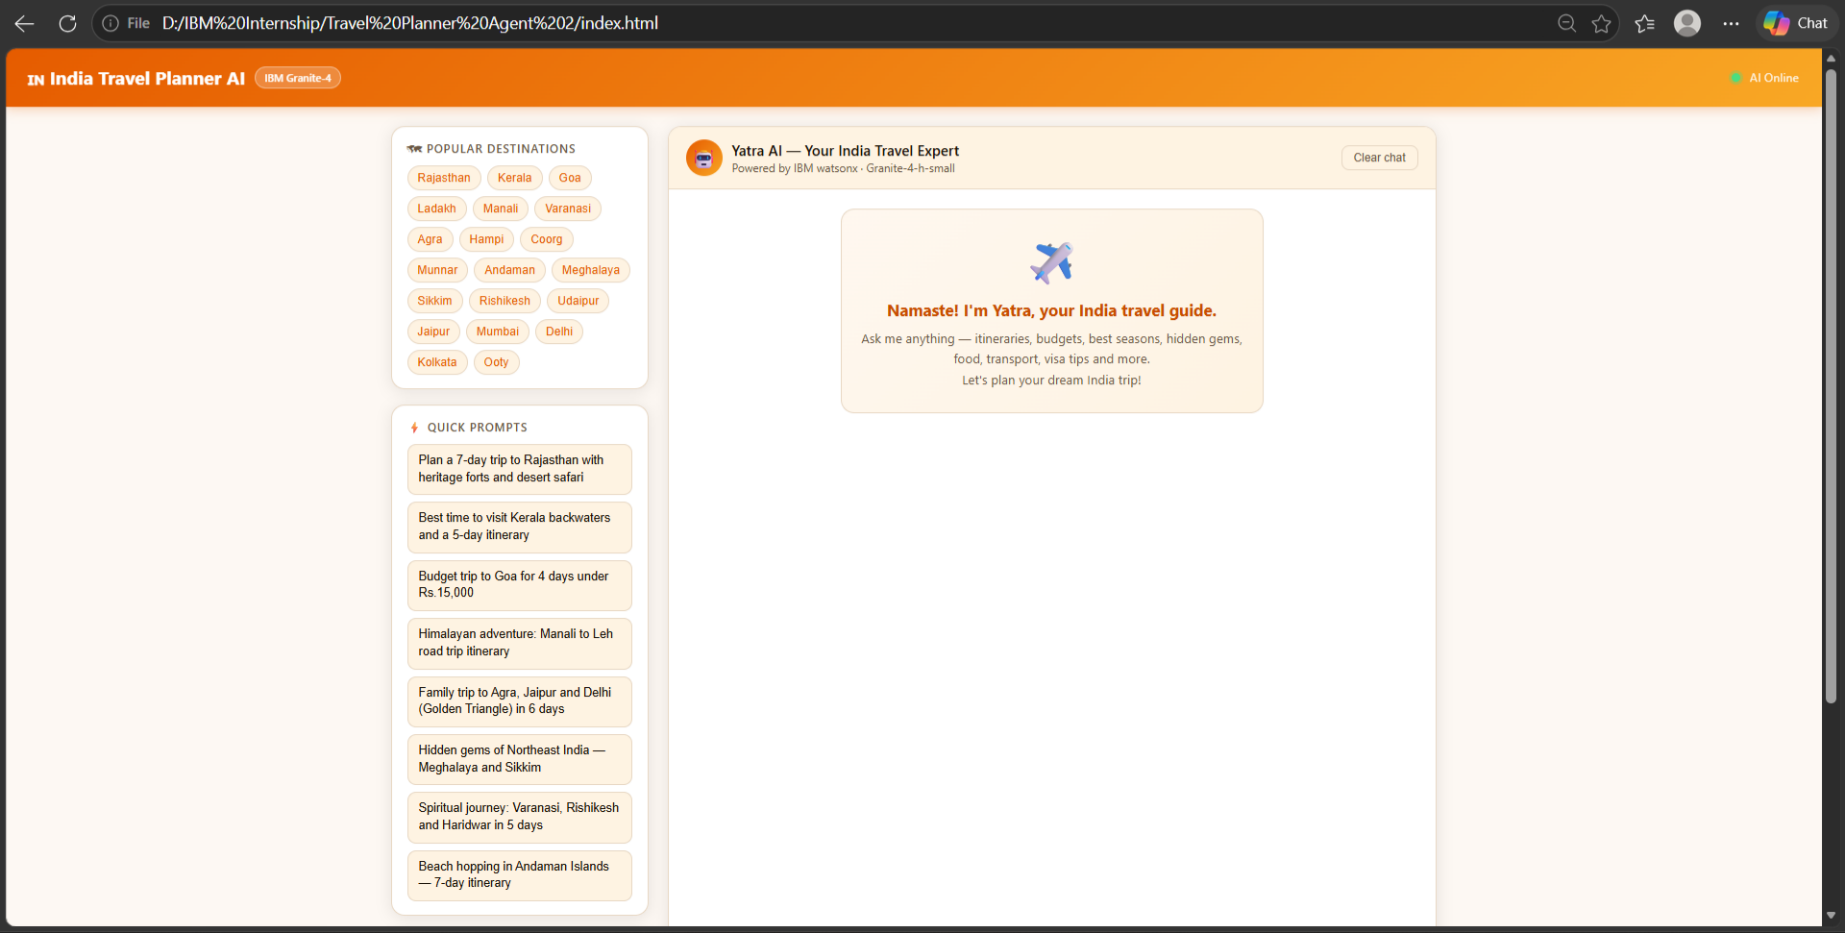
Project Output Screenshot
Please put IBM Bob output screenshots with 2-3 prompts.
You can take 2-3 more slides for each screenshot
·
·
·

Slide 13
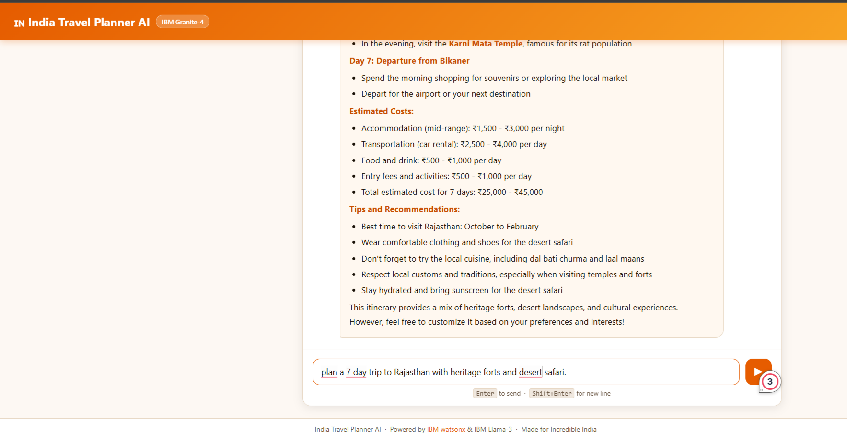
Project Output Screenshot
Please put IBM Bob output screenshots with 2-3 prompts.
You can take 2-3 more slides for each screenshot
·
·
·

Slide 14
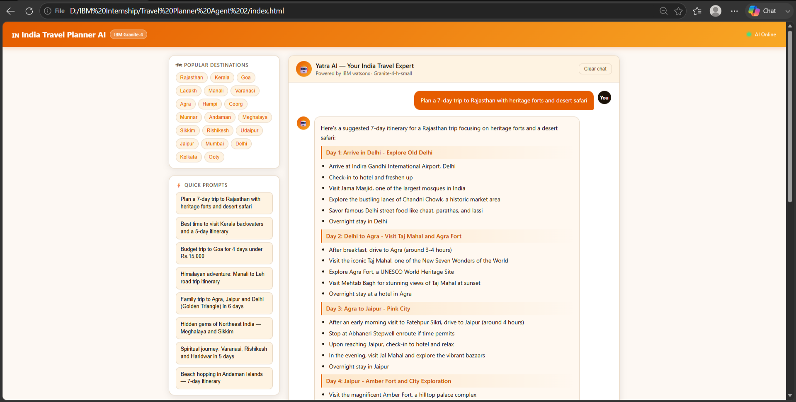
Project Output Screenshot
Please put IBM Bob output screenshots with 2-3 prompts.
You can take 2-3 more slides for each screenshot
·
·
·

Slide 15
Novelty and Uniqueness
The proposed Travel Planner Agent stands out by combining Agentic AI, real-time data, personalization, and intelligent optimization into a single travel planning system.
Multi-Agent Intelligence – Specialized agents collaborate for destinations, itineraries, transport, accommodation, weather, and budget.
Personalized Planning – Creates travel plans based on budget, dates, interests, preferences, and travel style.
Real-Time Adaptation – Updates recommendations based on weather, routes, schedules, and changing user requirements.
Smart Itinerary Optimization – Optimizes plans using time, distance, cost, weather, and activity schedules.
AI Travel Assistant – Allows users to modify and manage their trips using natural language.
End-to-End Planning – Combines destination discovery, itinerary creation, transport, accommodation, and budget management in one platform.
IBM Granite Integration – Uses IBM Granite through watsonx.ai to support intelligent recommendations and decision-making.
This makes the solution a smart, adaptive, and proactive travel assistant, rather than a static itinerary or destination recommendation tool.

Slide 16
Git Hub Link
GitHub Repsitory link - https://github.com/mouli200six-bot/Travel-Planner-Agent
Files included -
Problem statement pdf
PPT of the projeect
Other files
·
·
·

Slide 17
Future Scope
1. Real-Time Booking & Payment Integration –
The Travel Planner can be integrated with flight, train, bus, and hotel booking services to provide real-time availability, pricing, and seamless trip booking.
2. Advanced Real-Time Trip Adaptation –
The system can continuously monitor weather, traffic, delays, and local conditions and automatically suggest alternative routes, activities, and schedules.
·
·
·

Slide 18
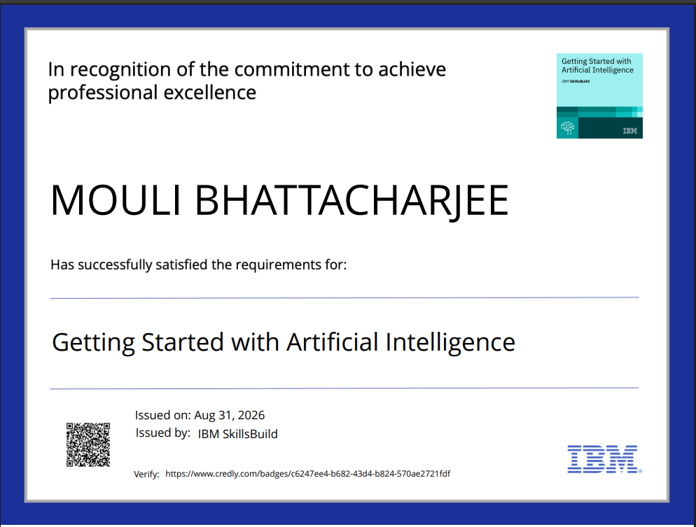
Certificates Earned:
Please add your credly certificate(Getting Started with Artificial Intelligence)

Slide 19
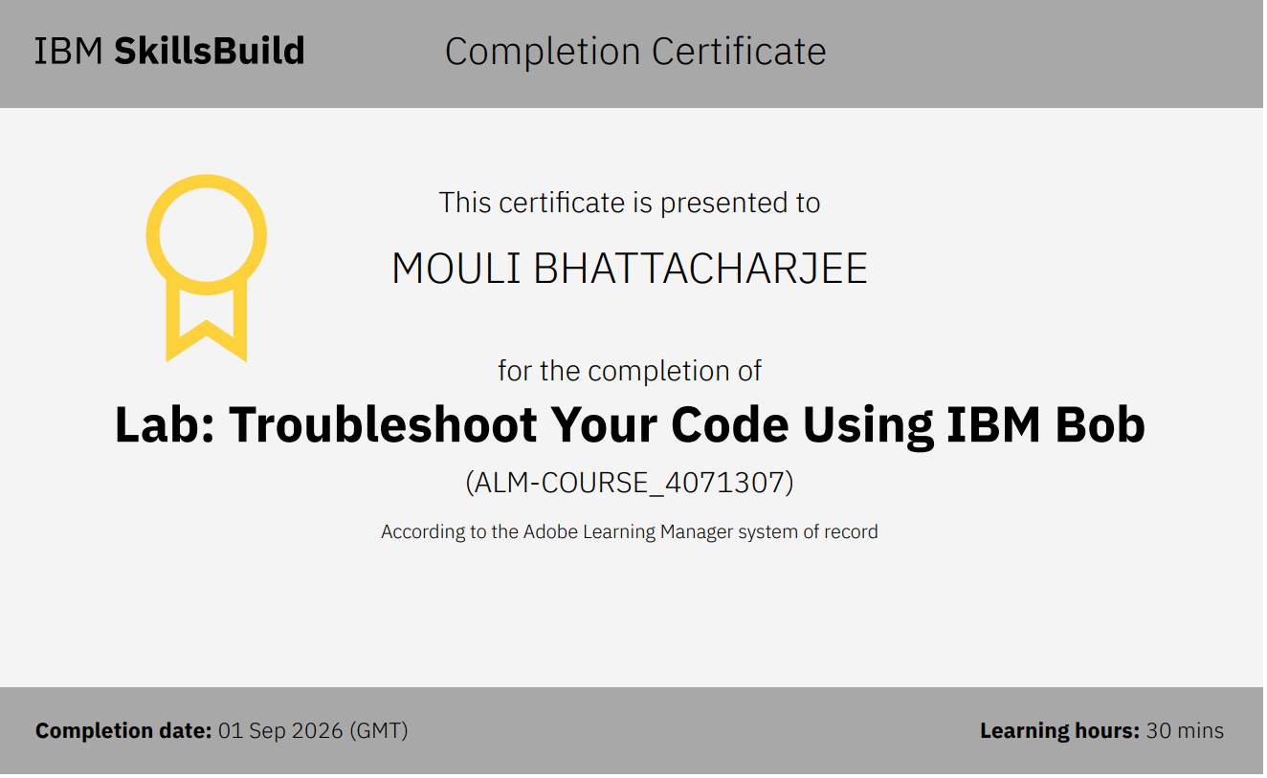
Certificates Earned:​
Add your IBM BOB Certificate

Slide 20


