Slide 1
CAPSTONE PROJECT
ONLINE QUIZ APPLICATION
Presented By:
1. Mouli Duggirala-Velagapudi Ramakrishna Siddhartha
Engineering College-Computer Science and Engineering

Slide 2
OUTLINE
Problem Statement (Should not include solution)
System Development Approach (Technology Used)
Algorithm & Deployment (Step by Step Procedure)
Result
Conclusion
Future Scope(Optional)
References

Slide 3
PROBLEM STATEMENT
Students and educators lack lightweight, interactive quiz tools for practice and testing. This project features a quiz app with multiple-choice questions, timers, and instant scoring. It supports learning through immediate feedback.

Slide 4
SYSTEM APPROACH
Front-End Technologies:
HTML5: For structuring the content and layout of the quiz.
CSS3: For styling, enhancing the user interface, and making the application responsive.
JavaScript (Vanilla JS): For implementing interactive features such as timers, instant feedback, scoring, and navigation between questions.
Advantages of the Chosen Approach:
Lightweight and browser-friendly (no server required).
Real-time interactivity with instant feedback.
Easy to extend and customize.

Slide 5
ALGORITHM & DEPLOYMENT
Algorithm:
Initialize quiz data (questions, options, correct answers).
Display the first question with multiple-choice options.
Start a countdown timer for the quiz session.
Wait for the user to select an answer.
On selection, provide instant feedback (correct/wrong).
Enable the “Next” button only after an answer is selected.
Repeat steps 2–6 for all questions.
After the last question or when the timer ends:
Calculate the total score.
Display the result and feedback.
Allow the user to restart the quiz.

Slide 6
ALGORITHM & DEPLOYMENT
Deployment Procedure:
Create a folder structure:
OnlineQuiz/
index.html style.css script.js
Write the HTML, CSS, and JavaScript code as per the application design.
Open index.html in any modern web browser (Chrome, Firefox, Edge).
Test all functionalities: question display, timer, answer selection, feedback, scoring, and restart.
(Optional) Host on a platform like GitHub Pages for online access.

Slide 7
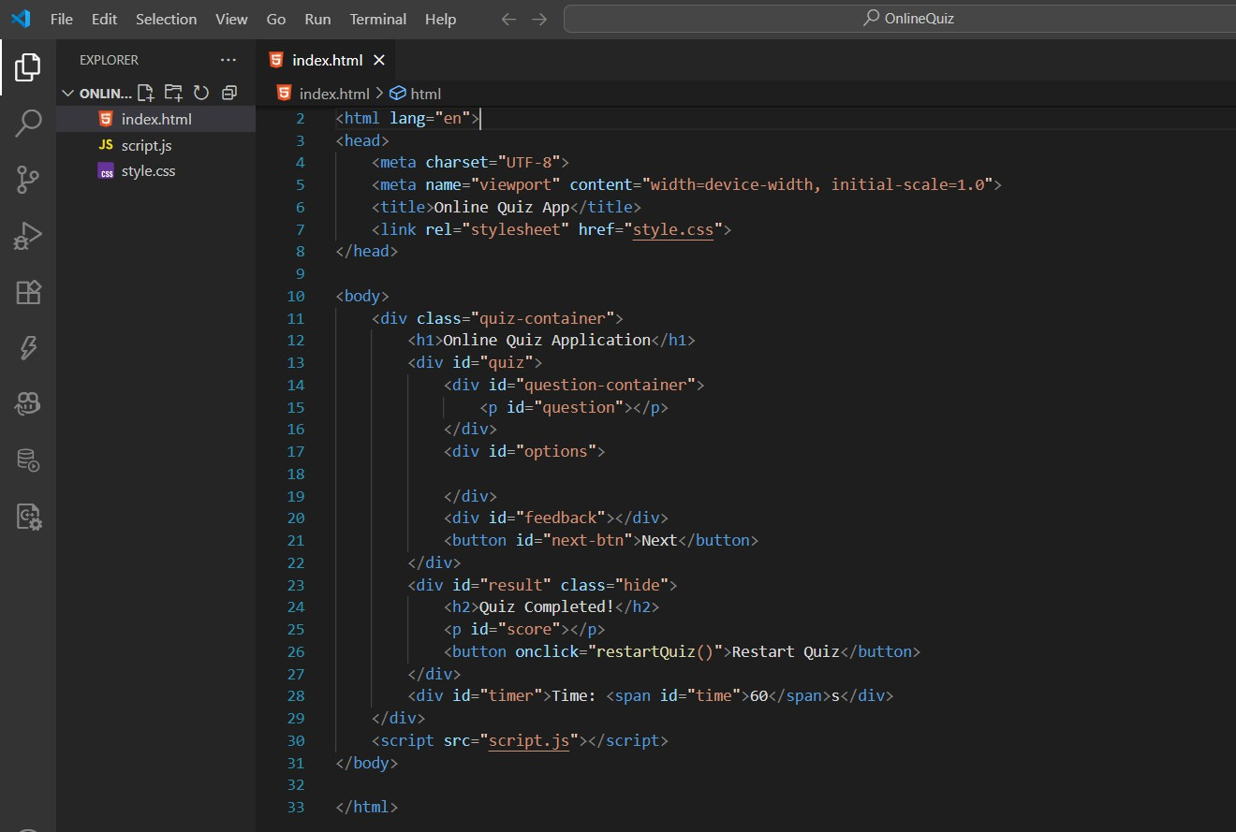
RESULT

Slide 8
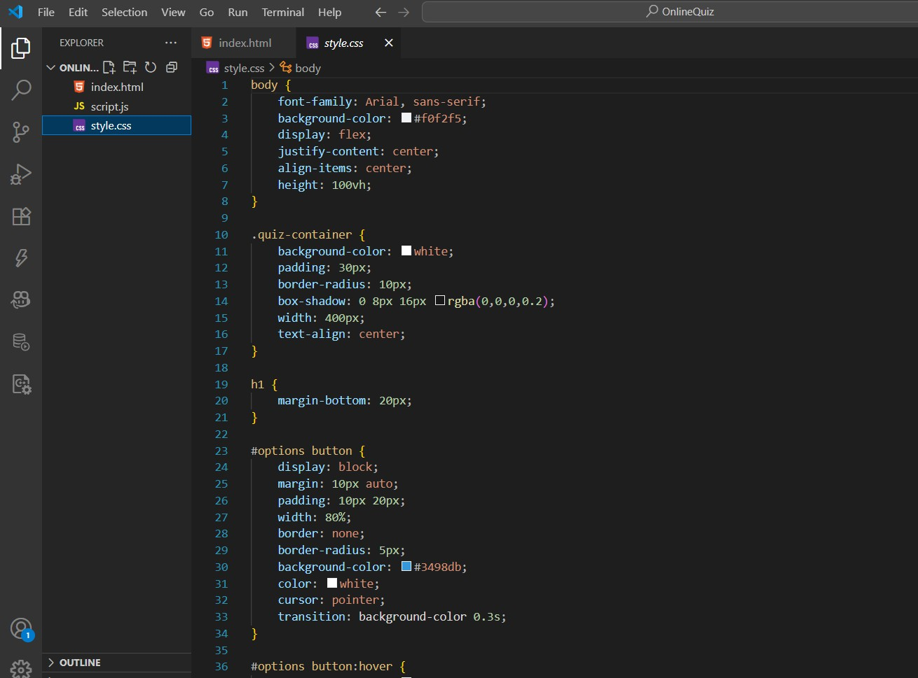
RESULT

Slide 9
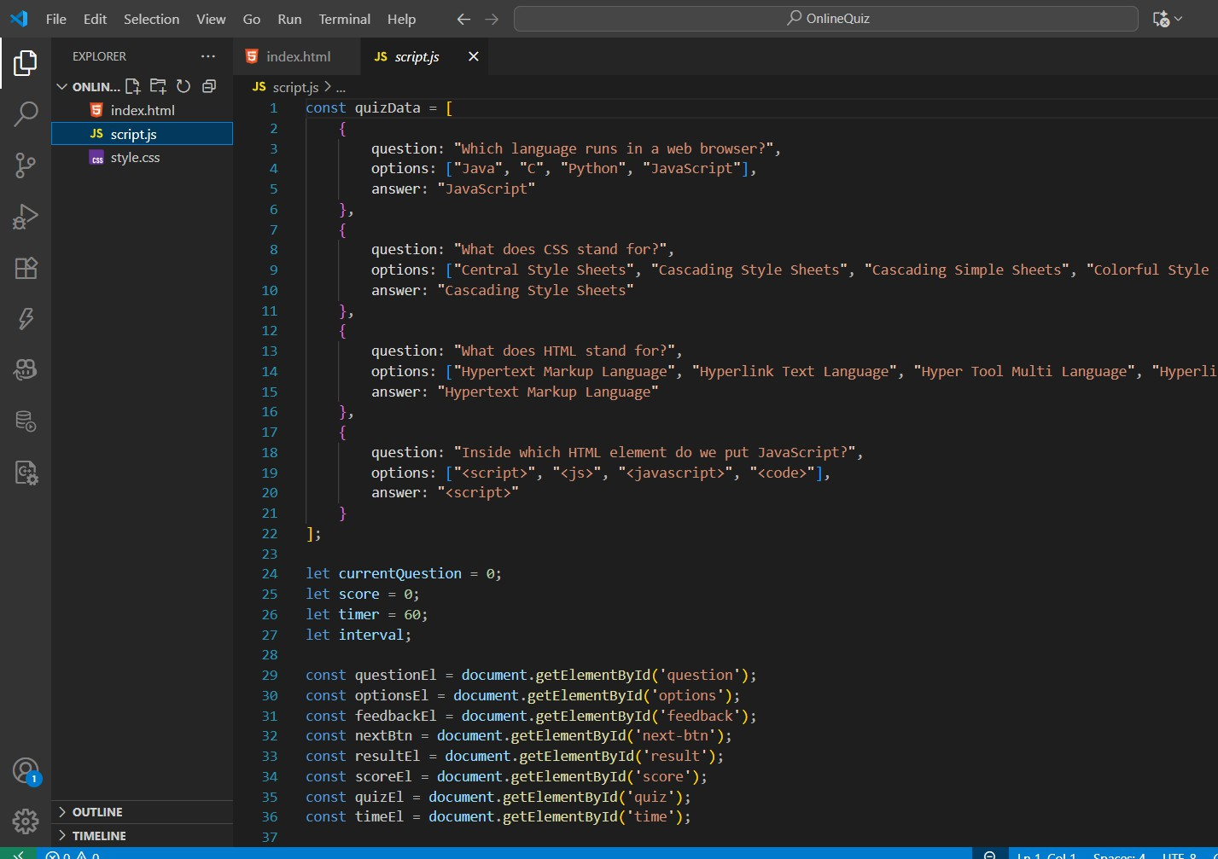
RESULT

Slide 10
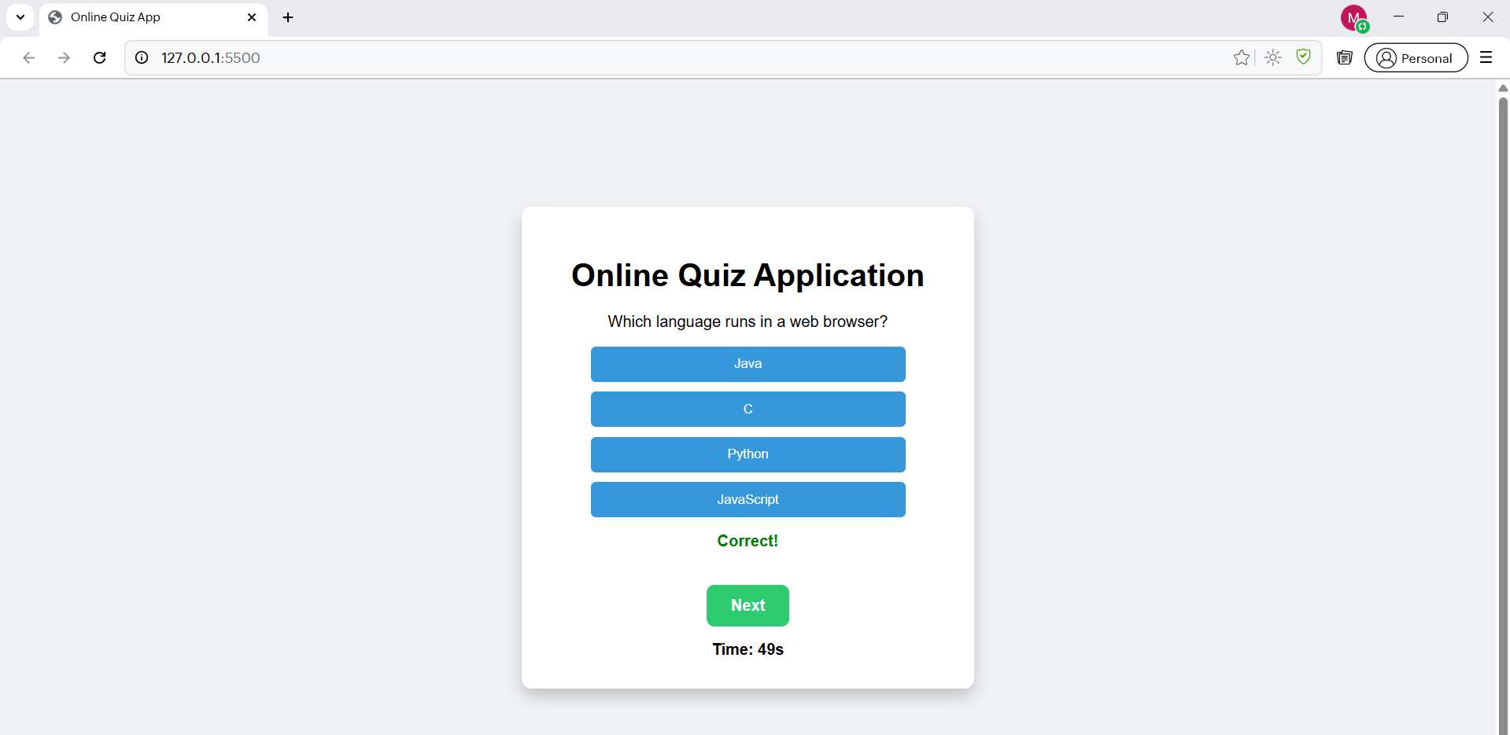
RESULT

Slide 11
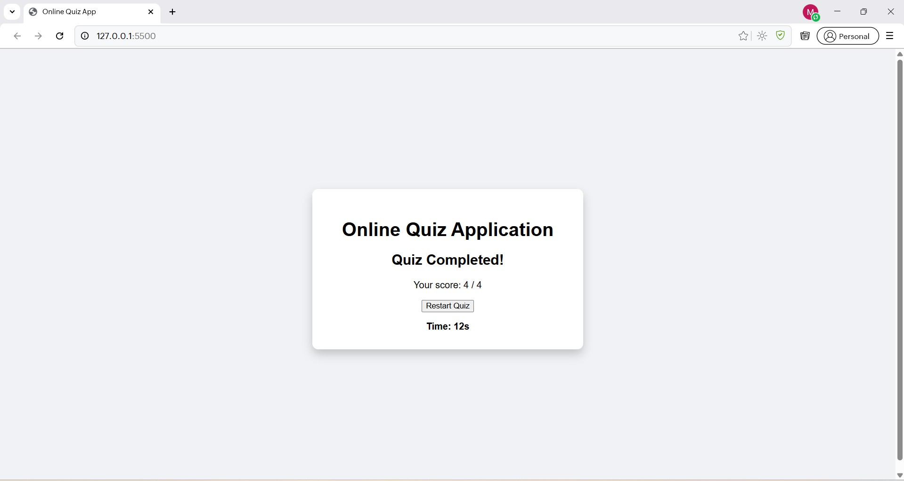
RESULT

Slide 12
GITHUB AND DEPLOYMNET LINK
Github Link : https://github.com/mouli4401
Deployment link: https://mouli4401.github.io/OnlineQuizFWD/

Slide 13
CONCLUSION
The Online Quiz Application successfully provides an interactive and lightweight platform for learning and assessment. It allows students to practice multiple-choice questions with instant feedback and scoring. This approach enhances learning efficiency by giving immediate results and motivation to improve.

Slide 14
REFERENCES
MDN Web Docs: HTML, CSS, JavaScript
W3Schools: Quiz App Example
Stack Overflow community discussions for interactive quiz implementation
techniques

Slide 15
THANK YOU

