Slide 1

HOSPITAL MANAGEMENT SYSTEM DATABASE PROJECT
Moulika Nagulavancha
Pranathi Kasula
Sampathreddy Hanmanthu
Sampath Reddy Odesari

Slide 2
OUTLINE
PROJECT DESCRIPTION
DATABASE DESIGN PROCESS
DATABASE STRUCTURE
DATABASE ED DIAGRAM AND DATA DICTIONARY
SQL TABLE AND FUNCTIONALITY DESCRIPTION
USER INTERFACES AND FORMS
PARTICIPATION AND CODE
REFERENCE SCREENSHOT
FUTURE OF THE DATABASE
SUMMARY

Slide 3
Project Description
This project aims to develop a hospital management system that will allow doctors and hospital staff to efficiently manage patient information, treatment details, room allocation, and billing.
The system will be designed to handle patient registration, diagnosis, treatment, and discharge. Each patient will have a unique patient ID that will be used to track their medical records and history.
Overall, the hospital management system will provide a comprehensive solution for managing patient information, treatment, and billing to improve the quality of patient care and streamline hospital operations.

Slide 4
DATABASE DESIGN PROCESS
Our goal is to develop the Hospital Management System in MySQL and PHP.
We began the project by doing some requirements analysis and planning, design, and review.
We started the planning phase where we jotted down the required things to build a database from scratch like an ER diagram conceptually.
Later we moved to the design phase where we plotted things on how to develop the database logically like the relationship sets and the table constraints.
We also reviewed the indexes we would need for faster processing on the web application we develop.

Slide 5
DATABASE STRUCTURE
DATABASE TABLES | DESCRIPTION
Admit | It will contain information about the patient after being admitted to the hospital like the patient id and room number doctor who is monitoring the patient and the patient's status
Staff | Contains the staff information like name, id, Phone number, Password, address, and dob
Department | In this, it will contain the doctor's name and the department he is working on
Billing | In the billing we can see the room id advance and the appointment id room charges status and the total amount
Patient | In the patient database, u will see the patient id, status of the patient and the dob, blood group phone number staff who is appointed for the patient
Doctor | In this database, u will see the information about the doctor's name, Id, available time, department id, and the phone number
Room | In the room database, u can see the room number and type of room and status, and rent
Doc_Appointment | In the appointment database date of the appointment, department, the doctor assigned, patient and symptom, and time of the appointment
The database consists of eight tables. The table names are Admit, Staff, Department, billing, Patient, doctor, room, and doc_appointment. All the tables will have their corresponding data of the system.

Slide 6
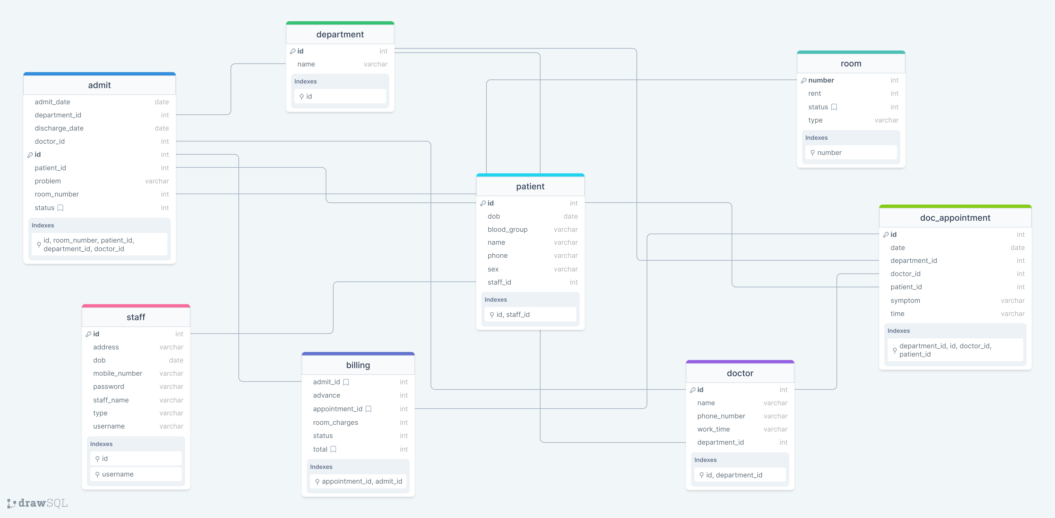
DATABASE ED DIAGRAM
Caption

Slide 7
SQL TABLE AND FUNCTIONALITY DESCRIPTION
The web page and the database will be used for managing the hospital to do the following functions:
To admit the patient and view admitted patient details.
To add the staff and to view the staff information. To see the doctors belonging to the department and add them.
To add the patient information and view the details about the Appointment details, Room details, and Billing for the patient

Slide 8
USER INTERFACE AND FORMS
The project Application will be using the technologies of HTML5, JavaScript, Bootstrap, PHP, and JQuery for the user interface design
We used MySQL as a database
The client-side support and validation are taken care by the JavaScript, JQuery for interactive design
The server-side support and validation are taken care by PHP.

Slide 9
PARTICIPATION AND CODE
The main customers for the web application are the Hospital Staff, Nurses in various hospital departments.
The Staff can manage all the details of the patients, appointments, and doctors.
The nurses can view the admitted patient details to check and verify if they are discharged appropriately or not.

Slide 10
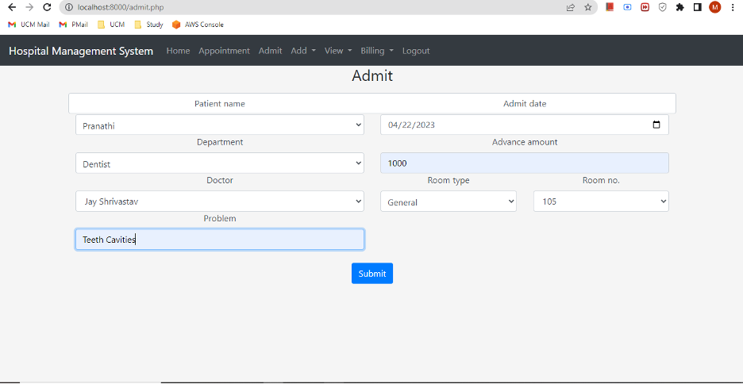
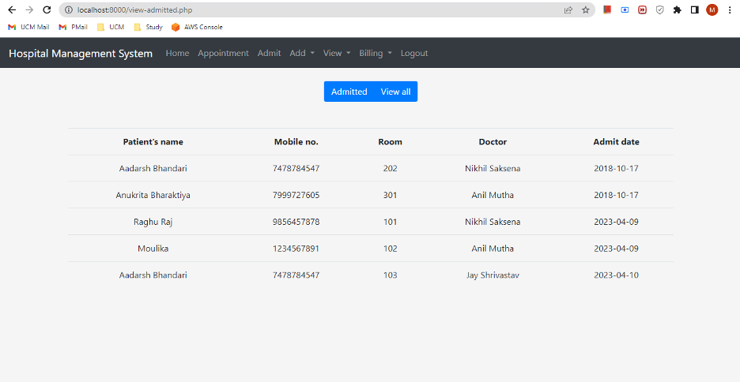
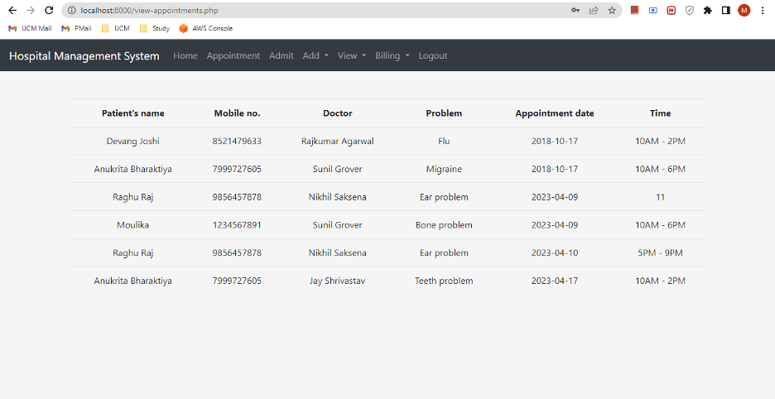
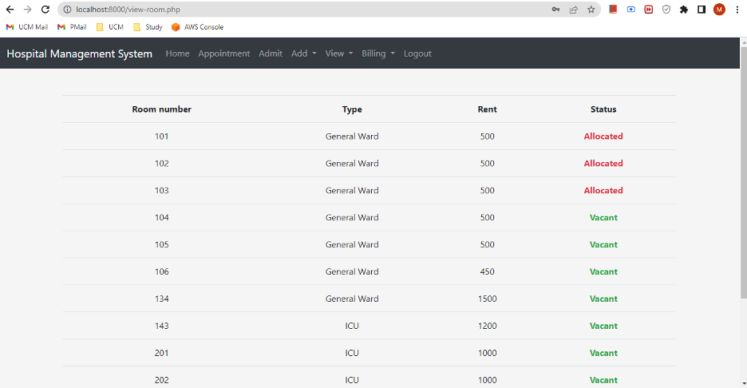
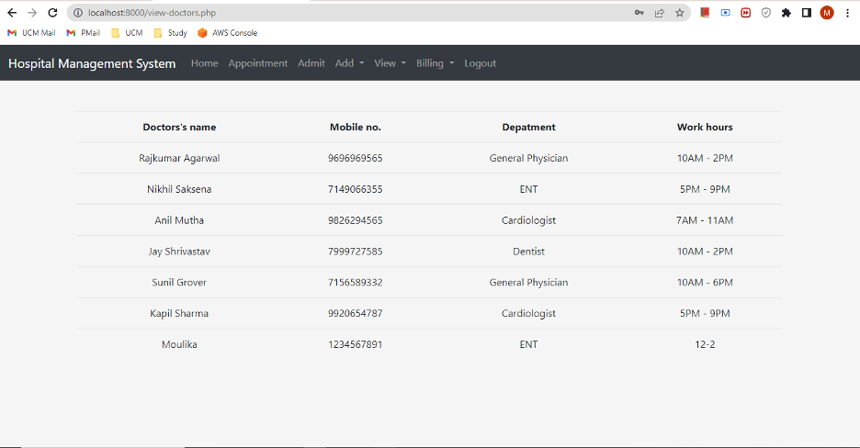
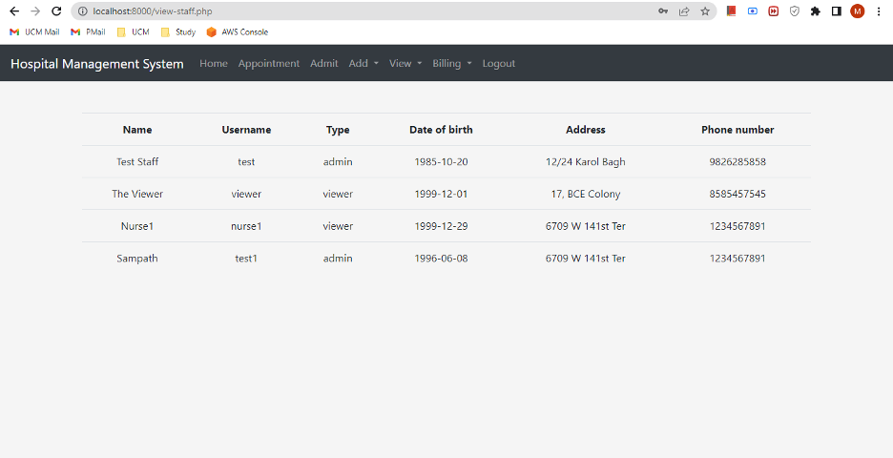
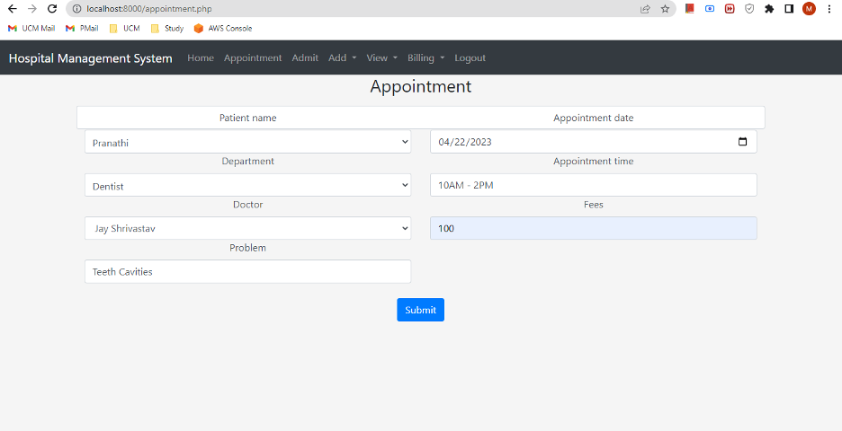
REFERENCE SCREENSHOTS

Slide 11
FUTURE OF THE DATABASE
The future of the hospital management system database is highly dependent on the evolving needs of the healthcare industry and advancements in technology. However, some potential future developments of the database may include:
Integration with Electronic Health Records (EHR): The system may be integrated with EHR to provide doctors with complete access to a patient’s medical history and provide more personalized treatment.
AI and Machine Learning: The integration of AI and machine learning can help automate repetitive tasks, such as appointment scheduling, and assist doctors in making more informed decisions.

Slide 12
SUMMARY
The project is for computerizing the working in a hospital. It is a great improvement over a manual system which helps speed up the process. This web application can provide an easy and effective way of storing the records of patients, doctors, rooms, and staff and managing the appointments, admitted patients, their billing information etc.,

Slide 13
REFERENCES
https://www.php.net/manual/en/book.mysql.php
https://www.w3schools.com/Php/php_mysql_connect.asp

