Slide 1
Diabetes 30-Day Readmission Prediction
End-to-end ML system — demo walkthrough
Care-team decision support · UCI Diabetes 130-US Hospitals (1999–2008) · ~101k encounters

Slide 2
1. EDA & Column Segregation
Dataset & traps
• 101,766 encounters (1 row = 1 hospital stay), ~50 columns
• Target: readmitted ∈ {<30, >30, NO} → binary '<30' = 1
– Positive rate ~11.3% → accuracy is a trap
• Missing coded as '?' → treated as NaN on load
• weight ~97% missing → dropped (justified)
• A missing A1C/glucose test is information →
– kept as its own 'NotMeasured' category, never imputed
• Excluded encounters that can't be readmitted
– (expired / hospice discharge)
Columns grouped into blocks
• Demographics: race, gender, age
• Encounter: time_in_hospital, num_lab_procedures,
– num_procedures, num_medications, number_diagnoses, medical_specialty
• Prior utilization: number_outpatient / emergency / inpatient, payer_code
• Diagnoses & labs: diag_1/2/3, max_glu_serum, A1Cresult
• Medications: 21 drug flags + change + diabetesMed
• Admission / discharge: type, source, disposition

Slide 3
2. Engineered Features
• ICD-9 diag_1/2/3 → clinical buckets (Strack et al.): Circulatory, Respiratory,
– Digestive, Diabetes, Injury, Musculoskeletal, Genitourinary, Neoplasms, Other
– → diag_1_group, diag_2_group, diag_3_group, diabetes_diag_any
• total_prior_visits = number_outpatient + number_emergency + number_inpatient
• n_med_changes, n_active_meds → summarized from the 21 medication columns
• age_ordinal → age bracket mapped to an ordinal 0–9
• lump_rare: rare medical_specialty / payer_code (<1% of train) collapsed to 'Other'
• One shared engineer() runs at BOTH train and serve time → no training/serving skew
• Every feature + source + rationale logged in src/features/FEATURES.md

Slide 4
3. Features Going to the Model
The 48-feature matrix → features.parquet
• 48 model features = 13 numeric + 35 categorical
• Numeric: time_in_hospital, num_lab_procedures, num_procedures,
– num_medications, number_outpatient/emergency/inpatient,
– number_diagnoses, total_prior_visits, n_med_changes,
– n_active_meds, diabetes_diag_any, age_ordinal
• Categorical: 21 medication flags + race, gender, labs,
– admission/discharge, specialty, payer, diag groups
26 human inputs → 48 features
• Care team types ~26 facts; only gender & age required
• Server DERIVES ~8 engineered features (not typed)
– visit counts → total_prior_visits; codes → diag groups; age → age_ordinal
• 18 of 21 drugs default to 'No' (not prescribed)
– form surfaces the common ones (metformin, glyburide, insulin)
• XGBoost native-categorical: category order frozen in feature_spec.json

Slide 5
4. Modeling — Baseline vs Advanced
model (validation) | PR-AUC | ROC-AUC | recall@p≥30% | Brier
Logistic regression (baseline) | 0.221 | 0.667 | 0.189 | 0.225
XGBoost (winner) | 0.239 | 0.680 | 0.216 | 0.206
LightGBM | 0.239 | 0.675 | 0.215 | 0.201
XGBoost + isotonic calibration | 0.236 | 0.680 | 0.205 | 0.097
• Split by patient_nbr (GroupShuffleSplit); tuned with StratifiedGroupKFold → no leakage
• Imbalance via class weights (not resampling) — keeps grouped CV & calibration valid
• Tuned on PR-AUC, not ROC-AUC — at 11% positives PR-AUC is what the care team feels
• Calibration fixed the Brier disaster: 0.206 → 0.097 with ranking intact (honest %)

Slide 6
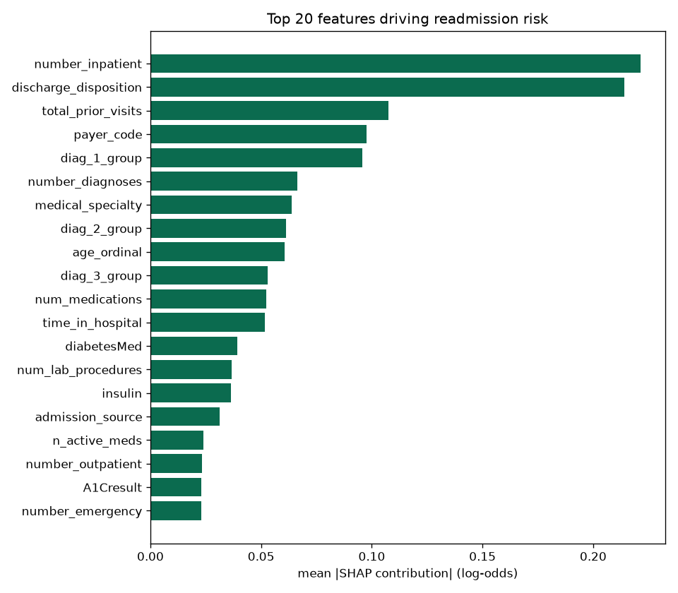
5. Model Evaluation (held-out test)
metric | value
Recall @ 0.10 | 70.0%
Precision @ 0.10 | 16.8%
Flag rate | 47.2%
PR-AUC | 0.244
ROC-AUC | 0.688
Brier | 0.095
Net savings / 1,000 | $96,103
• Decision rule: risk × 0.2 × $15,000
– > $300 → flag when risk ≥ 0.1
• Low precision is BY DESIGN — a $300 call vs a $15k readmission

Slide 7
6. Monitoring — What & How
Service & model metrics
• Prometheus scrapes /metrics every 15s → Grafana
– request rate, p95 latency, error rate, flag rate, score distribution
• Every prediction logged to logs/predictions.jsonl
– inputs + score + version + timestamp (audit + drift window)
• Alerts (Prometheus rules):
– APIDown · HighErrorRate · HighPredictLatencyP95 · FlagRateSurge
Drift & retraining
• GET /drift — live Evidently report
– recent requests vs the training baseline
– data drift + prediction (score) drift
• Retraining trigger (concrete):
– ≥30% of features drift, or prediction drift
– recall < 0.55 on newly labelled data
– quarterly floor regardless

Slide 8
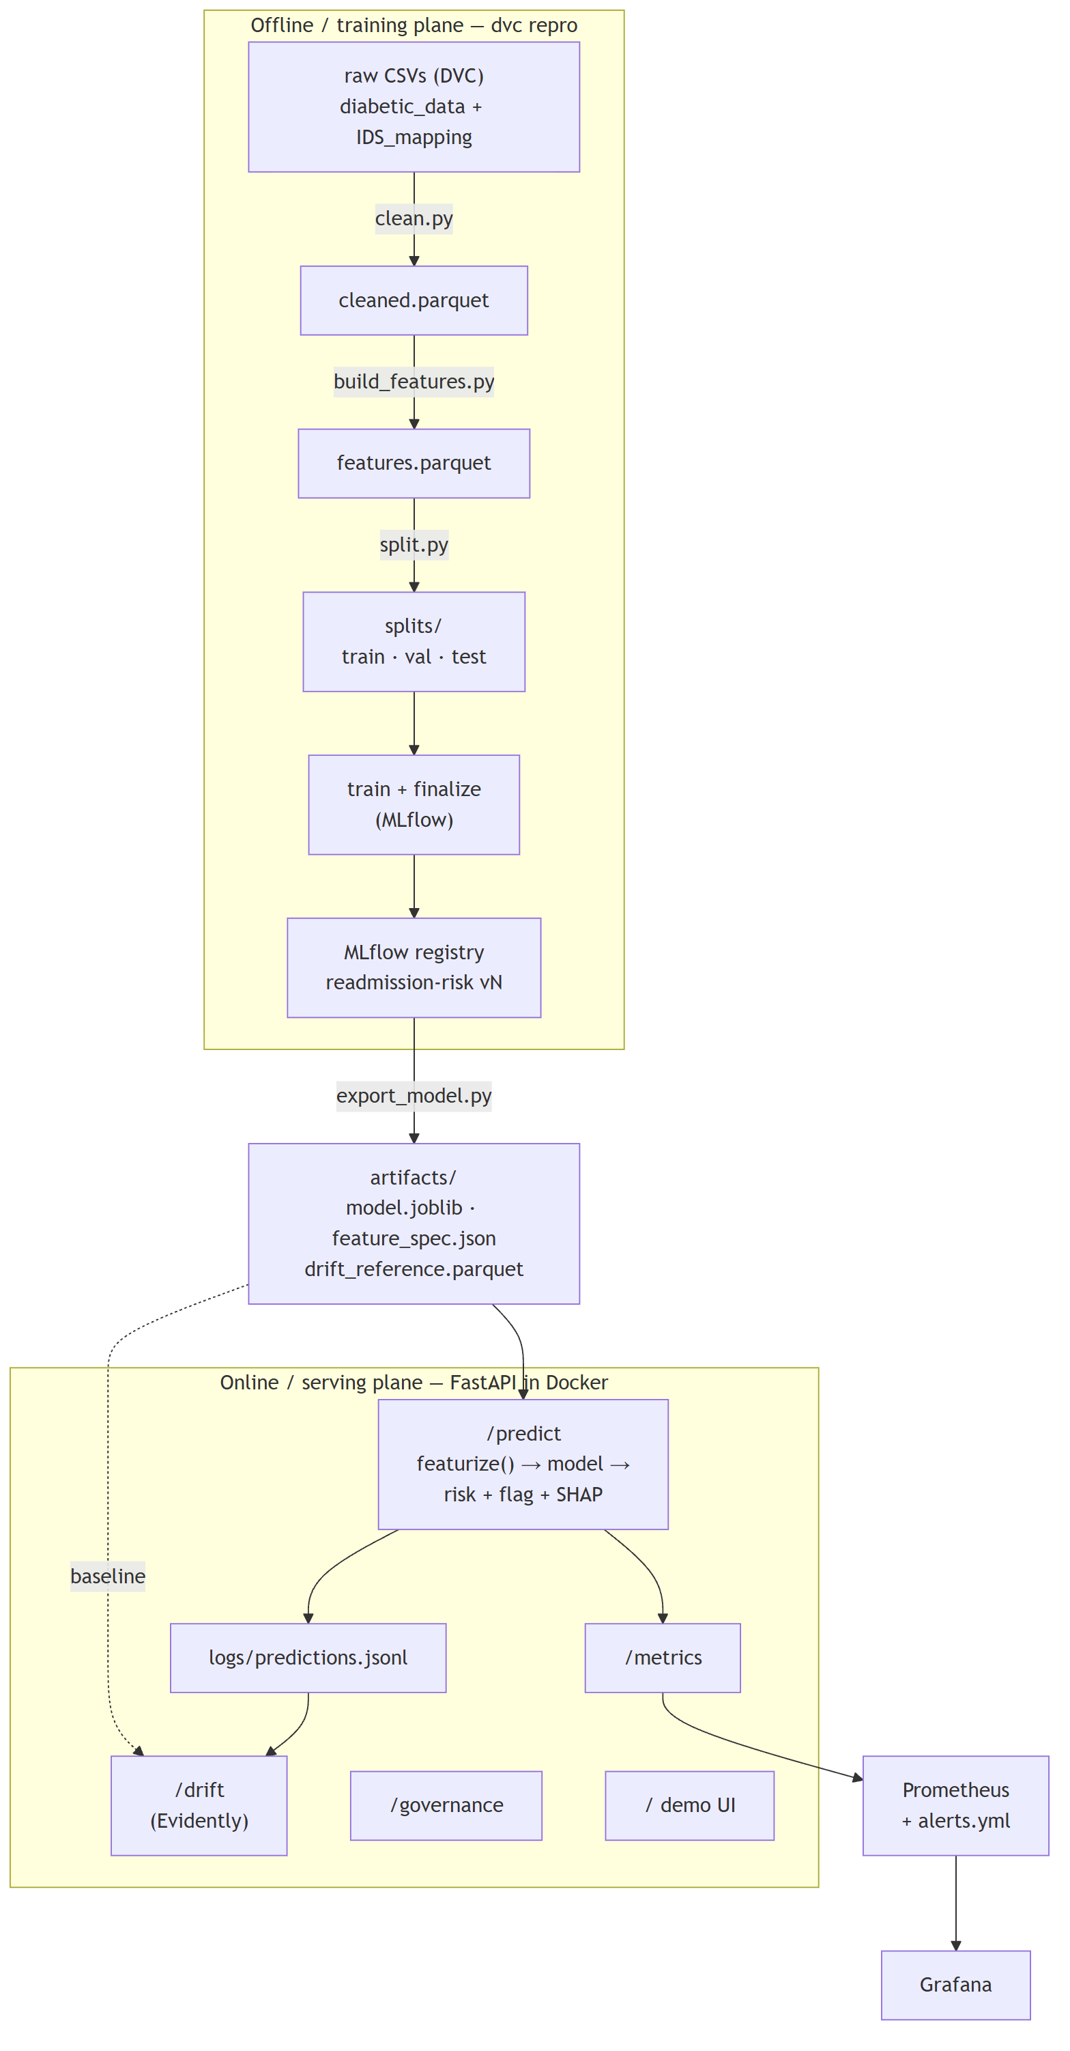
7. Architecture & Data Flow
• Offline plane (dvc repro → MLflow → export) feeds artifacts/; online plane serves them. Monitoring & governance read the audit log and the trained model.

Slide 9
8. Live Demo
• / demo UI — enter a patient, get risk + flag + SHAP factors
• /predict JSON API — calibrated risk, flag, top contributing factors
• /governance tabs: Model Card · Model Evaluation · Fairness Audit · SHAP
• /drift live Evidently data + prediction drift report
• Grafana (:3000) service & model dashboards
• Prometheus (:9090) metrics & firing alerts
•
• One command runs the whole stack: docker compose up --build

