Slide 1
STUDENT DETAILS
Name : A.Moulivenkat
SkillsBuild Email ID :moulivenkat2004@gmail.com
College Name :Ideal institute of technology
College State : Andhra Pradesh
Internship Domain and Internship
Start and End Date :
Cybersecurity Using Kali Linux / 3 June 2024 to 15 July 2024

Slide 2

HIDING A TEXT INSIDE AN IMAGE USING STEGANOGRAPHY
An officer in danger requires a method to send a secret text message without alerting nearby criminals to his higher officials. Traditional communication methods are easily intercepted or monitored, so, he his necessitating a covert technique to embed and transmit critical information securely to his higher officials.

Slide 3
AGENDA
PROJECT OVERVIEW
SOFTWARE AND TOOLS SELECTION
WHO ARE THE END USERS OF THIS PROJECT?
YOUR SOLUTION AND ITS VALUE PROPOSITION
HOW DID YOU CUSTOMIZE THE PROJECT AND MAKE IT YOUR OWN
MODELLING
RESULTS
LINKS

Slide 4
PROJECT OVERVIEW
This project implements a steganography technique to securely hide and reveal secret within an image using the RGB color mechanism and a key based XOR operation for encryption. Steganography allows for concealing messages within non-secret text or data, ensuring secure communication by embedding sensitive information within an image in a way that is imperceptible to unauthorized viewers.
Image Encoding: Secret text is hidden within the image’s pixel values using the LSB method, with additional security provided by XOR the text characters with a user-provided security key.
Pixel Manipulation: The encoded text is distributed across the image’s pixels, maintaining the visual integrity of the image while embedding the hidden message.
Text Decoding: The project includes functionality to decrypt and retrieve the hidden text from the image using the correct security key, ensuring that only authorized users can access the information.
This project demonstrates a practical application of steganography for secure communication, embedding and retrieving secret messages within images in a secure and efficient manner.

Slide 5
WHO ARE THE END USERS OF THIS PROJECT ?
General Users: Everyday individuals who use steganography tools to hide sensitive information
within digital media (like images, audio files, or videos) for privacy or security reasons.
Law Enforcement and Intelligence Agencies: These entities may use steganography detection
tools to uncover hidden messages or data during investigations.
Military Personnel: Military applications may involve embedding secret messages in images or
other media for secure communication.
Security Experts: Cybersecurity professionals might utilize steganography tools to test network
defenses or to secure data transmission.

Slide 6
YOUR SOLUTION AND ITS VALUE PROPOSITION
Steganography is the basic concept to hide the data inside other data.
In this project RGB Mechanism is used for pixel manipulation.
XOR operation is used for encryption and decryption of the test inside the image.
The project reads an image and hides the secret text within the pixel values using the least significant bits (LSB) method.
For security purpose that means to avoid unauthorized users taking the advantage of the message, a secret key used to hide and unhide the data.
Finally, By using this project we can hide the data inside an image using secret key and for unhide the message secret is used.

Slide 7
HOW DID YOU CUSTOMIZE THE PROJECT AND MAKE IT YOUR OWN
ALGORITHM SELECTION AND MODIFICATION:
The choice of steganographic algorithm was carefully considered based on its suitability for embedding data within various media types.
USER INTERFACE DESIGN:
The user interface (UI) was customized to ensure ease of use and intuitive interaction.
INTEGRATION OF ADDITIONAL FEATURES:
Additional functionalities were integrated to extend the utility of the application beyond basic steganographic operations.
TESTING AND VALIDATION PROCEDURES:
Rigorous testing procedures were customized to validate the accuracy and reliability of the steganographic techniques employed.
DOCUMENTATION AND REPORTING:
Detailed documentation was customized to provide comprehensive insights into the project’s development process.

Slide 8
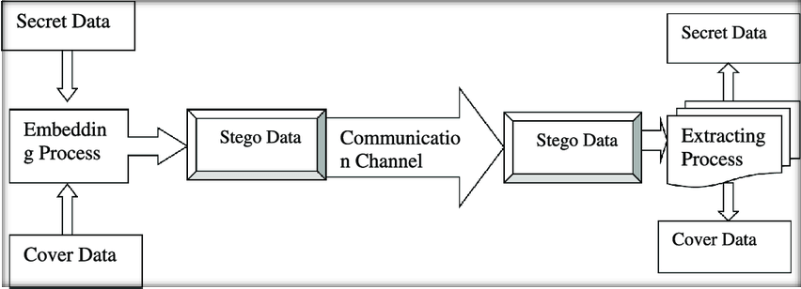
MODELLING
Step 1: Importing some libraries like cv2 and os for accessing relevant concept into code.
Step 2: After converting the text into their ascii values then that ascii values are stored in variable.
Step 3: Read the image from it’s path and hiding the image using XOR operation , RGB
mechanism
Step 4: A secret is created to avoid unauthorized users.
Step 5: To unhide the image user wants to enter the secret key.
Step 6: Finally, user can able to see the secret message.

Slide 9
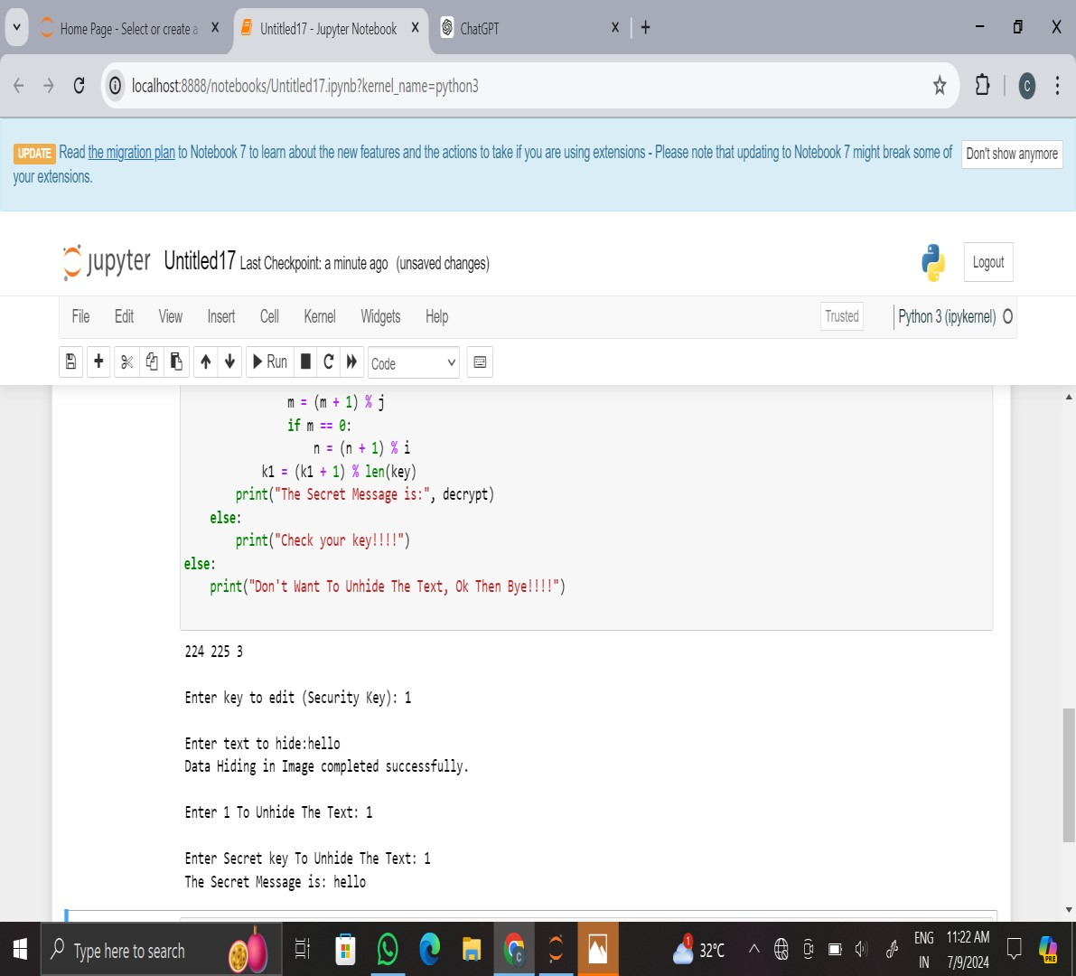
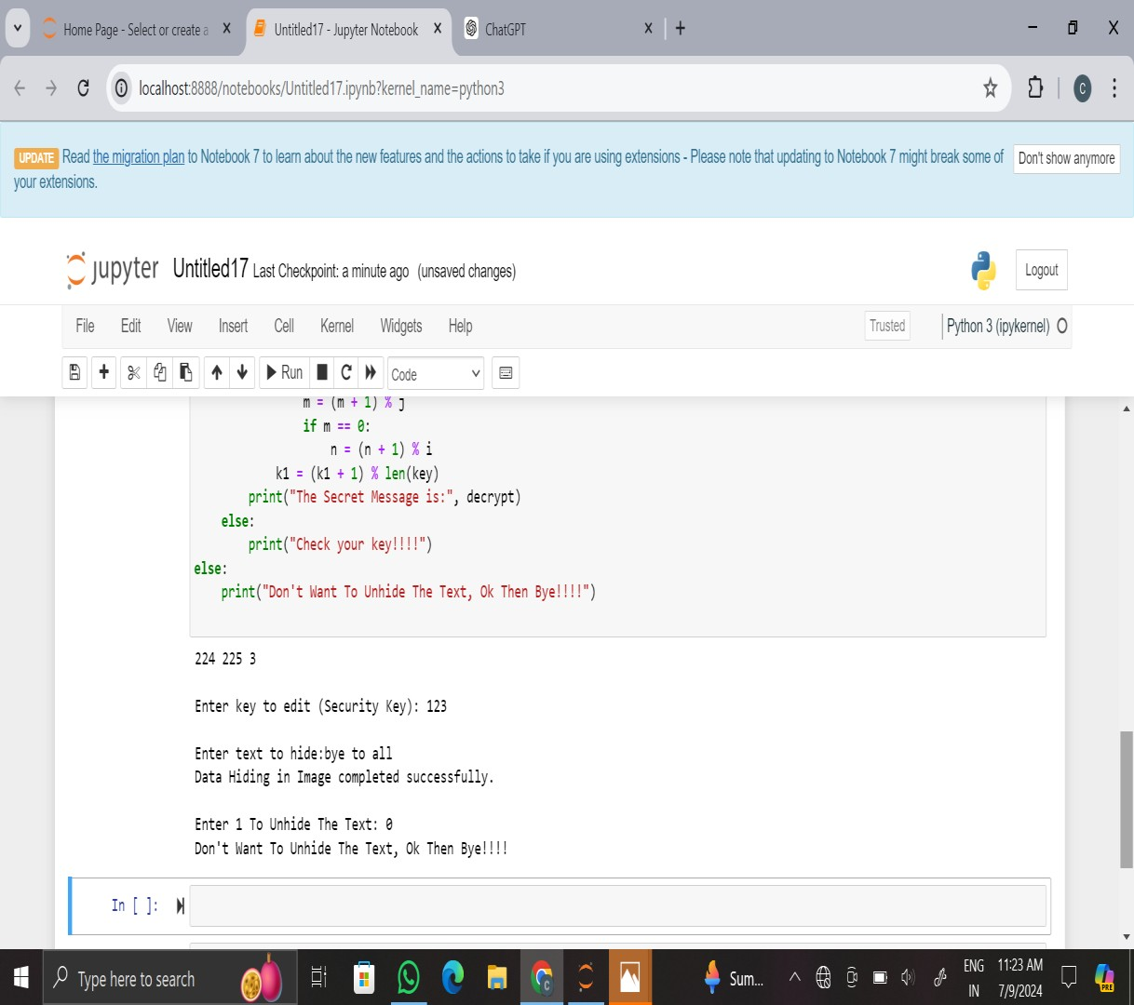
RESULTS

Slide 10


Original image
Encrypted image
Above image is normal image.
We can choose the image on which we want to do the encryption
We can see there is no difference in both the normal and encrypted images

Slide 11

Thank You

