Slide 1
Introduction to Blockchain and its Application
Team project1 - A simple blockchain network with Python
Homework Requirements

Slide 2
Introduction
What we will learn?
1. Write a simple blockchain network using the Python language.
2. Simulate the process of miners engaging in mining activities, creating blocks, and reaching consensus using the Proof of Work (PoW) consensus algorithm.
3. Simulate virtual currency transactions between users, with miners verifying transactions and blocks.

Slide 3
Two Roles in this project
Miner：
1. Maintain the blockchain network.
2. Mine the new block and get
some rewards.
3. Validate and package the
transactions into the block.
Customer：
1. Connect with a miner to join the
blockchain network.
2. Generate a pair of public and private
keys and establish your own wallet.
3. Initiate transactions with other nodes.
Notes:
解釋 公私鑰的產生機制。

Slide 4
Flow Chart - Miner
Create genesis block
Pack transactions
Change nonce
False
Confirm
True
Generate hash value
Get a new block

Slide 5
Flow Chart - Customer
Generate address
Apply tokens
Create transactions
Check public key
False
False
True
Confirm
True
Check balance
Add to transaction pool

Slide 6
Homework Requirements
Personal Report(PDF)
Complete several functions for both the miner and the customer
Detailed annotations and descriptions of how each function is performed in section (a)
Running Results with 11 snapshots (Each function corresponds to a snapshot. Teamwork with different IP addresses is necessary.)
Experience
CSV File (For the miner’s terminal results)
Python File
Package all above files into a single zip file named as “student ID_name” and upload to Moodle. (Deadline: 4/14 (Sun.) 23:59)

Slide 7
Environment
1. VS code 1.87
2. Python 3.11.8

Slide 8
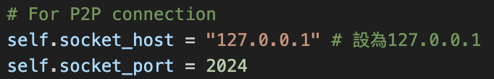
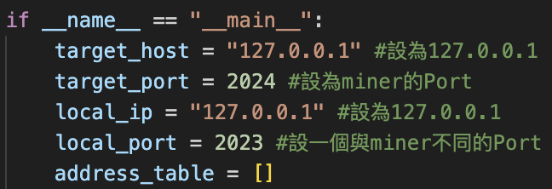
Connect the Miner and the Customer
Miner
Customer
Notes:
For 個人test，小組工作時要再另外設定

Slide 9
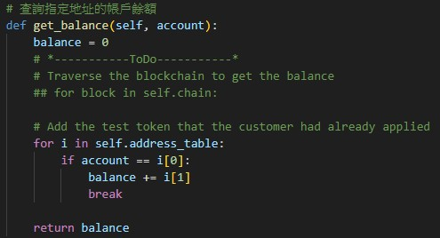
Functions You Need to Complete
1. Get_ balance

Slide 10
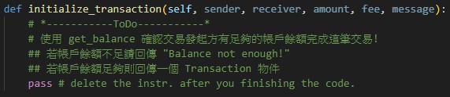
Functions You Need to Complete
2. Initialize_ transaction(Miner)

Slide 11
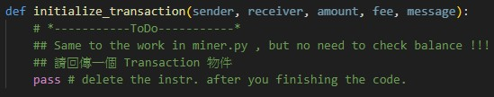
Functions You Need to Complete
3. Initialize_ transaction(Customer)

Slide 12
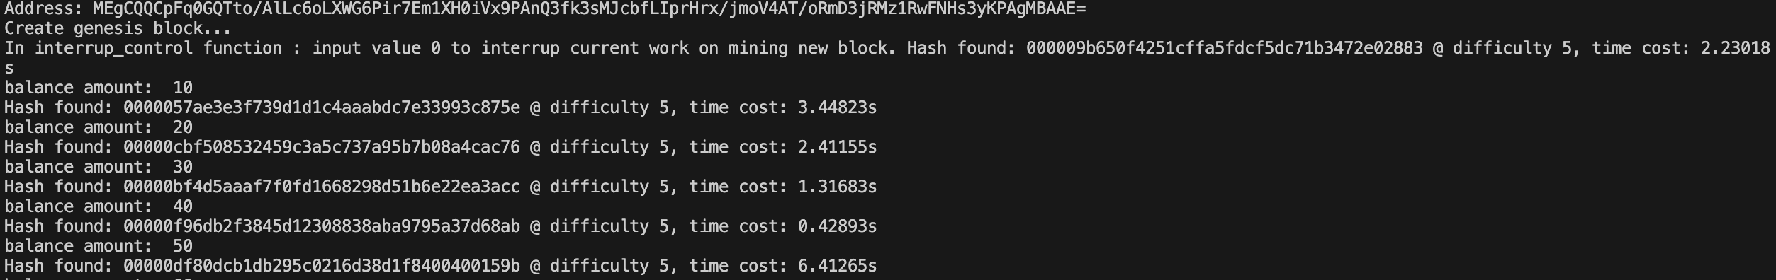
Running Results - Miner
Step1 Start mining

Slide 13
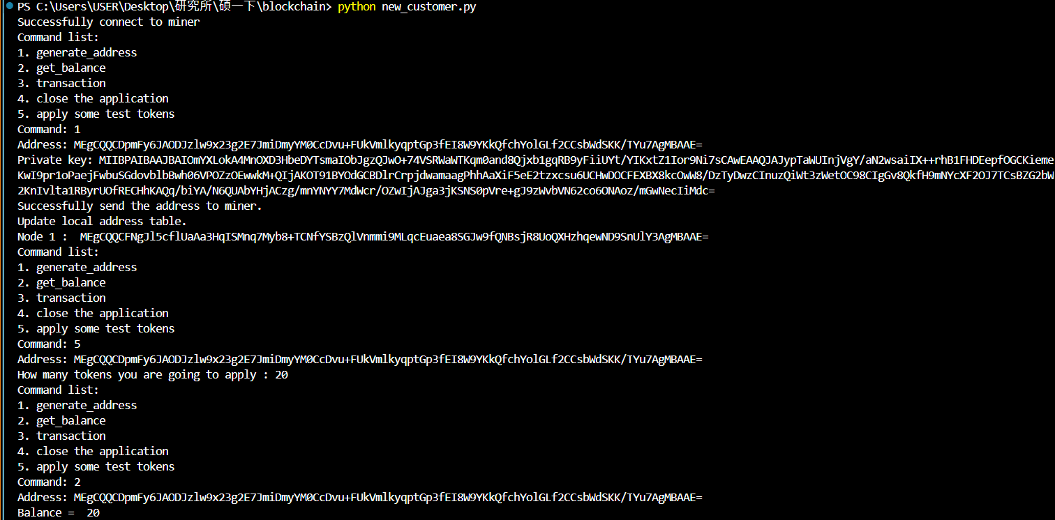
Running Results - Customer
Step2 Command1:Generate_address(Customer1 and Customer2)

Slide 14
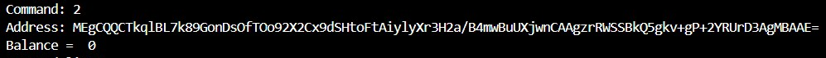
Running Results - Customer
Step3 Command2:Get_balance

Slide 15
Running Results - Customer
Step4 Command5:Apply some test token

Slide 16
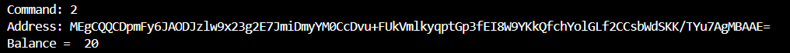
Running Results - Customer
Step5 Command2:Get_balance (sender and receiver)

Slide 17
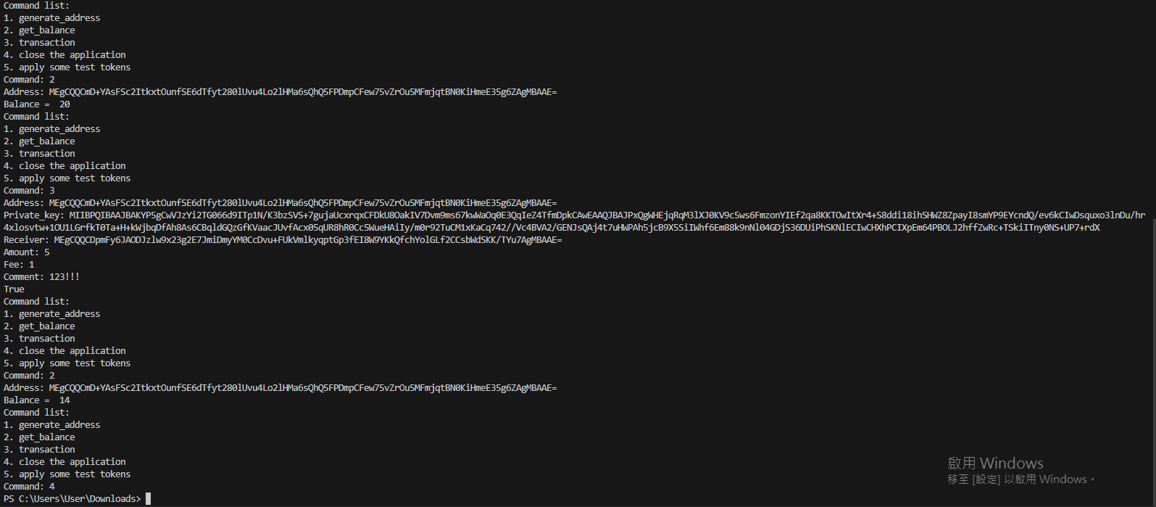
Running Results - Customer
Step6 Command3:Transaction

Slide 18
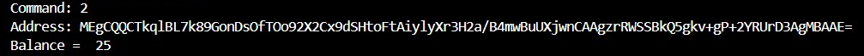
Running Results - Customer
Step7 Command2:Get_balance(sender and receiver)

Slide 19
Running Results - Miner
Step8 Command4:Close(2 different IP address by customer1 and customer2)

Slide 20
Bonus
1. Customer's address table update: The customer who connected first to the miner cannot obtain the address of the second connected miner. Please try to add an update mechanism so that the customer who connected first can obtain the complete address table. (3%)
2. Supplement the miner code: So that the miner can also initiate transactions with customers (get_balance needs to be changed together).(7%)
Notes:
每個block留一個位子給miner打包的獎勵transaction
Miner交易時沒有任何驗證

Slide 21
TA Time
Wednesday 16:00 ~ 18:00
E1 201-1
network6459@gmail.com

