Slide 1
Introduction to Blockchain and its Application
Term project1 - A simple blockchain network with Python

Slide 2
Outline
1. Miner.py
2. Customer.py

Slide 3
Let’s start with miner.py

Slide 4
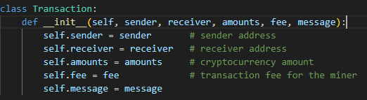
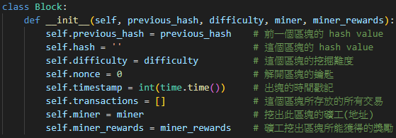
Step1：We are going to define the class about the transaction and the block

Slide 5
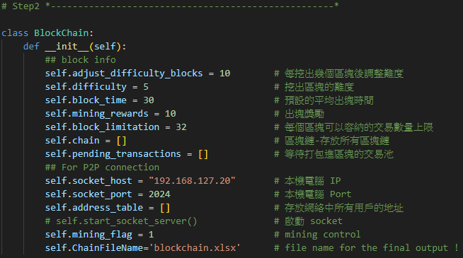
Step2：We are going to define the class about the blockchain

Slide 6
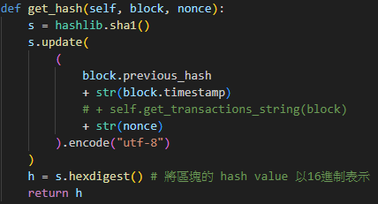
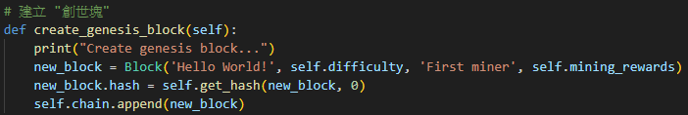
Step3：Create the “genesis block”
if __name__ == '__main__':
BLOCKCHAIN = BlockChain()
BLOCKCHAIN.create_genesis_block()
print(BLOCKCHAIN.chain[0].hash)

Slide 7
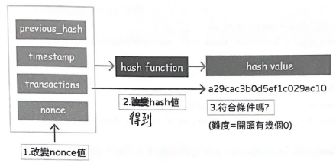
Step4：Mine the block and also dynamically adjust the difficulty (1/5)
1. Simulate the traditional PoW mechanism, the condition for mining a block is to produce a hash value with a specified number of consecutive zeros as a prefix.
2. Miners adjust the nonce value to compute the new hash value for the block and check if the hash value meets the aforementioned condition.

Slide 8
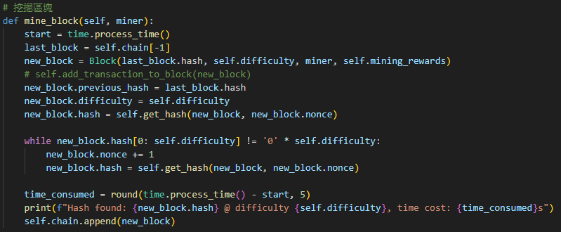
Step4：Mine the block and also dynamically adjust the difficulty (2/5)

Slide 9
Step4：Mine the block and also dynamically adjust the difficulty (3/5)
1. The issuance of cryptocurrency is finite, requiring dynamic adjustment of block difficulty based on the total computational power of the blockchain network to achieve a stable currency issuance rate.
2. Simulating this, the total computational power of the blockchain network is measured by the average block time of a certain number of consecutive blocks. If the average block time is lower than expected, indicating excessive computational power, the block difficulty is increased.
3. The more consecutive zeros required in the prefix of the hash value, the higher the difficulty; conversely, the difficulty decreases.

Slide 10
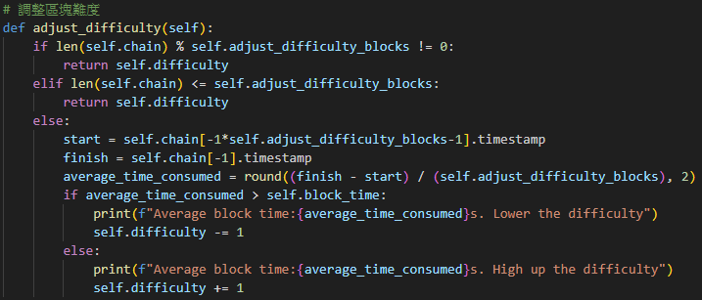
Step4：Mine the block and also dynamically adjust the difficulty (4/5)
Notes:
1. 前十塊不會調整難度
2. 之後每十塊區塊調整一次難度!

Slide 11
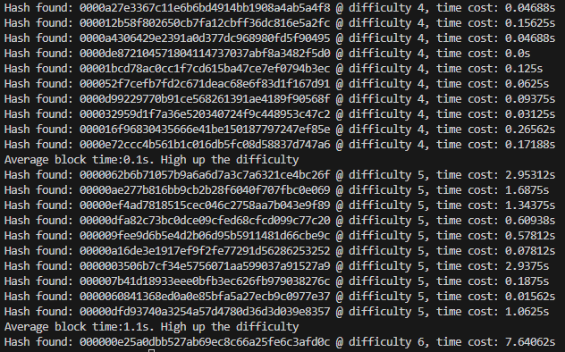
Step4：Mine the block and also dynamically adjust the difficulty (5/5)
# add the following code into main()
# Test mine_block and adjust_difficulty
for i in range(30):
BLOCKCHAIN.mine_block("Test miner")
BLOCKCHAIN.adjust_difficulty()

Slide 12

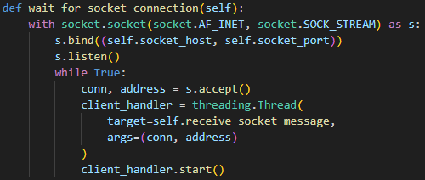
Step5：Start the socket server and wait for other customers to connect.
1. 首先查詢本機的IP位址並設定連接埠。(也可以使用127.0.0.1)
2. 啟動本機端socket、監聽其他電腦發起的連線請求。
# Look up the IP address.
import socket
s = socket.socket(socket.AF_INET,socket.SOCK_DGRAM)
s.connect(("8.8.8.8", 80))
print(s.getsockname()[0])

Slide 13
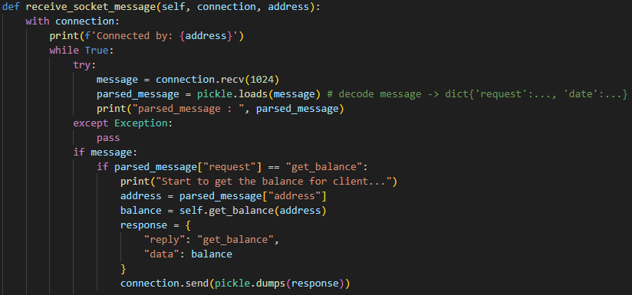
Step6：Receive and handle the message from customer. (1/6)

Slide 14
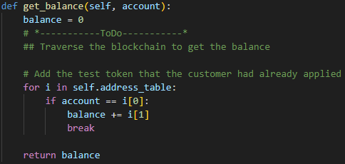
Step6：Receive and handle the message from customer. (2/6)
Miner | Customer
Mining rewards Transaction fee | Apply test tokens Transacion (as a sender) Transacion (as a receiver) Transacion fee

Slide 15
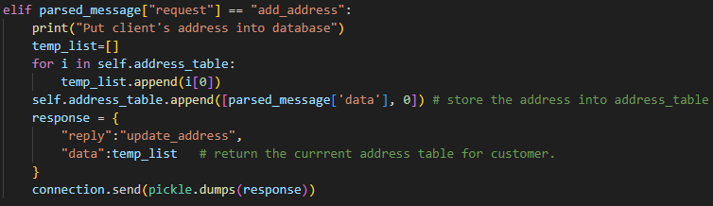
Step6：Receive and handle the message from customer. (3/6)

Slide 16
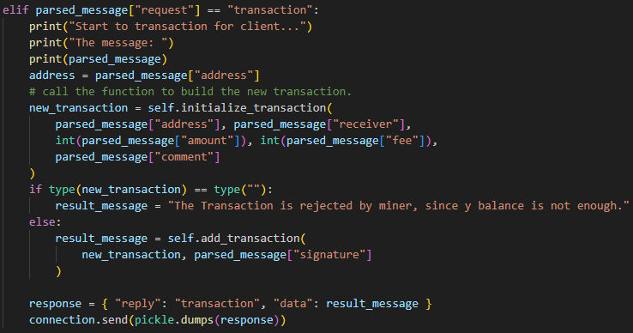
Step6：Receive and handle the message from customer. (4/6)

Slide 17
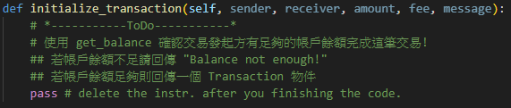
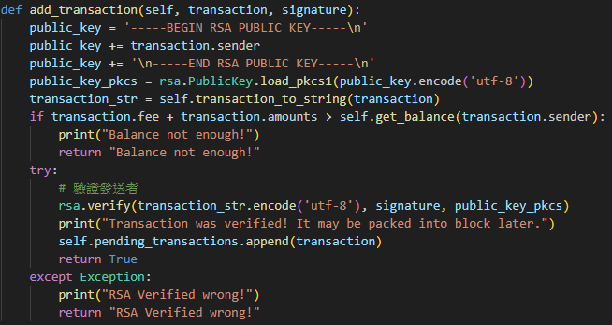
Step6：Receive and handle the message from customer (5/6)

Slide 18
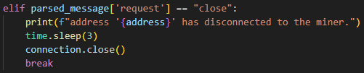
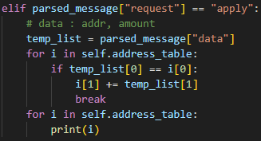
Step6：Receive and handle the message from customer (6/6)

Slide 19
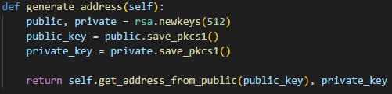
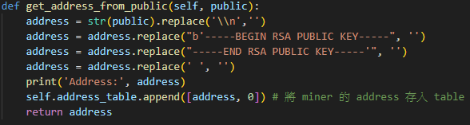
Step7：Generate the miner’s address and set the start function. (1/2)

Slide 20
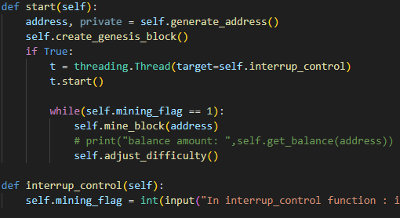
Step7：Generate the miner’s address and set the start function. (2/2)

Slide 21
Now, for the customer.py

Slide 22
Step1：Define the class about the transaction

Slide 23
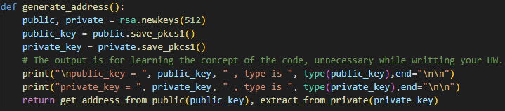
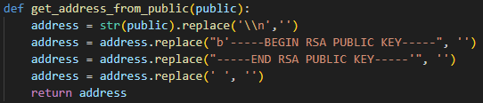
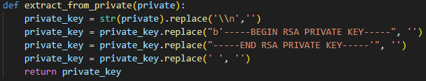
Step2：Generate the address and Private Key (1/2)

Slide 24
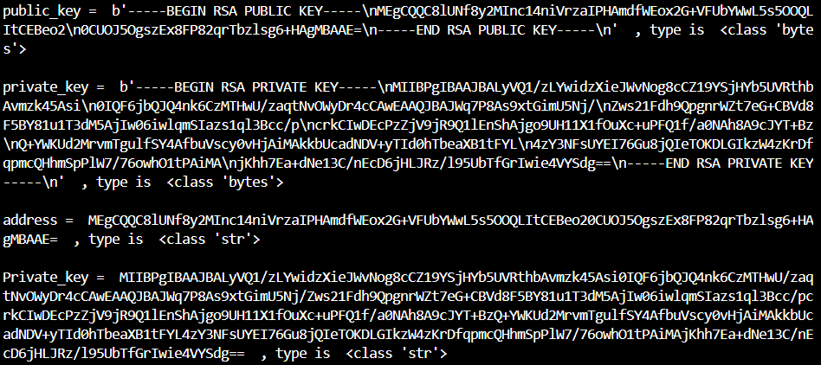
Step2：Generate the address and Private Key (2/2)
if __name__ == "__main__":
# Test generate_address function
address, Private_key = generate_address()
print("address = ", address, " , type is ", type(address),end="\n\n")
print("Private_key = ", Private_key, " , type is ", type(Private_key),end="\n\n")

Slide 25
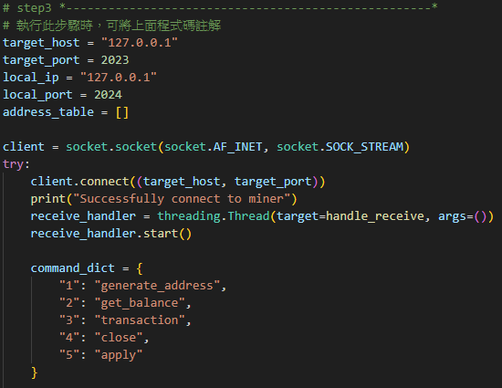
Step3：Write the main function. (1/4)

Slide 26
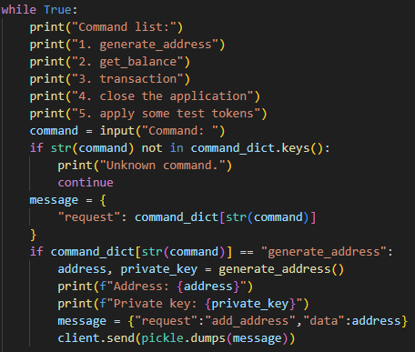
Step3：Write the main function. (2/4)

Slide 27
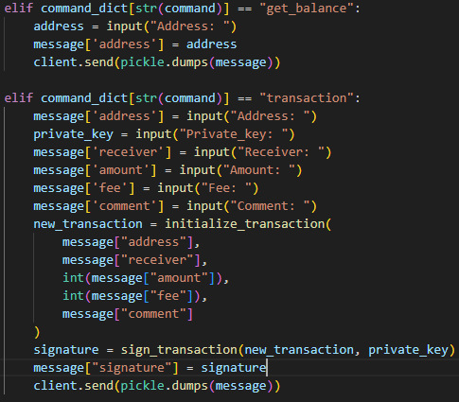
Step3：Write the main function. (3/4)

Slide 28
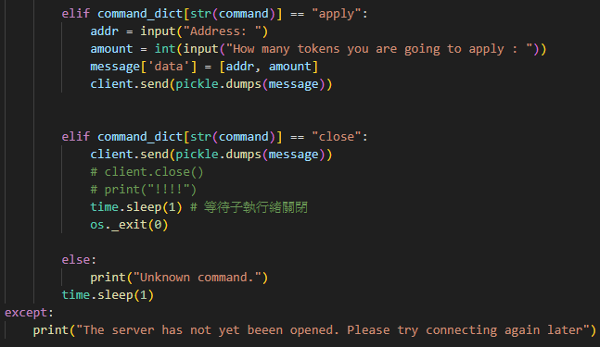
Step3：Write the main function. (4/4)

Slide 29
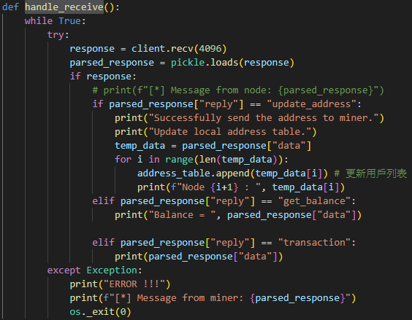
Step4：Write the handle_receive function.

Slide 30
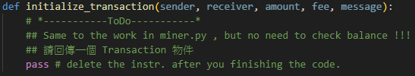
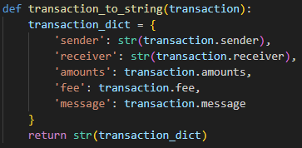
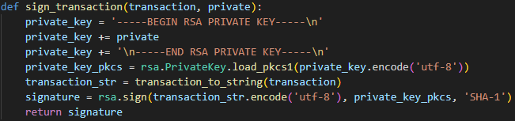
Step5：Deploy and sign a transaction.

Slide 31
Finally, we can run up both miner.py and customer.py

Slide 32
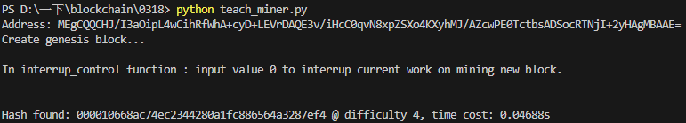
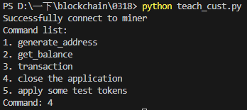
Miner.py
Customer.py

